Slide 1

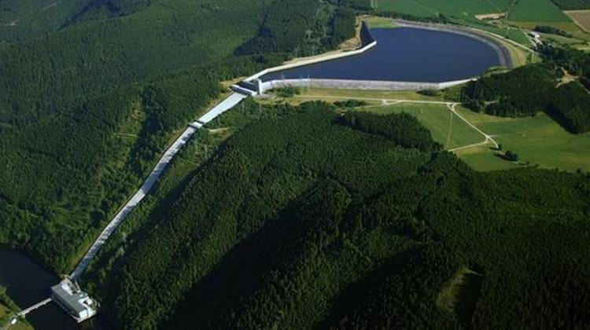


Pumped Storage Power Plant – Team 5
Digital Twin Engineering
Modeling of a watertank with pipeline, turbine and engine under environmental influences
Author: Lukas Hurrle, Stefan Gerhartz, Manuel Szedlak
Task
The task was to simulate a pumped storage power plant. For this purpose, a digital twin was created using the OpenModelica (OME) software.
The physical chain of action of the components of a generic pumped storage power plant was represented.
Modeled parts
Environment
Tank
Pipeline
Turbine
Generator
Modeled connectors
Hydraulic port
Mechanical port
Electrical port
Physical chain of effects
Environment
Tank
Pipe
Turbine
Generator
Goal
The goal of the simulation and the creation of a digital twin was the representation of all influencing variables in the context of the efficiency and effectiveness of the existing pumped storage power plants.
Environment
Temperature
Air Density
Rain
Tank
Pressure
Volume
Pipe
Pressure
Volume flow
Mass flow
Roughness
Tank
Speed
Volume flow
Mass flow
Tank
Speed
Summary
By means of acausal modeling using OME and the associated creation of a generic digital twin, the influencing variables of existing pumped storage power plants could be evaluated in the context of efficiency and effectiveness. Here, the greatest benefit is the generic, but also specifically composable approach. Due to the modularity, it is possible to tailor the generic basic model to the already existing power plants and to obtain a modelable evaluation in addition to an evaluation.
Furthermore, future power plants can be better planned in terms of their network performance and capacities in the context of the influencing factors.
Lukas.Hurrle@student.kit.edu, Stefan.Gerhartz@student.kit.edu, Manuel.Szedlak@student.kit.edu

