Slide 1


Attitude estimation with Extended Kalman Filter
Mirko Mazzoleni
Corso di IDENTIFICAZIONE DEI MODELLI E ANALISI DEI DATI
A.A. 2018/2019

Slide 2
Outline
For errors, contribution, discussion, write at: mirko.mazzoleni@unibg.it

Slide 3
Outline
Introduction
Model
Preprocessing and implementation of EKF

Slide 4
Outline
Introduction
Model
Preprocessing and implementation of EKF

Slide 5
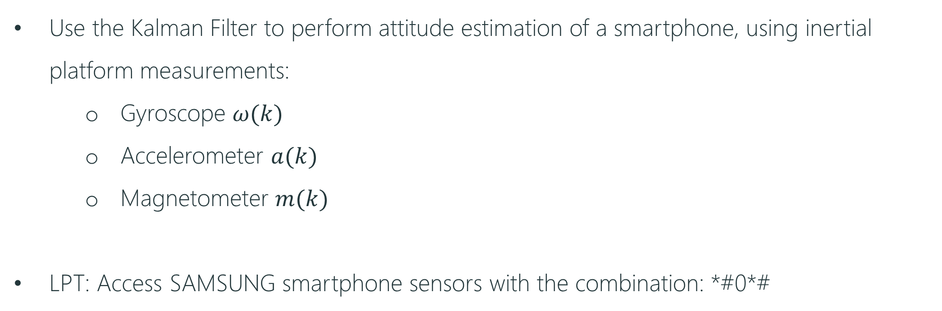
Introduction
Scope of the laboratory
Use the Kalman Filter to perform attitude estimation of a smartphone, using inertial platform measurements:
Gyroscope $ω(k)$
Accelerometer $a(k)$
Magnetometer $m(k)$
LPT: Access SAMSUNG smartphone sensors with the combination: *#0*#
Reference ➔ Orientation Estimation using Smartphone Sensors – Linkoping university

Slide 6

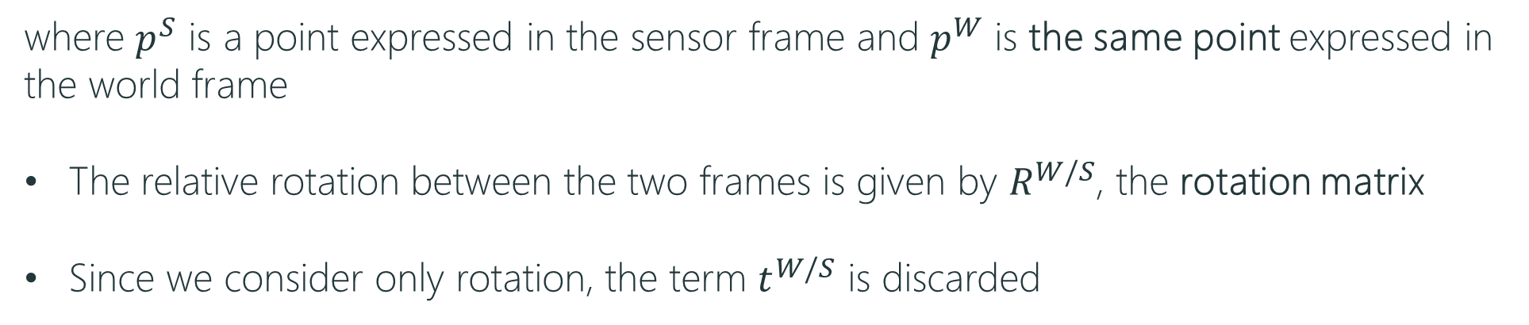
Introduction
Frames
Reference ➔ Robotica: modellistica, simulazione e controllo
Siciliano, Sciavicco, Villani, Oriolo
We will use two coordinate systems: the world frame and the sensor frame
These coordinate systems are related via linear transformations
where $p^{S}$ is a point expressed in the sensor frame and $p^{W}$ is the same point expressed in the world frame
The relative rotation between the two frames is given by $R^{W/S}$, the rotation matrix
Since we consider only rotation, the term $t^{W/S}$ is discarded

Slide 7
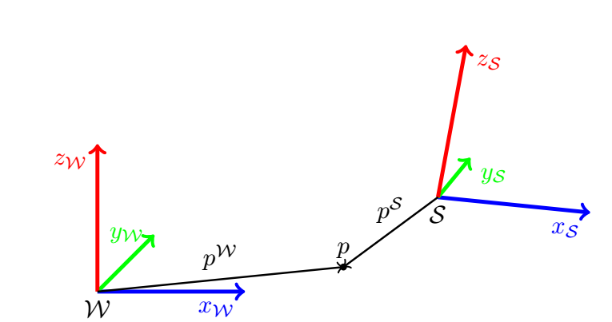
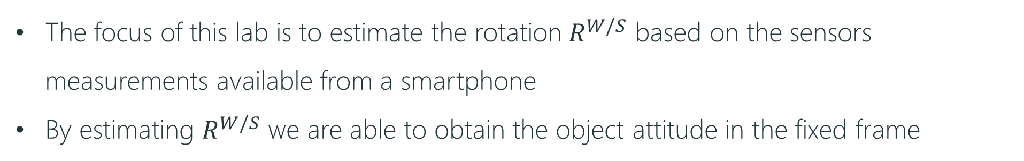
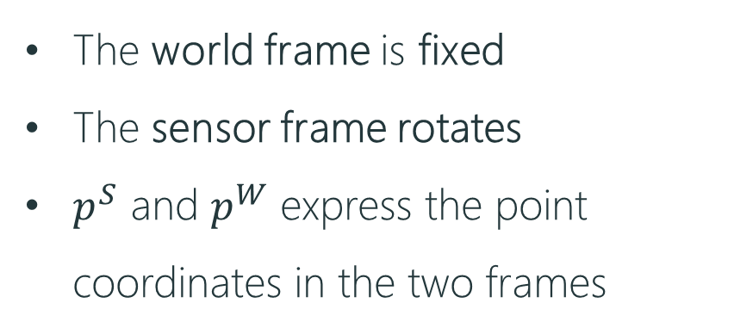
Introduction
Frames
The world frame is fixed
The sensor frame rotates
$p^{S}$ and $p^{W}$ express the point coordinates in the two frames
The focus of this lab is to estimate the rotation $R^{W/S}$ based on the sensors measurements available from a smartphone
By estimating $R^{W/S}$ we are able to obtain the object attitude in the fixed frame

Slide 8








Introduction
Frames
A rotation matrix has 3 meanings:
Gives the orientation of one set of coordinates with respect to another
Represents a coordinates transformation that relates the coordinates of the same point in two different frames
Is the operator which rotates a vector in the same frame
$$p^{W}$$
$$p_{y}^{W}$$
$$p^{S}$$
$$p_{y}^{S}$$
$$θ$$
$$p_{x}^{W}$$
$$p_{x}^{S}$$
$$p_{z}^{W}=p_{z}^{S}$$

Slide 9


Introduction
Attitude representation
An object attitude can be expressed via rotation matrices (9 elements)
The 9 elements are not independent because of orthogonality constraints ➔ 3 indenpendent parameters (3 angles)
Euler angles
PROBLEM: Singularities
$$R=R_{z}\left(φ\right)R_{y^{′}}\left(θ\right)R_{z^{′′}}\left(ψ\right)$$
ZYZ representation (current frame)
Different positions in the same have the same representation
$$R=R_{z}\left(φ\right)R_{y}\left(θ\right)R_{x}\left(ψ\right)$$
RPY representation (fixed frame)

Slide 10
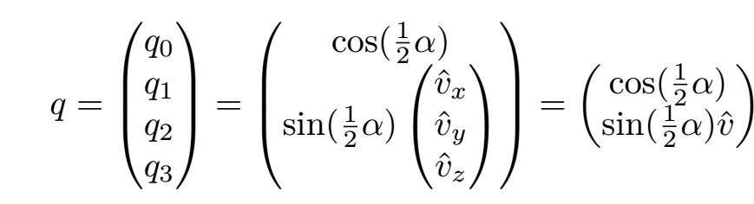
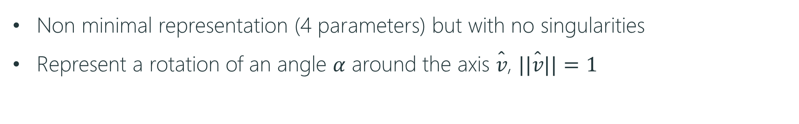

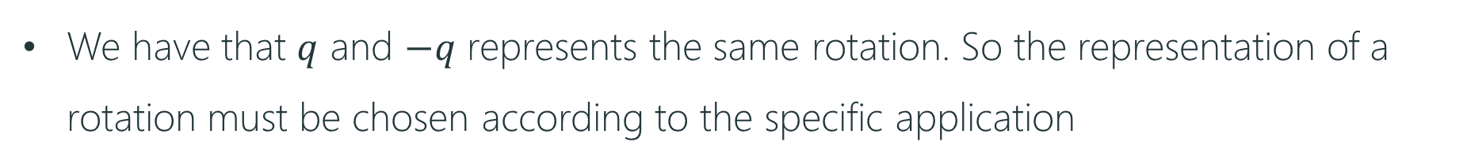
Introduction
Quaternions
Non minimal representation (4 parameters) but with no singularities
Represent a rotation of an angle $α$ around the axis $\hat{v}$, $||\hat{v}||=1$
$$q_{o}^{2}+q_{1}^{2}+q_{2}^{2}+q_{3}^{2}=1$$
We have that $q$ and $−q$ represents the same rotation. So the representation of a rotation must be chosen according to the specific application

Slide 11
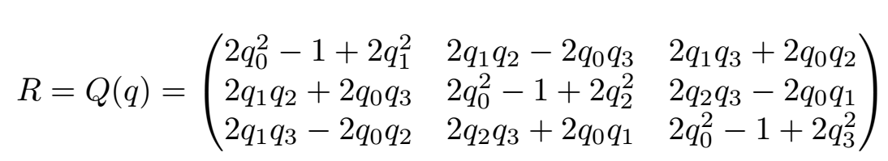
Introduction
Rotation matrix corresponding to a quaternion

Slide 12
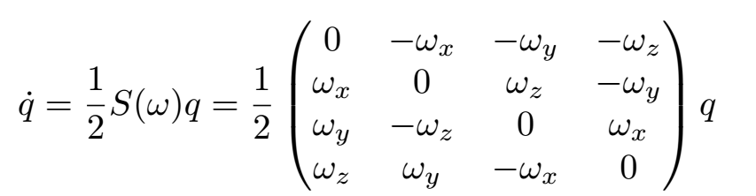


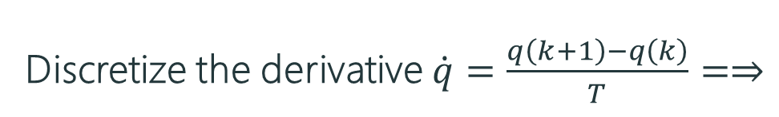
Introduction
Time derivative of a quaternion
Discretize the derivative $\dot{q}=\frac{q\left(k+1\right)−q\left(k\right)}{T}=⇒$

Slide 13
Outline
Introduction
Model
Preprocessing and implementation of EKF

Slide 14
Model
Simple model
The unknown states are the quaternion components. We want to estimate them in order to obtain the object attitude which we do not measure (4-d vector)
Input: gyroscope measurements (3-d vector)
Outputs: accelerometers and magnetometer measurements (6-d vector)

Slide 15
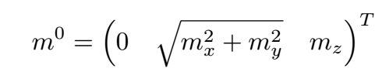

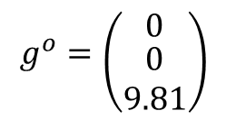
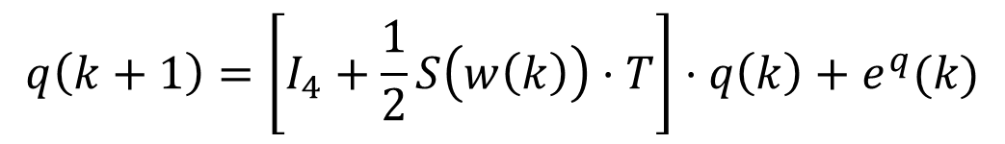

Model
Model state space equations
$$q\left(k+1\right)=\left[I_{4}+\frac{1}{2}S\left(w\left(k\right)\right)⋅T\right]⋅q\left(k\right)+e^{q}(k)$$
$$g^{o}=\left({0 \atop \begin{aligned}0 \\ 9.81\end{aligned}}\right)$$
$$y^{a}\left(k\right)=Q^{T}\left(q\left(k\right)\right)⋅g^{o}+e^{a}\left(k\right)$$
$$y^{m}\left(k\right)=Q^{T}\left(q\left(k\right)\right)⋅m^{o}+e^{m}\left(k\right)$$

Slide 16
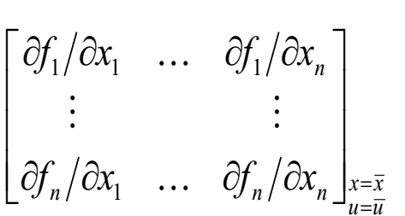
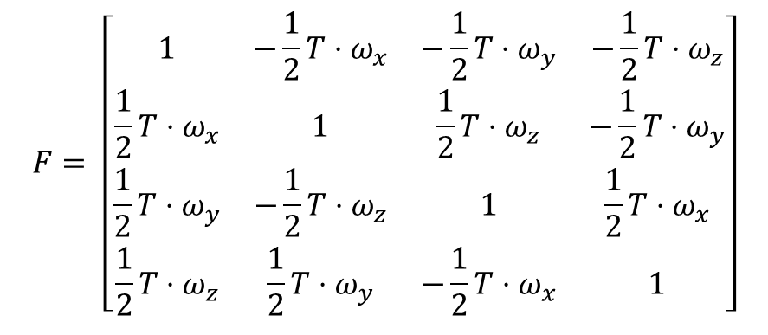

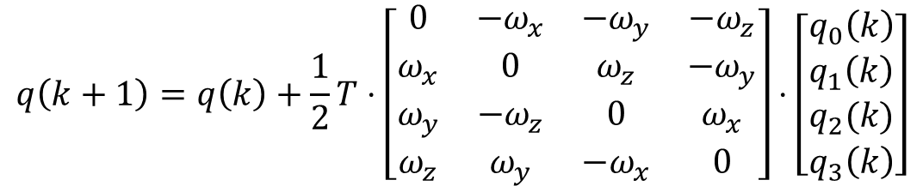
Model
Linearization – state space matrix $F_{4×4 }$
$$q\left(k+1\right)=q\left(k\right)+\frac{1}{2}T⋅\left[\begin{matrix}0 & −ω_{x} & −ω_{y} & −ω_{z} \\ ω_{x} & 0 & ω_{z} & −ω_{y} \\ ω_{y} & −ω_{z} & 0 & ω_{x} \\ ω_{z} & ω_{y} & −ω_{x} & 0\end{matrix}\right]⋅\left[\begin{matrix}q_{0}\left(k\right) \\ q_{1}\left(k\right) \\ q_{2}(k) \\ q_{3}\left(k\right)\end{matrix}\right]$$
$$F= \left[\begin{matrix}1 & −\frac{1}{2}T⋅ω_{x} & −\frac{1}{2}T⋅ω_{y} & −\frac{1}{2}T⋅ω_{z} \\ {\frac{1}{2}T⋅ω}_{x} & 1 & \frac{1}{2}T⋅ω_{z} & −{\frac{1}{2}T⋅ω}_{y} \\ \frac{1}{2}T⋅ω_{y} & −{\frac{1}{2}T⋅ω}_{z} & 1 & \frac{1}{2}T⋅ω_{x} \\ \frac{1}{2}T⋅ω_{z} & {\frac{1}{2}T⋅ω}_{y} & −\frac{1}{2}T⋅ω_{x} & 1\end{matrix}\right]$$
$$F=$$

Slide 17
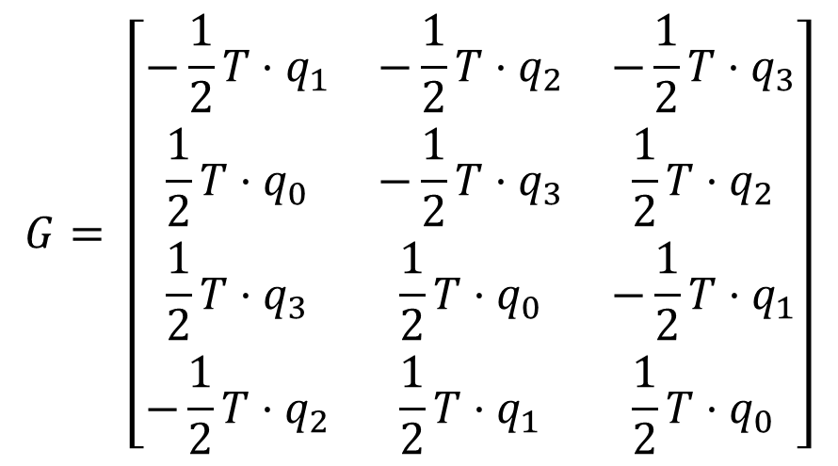
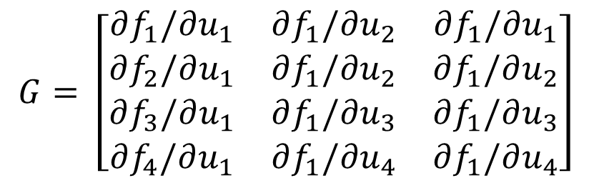
Model
Linearization – input matrix $G_{4×3 }$
$$G= \left[\begin{matrix}∂f_{1}/∂u_{1} & ∂f_{1}/∂u_{2} & ∂f_{1}/∂u_{1} \\ ∂f_{2}/∂u_{1} & ∂f_{1}/∂u_{2} & ∂f_{1}/∂u_{2} \\ ∂f_{3}/∂u_{1} & ∂f_{1}/∂u_{3} & ∂f_{1}/∂u_{3} \\ ∂f_{4}/∂u_{1} & ∂f_{1}/∂u_{4} & ∂f_{1}/∂u_{4}\end{matrix}\right]$$
$$G= \left[\begin{matrix}−\frac{1}{2}T⋅q_{1} & −\frac{1}{2}T⋅q_{2} & −\frac{1}{2}T⋅q_{3} \\ \frac{1}{2}T⋅q_{0} & −\frac{1}{2}T⋅q_{3} & \frac{1}{2}T⋅q_{2} \\ \frac{1}{2}T⋅q_{3} & \frac{1}{2}T⋅q_{0} & −\frac{1}{2}T⋅q_{1} \\ −\frac{1}{2}T⋅q_{2} & \frac{1}{2}T⋅q_{1} & \frac{1}{2}T⋅q_{0}\end{matrix}\right]$$

Slide 18
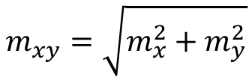
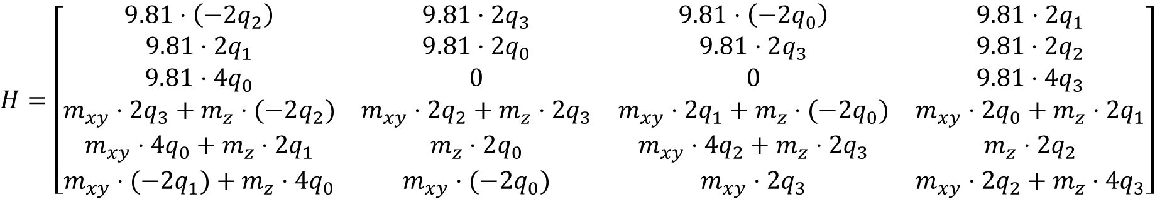
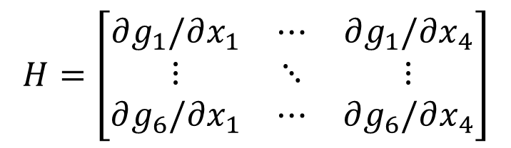
Model
Linearization – Output matrix $H_{6×4 }$
$$H=\left[\begin{matrix}∂g_{1}/∂x_{1} & ⋯ & ∂g_{1}/∂x_{4} \\ ⋮ & ⋱ & ⋮ \\ ∂g_{6}/∂x_{1} & ⋯ & ∂g_{6}/∂x_{4}\end{matrix}\right]$$
$$m_{xy}=\sqrt{m_{x}^{2}+m_{y}^{2}}$$
$$H=\left[\begin{matrix}9.81⋅\left(−2q_{2}\right) & 9.81⋅2q_{3} & 9.81⋅\left(−2q_{0}\right) & 9.81⋅2q_{1} \\ 9.81⋅2q_{1} & 9.81⋅2q_{0} & 9.81⋅2q_{3} & 9.81⋅2q_{2} \\ 9.81⋅4q_{0} & 0 & 0 & 9.81⋅4q_{3} \\ m_{xy}⋅2q_{3}+m_{z}⋅(−2q_{2}) & m_{xy}⋅2q_{2}+m_{z}⋅2q_{3} & m_{xy}⋅2q_{1}+m_{z}⋅(−2q_{0}) & m_{xy}⋅2q_{0}+m_{z}⋅2q_{1} \\ m_{xy}⋅4q_{0}+m_{z}⋅2q_{1} & m_{z}⋅2q_{0} & m_{xy}⋅4q_{2}+m_{z}⋅2q_{3} & m_{z}⋅2q_{2} \\ m_{xy}⋅(−2q_{1})+m_{z}⋅4q_{0} & m_{xy}⋅(−2q_{0}) & m_{xy}⋅2q_{3} & m_{xy}⋅2q_{2}+m_{z}⋅4q_{3}\end{matrix}\right]$$

Slide 19
Outline
Introduction
Model
Preprocessing and implementation of EKF

Slide 20
Introduction
Steps
Check sensors frames on the smarthpone
Acquire static measurement to compensate for biases in the sensors
Calibrate magnetometer
Implement the code

