Slide 1
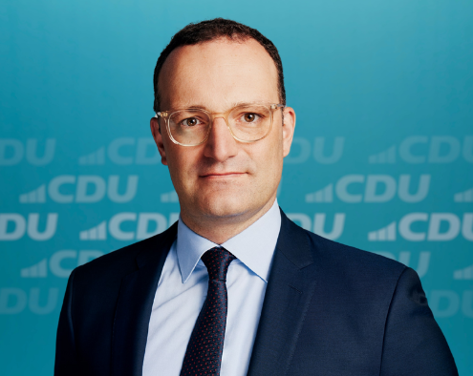
GERMANY · FEDERAL MINISTRY OF HEALTH · 2020
€4.50 a mask. From anyone. In any quantity.
The ministry promised to buy every FFP2 mask offered to it, at one fixed price.
5.7 bn
≈2 bn
€2.3 bn
Jens Spahn
Federal Minister of Health, 2018–2021
masks bought, for €5.9 bn
ever handed out. Most of the rest destroyed.
still in court. Ruling due 15 Dec 2026.
Sources: Tagesspiegel, ZDF, Handelsblatt (Sep 2026); Bund der Steuerzahler
Nobody negotiated that price. ProcureCabana would have.
Notes:
Spring 2020. The health ministry offers 4.50 euros for every FFP2 mask, from anyone, in any quantity. 5.7 billion masks, 5.9 billion euros. About two billion were ever handed out. Suppliers still claim 2.3 billion in court, and the Federal Court rules on 15 December. Nobody negotiated that price. Our agent would have.

Slide 2
Demo
Notes:
Spring 2020. The health ministry offers 4.50 euros for every FFP2 mask, from anyone, in any quantity. 5.7 billion masks, 5.9 billion euros. About two billion were ever handed out. Suppliers still claim 2.3 billion in court, and the Federal Court rules on 15 December. Nobody negotiated that price. Our agent would have.

Slide 3
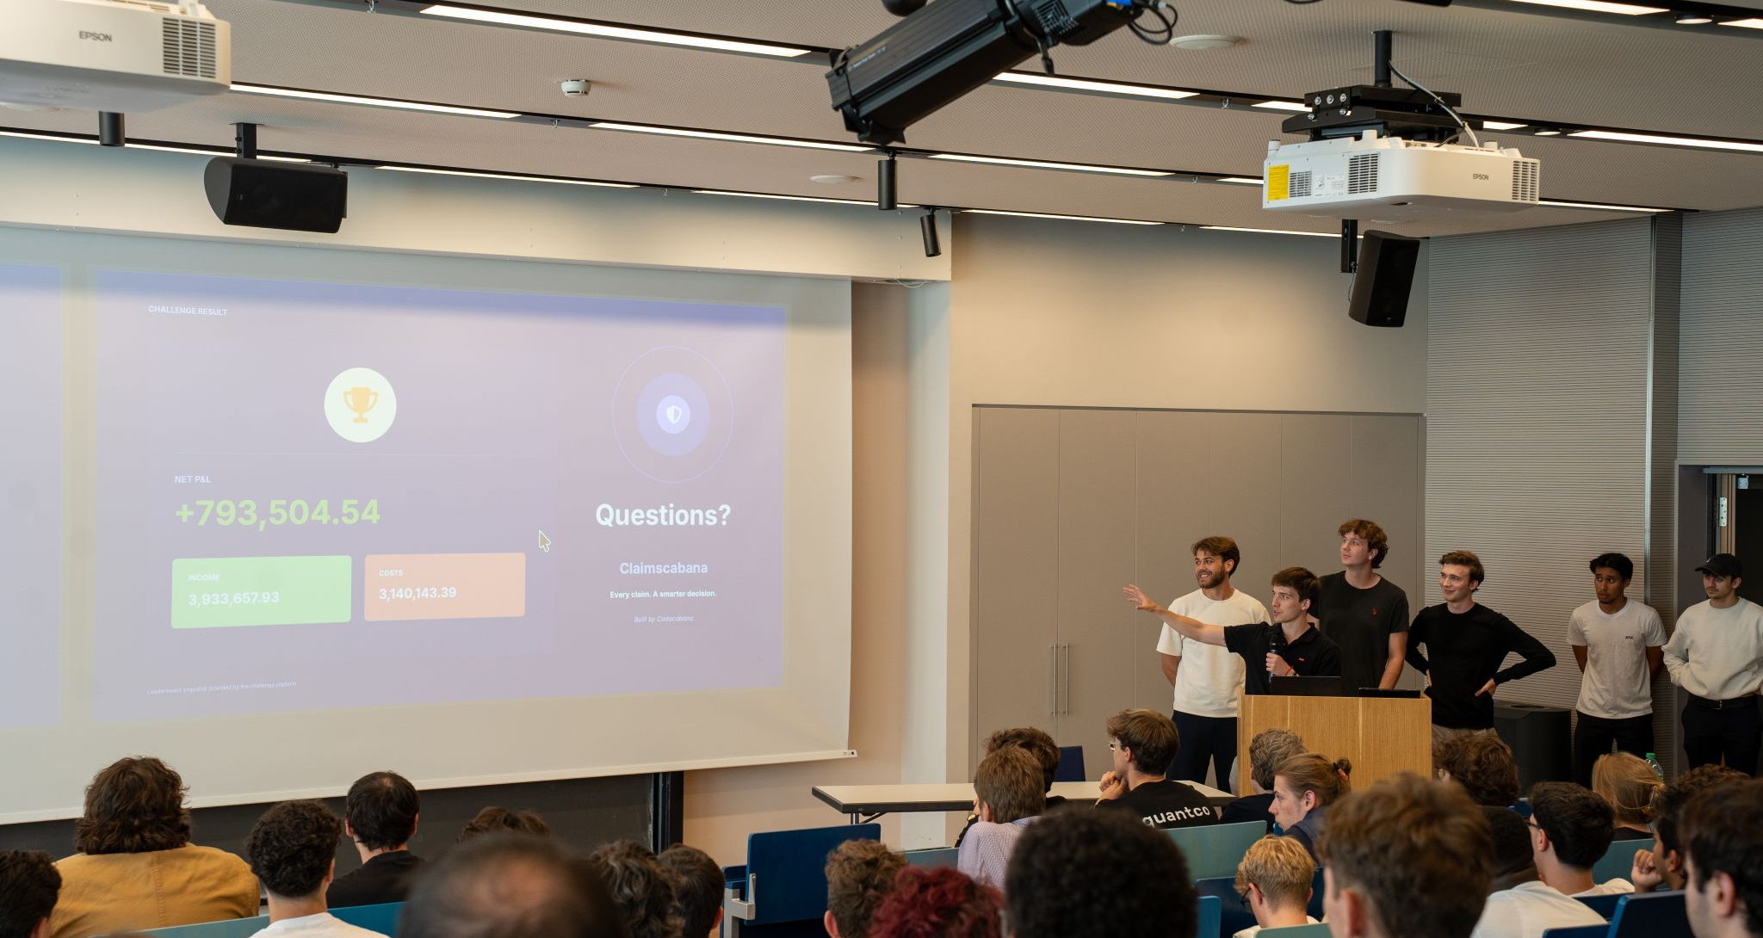
Codacabana
Tacto Negotiation Arena
Our agent buys parts by e-mail. It negotiates with supplier bots and closes the deal on its own.
Questions
AGENTS USED
SAVED VS. OPENING QUOTES · 10 PRACTICE CASES
10
€1.17M
Notes:
Two minutes of questions. Everything we built is on this slide; leave it up.

