Slide 1
Bonus: tail area probabilities for multilevel factors
Juan Steibel

Slide 2

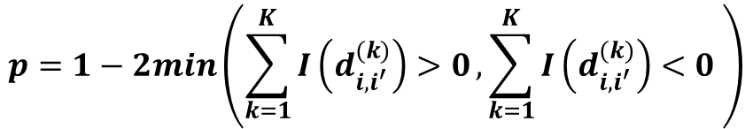
With only two levels
An alternative is to look at the distribution of the difference of two levels:
Compute this tail area
A very small value shows evidence against the null hypothesis that the two distributions are different.
0
$$p=1−2min\left(\sum_{k=1}^{K}{I\left(d_{i,i^{′}}^{(k)}\right)>0},\sum_{k=1}^{K}{I\left(d_{i,i^{′}}^{(k)}\right)<0} \right)$$

Slide 3
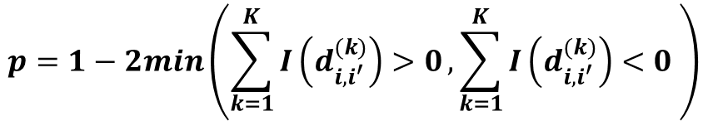
Computing tail area probabilities
Compute this tail area and double it (assume symmetry)
0
0
$$p=1−2min\left(\sum_{k=1}^{K}{I\left(d_{i,i^{′}}^{(k)}\right)>0},\sum_{k=1}^{K}{I\left(d_{i,i^{′}}^{(k)}\right)<0} \right)$$
Note: computation to a single tail can be used if the a direction of change is assumed, similar to a single-tailed test.

Slide 4
Tail area probabilities for multiple levels Credit: Donald Bates (unpublished)
Compute tail area probability for each contrast, then see if at least one is small enough to reject hypothesis. This is appropriate for comparing against a reference level.
But using these contrasts, there is a general alternative that is a generalized version of the tail area computation showed before. That computes the joint tail area probability
I will illustrate it here with two dimensions (three levels)

Slide 5
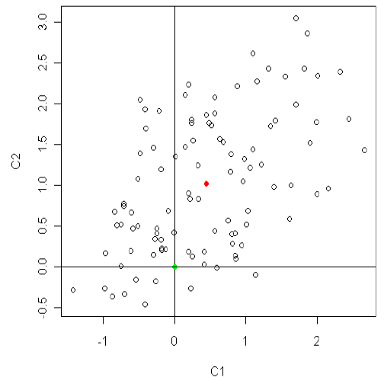
MCMC chain of two diferences

Slide 6


Interpretation
Posterior mean
0,0

Slide 7



Grow an ellipse along the axis of variation and count how many points lye outside

Slide 8
It’s easier if we rotate and standardize

Slide 9

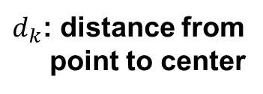
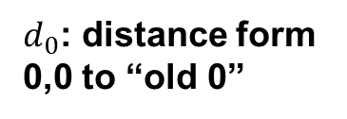

Rotated and scaled
0,0 is now re-scaled posterior mean.

Slide 10
How to do it in R (three lines)
Solves system of equations
function(difs){
std<-backsolve(
chol(var(difs)),
cbind(0,t(difs))-colMeans(difs),
transpose=T)
sqdist<-colSums(std*std)
sum(sqdist[-1]>sqdist[1])/nrow(difs)
}
LHS
RHS
Squared distance
Distance from new 0,0 to old center
Distance from point to new 0,0

