Slide 1
Extraction of questions from the Internet using a Machine Learning approach
Alok Saw B090924CS
Jerrin Shaji George B090437CS
Shubhangam Agrawal B090904CS
Stein Astor Fernandez B090006CS
Guide : Dr. Priya Chandran
Notes:
This template can be used as a starter file for presenting training materials in a group setting.
Sections
Right-click on a slide to add sections. Sections can help to organize your slides or facilitate collaboration between multiple authors.
Notes
Use the Notes section for delivery notes or to provide additional details for the audience. View these notes in Presentation View during your presentation.
Keep in mind the font size (important for accessibility, visibility, videotaping, and online production)
Coordinated colors
Pay particular attention to the graphs, charts, and text boxes.
Consider that attendees will print in black and white or grayscale. Run a test print to make sure your colors work when printed in pure black and white and grayscale.
Graphics, tables, and graphs
Keep it simple: If possible, use consistent, non-distracting styles and colors.
Label all graphs and tables.

Slide 2
Contents
Introduction
Literature Survey
Work Done
Future Work

Slide 3
Introduction
There is a massive amount of data available on the internet.
Though searching for relevant pages is trivial, extracting only the relevant sections of data has become very important.
This would result in massive savings of both time and effort.
Notes:
Give a brief overview of the presentation. Describe the major focus of the presentation and why it is important.
Introduce each of the major topics.
To provide a road map for the audience, you can repeat this Overview slide throughout the presentation, highlighting the particular topic you will discuss next.

Slide 4
Introduction
For both faculty and students, obtaining a list of questions pertaining to a topic would be useful.
It is tedious to search for various query permutations and manually visit each page and then find such questions.
Would be highly useful if this could be automated.

Slide 5
Problem Statement
Given input a topic t,
Search the internet for pages possibly containing questions related to t
Output a set R comprising of relevant questions extracted from these pages.

Slide 6
Contents
Introduction
Literature Survey
Work Done
Future Work

Slide 7
A Trivial Solution
Simply search for presence of input topic and output sections with matches.
Bad Performance
No way of identifying questions

Slide 8
Contextual Information
The relevance of contextual information vs. simple keyword matching - Teevan et al.^{[2]}
Identify patterns in the text sections which :
make it a question
make it relevant to the input topic

Slide 9
Identifying Patterns in Text
Statistical Analysis
Machine Learning
Joachims has concluded that Support Vector Machines are an effective text classification tool which use the Supervised Machine Learning model.^{[5]}
Inoue et al. propose an SVM based approach to identify the most relevant subsection in Web pages returned by a search query (SQUINT). They have obtained very accurate results using this model.^{[1]}

Slide 10
Machine Learning
Arthur Samuel (1959) –
The field of study that gives computers the ability to learn without being explicitly programmed.

Slide 11
Machine Learning
Tom Mitchell (1998)
Well-posed Learning Problem:
A computer program is said to learn from experience E with respect to some task T and some performance measure P, if its performance on T, as measured by P, improves with experience E.

Slide 12
Machine Learning
AI algorithms that take as input empirical data and yield patterns or predictions thought to be features of the underlying mechanism that generated the data.
Data can be seen as instances of the possible relations between observed variables. It is used to find the unknown underlying probability distribution.^{[3]}

Slide 13
Machine Learning Algorithms
Broadly categorized as ^{[4]} –
Supervised Machine Learning
Unsupervised Machine Learning

Slide 14
Supervised v/s Unsupervised Learning
Supervised learning
The goal is to predict the value of an outcome measure based on a number of input measures. ^{[4]}
Unsupervised learning
There is no outcome measure, and the goal is to describe the associations and patterns among a set of input measures. ^{[4]}

Slide 15
Supervised Learning
The training data consists of a set of training examples consisting of an input object and a desired output value.
The algorithm analyzes the training data and produces an inferred function called a regression function.
The inferred function should predict the correct output value for any valid input object.^{[9]}

Slide 16
SQUINT - SVM for Identification of Relevant Sections in Web Pages for Web Search
This IEEE paper^{[1]} proposes an SVM based approach to identify sections of a web page that are relevant to a query in a web search.
It analyzes various features to determine relevance to the query and its context.
It then uses an SVM with a linear kernel to score sections of a web page based on these features.

Slide 17
Contents
Introduction
Literature Survey
Work Done
Design
Prototype
Future Work

Slide 18
Approach
We explore a SVM based approach similar to SQUINT^{[1]} in order to detect relevance to the input topic.
We also aim to identify various features which indicate that a text section is a question.
Notes:
Give a brief overview of the presentation. Describe the major focus of the presentation and why it is important.
Introduce each of the major topics.
To provide a road map for the audience, you can repeat this Overview slide throughout the presentation, highlighting the particular topic you will discuss next.

Slide 19
Architectural Overview
Topic + Subtopic
Query Generation
Query set Q
Get relevant links Lq
SEARCH ENGINE
Q, L_{q}
Break each page into sections Sq
PAGE PREPROCESSOR
Sections Sq
Label each section
Generate features for each section
LABELLING
FEATURE GENERATOR
SVM
Training Set
RESULT

Slide 20
Query Generation
Take topic t as input.
Generate set T of n related keywords (sub-topics). Add t to T.
Generate query set Q := T x { “questions”, “problems”, “solved examples”}

Slide 21
Page Retrieval
For each q ϵ Q, get relevant search results using Google Custom Search API (or any other search engine).
Add the top n links to set L_{q}.

Slide 22
Page Preprocessor
Each link l from L_{q} is first loaded to get the HTML content.
The JSoup Java HTML Parser is used to convert the HTML to text by stripping away all the markup data.

Slide 23
Page Preprocessor
The page is divided into sections on the basis of
Number of lines
Paragraph structure
Interrogative indicators such as “what”, “why”, “explain”, “define”, “?”, “elucidate” etc.
Each section of text s is added to the set S_{q}.

Slide 24
Feature Generator
Features for relevance of text^{[1]} -
Word Rank Based Features
Bigram Rank Based Features
Coverage of Top Ranked Tokens
Proposed features to determine if text is a question -
Coverage of Interrogative Indicators
Absence of Specific Keywords

Slide 25
Feature Vector
The Feature Vector is a column vector X.
Each x_{i} is the value of the i^{th} feature. ^{[4]}

Slide 26
I. Word Rank Based Features
The rank of a word is defined to be its position in the list if the words were ordered by frequency of occurrence in S_{q}.^{[1]}
Find the top n ranked words in S_{q}.

Slide 27
I. Word Rank Based Features
Each word rank is a feature.
Value = Frequency of the word in s
Dimensionality reduction can be achieved by bucketing the ranks. The degree of bucketing will be adjusted on the basis of performance.

Slide 28
II. Bigram Rank Based Features
A bigram is defined to be two consecutive words occurring in a section.^{[1]}
Find the top n frequently occurring bigrams in S_{q}.
The feature vector is computed in a manner similar to the previous one.
Eg. “Machine learning” may be more important than “machine” and “learning” separately.

Slide 29
III. Coverage of Top Ranked Tokens
Relevance may also be determined by the number of top ranked words which occur in the section. ^{[1]}
Words are ranked on the basis of frequency of occurrence.
For each section, find the coverage of the top ranked words per bucket.

Slide 30
IV. Coverage of Interrogative Indicators
This feature indicates the likelihood of the section being a question.
The coverage of a predefined list of interrogative indicators such as
“what”
“why”
“?”
is taken as the value for this feature.

Slide 31
V. Absence of Specific Keywords
Questions are generally devoid of specific keywords such as “because” and “Yes”.
The coverage of a predefined list of such keywords is taken as a negative value for this feature.

Slide 32
Training Set Generation
The training set required is a set of sections and their corresponding binary labels as “relevant” or “irrelevant”.
This will be generated by choosing a set of queries and manually labeling the sections.

Slide 33
Learning Algorithm
Given the relatively high dimensionality of our feature vector, it is suitable to use a Support Vector Machine with a linear kernel.^{[1]}
The SVM will identify the relevant sections and tag them appropriately. The sections tagged as “relevant” will be added to the result set R.

Slide 34
Support Vector Machine
SVMs are supervised learning models with associated learning algorithms that analyze data and recognize patterns, used for classification and regression analysis.^{[6]}
The basic SVM takes a set of input data and predicts, for each given input, which of two possible classes forms the output, making it a non-probabilistic binary linear classifier.^{[6]}

Slide 35
Support Vector Machine
Given the training set, an SVM training algorithm constructs a model consisting of a hyperplane or set of hyperplanes in a high- or infinite-dimensional space, which can be used for classification.^{[6]}
The features form the axes of the space and the values are used to map the data.^{[4]}

Slide 36
Support Vector Machine
The data is mapped so that the examples of the separate categories are divided by a hyperplane that has the largest functional margin.
New examples are then mapped into that same space and predicted to belong to a category based on which side of the margin they fall on.
The larger the functional margin, the lower the generalization error of the classifier.

Slide 37
Output
The sections identified as questions pertaining to the input topic present in result set R are outputted in a clean format.

Slide 38
Contents
Introduction
Literature Survey
Work Done
Design
Prototype
Future Work

Slide 39
Prototype
We have created a prototype in Java.
It has placeholder stub functions for each component.
Currently each stub does no useful work but just passes the data along.
Each component can be individually developed and further refined to produce the optimal output.

Slide 40
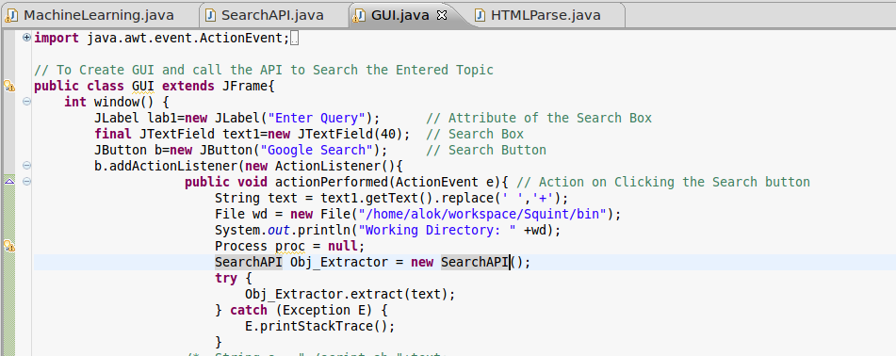
Screenshots

Slide 41
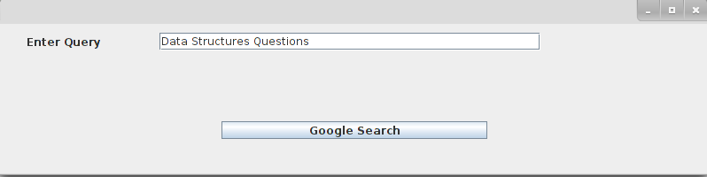
Screenshots

Slide 42
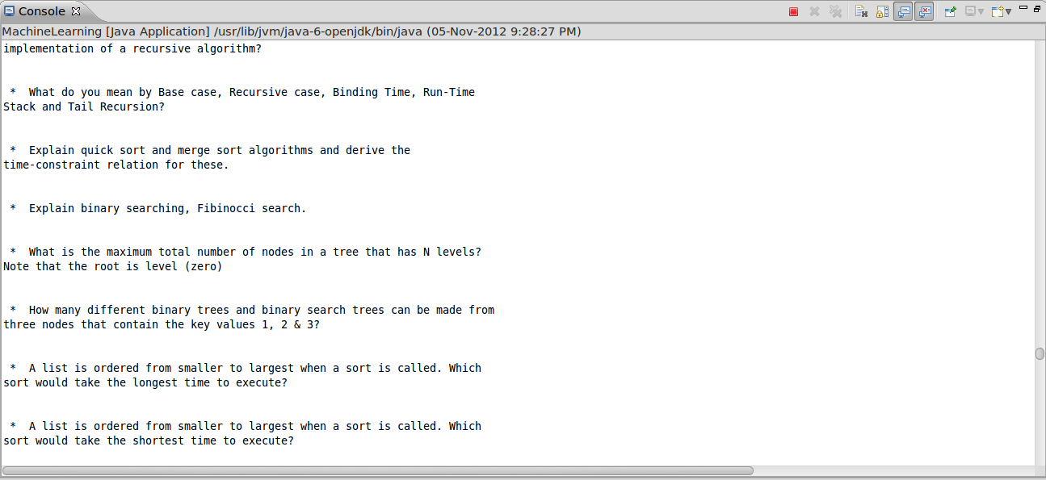
Screenshots

Slide 43
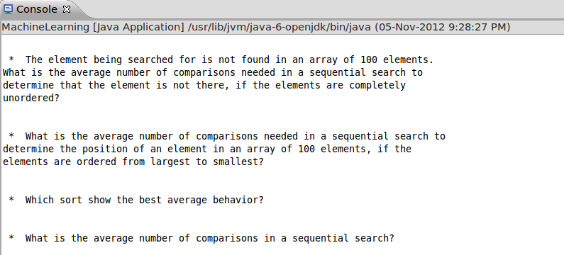
Screenshots

Slide 44
Contents
Introduction
Literature Survey
Work Done
Future Work

Slide 45
Further Work
While the overall architecture of the application seems promising, we need to find out the exact parameters for each section which will produce the best results.
This can be only determined experimentally once the programming part of the project is completed.

Slide 46
Programming
Over the course of the next semester, we will first finish coding the application with configurable parameters.
We will then tune the parameters and refine each component by performing iterations of training, testing and validation.

Slide 47
Feature Analysis
Analysis of which features are actually useful and the weightage of each feature in determining whether a section is a question relevant to the input topic needs to be determined experimentally.
During the course of implementation and analysis, we may also consider other features which correlate to a section's relevance.

Slide 48
References
Siddharth Jonathan J.B., Riku Inoue and Jyotika Prasad. SQUINT – SVM for Identification of Relevant Sections in Web Pages for Web Search.
The Perfect Search Engine is Not Enough : A Study of Orienteering Behavior in Directed Search, Jaime Teevan, Christine Alvarado, Mark S. Ackerman and David R. Karger, Proceedings of the SIGCHI conference on Human factors in computing systems. pp. 415-422, April 2004.
Wikipedia article on Machine Learning, http://en.wikipedia.org/wiki/Machine learning
The Elements of Statistical Learning: Data Mining, Inference, and Prediction, Trevor Hastie, Robert Tibshirani, Jerome Friedman
Thorsten Joachims, Text Categorization with Support Vector Machines – Learning with many relevant features. In Proceedings of the 10th European Conference on Machine Learning pp. 137-142, 1998.
Wikipedia article on Support Vector Machine, http://en.wikipedia.org/wiki/Support vector machine
Machine Learning, http://en.wikipedia.org/wiki/Machine Learning
Machine Learning Course on Coursera, https://class.coursera.org/ml-2012-002/class/index
Supervised Learning (http://en.wikipedia.org/wiki/Supervised_learning)
Unsupervised Learning (http://en.wikipedia.org/wiki/Unsupervised_learning)

