Slide 1
Extraction of questions from the Internet using a Machine Learning approach
Alok Saw B090924CS
Jerrin Shaji George B090437CS
Shubhangam Agrawal B090904CS
Stein Astor Fernandez B090006CS
Notes:
This template can be used as a starter file for presenting training materials in a group setting.
Sections
Right-click on a slide to add sections. Sections can help to organize your slides or facilitate collaboration between multiple authors.
Notes
Use the Notes section for delivery notes or to provide additional details for the audience. View these notes in Presentation View during your presentation.
Keep in mind the font size (important for accessibility, visibility, videotaping, and online production)
Coordinated colors
Pay particular attention to the graphs, charts, and text boxes.
Consider that attendees will print in black and white or grayscale. Run a test print to make sure your colors work when printed in pure black and white and grayscale.
Graphics, tables, and graphs
Keep it simple: If possible, use consistent, non-distracting styles and colors.
Label all graphs and tables.

Slide 2
Problem Statement
There is a massive amount of data available on the internet. Though search engines have made searching for relevant pages trivial, extracting only the relevant sections of data from the huge set of search results has become very important. Automating this process is altogether a more relevant and challenging prospect.
Notes:
Give a brief overview of the presentation. Describe the major focus of the presentation and why it is important.
Introduce each of the major topics.
To provide a road map for the audience, you can repeat this Overview slide throughout the presentation, highlighting the particular topic you will discuss next.

Slide 3
Objective
We propose to apply the concept of machine learning to solve this problem. A machine learning approach to tackle this problem has the capability to keep adapting to the rapidly changing dynamics of the internet. We plan to make an application which will take a topic as input and return a list of questions based on the topic from the internet.
Notes:
Give a brief overview of the presentation. Describe the major focus of the presentation and why it is important.
Introduce each of the major topics.
To provide a road map for the audience, you can repeat this Overview slide throughout the presentation, highlighting the particular topic you will discuss next.

Slide 4
Machine Learning
Arthur Samuel (1959) : The field of study that gives computers the ability to learn without being explicitly programmed.
Tom Mitchell (1998) Well-posed Learning Problem: A computer program is said to learn from experience E with respect to some task T and some performance measure P, if its performance on T, as measured by P, improves with experience E.

Slide 5
Machine Learning Algorithms
Supervised Machine Learning
Unsupervised Machine Learning
Reinforcement Learning
Recommender System

Slide 6
Supervised v/s Unsupervised Learning
Supervised learning is the machine learning task of inferring a function from labeled training data.
Unsupervised learning refers to the problem of trying to find hidden structure in unlabeled data.

Slide 7
Supervised Learning
The training data consist of a set of training examples. Each example is a pair consisting of an input object and a desired output value.
The supervised learning algorithm analyzes the training data and produces an inferred function, which is called a classifier or a regression function.
The inferred function should predict the correct output value for any valid input object. This requires the learning algorithm to generalize from the training data to unseen situations.

Slide 8
Support Vector Machine (SVM)
In machine learning, support vector machines are supervised learning models with associated learning algorithms that analyze data and recognize patterns, used for classification and regression analysis.
The basic SVM takes a set of input data and predicts, for each given input, which of two possible classes forms the output, making it a non-probabilistic binary linear classifier.

Slide 9
Support Vector Machine (contd.)
Given a set of training examples, each marked as belonging to one of two categories, an SVM training algorithm builds a model that assigns new examples into one category or the other.
An SVM model is a representation of the examples as points in space, mapped so that the examples of the separate categories are divided by a clear gap that is as wide as possible.
New examples are then mapped into that same space and predicted to belong to a category based on which side of the gap they fall on.

Slide 10
Problem Modelling
Given a query Q, a standard Web search engine returns a set of pages ranked in descending order of relevance. We call this set, P. Given P, let S be the set of all sections in every page in P.
S = {s; s is a section in some page in P}
Given Q, we generate S, and use it to train a Support Vector Machine.

Slide 11
Problem Modelling (contd.)
During testing, given a particular section, we can predict a numerical score indicative of the relevance of the section to the query, Q. The sections can be ranked by their score, indicating their relative significance.
The SVM is trained with binary class labels for relevant and irrelevant classes and we use the SVM’s predicted margins during testing for scoring sections.

Slide 12
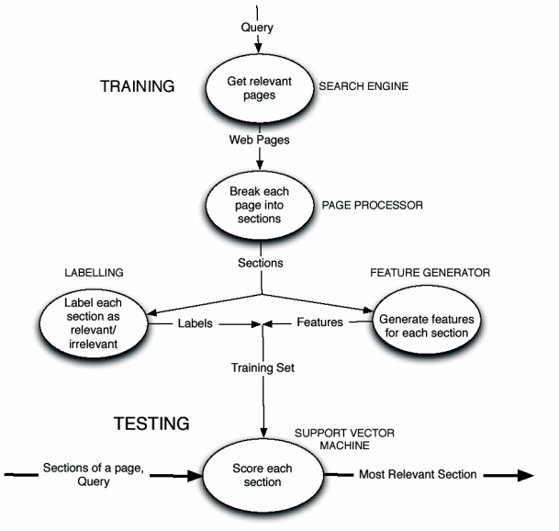
Architectural Overview

Slide 13
Query
The basic algorithm:
The topic is given as input and a list of sub-topics and other keywords which relate to the topic are generated.
This list of keywords will then be used to generate a number of key-phrases comprising set Q which will be queried on the search engine to get a list of pages which are likely to contain questions related to the required topic. These pages will comprise the set P.

Slide 14
Page Preprocessor
Each page that we load will need to be stripped of all useless markup data, links and pictures and the text portions available on the page which may contain the questions is parsed out.
The page will then be broken into various sections which will be passed onto the further components. The set S will contain all sections from all pages that we have loaded.

Slide 15
Feature Generation
Word Rank Based Features
Bigram Rank Based Features
Coverage of Top Ranked Tokens
Distance from the Query
Query Word Frequency
Final Set of Features

Slide 16
Labelling
For generating the training set, we will manually label a set of sections as to whether they are relevant questions of the given topic or not and this data will be used by the SVM to generate the model.
The difficulty level of the question will also be given a rating on a scale of 10.

Slide 17
Plan of Action
S7
Literature Survey
Design algorithms for each of the components
Selecting platform for implementation
S8
Implementation
Possible extension to classification of questions

Slide 18
References
Siddharth Jonathan J.B., Riku Inoue and Jyotika Prasad. SQUINT – SVM for Identification of Relevant Sections in Web Pages for Web Search.
Thorsten Joachims, Text Categorization with Support Vector Machines – Learning with many relevant features. In Proceedings of the 10th European Conference on Machine Learning pp. 137-142, 1998.
Wikipedia. (http://www.wikipedia.org)

