Slide 1
Extraction of questions from the Internet using a Machine Learning approach
Alok Saw B090924CS
Jerrin Shaji George B090437CS
Shubhangam Agrawal B090904CS
Stein Astor Fernandez B090006CS
Guide : Dr. Priya Chandran
Notes:
This template can be used as a starter file for presenting training materials in a group setting.
Sections
Right-click on a slide to add sections. Sections can help to organize your slides or facilitate collaboration between multiple authors.
Notes
Use the Notes section for delivery notes or to provide additional details for the audience. View these notes in Presentation View during your presentation.
Keep in mind the font size (important for accessibility, visibility, videotaping, and online production)
Coordinated colors
Pay particular attention to the graphs, charts, and text boxes.
Consider that attendees will print in black and white or grayscale. Run a test print to make sure your colors work when printed in pure black and white and grayscale.
Graphics, tables, and graphs
Keep it simple: If possible, use consistent, non-distracting styles and colors.
Label all graphs and tables.

Slide 2
Contents
Introduction
Work Done in S7
Work Done in S8
Future Work

Slide 3
Introduction
There is a massive amount of data available on the internet.
Extracting only the relevant sections of data has become important.
This would result in massive savings of both time and effort.
For both faculty and students, obtaining a list of questions pertaining to a topic would be useful.
It is tedious to search for various query permutations and manually visit each page and then find such questions.
Would be highly useful if this could be automated.
Notes:
Give a brief overview of the presentation. Describe the major focus of the presentation and why it is important.
Introduce each of the major topics.
To provide a road map for the audience, you can repeat this Overview slide throughout the presentation, highlighting the particular topic you will discuss next.

Slide 4
Problem Statement
Given input a topic t,
Search the internet for pages possibly containing questions related to t
Output a set R comprising of relevant questions extracted from these pages.

Slide 5
Contents
Introduction
Work Done in S7
Work Done in S8
Future Work

Slide 6
Architecture
Topic
Generate Queries
QUERY GENERATOR
Query set Q
Get relevant links Lq
SEARCH ENGINE
Q, L_{q}
Break each page into sections Sq
PAGE PREPROCESSOR
Sections Sq
Label each section
Generate features for each section
MANUAL LABELLER
FEATURE GENERATOR
SVM
Training Set
RESULT

Slide 7
Features
Features for relevance of text^{[1]} -
Word Rank Based Features
Bigram Rank Based Features
Coverage of Top Ranked Tokens
Proposed features to determine if text is a question -
Coverage of Interrogative Indicators
Absence of Specific Keywords

Slide 8
I. Word Rank Based Features
Rank – position in the list if the words were ordered by frequency of occurrence in S_{q}
Each word rank is a feature.
Value – Frequency of word in section
Dimensionality reduction by bucketing.

Slide 9
II. Bigram Rank Based Features
A bigram is defined to be two consecutive words occurring in a section^{[1]}.
Find the top n frequently occurring bigrams in S_{q}.
The feature vector is computed in a manner similar to the previous one.
“Machine learning” may be more important than “machine” and “learning” separately.

Slide 10
III. Coverage of Top Ranked Tokens
Relevance may also be determined by the coverage of top ranked words in the section^{[1]}.
Words are ranked on the basis of frequency of occurrence.
For each section, find the coverage of the top ranked words per bucket.
Example –
Top 5 tokens - `learning', `machine', `data', `access', `database'.
Section contains `learning' and `data', feature value is 2

Slide 11
IV. Coverage of Interrogative Indicators
This feature indicates the likelihood of the section being a question.
The coverage of a predefined list of interrogative indicators is taken as the value for this feature.
Examples of interrogative indicators –
“what”
“why”
“?”

Slide 12
V. Absence of Specific Keywords
Questions are generally devoid of specific keywords such as “because” and “yes”.
The coverage of a predefined list of such keywords is taken as a negative value for this feature.

Slide 13
Contents
Introduction
Work Done in S7
Work Done in S8
Conclusion and Future Work

Slide 14
Work done in S8
Class Design
Data Design
Data Structure Design
Data File Design
Config Design
SVM Identification
Implementation
Analysis

Slide 15
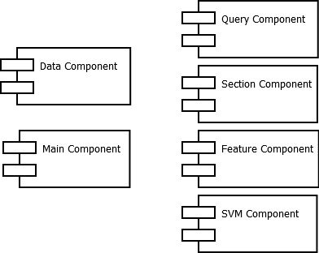
Class Design
The overall design consists of six components designed for high cohesion and low coupling.

Slide 16

Main Component
This component is responsible for calling all other components and finally generating the list of questions as output.

Slide 17
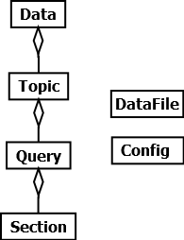
Data Component
The data component stores the overall data and its classes provided interfaces to access and modify this data.

Slide 18
Query Component
The query component is responsible for taking the input topic, then generating the requisite subtopics and queries related to the same.

Slide 19
Section Component
The section component processes each query and generates a list of Section objects for each query.

Slide 20
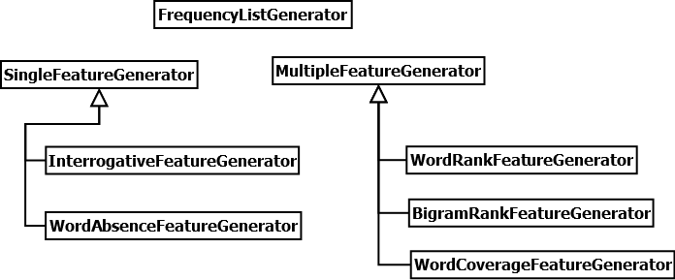
Feature Component
The feature component has classes to generate all the requisite features for the sections.

Slide 21
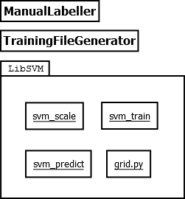
SVM Component
Consists of all the classes which are related to the machine learning aspect of the program.

Slide 22
Work done in S8
Class Design
Data Design
Data Structure Design
Data File Design
Config Design
SVM Identification
Implementation
Analysis

Slide 23
Data Structure Design
n–ary tree
Suitable for component-based architecture
Easy modeling of data
Extensible
Quick access
Group data in a functional manner

Slide 24
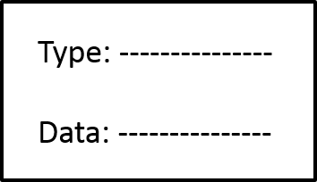
Node Design
The node will have the following attributes:
Type: The type of node
Data: The corresponding data
ChildList: List of child nodes

Slide 25
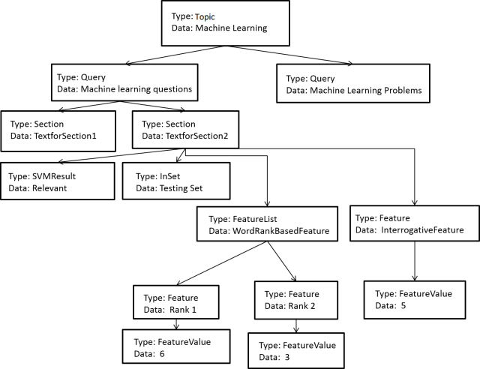
Tree Design

Slide 26
Data Tree Life-Cycle

Slide 27
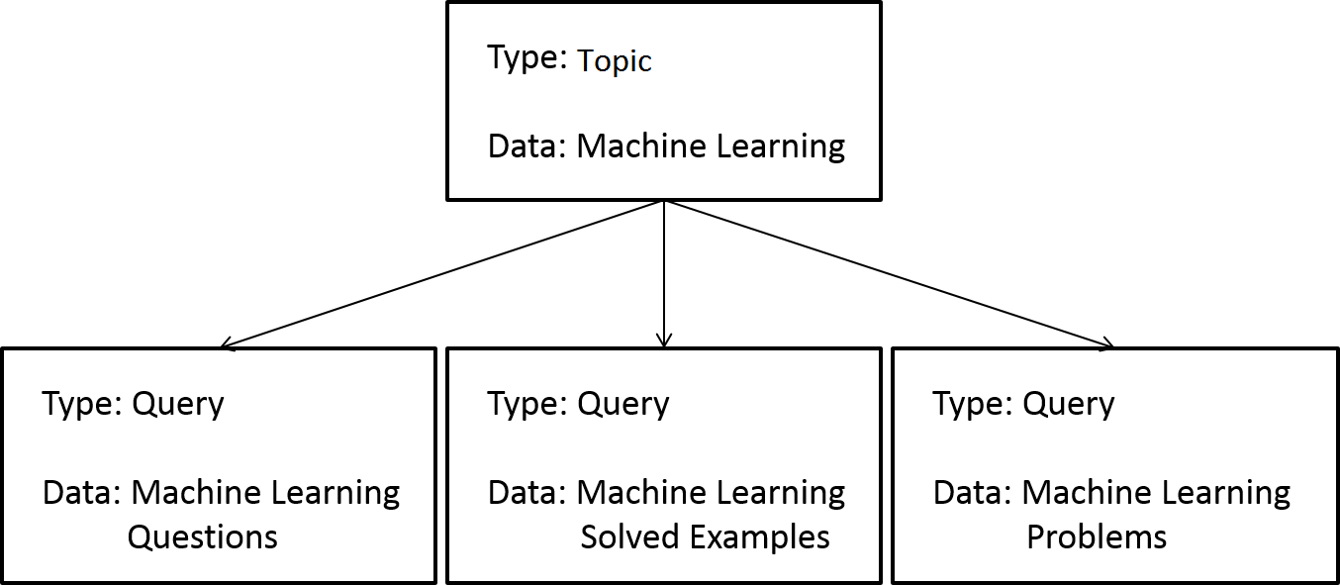
Query Generation
The Query Generator generates a set of queries to search for from the given search topic.

Slide 28
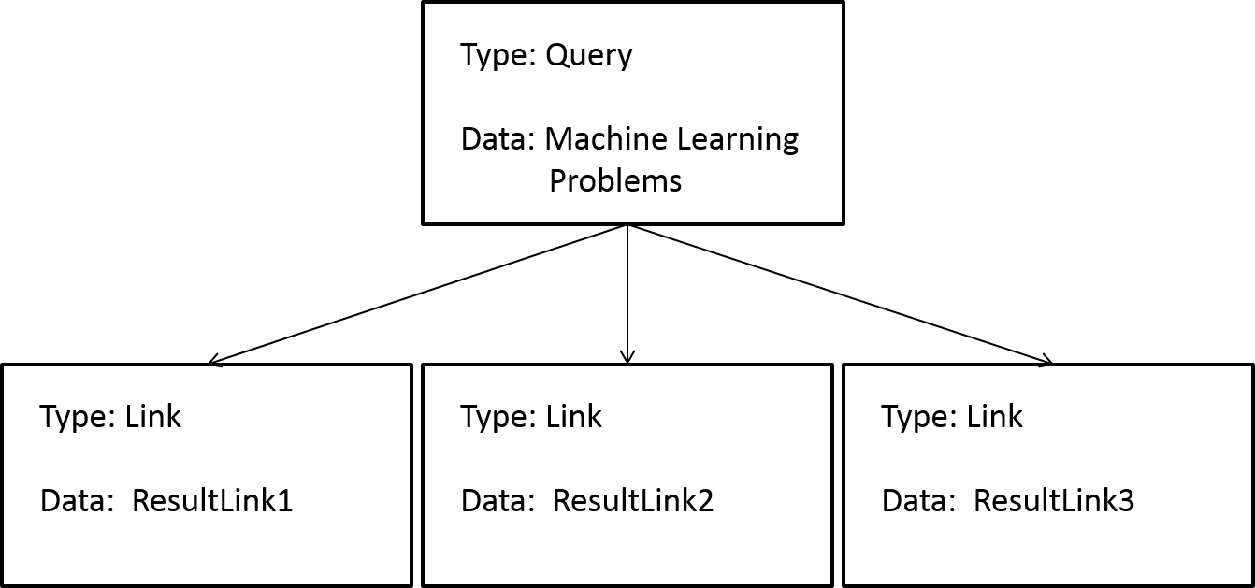
Link Generation
For each of the queries, a set of links corresponding to the search results for that query is generated.

Slide 29
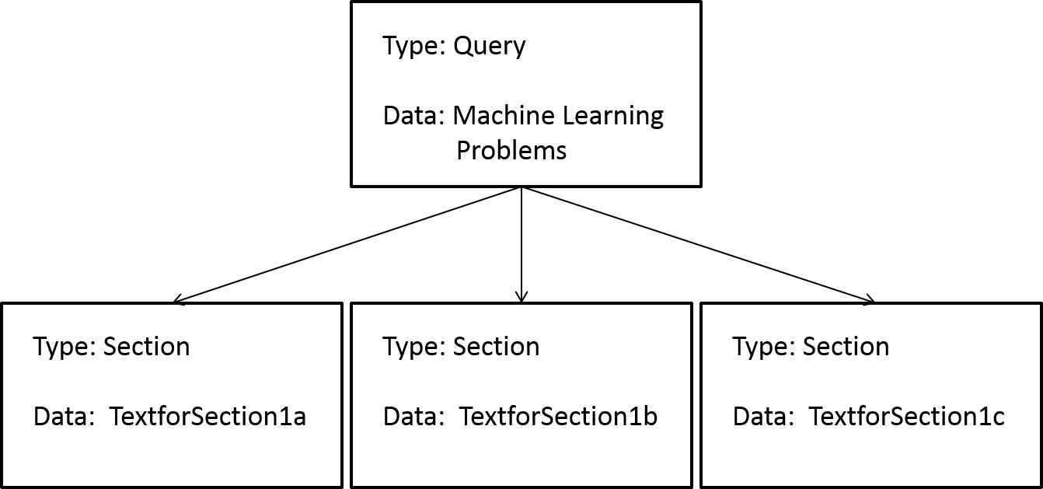
Section Generation
The Section Generator parses each of the links, removes unnecessary data and then divides each page into sections.

Slide 30
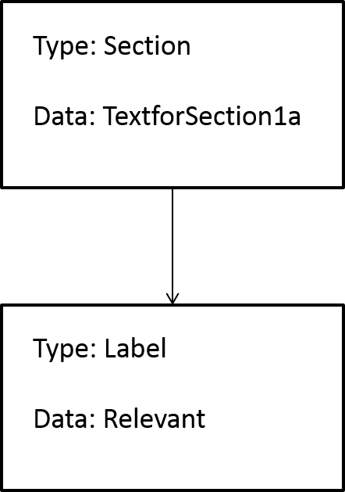
Labelling
Sections intended to be part of the training set will be labelled as relevant or not relevant.

Slide 31
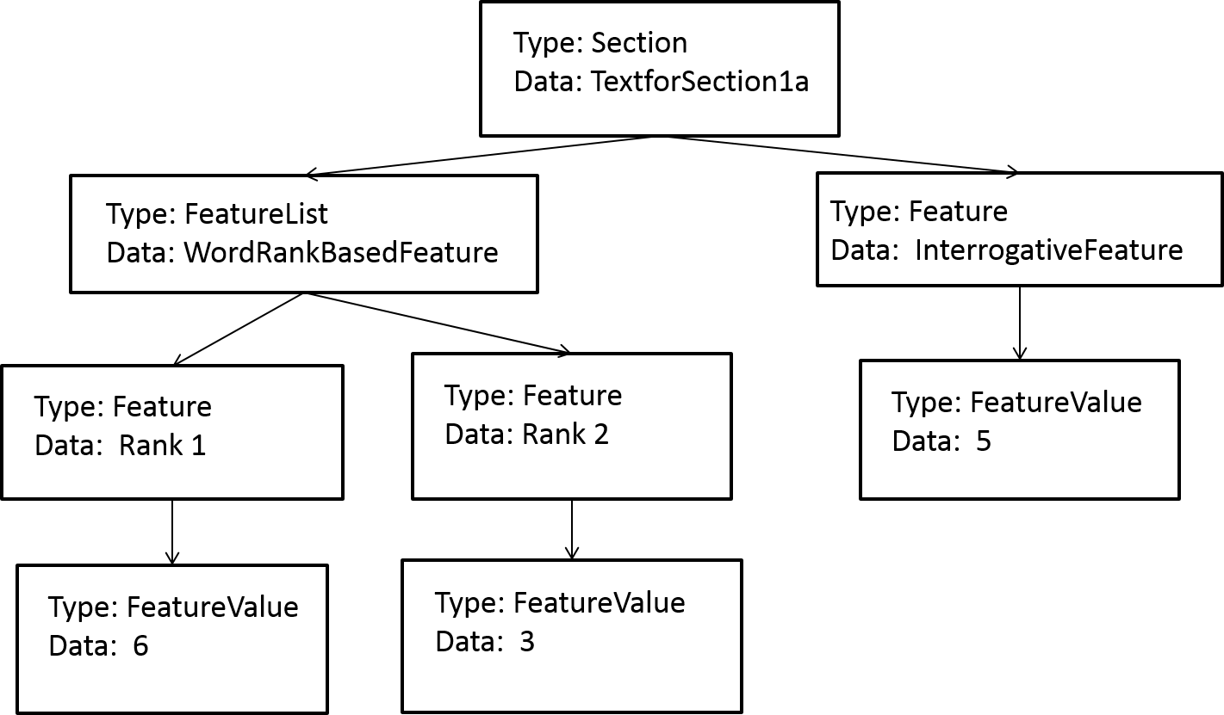
Feature Generation
The features of each section are generated by the Feature Generator.

Slide 32
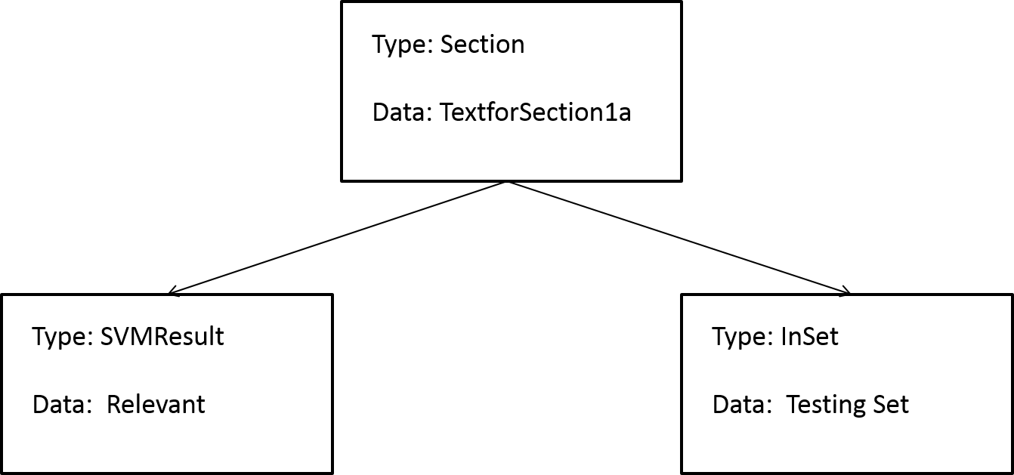
SVM Classification
The results of the Support Vector Machine classification and the set to which the result belongs are also represented as shown.

Slide 33
Data File Design
XML file format
Suitable for a tree like data structure^{[2]}
High Performance
Extensibility
Transparency - analyze or modify the file at any point
JAXB^{[5]} (Java Architecture for XML Bindings)

Slide 34
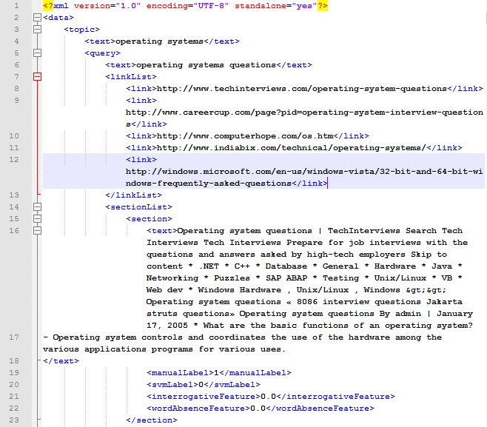
data.xml Example
data.xml example

Slide 35
Work done in S8
Class Design
Data Design
Data Structure Design
Data File Design
Config Design
SVM Identification
Implementation
Analysis

Slide 36
Config File Design
config.properties
Configurable parameters in the Java Properties format
The user is free to change parameters as per requirements
Reduce wastage of time during testing and analysis by eliminating needless recompilations

Slide 37
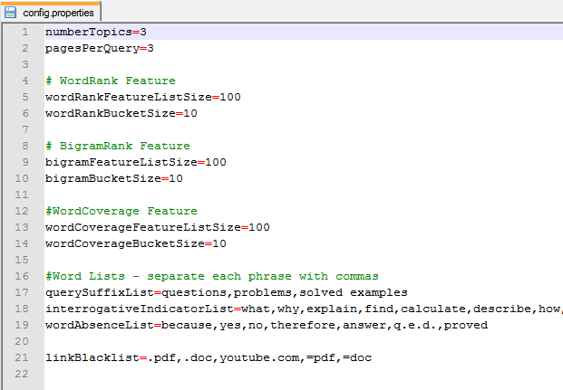
config.properties example

Slide 38
Work done in S8
Class Design
Data Design
Data Structure Design
Data File Design
Config Design
SVM Identification
Implementation
Analysis

Slide 39
SVM Package Identification
LIBSVM^{[3]} library for the Support Vector Machine
Efficient implementation of Radial Basis Kernel^{[3]}
Good performance^{[4]}
High accuracy^{[4]}

Slide 40
Work done in S8
Class Design
Data Design
Data Structure Design
Data File Design
Config Design
SVM Identification
Implementation
Analysis

Slide 41
Section Generation Heuristic
Paragraph and sentence boundary detection is done using the SentParDetector class from the spiatools library by Scott Piao^{[6]}
Sentences with length > 400 characters further broken down
Every paragraph with sentences >= 6 split in half and the check is repeated

Slide 42
Frequency List Generation
Generated for Query objects and corresponding Section objects
Done for both unigrams and bigrams
Text content broken into tokens using the StandardTokenizer class from the Apache Lucene library^{[7]}
The frequency of each token calculated and stored in a hashtable
Key – token
Value – frequency
The hashtable is sorted in order of decreasing frequency

Slide 43
Training Data Generation
The Training Data was generated for 3 topics –
operating systems
data structures and algorithms
computer architecture
6467 sections
1243 relevant
5223 irrelevant
To avoid unbalanced data bias^{[8]}, SVM weightage –
4 for relevant sections
1 for irrelevant sections

Slide 44
Work done in S8
Class Design
Data Design
Data Structure Design
Data File Design
Config Design
SVM Identification
Implementation
Analysis

Slide 45
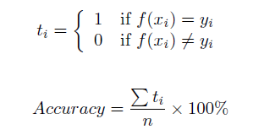

Performance Measure
$x_{1},x_{2}$,…,$x_{n}$ are the testing data
$f(x_{1})$, $f(x_{2})$,…, $f(x_{n})$ are the decision values by the SVM
$y_{1},y_{2}$,…,$y_{n}$ are the manual labels^{[4]}

Slide 46
Performance Measure
5-fold Cross Validation Accuracy
In k-fold cross-validation, the sample is partitioned into k equal size subsamples and a single subsample is retained as the validation data, and the remaining k-1 subsamples are used as training data.
This is repeated k times and the results averaged to produce a single estimation.

Slide 47
Feature Analysis
For each combination of features –
Features scaled^{[9]} to [0,1] using svm_scale
Optimal C and γ SVM parameters determined using grid.py
5-fold Cross Validation Accuracy determined

Slide 48
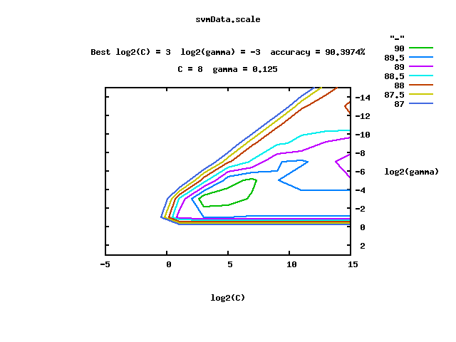
Feature Analysis

Slide 49
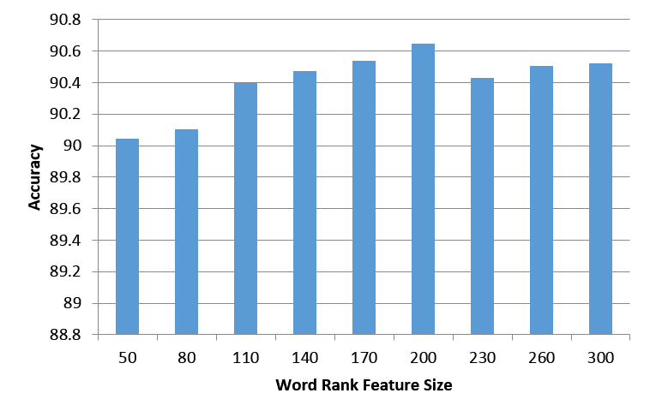
Word Rank Based Features
Word Rank Bucket Size = 1 Bigram Rank Features = 150
Bigram Rank Bucket Size = 1 Word Coverage Based Features = 150
Word Coverage Bucket Size = 5

Slide 50
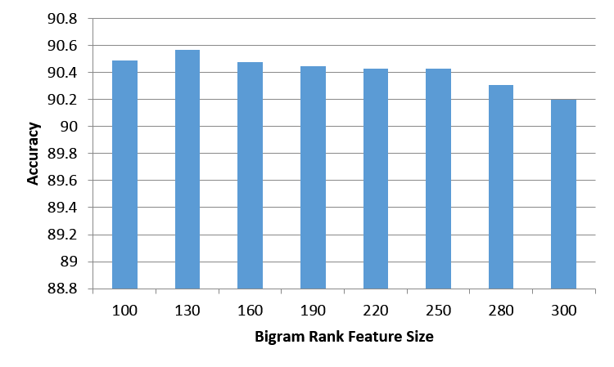
Bigram Rank Based Features
Word Rank Features = 150 Word Rank Bucket Size = 1
Bigram Rank Bucket Size = 1 Word Coverage Based Features = 150
Word Coverage Bucket Size = 5

Slide 51
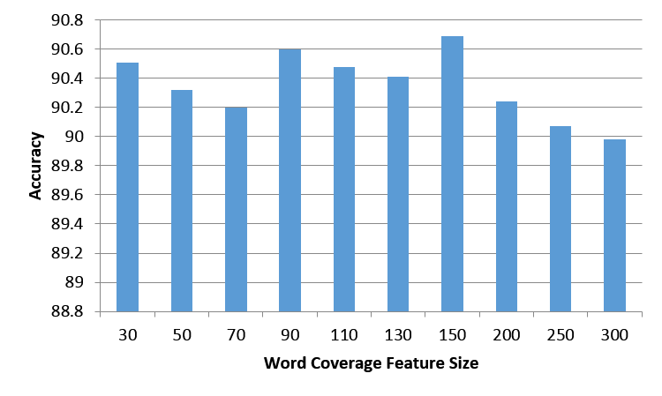
Word Coverage Based Features
Word Rank Features = 150 Word Rank Bucket Size = 1
Bigram Rank Features = 150 Bigram Rank Bucket Size = 1
Word Coverage Bucket Size = 5

Slide 52
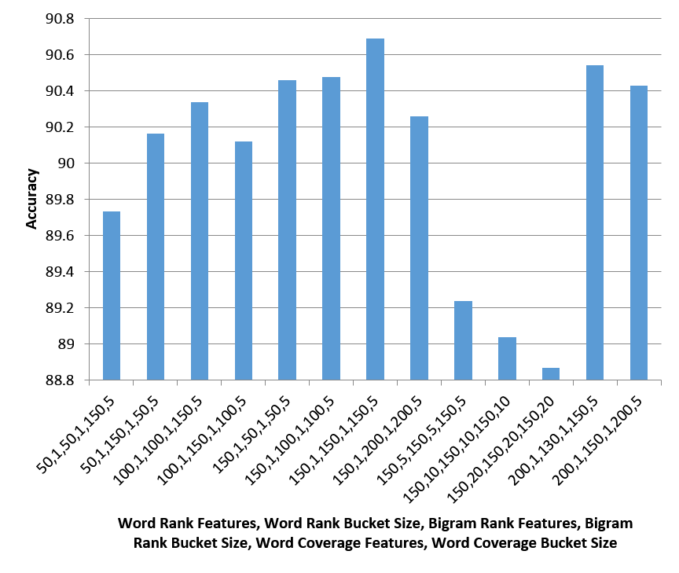
Optimal Feature Configuration

Slide 53
Optimal Feature Configuration
Accuracy 90.69%
Word Rank Features = 150
Word Rank Bucket Size = 1
Bigram Rank Features = 150
Bigram Rank Bucket Size = 1
Word Coverage Features = 150
Word Coverage Bucket Size = 5
Optimal SVM parameters
C = 8.0
γ = 0.125

Slide 54
Training Set Size Analysis
Procedure –
Training Set generated using stratified subsampling of Data Set
The features were scaled^{[9]} to [0, 1] using svm_scale
Optimal C and γ SVM parameters determined using grid.py
SVM Model generated using the Training Set
Accuracy calculated by predicting the Data Set

Slide 55
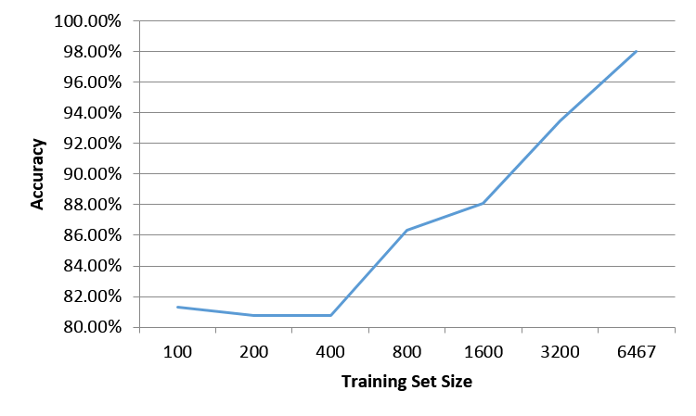
Observation
Accuracy increases exponentially with training set size.

Slide 56
Proposed Feature Analysis
The effect of our proposed features was studied by
Configurations of the Training File generated by selecting combinations of the 3 classes of features
Features scaled^{[9]} to [0,1] using svm_scale
Optimal C and γ SVM parameters determined using grid.py
5-fold Cross Validation Accuracy determined

Slide 57
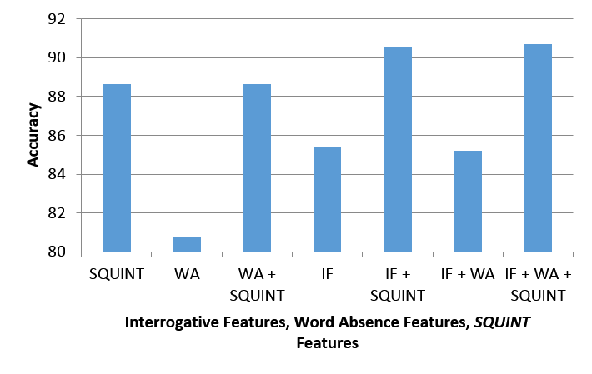
Observation
Interrogative feature + SQUINT features – 90.55% accuracy
All features – 90.69% accuracy

Slide 58
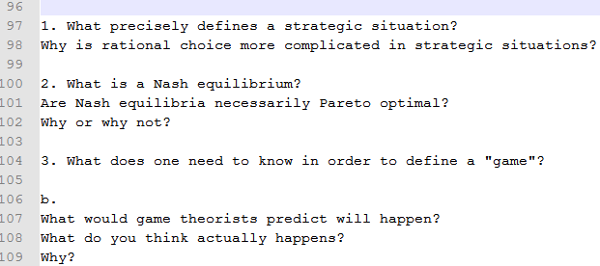
Real Run
Sample topic – ‘Game Theory’

Slide 59
Contents
Introduction
Work Done in S7
Work Done in S8
Conclusion and Future Work

Slide 60
Conclusion and Future Work
Proposed method of using a SVM to classify relevant questions from the internet – successful
Future work –
Multi-class SVM classification
Other features
Using different types of classifiers eg. Neural Networks

Slide 61
References
SQUINT - SVM for Identification of Relevant Sections in Web Pages for Web Search, Riku Inoue, Siddharth Jonathan J.B., Jyotika Prasad, Department of Computer Science, Stanford University
XML, http://en.wikipedia.org/wiki/XML
LIBSVM, http://www.csie.ntu.edu.tw/~cjlin/libsvm/
LIBSVM, Chih-Wei Hsu, Chih-Chung Chang, and Chih-Jen Lin, April 15, 2010.
JAXB, Ort, Ed, and Bhakti Mehta. "Java architecture for xml binding (jaxb)." Sun Developer Network (2003).
A Highly Accurate Sentence and Paragraph Breaker, Scott Piao, 2008, http://text0.mib.man.ac.uk:8080/scottpiao/sent_detector
Apache Lucene - a high-performance, full-featured text search engine library, Jakarta, Apache, 2004.
An approach for classification of highly imbalanced data using weighting and undersampling, Ashish Anand, Ganesan Pugalenthi, Gary B.Fogel, P. N. Suganthan, Springer Journal.
A Practical Guide to Support Vector Classication, Chih-Jen Lin, Department of Computer Science, National Taiwan University, Talk at University of Freiburg, July 15, 2003.

