Slide 1
Extraction of questions from the Internet using a Machine Learning approach
Alok Saw B090924CS
Jerrin Shaji George B090437CS
Shubhangam Agrawal B090904CS
Stein Astor Fernandez B090006CS
Guide : Dr. Priya Chandran
Notes:
This template can be used as a starter file for presenting training materials in a group setting.
Sections
Right-click on a slide to add sections. Sections can help to organize your slides or facilitate collaboration between multiple authors.
Notes
Use the Notes section for delivery notes or to provide additional details for the audience. View these notes in Presentation View during your presentation.
Keep in mind the font size (important for accessibility, visibility, videotaping, and online production)
Coordinated colors
Pay particular attention to the graphs, charts, and text boxes.
Consider that attendees will print in black and white or grayscale. Run a test print to make sure your colors work when printed in pure black and white and grayscale.
Graphics, tables, and graphs
Keep it simple: If possible, use consistent, non-distracting styles and colors.
Label all graphs and tables.

Slide 2
Contents
Introduction
Work Done in S7
Work Done in S8
Future Work

Slide 3
Introduction
There is a massive amount of data available on the internet.
Though searching for relevant pages is trivial, extracting only the relevant sections of data has become very important.
This would result in massive savings of both time and effort.
Notes:
Give a brief overview of the presentation. Describe the major focus of the presentation and why it is important.
Introduce each of the major topics.
To provide a road map for the audience, you can repeat this Overview slide throughout the presentation, highlighting the particular topic you will discuss next.

Slide 4
Introduction
For both faculty and students, obtaining a list of questions pertaining to a topic would be useful.
It is tedious to search for various query permutations and manually visit each page and then find such questions.
Would be highly useful if this could be automated.

Slide 5
Problem Statement
Given input a topic t,
Search the internet for pages possibly containing questions related to t
Output a set R comprising of relevant questions extracted from these pages.

Slide 6
Contents
Introduction
Work Done in S7
Work Done in S8
Future Work

Slide 7
Architectural Overview
Topic + Subtopic
Query Generation
Query set Q
Get relevant links Lq
SEARCH ENGINE
Q, L_{q}
Break each page into sections Sq
PAGE PREPROCESSOR
Sections Sq
Label each section
Generate features for each section
LABELLING
FEATURE GENERATOR
SVM
Training Set
RESULT

Slide 8
Program Structure
Query Generation
Page Retrieval
Page Preprocessor
Feature Generator
Training Set Generation
Support Vector Machine
Output

Slide 9
Feature Generator
Features for relevance of text^{[1]} -
Word Rank Based Features
Bigram Rank Based Features
Coverage of Top Ranked Tokens
Proposed features to determine if text is a question -
Coverage of Interrogative Indicators
Absence of Specific Keywords

Slide 10
Contents
Introduction
Work Done in S7
Work Done in S8
Future Work

Slide 11
Work done in S8
Class Design
Data Design
Data Structure Design
Data File Design
Config Design
SVM Identification + Testing
Coding

Slide 12
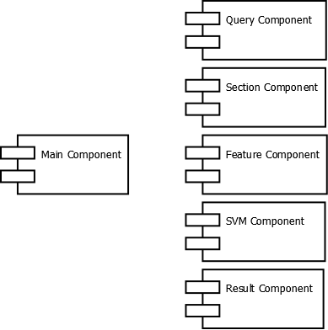
Class Design
The overall design consists of six components designed for high cohesion and low coupling.

Slide 13
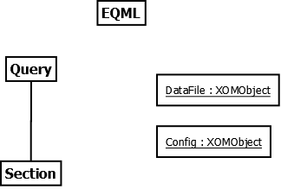
Main Component
The main component stores the overall data and its classes provide interfaces to access and modify this data.

Slide 14
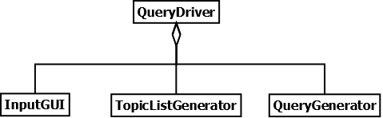
Query Component
The query component is responsible for taking the input topic, then generating the requisite subtopics and queries related to the same.

Slide 15
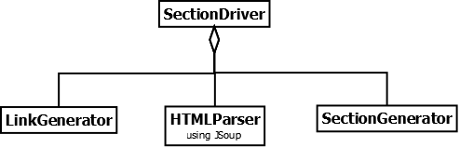
Section Component
The section component processes each query and generates a list of Section objects for each query.

Slide 16
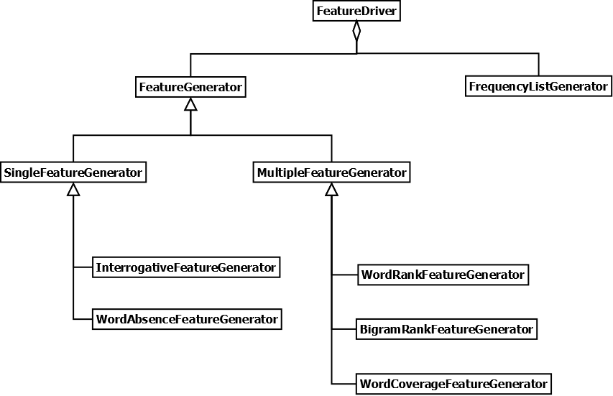
Feature Component
The feature component has classes to generate all the requisite features for the sections.

Slide 17
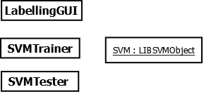
SVM Component
Consists of all the classes which are related to the machine learning aspect of the program.

Slide 18
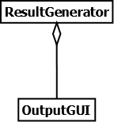
Output Component
This component is responsible for generating the list of questions as output.

Slide 19
Work done in S8
Class Design
Data Design
Data Structure Design
Data File Design
Config Design
SVM Identification + Testing
Coding

Slide 20
Data Structure Design
We have chosen to use an n-ary tree as the data structure keeping in mind the component-based architecture.
The tree structure allows us to model the data easily while being completely extensible at any point.
It allows quick access to required data and allows us to group data in a functional manner.

Slide 21
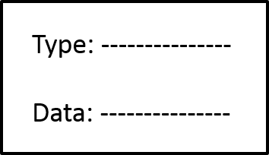
Node Design
The node will have the following attributes:
Type: The type of node
Data: The corresponding data
ChildList: List of child nodes

Slide 22
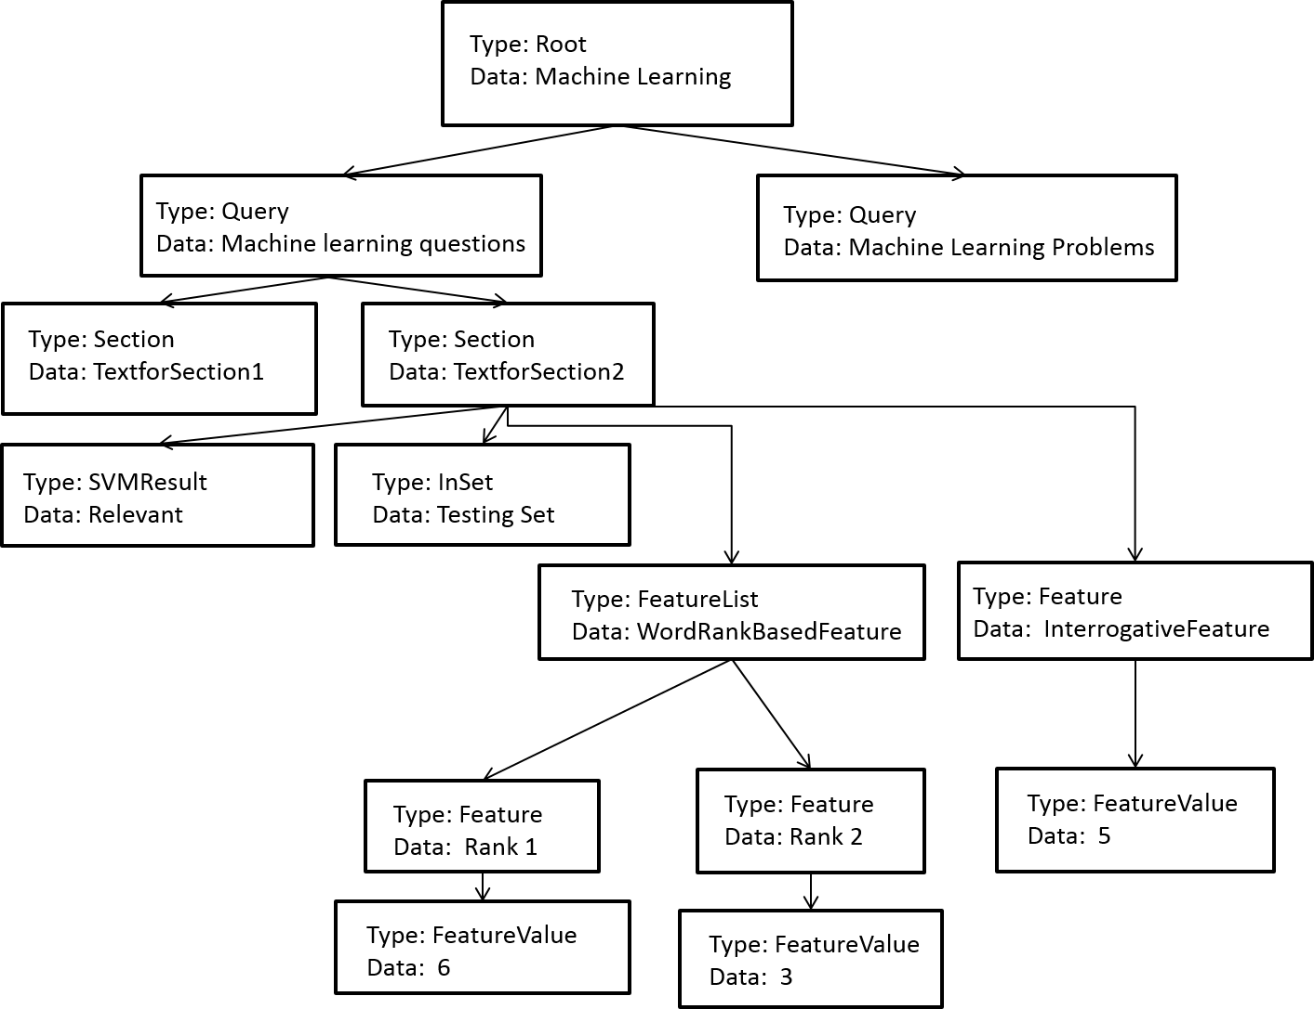
Tree Design
The tree will look as follows:

Slide 23
Data Tree Life-Cycle

Slide 24
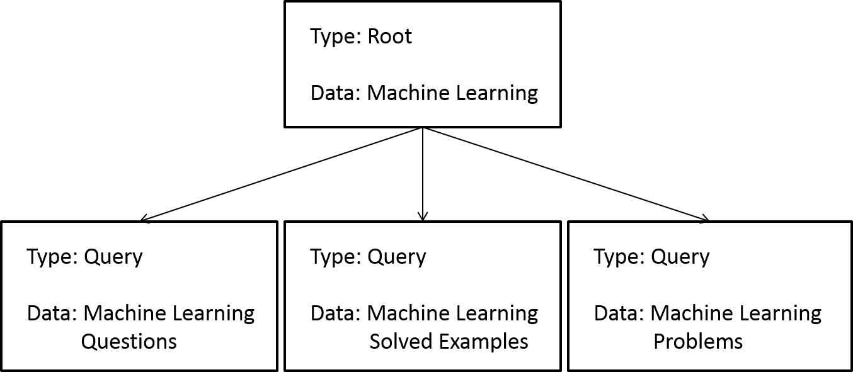
Query Generation
The Query Generator generates a set of queries to search for from the given search topic and creates a set of corresponding nodes as children to the root node, as shown.

Slide 25
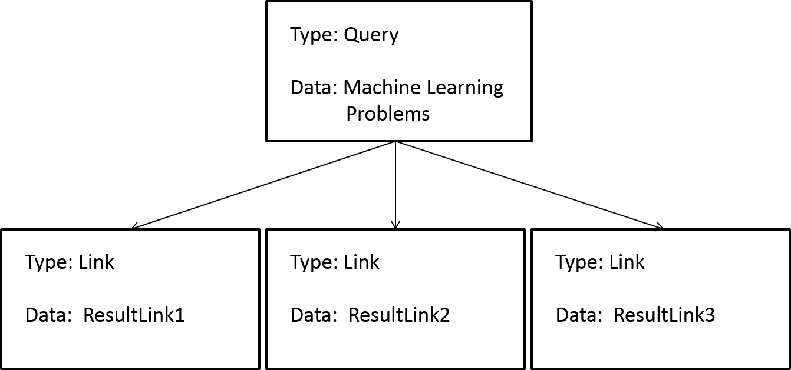
Link Generation
For each of the queries generated in the previous step, a set of links corresponding to the search results for that query is generated as children of each query node.

Slide 26
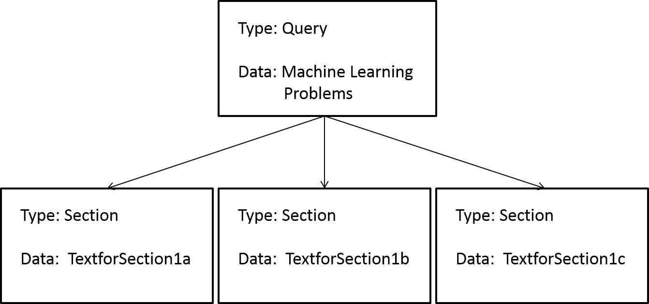
Section Generation
The Section Generator parses each of the links generated in the previous step, removing unnecessary data and then divides each such page into sections, each of which may contain a question relevant to the topic at hand.

Slide 27
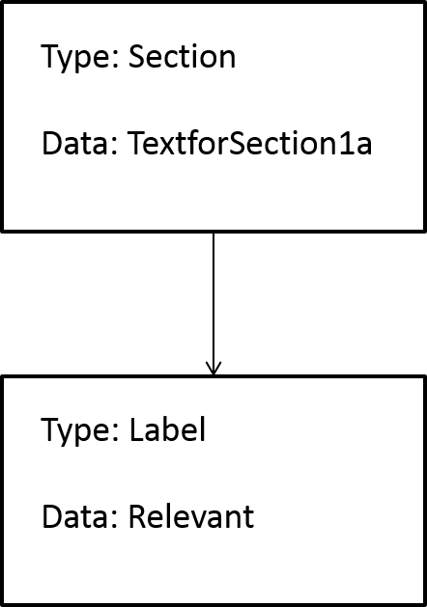
Labelling
Sections intended to be part of the training set will be labelled as relevant or not relevant. This is indicated by a corresponding child node for that section node, as shown.

Slide 28
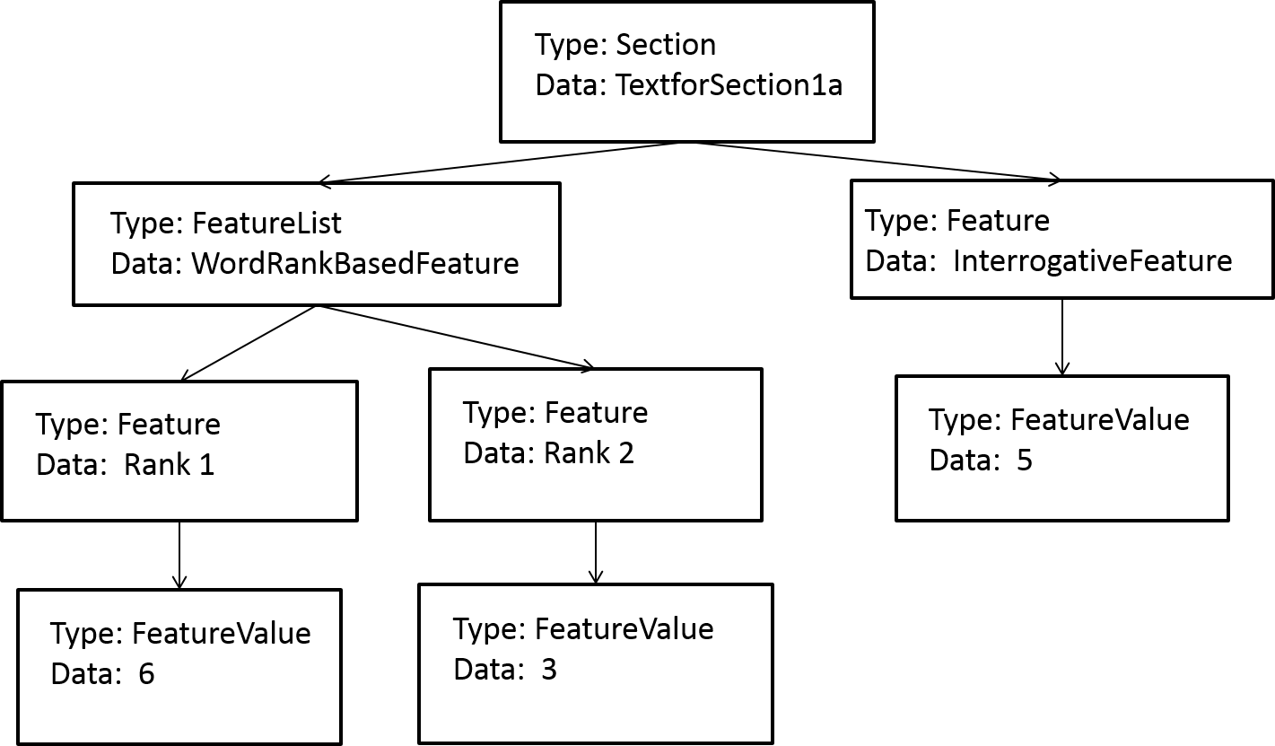
Feature Generation
The features of a section are similarly represented by corresponding child nodes of each feature category.

Slide 29
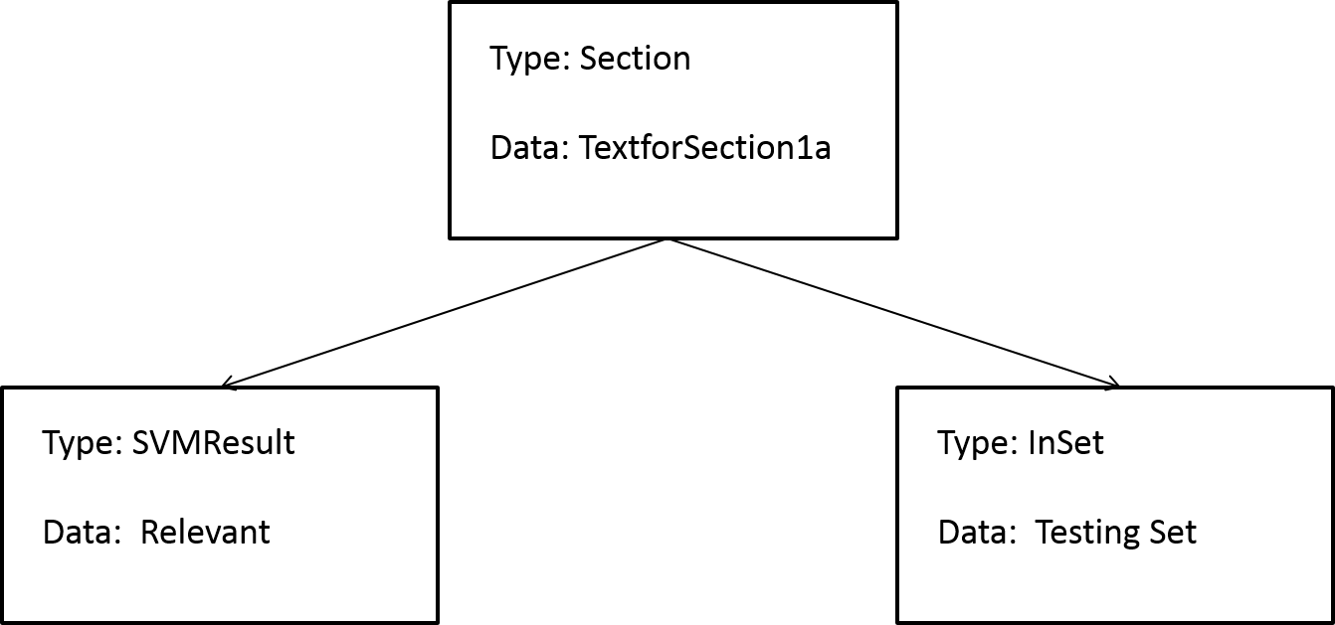
SVM Classification
The results of the Support Vector Machine classification and the set to which the result belongs are also represented as shown.

Slide 30
Data File Design
We will be using the XML file format for the data file since the tree-like structure of the XML format is highly suitable for representing a tree data structure^{[2]}.
The key features of this design are its performance, extensibility and transparent nature which allows us to analyze or modify the file at any point in the application’s life-cycle.
We will be using the JAVA XOM class^{[5]} as it is suitable for our purposes.

Slide 31
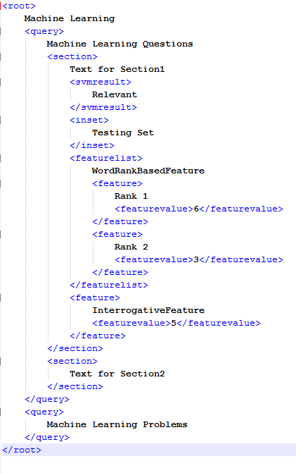
data.xml Example

Slide 32
Work done in S8
Class Design
Data Design
Data Structure Design
Data File Design
Config Design
SVM Identification + Testing
Coding

Slide 33
Config File Design
The file config.xml will have all the configurable parameters in the XML format.
The user is free to change parameters as per requirements.
This will help reduce wastage of time during testing and analysis by eliminating needless recompilations.

Slide 34
Work done in S8
Class Design
Data Design
Data Structure Design
Data File Design
Config Design
SVM Identification + Testing
Coding

Slide 35
SVM Package Identification
We have identified the LIBSVM^{[3]} library to implement the Support Vector Machine.
It has functions for the Linear Kernel^{[1]} that our algorithm uses.
LIBSVM is a mature SVM library for JAVA with good performance and high accuracy^{[4]}.

Slide 36
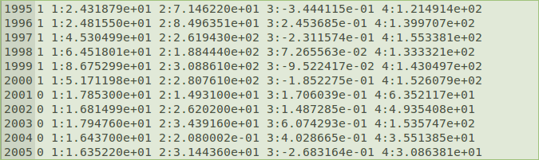
SVM Package Testing
Training Data in SVM Format

Slide 37
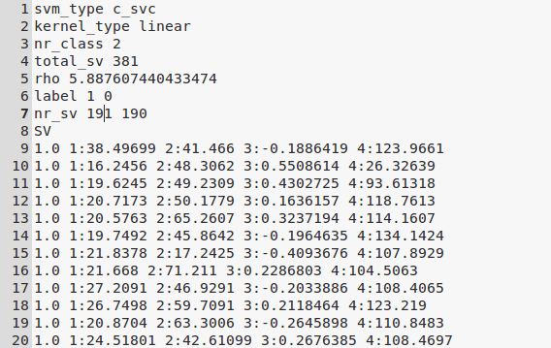
SVM Package Testing
Model Generated from Training Data

Slide 38
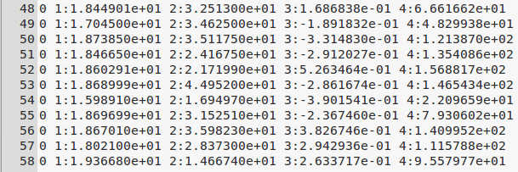
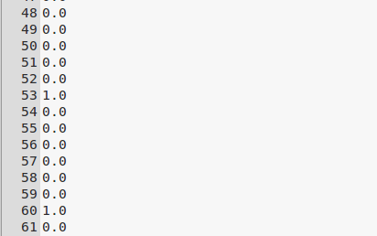
SVM Package Testing
Testing Data v/s Predicted Output

Slide 39
Work done in S8
Class Design
Data Design
Data Structure Design
Data File Design
Config Design
SVM Identification + Testing
Coding

Slide 40
Coding Delegation
Shubhangam
Main Component
Feature Component
Jerrin
Feature Component
Section Component
Alok
SVM Component
Result Component
Stein
Query Component
Section Component

Slide 41
Coding Progress
Main Component
Completed apart from XML file interactions and config
Section and Query Components
SearchAPI, InputGUI, HTMLParser completed
Feature Component
Word and Bigram Frequency Lists generated
SVM Component
SVM Object Implemented and tested

Slide 42
Contents
Introduction
Work Done in S7
Work Done in S8
Future Work

Slide 43
Future Work
We will first finish coding the application and refine each component by performing iterations of training, testing and validation.
Analysis with respect to
Relevance of the features
Weightage of the features in SVM classification
Impact of the configurable parameters

Slide 44
References
SQUINT - SVM for Identification of Relevant Sections in Web Pages for Web Search, Riku Inoue, Siddharth Jonathan J.B., Jyotika Prasad, Department of Computer Science, Stanford University
XML, http://en.wikipedia.org/wiki/XML
LIBSVM, http://www.csie.ntu.edu.tw/~cjlin/libsvm/
LIBSVM, Chih-Wei Hsu, Chih-Chung Chang, and Chih-Jen Lin, April 15, 2010.
XOM, http://www.xom.nu/

