Slide 1
Promotion Board Study Tool
By: SGT Steinbach

Slide 2
Overview
The tool is a python script for assistance on studying for the promotion board
Any questions/concerns should be directed to SGT Steinbach, as he is the one that built it and can edit it
The tool is constantly being changed/edited for better improvement
There are two ways to use it - I will cover how to do both
Online Interpreter - Recommended for beginners
Downloading the tool and using an interpreter on your own device
Will go through a brief explanation on how to use the tool

Slide 3
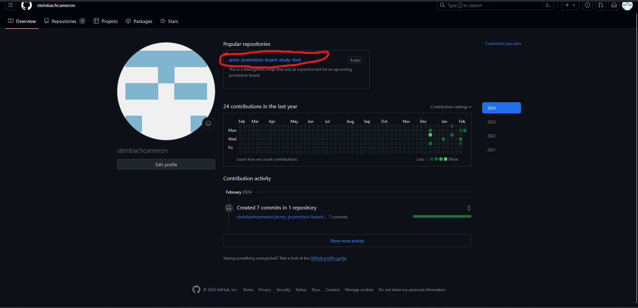
Go to: https://github.com/steinbachcameron
Click on ‘army-promotion-board-study-tool’

Slide 4
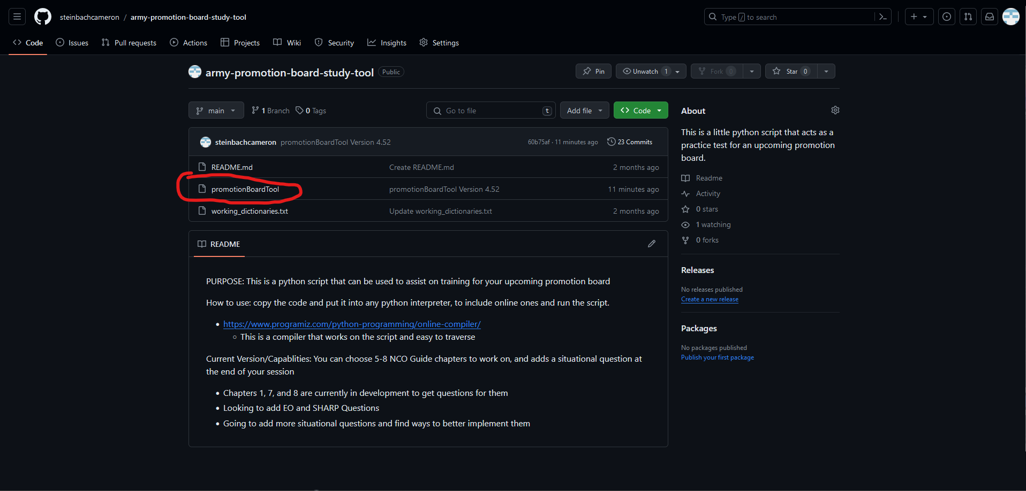
Click on promotionBoardTool

Slide 5
Using an Online Interpreter

Slide 6
Using an Online Interpreter
You can search for ‘Online Python Interpreter’ in google and find one that works best for you…
They function very similar to each other
I will demonstrate how to use the interpreter at https://www.online-python.com/

Slide 7
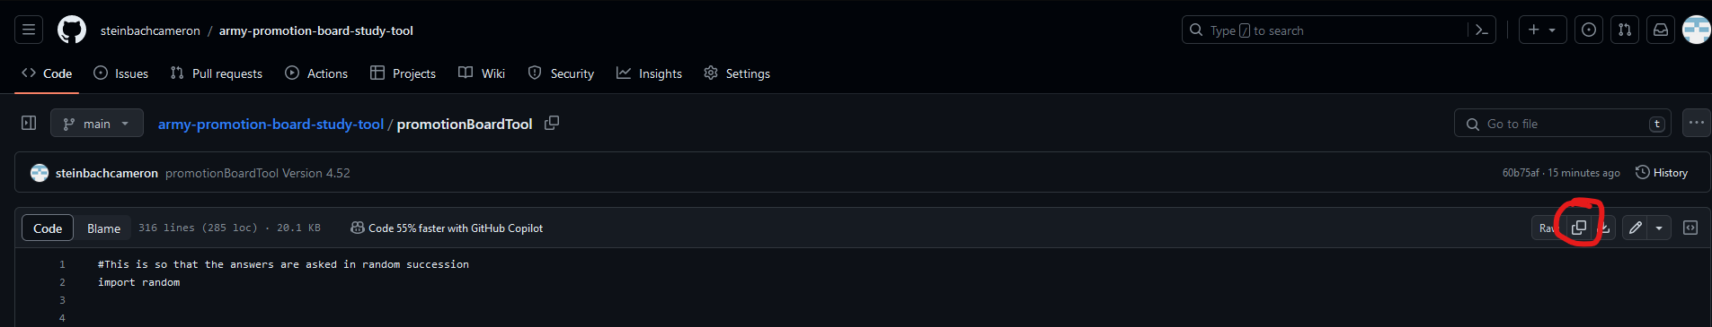
Using An Online Interpreter
Click on the Copy’ icon

Slide 8
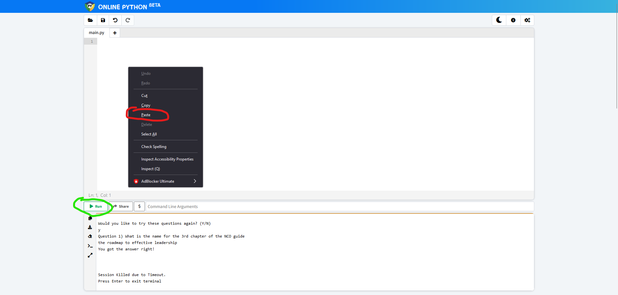
Using an Online Interpreter
https://www.online-python.com/
Paste the code into top box
Click on ‘-> Run’ to run the code

Slide 9
Downloading the Tool

Slide 10
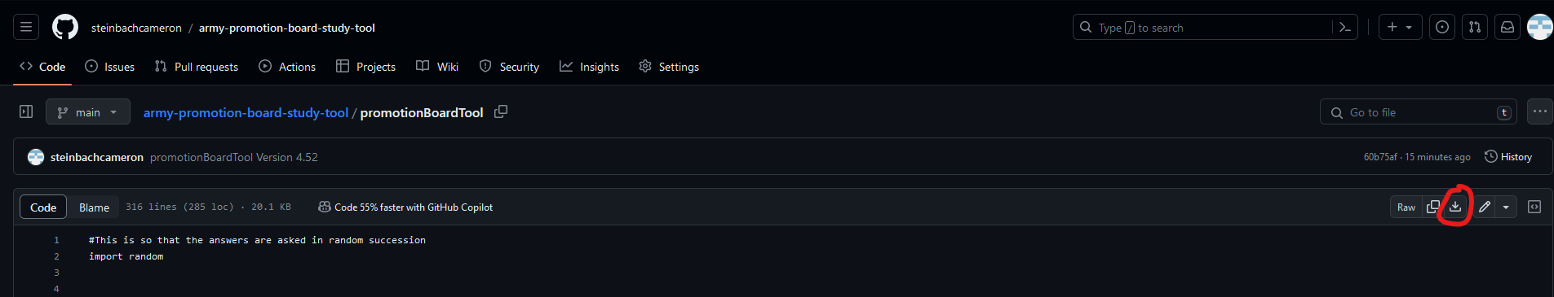
Downloading the tool
Click on the ‘Download’ icon

Slide 11
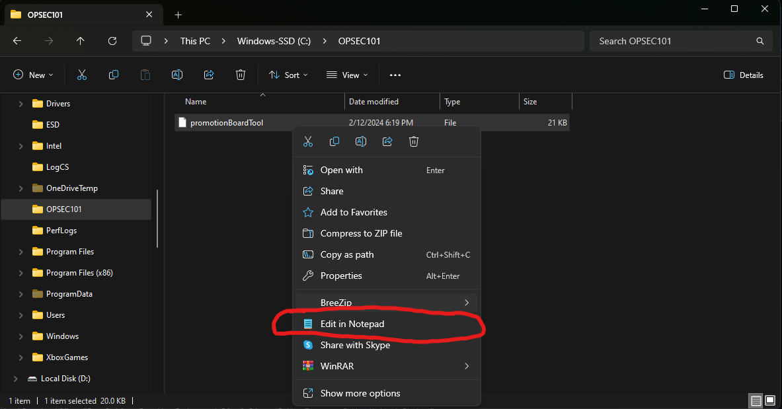
Downloading the tool
Click on ‘Edit in Notepad’

Slide 12
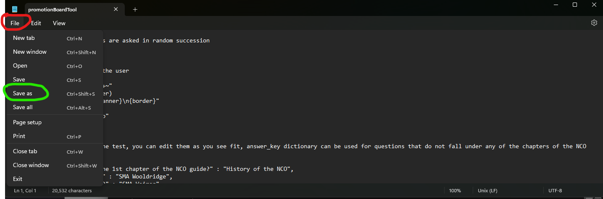
Downloading the tool
Click on ‘File’
Click on ‘Save As’

Slide 13
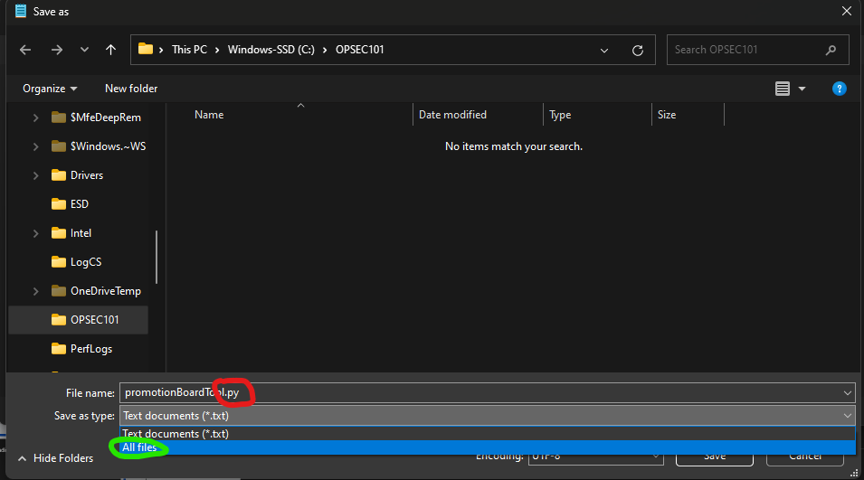
Downloading the tool
Add ‘.py’ to the end of File Name
Click on ‘Save as type’ and choose ‘All files’

Slide 14

Downloading the tool
If done correctly, the icon should look like this…. If not it is most likely due to 1 of 2 things:
Made a mistake on previous slide
Go back and review the previous slide
You do not have python installed on your system
Install python from https://www.python.org/downloads/

Slide 15
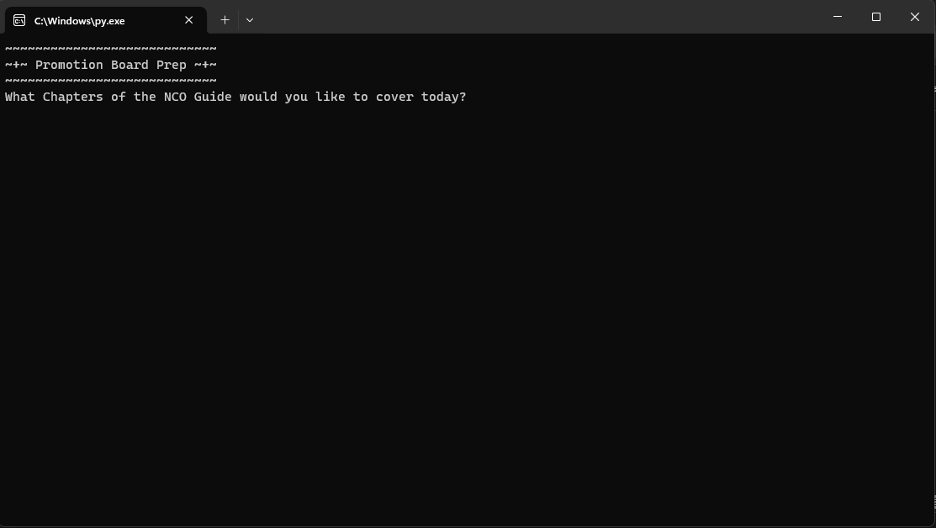
Downloading the Tool
Double-click the file and it should open a window that looks like the image on the right

Slide 16
Using the Tool

Slide 17
Choosing Chapters
Type any number from 1-8 (# of chapters in the NCO Guide)
For Example:
3 = Chapter 3 of NCO Guide
12345678 = Entirety of NCO Guide
*Recommended to do a chapter at a time*
Can press enter without any numbers, if you do not want to review the NCO Guide

Slide 18
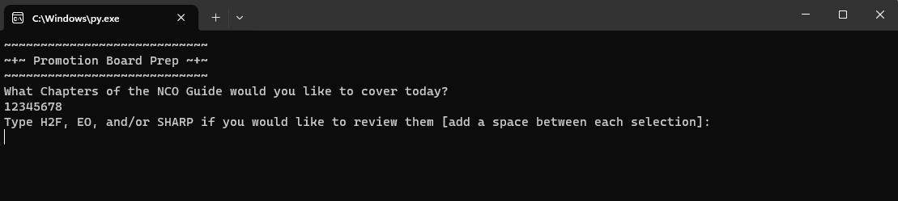
Choosing H2F, EO and/or SHARP Questions
Follow directions on the screen
For Example:
H2F = H2F
H2F SHARP = H2F and SHARP
These are case-insensitive
You do not have to include them, if you do not want to review them (Just press enter instead)

Slide 19
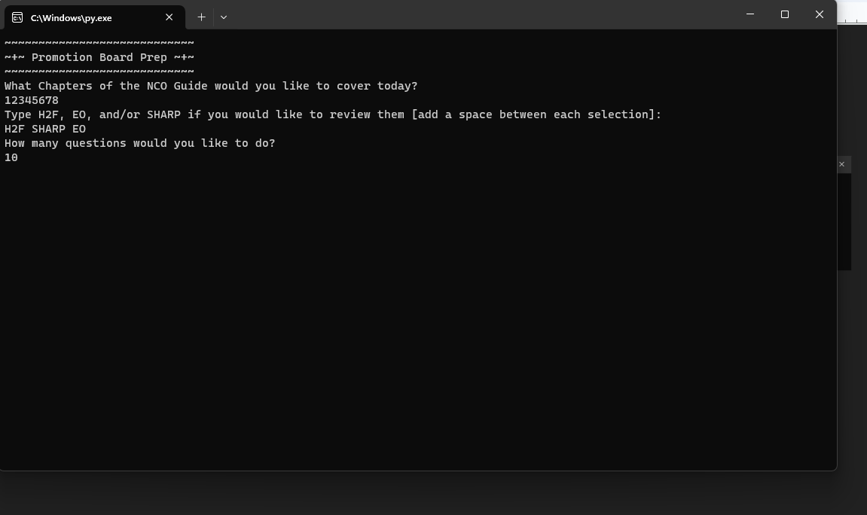
Choosing # of Questions
Follow directions on the screen
Type the Number of questions you would like to do
MUST BE AN INTEGER
I.E. ‘10’
NOT ‘TEN’
Refer to the image on the right

Slide 20
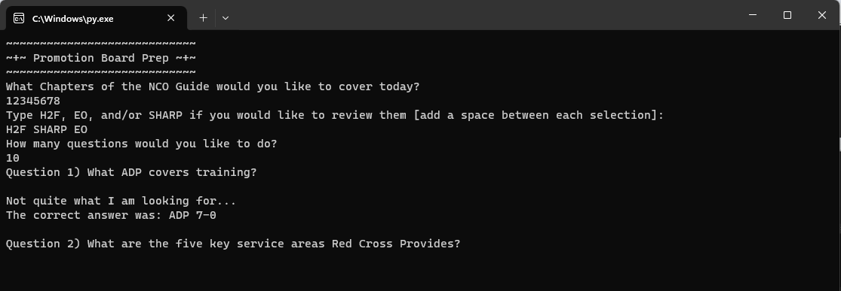
The Quiz
Recommend doing ‘Flashcard Method’ when first using the tool
Press ‘Enter’ to reveal the answer
Typing Method
Type the answer to the question asked
Case and Order insensitive
Anything with a list of items must be separated by commas and do not add ‘AND’

Slide 21
Conclusion
If you have any suggestions/comments feel free to reach out to me (SGT Steinbach)
More input, the better
If you have any questions you would like to see in the script, I will add them
Right now there are 200 questions within the tool (Yes I counted….)

