Slide 1


Slide 2
Outline
What it is
How it works
Monetization

Slide 3
How it all began
Let me tell you a story…

Slide 4



A centralized Lost and Found
Where do you go to shop online?

Slide 5

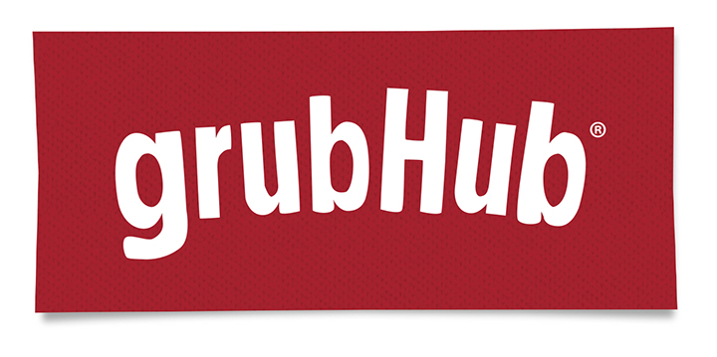

A centralized Lost and Found
Where do you go to order food online?

Slide 6
A centralized Lost and Found
Where do you go to find a lost item online?
?

Slide 7

Our goal is for the answer to be…

Slide 8
Outline
What it is
How it works
Monetization

Slide 9
The Ecosystem
Our ecosystem consists of two parts: Lost items and Found Items

Slide 10
Lost Items
These are the items that people file on the site with the hopes that they might find them

Slide 11
Found Items
These are the items that people and organizations file in the hope that they may be found

Slide 12
What we do
Provide a friendly, easy to navigate directory of found items.

Slide 13
Platforms
Web application, native Android app, native iOS app

Slide 14
Outline
What it is
How it works
Monetization

Slide 15
A scenario…
Let’s say Bob get’s out of a cab on 34th and Broadway. As he gets out, he leaves his expensive coat in the back of the cab.

Slide 16
The scenario continues..
When Bob gets home he realizes he left his coat in the cab. So he goes on his computer and files a lost item claim on back-step.com

Slide 17




Why is this data valuable?
The most immediate answer: Bob is now without a coat. This provides the opportunity for ultra-targeted ads.

Slide 18

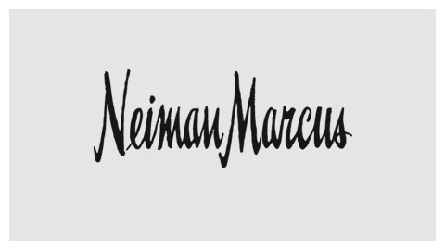


Why else is this data valuable?
As more data is gathered, trends emerge. For instance, lots of people lose coats near 34th and Broadway so this might be a good place for an advertisement.

