Slide 1
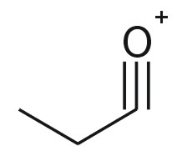

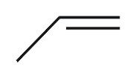
@relation CarbonylElimination
@attribute PartialSigmaChargeDescriptor_PA numeric
@attribute PartialPiChargeDescriptor_PA numeric
@attribute EffectiveAtomPolarizabilityDescriptor_PA numeric
@attribute class {0_00,0_01,0_02,...,0_97,0_98,0_99,1_00}
@data
-00.0559, 00.0000, 04.2565, 0_35,
-00.0316, -00.0821, 05.0540, 0_49,
A
B
A
P=0.35
+
+
D1=-0.0559
D2=-0.000
D2=4.2565
B
P=0.49
+
+
D1=-0.0316
D2=-0.0821
D2=5.0540

Slide 2
+
+
+
+

