Slide 1
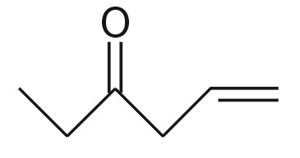
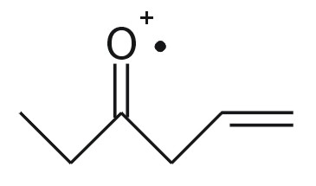
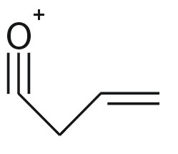
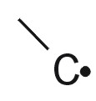
NIST database
100
50
0
0
50
100
Experimental
Mass Spectrum
Fragmentation
Generator
P=0.865%
α-cleavage
+

