Slide 1
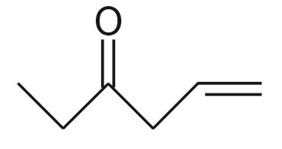
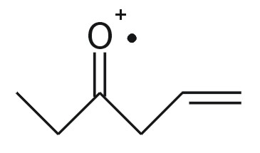
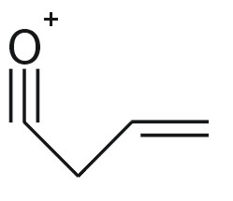
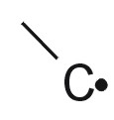
NIST database
100
50
0
0
50
100
Reaction Rules
Elimination
H-rearrangement
Inductive cleavage
.
.
α-cleavage
Fragmentation
Generator
data about
Elimination
data about
H-rearrangement
data about
Inductive cleavage
...
data about
α-cleavage
P=0.865%
α-cleavage
+

