Slide 1

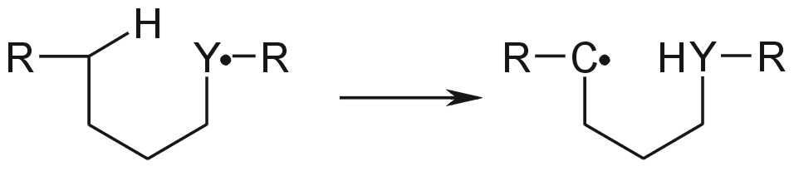
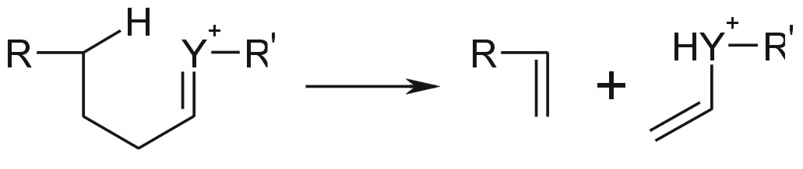
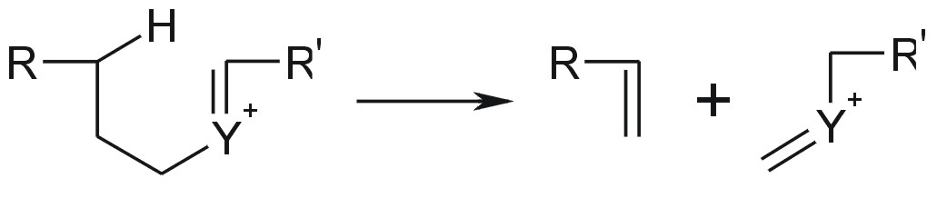
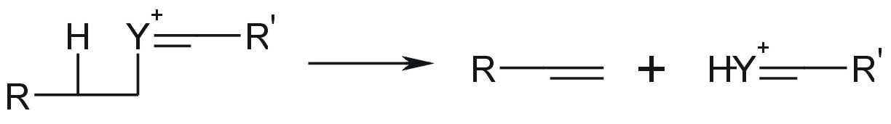
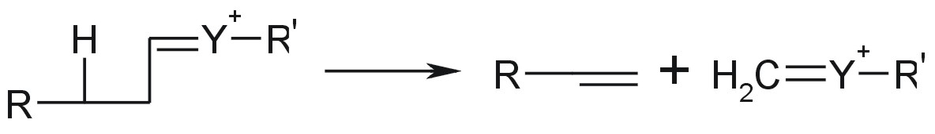
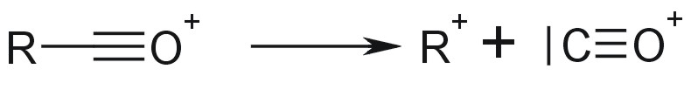

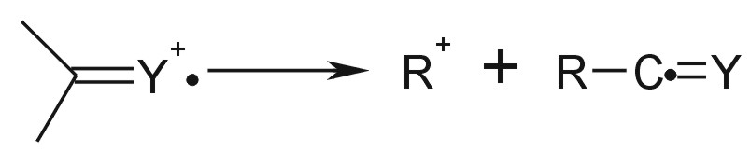
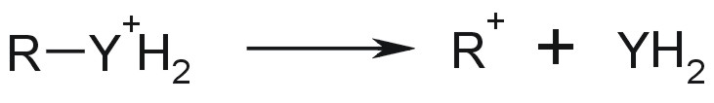
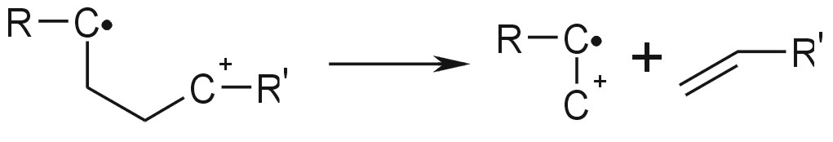
Alpha Cleavage reactions
Radical-Site initiation:
Radical Site Rearrangements
.
Hydrogen Rearrangement:
A
B
H
H
A
B
3-7
3-7
Inductive Cleavage reactions:
Hydrogen Rearrangement Unsatured CS_1:
Hydrogen Rearrangement Unsatured CS_2:
Hydrogen Rearrangement Unsatured CS_3:
Hydrogen Rearrangement Unsatured CS_4:
Inductive Cleavage reactions:
Carbonyl Elimination:
Charge-site initiation for odd satured:
Charge-site initiation for odd unsatured:
Charge-site initiation for even unsatured:
Charge migration:

