Slide 1
The Java Dynamic Proxy

Slide 2
Proxy pattern

Slide 3
Classical Proxy Implementation vs Dynamic Proxy
A Classical Proxy Implementation requires the Programmer to write
the code of the Proxy class for every Original Interface and compile it.
A dynamic proxy class is a class that implements a list of interfaces specified
at runtime when the class is created and immediately instantiated

Slide 4
Java dynamic proxy
A dynamic proxy class is a class that implements a list of interfaces specified at runtime such that a method invocation through one of the interfaces on an instance of the class will be encoded and dispatched to another object through a uniform interface.
Thus, a dynamic proxy class can be used to create a type-safe proxy object for a list of interfaces without requiring pre-generation of the proxy class, such as with compile-time tools.
Method invocations on an instance of a dynamic proxy class are dispatched to a single method in the instance's invocation handler, and they are encoded with a java.lang.reflect.Method object identifying the method that was invoked and an array of type Object containing the arguments.
This process allows implementations to "intercept" method calls and reroute them or add functionality dynamically. The dynamic proxy can act as a Decorator pattern, where the proxy wraps invocations with additional functionality

Slide 5
The InvocationHandler Interface
public interface InvocationHandler {
Object invoke(Object proxy, Method method, Object[] args) throws Throwable;
}
The job of an invocation handler is to actually perform the requested method invocation on behalf of a dynamic proxy. He gets a Method object (from the Reflection API) and the objects that are the arguments for the method call. In the simplest case, he can just call Mehod.invoke() or add pre or post processings.

Slide 6
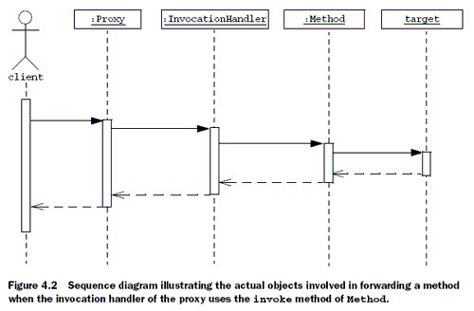
Proxy object – an instance
of the dynamic proxy class
created automatically at runtime
The service of the original
Object is called by Reflection

Slide 7
Creating a dynamic proxy in Java
To create a proxy for some interface Foo:
InvocationHandler handler = new MyInvocationHandler(...);
Class proxyClass = Proxy.getProxyClass( Foo.class.getClassLoader(), new Class[] { Foo.class });
Foo f = (Foo) proxyClass. getConstructor(new Class[] { InvocationHandler.class }). newInstance(new Object[] { handler });
A dynamic proxy class (simply referred to as a proxy class below) is a class that implements a list of interfaces specified at runtime when the class is created, with behavior as described below. A proxy interface is such an interface that is implemented by a proxy class. A proxy instance is an instance of a proxy class.
The unqualified name of a proxy class is unspecified. The space of class names that begin with the string "$Proxy" should be, however, reserved for proxy classes. A proxy class extends java.lang.reflect.Proxy. A proxy class implements exactly the interfaces specified at its creation, in the same order.

Slide 8
Creating a dynamic proxy in Java
A shorter way to create a proxy instance for Foo:
InvocationHandler handler = new MyInvocationHandler(...);
Foo f = (Foo) Proxy.newProxyInstance(Foo.class.getClassLoader(), new Class[] { Foo.class }, handler);

Slide 9
Java dynamic proxy
To read more about java dynamic proxy:
https://docs.oracle.com/javase/7/docs/api/java/lang/reflect/Proxy.html
https://docs.oracle.com/javase/7/docs/technotes/guides/reflection/proxy.html
IBM technical library: http://www.ibm.com/developerworks/java/library/j-jtp08305.html
https://opencredo.com/dynamic-proxies-java-part-2/

