Slide 1
Fundamental architectural styles
Continued - Part 2

Slide 2
Fundamental architectural styles
Outline and bibliography:
  Layers
    [POSA1] – in 2.2
  Pipes and Filters
    [POSA1] – in 2.2
  Blackboard; with its variants: Repository, Active Database
    [POSA1] – in 2.2
  Event-driven (Implicit Invocation); variants: Publisher-Subscriber, Event-Bus
    [POSA1] – from 3.6
    S. Gupta, J. Hartkopf, S. Ramaswamy: Event Notifier, a Pattern for Event Notification, in Java Report, 1998 (republished as chapter 11 in the book More Java Gems, Cambridge University Press, 2000) http://sites.google.com/site/jeffhartkopf/notifier
Optional reading:
    David Garlan, Mary Shaw, An Introduction to Software Architecture, online http://www.cs.cmu.edu/afs/cs/project/able/ftp/intro_softarch/intro_softarch.pdf
PART 2
Notes:
POSA

Slide 3
The Event-driven architectural style
(Publisher-Subscriber, Event Bus)
    Bibliography:
    [POSA1] – din cap. 3.6
    S. Gupta, J. Hartkopf, S. Ramaswamy: Event Notifier, a Pattern for Event Notification, in Java Report, 1998 (republished as chapter 11 in the book More Java Gems, Cambridge University Press, 2000) http://sites.google.com/site/jeffhartkopf/notifier
Notes:
POSA

Slide 4
The Event-driven style
Event driven systems are based on implicit invocation: instead of invoking a procedure directly, a component can broadcast one or more events. Other components in the system can register an interest in an event by associating a procedure with the event. When the event is announced the system itself invokes all of the procedures that have been registered for the event. Thus an event announcement ``implicitly'' causes the invocation of procedures in other modules. .
Event Service
op
Obj1
op
Obj2
Obj1
Obj2
Explicit invocation
Implicit invocation
Notes:
Definitia din Garlan&Shaw – Intro to SwArch
Exemplu din Event Notifier, a Pattern for Event Notification,
Gupta, Hartkopf, Ramaswamy, Java Report 1998

Slide 5
Characteristics of Event-driven
The components of an application do not interact directly with each other, but through implicit invocation
The implicit invocation is facilitated by an infrastructure called Event Service
Implicit invocation may happen according to the variants
  Publisher/Subscriber Direct
  Event Channel (Event Bus)

Slide 6
Publisher-Subscriber Direct
Examples:
  Mechanisms in some programming languages: Java Event – Listener, C# Event – delegate
  The Callback Mechanism, the Observer pattern
  ReactiveX, reactive Java http://reactivex.io/intro.html https://github.com/ReactiveX/RxJava
In all these cases the subscriber knows the publisher

Slide 7
Event Channel (Event Bus)
Publisher
Publisher
Subscriber
Subscriber
Event Channel (Event Bus)
Publisher
Publisher
Subscriber
Subscriber
Publish Event
Receive Event

Slide 8
Event Channel - Description
The central element = types of Events
Publishers: components that produce events, but they do not know the identity of the components that will “consume” these events.
It is possible that different publishers produce the same types of events.
Subscribers: components that receive certain types of events, but do not know and are not interested to know the identity of the components who publish these events (Subscriber)
It is possible that a Subscriber is interested in several different types of events
It is possible that a component is in the same time Publisher and Subscriber (for different event types)
The participants (Publishers or Subscribers) can be dynamically added or removed in the system
New event types can be dynamically added
Components (Publishers and Subscribers) are loosely coupled, they could be located in different processes

Slide 9
The structure of an event-driven application
Components (Elements): Publishers, Subscribers
Connectors (Relations): publish event, subscribe to event type
Infrastructure: Event Channel (Event Bus). Usually it is not part of the application !
Publisher
Publisher
Subscriber
Subscriber
Event Channel (Event Bus)
Publisher
Publisher
Subscriber
Subscriber

Slide 10
The structure of an event-driven application
Infrastructure Event Channel (Event Bus):
EventChannel: subscribe(Subscriber, Event); publish(Event)
Subscriber: notify(Event)
Publisher
Publisher
Subscriber
Subscriber
Event Channel (Event Bus)
Publisher
Publisher
Subscriber
Subscriber

Slide 11
Event Channel – Models of communication
Usually, when an event is received by (one or more) Subscribers, a data transfer will follow, from the Publisher who generated the event to the receiving Subscribers.
There are 4 models of communication, according to the type of data transfer:
  Push: Publisher is the active source that initiates the transfer, while Subscriber is a passive destination. Event Channel = Notifier
  Pull: Subscriber is active and initiates (requests) the data transfer from a passive source (Publisher) . Event Channel = Procurer
  Hybrid Push/Pull: Publishers and Subscribers are active initiators of the transfers, which occur between buffers of the Event Channel = Queue
  Hybrid Pull/Push: Publishers and Subscribers are passive components, the Event Channel has the initiative of the data transfers = Intelligent Agent

Slide 12
Push: Notifier
Active behaviour
Passive behaviour
Publisher
Subscriber
Push data
Push data
Notifier
Publish Event
Receive Event
Data Transfer

Slide 13
Pull: Procurer
Passive behaviour
Active behaviour
Publisher
Subscriber
Pull data
Pull data
Procurer
Publish Event
Receive Event
Data Transfer

Slide 14
Hybrid Push/Pull: Queue
Active behaviour
Active behaviour
Publisher
Subscriber
Push data
Pull data
Queue
Publish Event
Receive Event
Data Transfer

Slide 15
Hybrid Pull/Push: Intelligent Agent
passive behaviour
passive behaviour
Publisher
Subscriber
Pull data
Push data
Intelligent Agent
Publish Event
Receive Event
Data Transfer

Slide 16
Discussion: compare the 4 combinations of Push/Pull
Advantages/disadvantages
Utility (examples)
Implementation

Slide 17
The structure of an event-driven application
Components (Elements): Publishers, Subscribers
Connectors (Relations): publish event, subscribe to event type
Infrastructure: Event Channel (Event Bus). Usually, it is not part of the application ! It can be a general purpose messaging/ event middleware like Java Message Service, CORBA message service, etc
Publisher
Publisher
Subscriber
Subscriber
Event Channel (Event Bus)
Publisher
Publisher
Subscriber
Subscriber

Slide 18
Example:
A Network Management System
Managed Objects
Management System
Router
Hub
Console
Paging
Managed Objects: network elements to be monitored; they are in a big number, of different types, and can dynamically appear and disappear (be on and off). When they are on, their activity is monitored by elements from the Management System.
Monitored events: errors (of different degrees of severity), performance indicators
Management System: comprises elements such as consoles, pagers, e-mail. Each element of the management system can be configured to receive notifications of certain types of monitored events.
Notes:
Definitioa din Garlan&Shaw – Intro to SwArch
Exemplu din Event Notifier, a Pattern for Event Notification,
Gupta, Hartkopf, Ramaswamy, Java Report 1998

Slide 19
Example – A Network Management System
We solve the Network Management problem in event-driven style
We assume that there is an Event Service (EventBus) infrastructure, offering an API with following facilities:
  subscribe
  publish
  inform - in all Subscribers
Managed Objects: Publishers
Management System: Subscribers

Slide 20
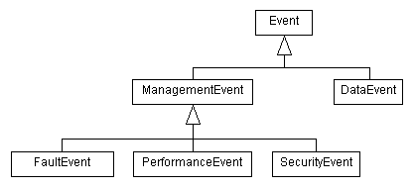
Example – contd.
Event types:

Slide 21
Example – contd.
A Subscriber:
public class PagingSystem extends Subscriber {
public PagingSystem() {
FaultEvent event = new FaultEvent();
CriticalFaultFilter filter = new CriticalFaultFilter();
EventService.instance().subscribe(filter.getClass(), filter, this);
}
public void inform(Event event) {
// Assumes that this subscriber has only subscribed to FaultEvent
FaultEvent faultEvent = (FaultEvent) event;
// Respond to the event
System.out.println("Critical Fault Event occurred:" + faultEvent);
}
}

Slide 22
Example – contd.
A Publisher:
public class Router {
public static void triggerPublication() {
Event event = new FaultEvent(FaultEvent.CRITICAL);
EventService.instance().publish(event);
}
}

Slide 23
Event Service Infrastructures
Infrastructures that provides a subscribe-publish-notify API to be used by applications
Event Bus, in-process:
  Guava (Google Core Libraries for Java) Event Bus: https://github.com/google/guava/wiki/EventBusExplained
  Akka event bus http://doc.akka.io/docs/akka/current/java/event-bus.html
Event Channel (Event Bus) inter-process: part of middleware for distributed computing
  Java Message Service (JMS)

Slide 24
How to implement an
Event Bus infrastructure ?
  S. Gupta, J. Hartkopf, S. Ramaswamy: Event Notifier, a Pattern for Event Notification, in Java Report, 1998 (republished as chapter 11 in the book More Java Gems, Cambridge University Press, 2000) http://sites.google.com/site/jeffhartkopf/notifier

Slide 25
Steps towards the design of a simple in-process Event-Bus
Starting point: The Network Management System example
Managed Objects
Management System
Router
Hub
Console
Paging

Slide 26
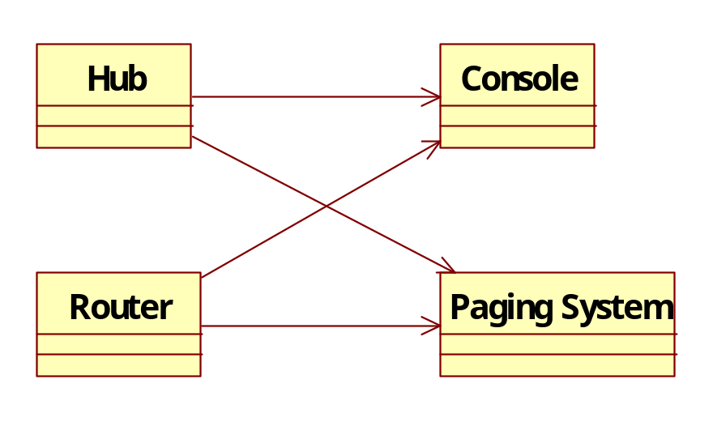
Network Management Example:
Try 1: A direct connections solution
Managed Objects
Management System
Problems:
Solution is not scalable: Every Managed object must transmit notifications to all Management System objects
Every change in Management System (example: adding e-mail Notification) affects all Managed Objects

Slide 27
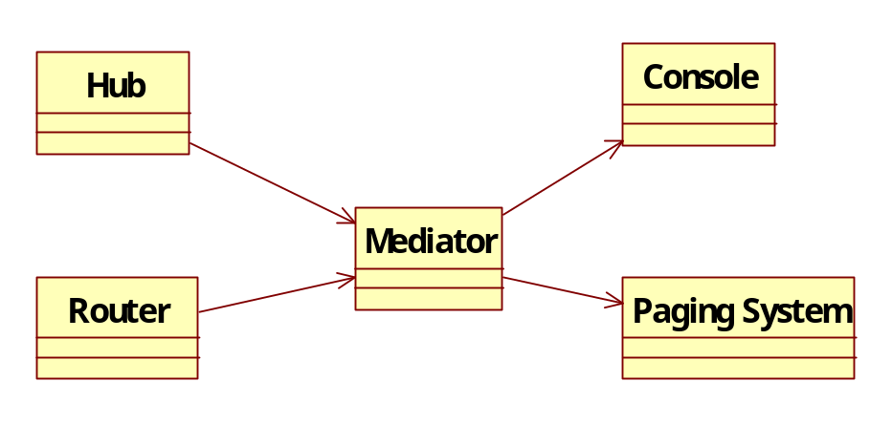
Network Management Example:
Try 2: A solution using Mediator
Managed Objects
Management System
Any change in Management System (example: adding e-mail Notification) affects only the Mediator
Better scalability (number of dependencies is n+m instead of n*m)
Problems:
It does not support dynamic adaptation and differentiation of the management system (example - every managed object should be monitored by a subset (maybe a dynamically variable one) of objects from the Management System

Slide 28
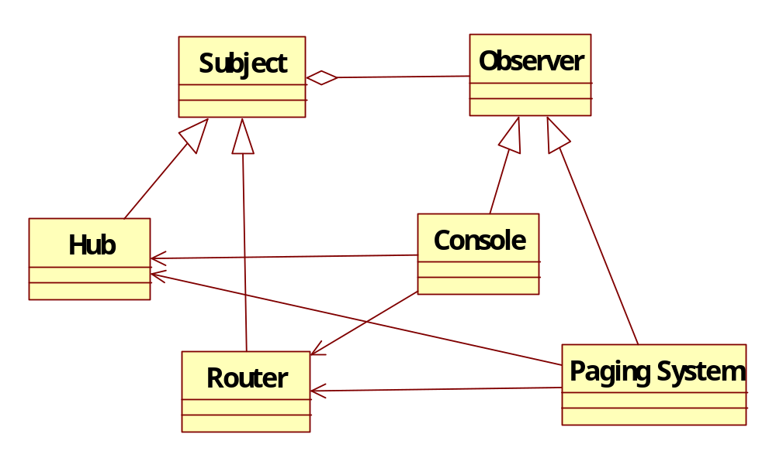
Network Management Example:
Try 3: A solution with Observer
Managed Objects
Management System
Managed Objects must not know in advance the set of management system objects that are watching them
Problems:
Every object from the management system must know every managed object that is of its interest
Disadvantages:
  Number of managed objects can be very big
  Managed objects may appear and disappear

Slide 29
Network Management Example:
Try 4: The Event Channel Solution
Publisher
Subscriber
Managed Objects
Management System
Hub
EventChannel
Console
Router
Paging System
Assures a better decoupling between Managed Objects and Management System
Managed Objects do not know the identity of objects in Management System
Objects in Management System do not know the identity of managed Objects, only the types of events generated by these

Slide 30
Event Channel - Applicability
When an object should be able to notify other objects of an event without needing to know who these objects are or what they do in response.
When an object needs to be notified of an event, but does not need to know where the event originated.
When more than one object can generate the same kind of event.
When some objects are interested in a broader classification of events, while others are interested in a narrower classification.
When an object may be interested in more than one kind of event.
When you need to dynamically introduce new kinds of events.
When objects participating in notification may be dynamically introduced or removed, as in distributed systems.
When you need to filter out events based on arbitrary criteria.

Slide 31
Detailed Implementation of the Event Channel as an Event Notifier
[Gupta, Hartkopf, Ramaswamy]
Participants:
Event: A common ancestor type for all events.
ConcreteEvent (example: FaultEvent): Represents a specific occurrence, possibly containing data about that occurrence.
Publisher (Hub, Router) Emits or produces events.
Subscriber: Defines an interface for all objects that need to handle events.
ConcreteSubscriber (Console, PagingSystem) Registers for events, and handles events by implementing the Subscriber interface.
EventService intermediary between subscriber and publisher.
Filter: Responsible for discarding events not of interest to a subscriber.

Slide 32
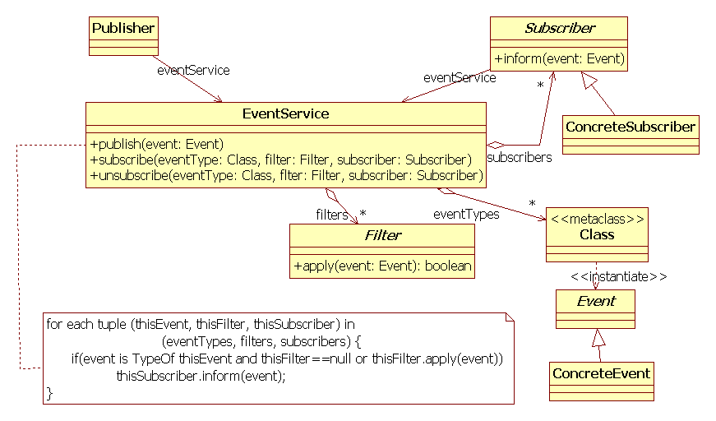

Slide 33
Dynamic scenario
Scenario:
Concrete Subscriber registers with Event Channel, specifies the event types of interest and optionally a filter
Concrete Publisher announces the EventChannel when an event is produced
EventChannel determines which Concrete Subscribers are interested by the event and their filter applies to the current event
Event Channel notifies the Concrete subscribers

Slide 34
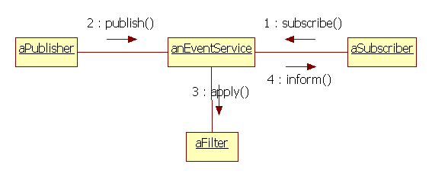

Slide 35
Event Notifier Implementation: Discussion
Subscription is based on event types and not on identity of the publisher
Publishers and Subscribers are independent. Coupling between them is reduced to knowing the set of allowed events
Subscribing to a certain event type automatically comprises all its subtypes
Filtering of events discriminates further according to other event attributes (ex: source of event, associated data, etc)
Disadvantage: type safety vs generality:
  Class
  isKindOf method in Event
Disadvantage: Event Service is a point of bottleneck – performance and reliability. Solution: several different EventServices, each specialized for a certain category of events
Optional features:: Advertisment and Discovery of available Event Types

Slide 36
Hybrid Event-Driven Architectures
Active Database: Event-Driven combined with Blackboard
Distributed Event Notification: Event-Driven combined with Broker

Slide 37
Fundamental architectural styles:
Conclusions (1)
They describes ways of structuring a system from different viewpoints:
  Module viewpoint (static structure): Layers
  Component & connector viewpoint (dynamic, runtime structure): Pipes-Filters, Blackboard, Event-driven
They describe elementary structures
In real systems, they may appear “pure” or “hybrids”

Slide 38
Fundamental architectural styles:
Conclusions (2)
The choice of the architectural style has an important influence over the systems properties !
For further reading: David Garlan, Mary Shaw, An Introduction to Software Architecture, Technical Report Carnegie-Mellon University, no CMU-CS-94-166, http://www.cs.cmu.edu/afs/cs/project/able/ftp/intro_softarch/intro_softarch.pdf
  Experiments: a problem is implemented according to different style and they study the impact of the style on the systems properties
Lab Assignment: “The Furniture Factory”

Slide 39
Fundamental architectural styles:
Conclusions (3)
The fundamental archit styles are general structuring solutions, that can be applied independent on a certain programming paradigm or technology
The components may have different granularities, from objects, components, and up to whole application that are integrated according to these patterns
For further reading: Enterprise Integration Patterns
  Book: Enterprise Integration Patterns, by Gregor Hohpe and Bobby Woolf, A Martin Fowler Signature Book, Addison Wesley, 2004
  Site: http://www.eaipatterns.com/
    Shared Database (Repository): http://www.eaipatterns.com/SharedDataBaseIntegration.html
    Pipes and Filters: http://www.eaipatterns.com/PipesAndFilters.html
    Messaging (Event-Driven) http://www.eaipatterns.com/Messaging.html

