Slide 1
Course contents
Basic concepts
  What is software architecture ?
Fundamental architectural styles
  Pipes and filters
  Layers
  Blackboard
  Event-driven
Architectural patterns for :
  Adaptive systems
    The Reflection Pattern
  Distributed systems
    The Broker Pattern
  Data access patterns
    Pattern for Object-Relational Mappings
    Pattern for decoupling data access

Slide 2
Distributed systems
Outline:
  Introduction:
    Models for distributed applications
    Very short intro in inter-process communication
  Patterns used for distributed systems middleware:
    Forwarder-Receiver: [POSA1], from chap.3.6 (pag 307-322)
    Client-Dispatcher-Server: [POSA1], from chap. 3.6 (pag 323-336)
    Remote Proxy: [POSA1], from chap. 3.4 (pag 263-275)
    Broker:
      [POSA1] chap 2.3
  Examples: technologies using the Broker pattern: Java RMI, CORBA, .NET Remoting

Slide 3
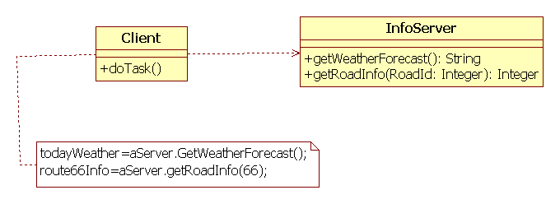
Distributed Object Computing ?
Process2 (Computer 2)
Process1 (Computer 1)
Because Client and InfoServer run in different processes,
there is no shared address space/no shared variables !
Inter-process communication mechanisms are needed

Slide 4
Very short intro in inter-process communication in a network
Data is transmittet over communication channels
A communication channel is defined by:
  2 communication endpoints
  the protocol
A communication endpoint (socket):
Address: has 2 components: identification of host + port

Slide 5
Typical Client-Server Interaction
SERVER
Open communication channel
CLIENT
Waits for a client request
Opens a communication channel
and connects to a channel
Opened by a server
Accept request
request
Write (date)
Read (date)
answer
Read (date)
Write (date)
notification
Close communication channel

Slide 6
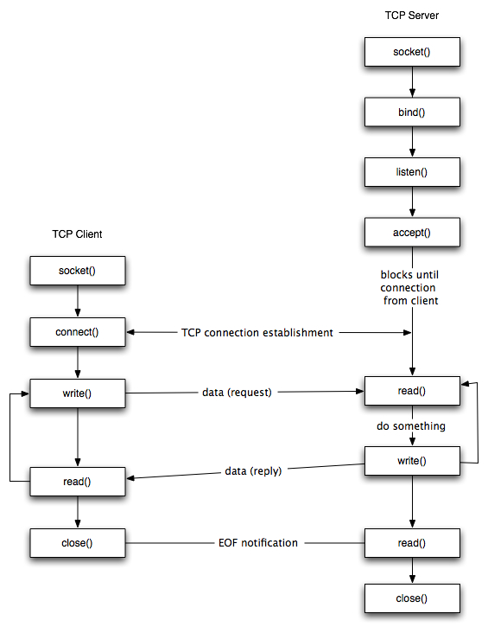
Disadvantages:
The application programmer must deal with low-level issues (sending/receiving data in binary format)
The application logic is not separated from the communication part

Slide 7
We need support for distributed applications:
Distributed applications must present following qualities:
  Separation of concerns: application logic must be separate from communication => “somebody” must establish the communication channel and do the messaging over this channel
  Location independence: client and server interact in the same way, independent from the location of the server => “somebody” must localize the server
  Location transparence: a client should interact wit a remote server in the same way as with a local server => “somebody” must procure a reference to the remote server object
Middleware:
  Infrastructure that supports distributed applications
  Usually some “off-the-shelf” software
  Examples: Java RMI, .NET Remoting, CORBA

Slide 8
Architectural pattern for distributed systems
Broker:
  Integrates 3 smaller patterns::
    Forwarder-Receiver: separation of concerns: hides the details of inter-process communication (data formats, transmit/receive messages in a specific protocol)
    Client-Dispatcher-Server: location independency: decouples the operation of establishing a connection from later communication
    Remote Proxy: location transparency: interaction with a remote server happens via its local proxy (representative).

Slide 9


Forwarder-Receiver
The Forwarder-Receiver design pattern provides transparent inter-process communication for software systems with a peer-to-peer interaction model. It introduces forwarders and receivers to decouple peers from the underlying communication mechanism.
Peer1
How are you ?
Peer2
I am alive !

Slide 10
Forwarder-Receiver Example
The problem:
A Peer does not need to know the underlying inter process communication mechanism
The communication mechanism could change, this must not affect the functionality of the Peers
Each Peer only knows the name of its Peer
There is a protocol (message format) agreed by both parties
class Peer1 {
Receiver r;
Forwarder f;
public void run() {
f = new Forwarder("Peer1");
Message msg = new Message
("Peer1", "How are you");
f.sendMsg("Peer2", msg);
Message result = null;
r = new Receiver("Peer1");
result = r.receiveMsg();
System.out.println("Peer1 receptionat mesaj " + result.data + " de la " + result.sender);
}
}
class Peer2 {
Receiver r;
Forwarder f;
public void run() {
Message result = null;
r = new Receiver("Peer2");
result = r.receiveMsg();
System.out.println("Peer2 receptionat mesaj "+result.data+" de la "+result.sender);
f = new Forwarder("Peer2");
Message msg = new Message
("Peer2", "I am alive");
f.sendMsg(result.sender, msg);
}
}

Slide 11
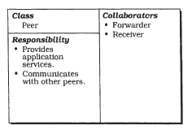
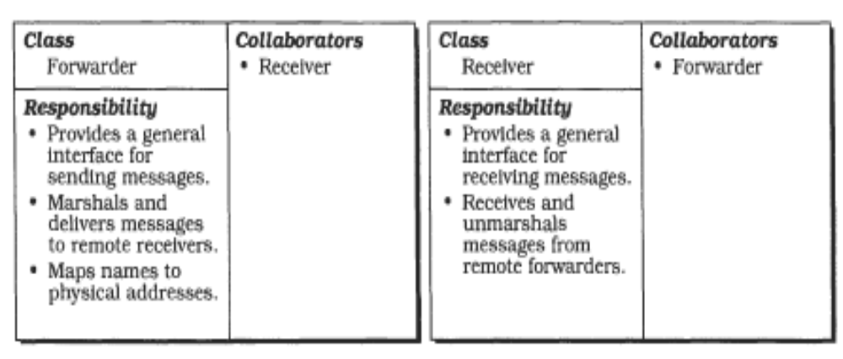
Structure of Forwarder Receiver
[POSA]-Fig/P.310

Slide 12
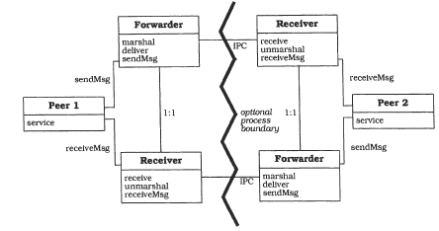
Structure of Forwarder-Receiver
[POSA]-Fig/P.311

Slide 13
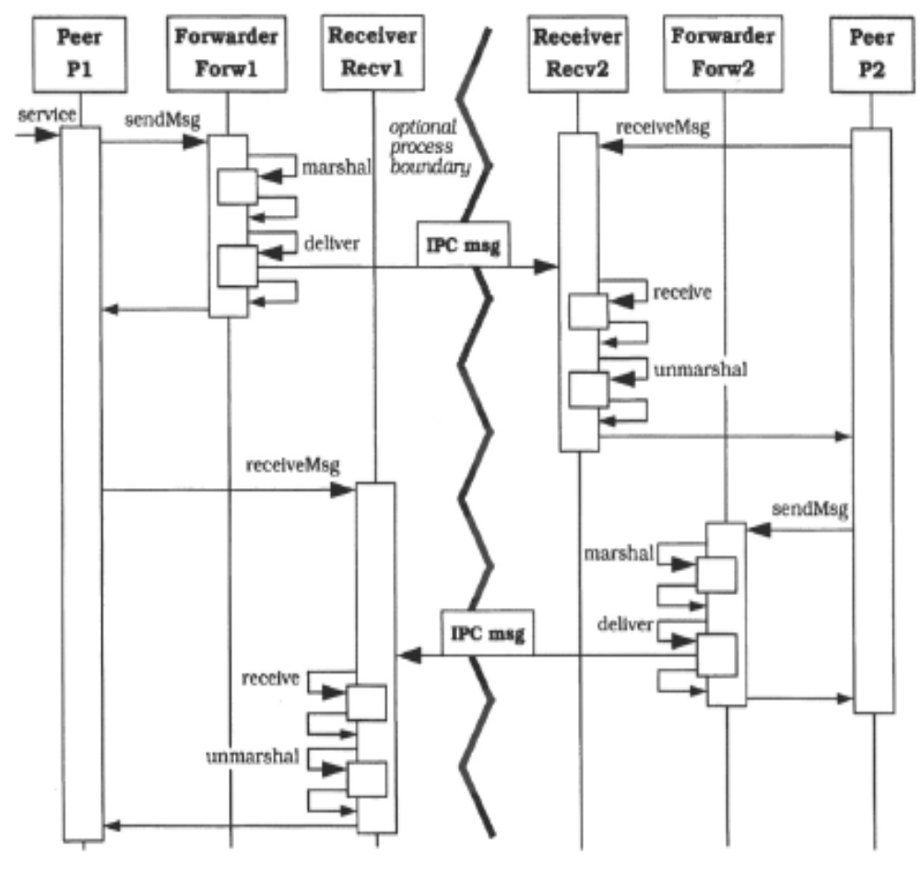
Dynamics Forwarder-Receiver
[POSA]-Fig/P.312

Slide 14
Implementation example
Peer1
deliver ( marshal ( How are you ) unmarshal ) receive
Peer2
F
R
R
receive ( unmarshal ( I am alive ) marshal ) deliver
F
Registry
Registry
Config.db
“Peer1”: adresa …
“Peer2”: adresa …
Config.db
“Peer1”: adresa …
“Peer2”: adresa …

Slide 15
Analysis of
Forwarder-Receiver
Benefits:
  Efficient inter-process communication
  Encapsulation of inter-process communication facilities
Liabilities:
  No support for flexible re-configuration of components => combination with cu dispatcher as NamingService

Slide 16
The Forwarder-Receiver Pattern and the Typical Client-Server
Typical Client-Server interaction:
  The server has a well known (public) address
  A client sends a request message to the server, and then waits for an answer message from the server
The Forwarder-Receiver pattern:
  Provides an abstraction for a unidirectional communication channel between Forwarder and Receiver
Client-Server implemented with Forwarder-Receiver:
  Uses 2 different unidirectional communication channels
Adr
Client
cerere
Server
F
R
R
raspuns
F
Adr

Slide 17
Types of communication channels
A communication channel can be 2-way (bidirectional) or 1-way (unidirectional)
  1-way: Send-Receive (Forward-Receive)
  2-way: Request-Reply
If the communication protocol supports 2-way communication channels, we prefer the request-replay pattern for implementing a typical client-server (where the client is a blocking/synchronous client)

Slide 18
Send-Receive
Client
Server
Adr
Sender
Receiver
Adr
Receiver
Sender
ByteSender {
public ByteSender(String theName) ;
public void deliver(Address theDest, byte[] data);
}
ByteReceiver {
public ByteReceiver(String theName, Address theAddr) {
public byte[] receive()
}

Slide 19
Request-Reply
Client
Server
Adr
Requestor
Replyer
Requestor{
public Requestor(String theName) ;
public byte[] deliver_and_wait_feedback(Address theDest, byte[] data);
}
public interface ByteStreamTransformer{
public byte[] transform(byte[] in);
}
Replyer {
public Replyer(String theName, Address theAddr);
public void receive_transform_and_send_feedback(ByteStreamTransformer t);
}

Slide 20
Implementations
Example implementations are provided in the course web page: http://staff.cs.utt.ro/~ioana/arhit-engl/curs.html
  ByteSender-ByteReceiver
  Requestor-Replyer
The code can be used as-is: the details of their implementation are outside the scope of this course (will be studied in a course for distributed applications and network programming)
Examples of client-server applications:
  Client-Server with Send-Receive (SR)
  Client-Server with Requestor-Replyer (RR)

Slide 21
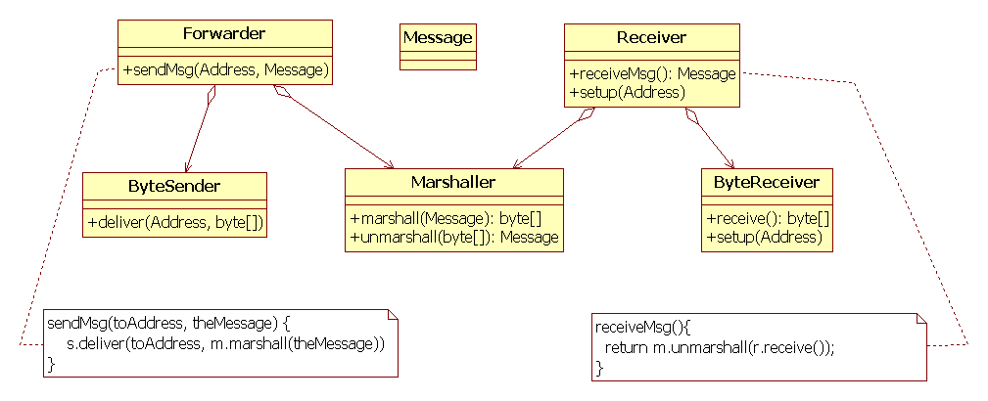
Implementation Forwarder-Receiver over Send-Receive

Slide 22
Client-Dispatcher-Server
The Client-Dispatcher-Server design pattern introduces an intermediate layer between clients and servers, the dispatcher component. It provides location transparency by means of a name service, and hides the details of the establishment of the communication connection between clients and servers.

Slide 23
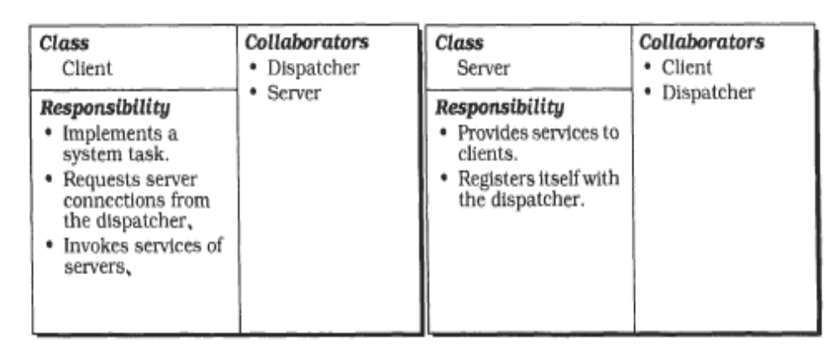
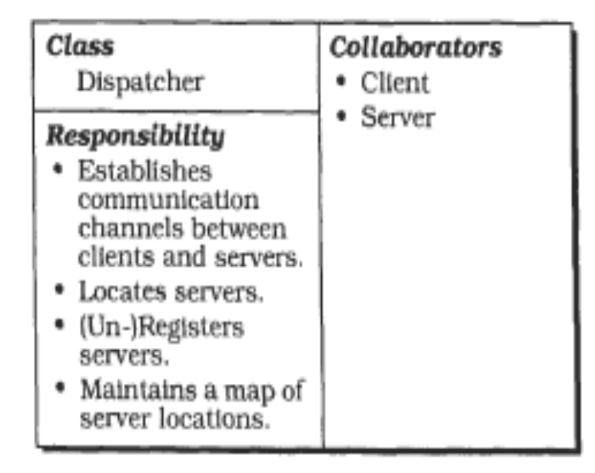
Structure of Client-Dispatcher-Server
[POSA]-Fig/P. 325

Slide 24
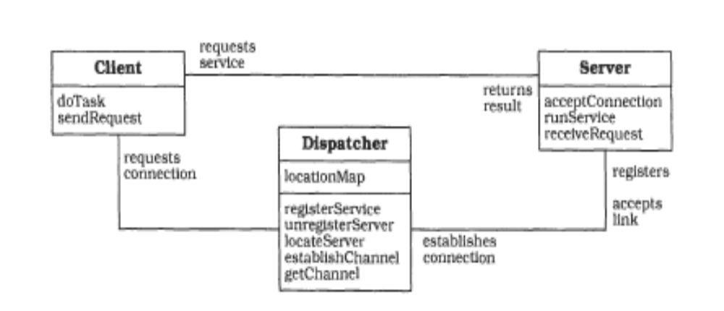
Structure of Client-Dispatcher-Server
[POSA]-Fig/P. 326

Slide 25
Variant: Client-Dispatcher-Service
Clients address Services, not Servers
The Dispatcher searches its repository to find a server that provides the service (There could be several servers providing the same service)

Slide 26
Interaction Client-Dispatcher-Server
CSProtocol
Client
Server
CDProtocol
DSProtocol
Dispatcher
All interactions use
inter-process communication mechanisms!

Slide 27
Example Peer-to-Peer:
Implementation with Forwarder-Receiver
Peer1
deliver ( marshal ( How are you ) unmarshal ) receive
Peer2
F
R
R
receive ( unmarshal ( I am alive ) marshal ) deliver
F
Registry
Registry
Config.db
“Peer1”: adresa …
“Peer2”: adresa …
Config.db
“Peer1”: adresa …
“Peer2”: adresa …

Slide 28
Example Peer-to-Peer:
Implementation with Forw-Rec + Dispatcher
Peer1
“How are you ? “
Peer2
F
R
R
“I am alive “
F
Peer 2 is at addr Y
“Peer 1 is at addr X ”
I am Peer 1 at addr X
Where is Peer 2 ?
F
“ I am Peer2 at addr Y ”
R
“Where is Peer 1? ”
Registry
Config.db
“Peer1”: adresa …
“Peer2”: adresa …

Slide 29
Example Peer-to-Peer:
Implem with Req-Repl + Dispatcher
Peer1
“How are you ? / I am alive “
Peer2
Req
Repl
Req
Where is Peer 2?
Peer 2 is at addr Y
“ I am Peer2 at addr Y ”
Repl
Registry
Config.db
“Peer1”: adresa …
“Peer2”: adresa …

Slide 30
Consequences of
Client-Dispatcher-Server
Benefits:
  Exchangeability of servers
  Location and migration transparency
  Re-configuration
  Fault-tolerance
Liabilities:
  Lower efficiency: performance is affecred by the overhead introduced by the dispatcher (1 Dispatcher to N Clients and M Servers)
    Locate server
    Register server
    Establish connection
  Does not encapsulate the details of the communication channel => best combined with Forwarder-Receiver

Slide 31
Example Client-Server:
Implem with Req-Repl + Dispatcher
InfoServer: gives information about the weather and road traffic
Weather today ?
Clouds and rain
InfoServer
Client1
InfoServer, addr X,
info Meteo and Roads
InfoServer
Address of a Meteo Info Server ?
Client2
Dispatcher

Slide 32
Example Client-Server:
Code implementing Client1:
Send message to NamingService (Dispatcher) – asks for the address of a server providing Meteo information
Receives the answer (containing the address of InfoServer) from Dispatcher
Send message to InfoServer and asks how is the weather today
Receives the answer from InfoServer with today weather
We would like to have the code of Client1 looking like this instead:
todayWeather=meteoServer.GetWeatherForecast(“today”);

Slide 33
Proxy and Remote Proxy
The Proxy pattern makes the clients of a component communicate with a representative rather than to the component Itself. Introducing such a placeholder can serve many purposes, including enhanced efficiency, easier access and protection from unauthorized access.
A Remote Proxy encapsulates and maintains the physical location of the original. It also implements the IPC (inter-process communi- cation) routines that perform the actual communication with the original. For every original, one proxy is instantiated per address space in which the services of the original are needed.

Slide 34
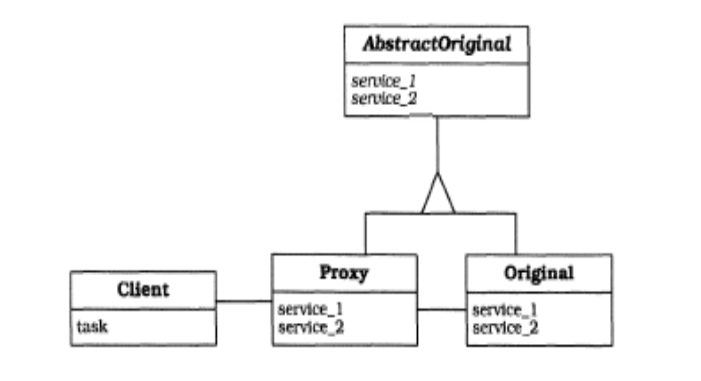
Proxy – The structure
[POSA]-Fig/P.

Slide 35
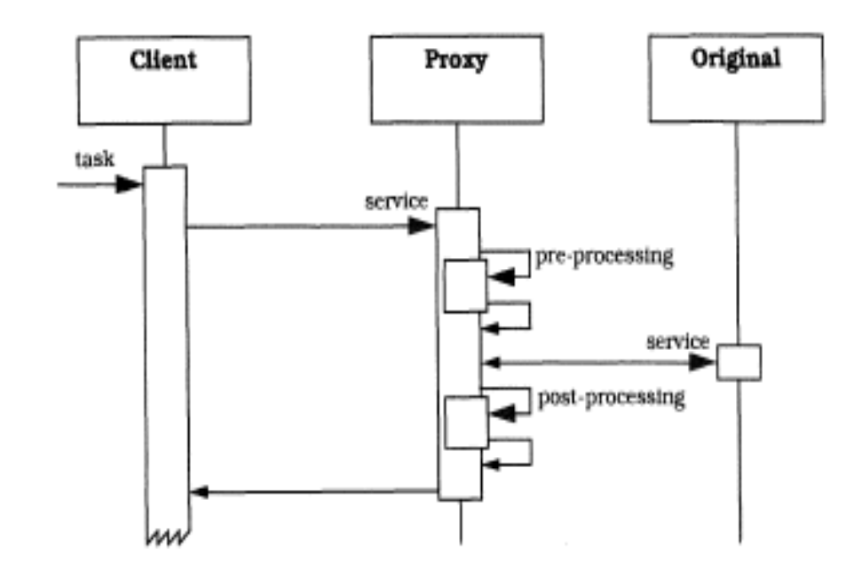
Proxy – The dynamics
[POSA]-Fig/P.

Slide 36
Remote Proxy
Remote Proxy: pre and postprocessing
contain a Forwarder-Receiver
Proxy
Helper
locateServer,
marshal, deliver
serverloop
receive,
unmarshal
service
marshal,
deliver
receive, unmarshal

Slide 37
Broker
The Broker architectural pattern can be used to structure distributed software systems with decoupled components that interact by remote service invocations. A broker component is responsible for coordinating communication, such as forwarding requests. as well as for transmitting results and exceptions.
Client1
Client2
Server1
Server2
Invoke
foo on
Object X
Invoke
bar on
Object Y
Object X
Object Y
foo
bar
Broker

Slide 38
Broker vs Forwarder-Receiver
Both patterns facilitate communication and hide the communication details from the communicating components
Forwarder-Receiver: communication happens via messages having a format known by the participating Peer components
Broker: components interact via remote method invocation, hiding the location of the object whose methods are invoked
  The Broker pattern integrates the patterns Remote Proxy with Forwarder-Receiver

Slide 39
Broker - variants
Indirect Broker:
  The Broker facilitates the indirect communication between client and server: any communication between client and server is transmitted via the Broker
Direct Broker:
  The Client can communicate directly with the Server, after the connection has been established by the Broker

Slide 40
Indirect Broker
2. pack_data
8. pack_data
F
3. forward_request
9. forward_response
ClientProxy
F
ServerProxy
R
R
R
10.return
F
11. unpack_data
5. call service
6.unpack_data
1. call server
7. run service
Broker
Client
Server
4.find server
NamingService

Slide 41
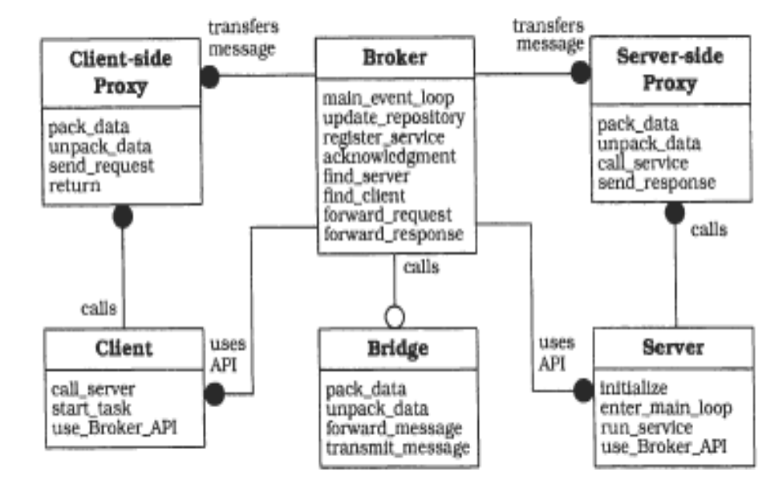
Broker
[POSA]-Fig/P.107

Slide 42
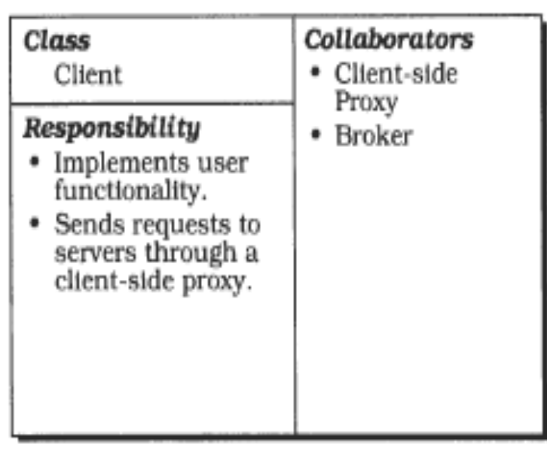
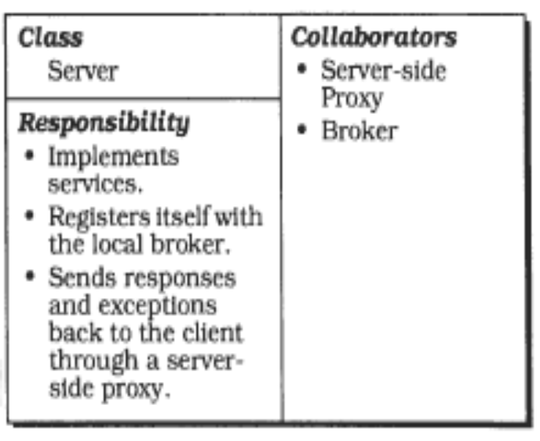
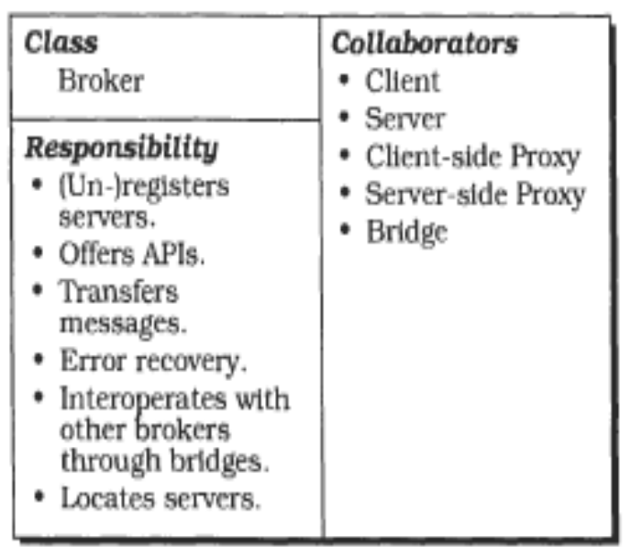
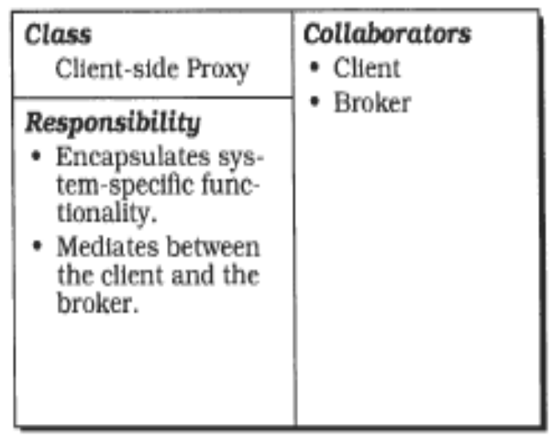
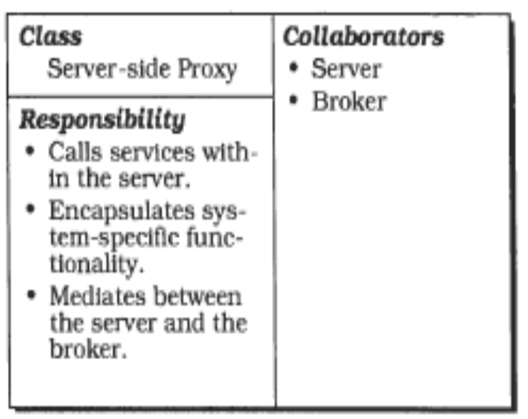
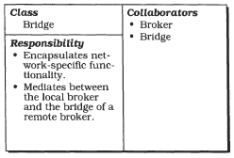
[POSA]-Fig/P. 103-105

Slide 43
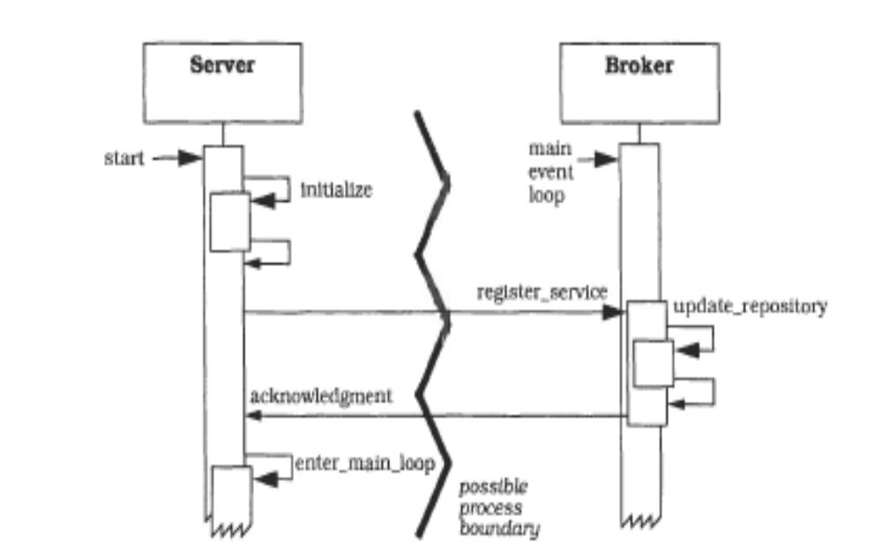
Server registers with Broker
[POSA]-Fig/P.108
Notes:
POSA

Slide 44
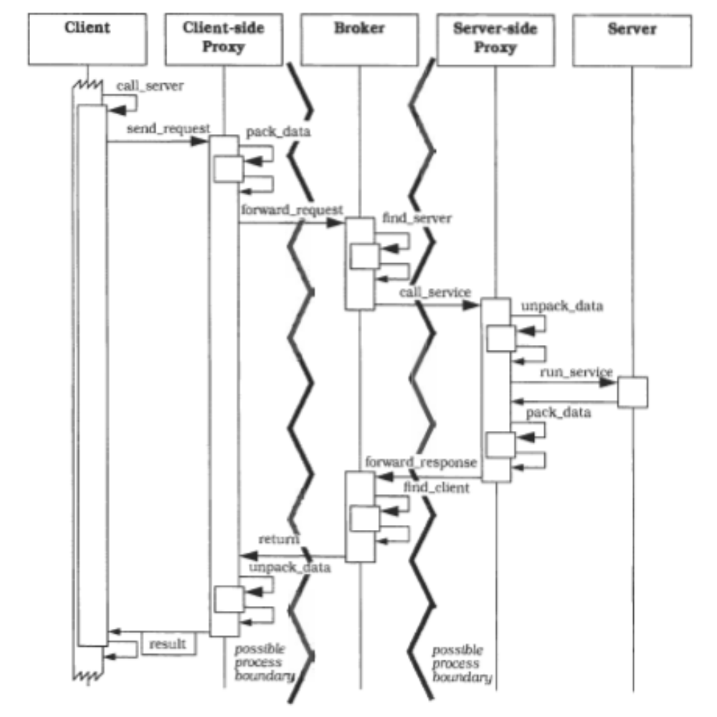
The Indirect Broker solves a Client-Server interaction
[POSA]-Fig/P.109

Slide 45
Broker - Variants
Indirect Broker:
  Facilitates indirect communication between client and server: any communication between client and server is transmitted via the Broker
  This corresponds with the diagrams presented before
  Inefficient as communication solution, but has as advantage the possibility to control/restrict the access to servers
Direct Broker:
  The Client can communicate directly with the Server, after the Broker establishes the connection => direct communication is more efficient
  The operations described in the diagram presented before are now re-allocated between Proxies and Broker: The Proxies will do now forward_request and forward_response instead of the Broker. The Proxy will also interrogate the nameService-ul (locate_server)

Slide 46
Direct Broker
2. pack_data
5.unpack_data
ClientProxy
F
4. forward_request
R
ServerProxy
R
F
9. unpack_data
8. forward_response
1. call server
7. pack_data
3. locate_server
6. run service
Client
R
Server
F
NamingService

Slide 47
Important remark
The presentation of the Broker pattern used the Forwarder-Receiver pattern (communication Send-Receive on 1-way communication channels)
If:
  The used protocols support 2-way channels
  The semantics of client calls is synchronous calls (client blocks waiting for an answer)
  => Better to use Request-Reply communication on 2-way channels !

Slide 48
Example: Client-Server: with Direct Broker
Code implementing Client1:
  todayWeather=meteoServer.GetWeatherForecast(“today”);
  meteoServer is an object of type MeteoClientProxy
Code implementing MeteoClientProxy:
  When creating the proxy:
    Send message to NamingService (Dispatcher) – ask for the address of a Meteo server
    Receives an answer, containing the address of InfoServer (actually MeteoServerProxy)
  In the method GetWeatherForecast:
    Send message to InfoServer (to the address received when creating the proxy) to ask how is the weather today. The message must include: operation name, parameter values in a specific format (marshall)
    Receives answer message from InfoServer
    Extracts (unmarshalls) weather forecast from message
    Returns result

Slide 49
Example Client-Server: with Direct Broker (cont)
The code implementing MeteoServerProxy:
    Creates Receiver (Replyer) and waits for messages
    When a message is received, extracts (unmarshalls) information about the requested operation and parameter values
    Invokes operation on InfoServer
    Marshalls the result into message format, sends message as answer

Slide 50
Generating the code of Proxies
We see that the “ugly stuff” moved from client code into proxy code
ClientProxy depends on the service interface (implements the same interface as the server) => for every server type we need another Proxy class
Advantage: code of Proxies does not have to be manually written, it can be automatically generated !
  Application programmer writes (manually) only the code for the client and server
Code
Generator
(Description)
Server
Interface
Proxies

Slide 51
Broker in practice: Middleware
Middleware:
  Infrastructure that supports distributed applications
  Usually provided by “off-the-shelf” software
  Examples: Java RMI, .NET Remoting, CORBA
What is in an “off-the-shelf” middleware package:
  Libraries+API for distributed application programmer
  Executable server/demon to be installed ( NamingService)
  Tools for application developers (example - Generator tool for proxies)

Slide 52
Broker in practice: Middleware
Tools for Generating Proxy
Library(API)+ Executable
Application Developer

