Slide 1
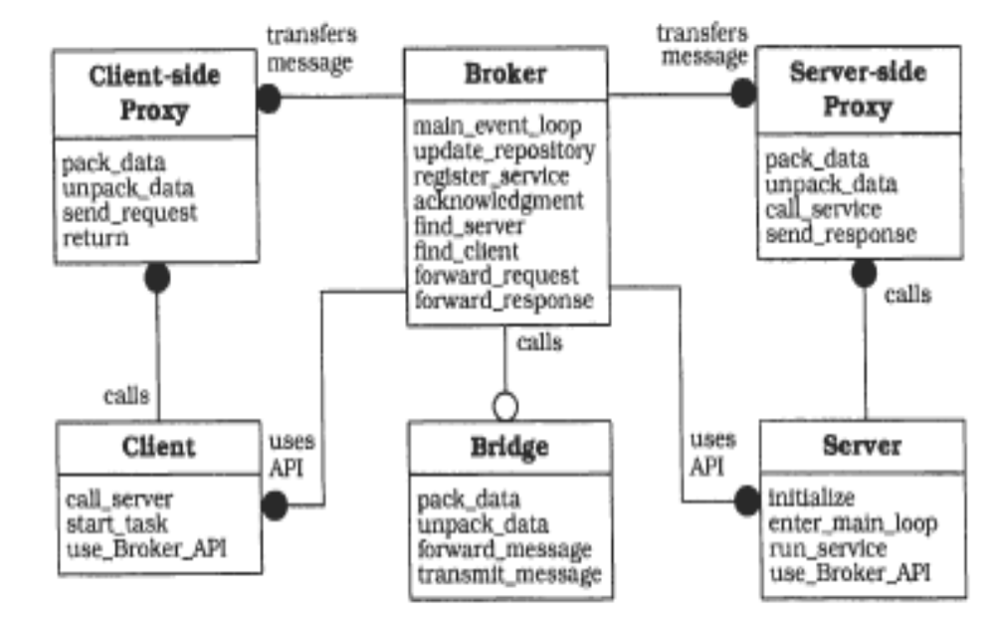
Broker in practice: Middleware
Tools for generating proxies
Library(API)+ Executable
Application Developer

Slide 2
Known uses of the Broker pattern
Middleware implementing the Broker pattern:
  RMI: Java Remote Method Invocation
  CORBA: Common Object Request Broker Architecture. Reference architecture by the OMG (Object Management Group)
    Had different implementations in commercial or open tools
  .NET Remoting
  Windows Communication Foundation (WCF) – has a part dealing with Remoting that presents Broker character
  WSDL web services : proxy generators (WSDL-to-language)

Slide 3
The Common Architecture
Invokes methods of Remote Object via a local Proxy object
Client
Server
Remote
Interface
implements
Remote
Object
uses
implements
ClientSide Proxy
ServerSide Proxy
Broker

Slide 4
Example
Consider a simple distributed StockMarket application where clients can ask for the current quotation of a company.
Middleware (Broker) used - 3 versions:
  RMI
  .NET Remoting
  CORBA
We compare:
  What kind of support do the 3 Broker implementation offer
  Steps to develop a simple client-server application using the Broker
The example helps us understand what a Broker is doing and how a Broker is implemented

Slide 5
Steps of application development
1. Define interface of remote object
INTERFACE
StockMarket
float get_price(Company)
2. Implement object
5. Implement Client
4. Implement Server
StockMarketServer
StockMarketClient
StockMarketImpl
3. Generate Proxy
6. Run application
3. Generate Proxy
StockMarket
ClientSide PROXY
StockMarket
ServerSide PROXY
Broker

Slide 6
RMI: Architecture
Client
Server
Remote
Interface
implements
Remote
Object
uses
implements
Stub
(ClientSide Proxy)
Skeleton
(ServerSide Proxy)
Remote Reference
Layer
Transport
Layer

Slide 7
RMI - Step1. Define interface
Define interface StockMarket
This contains operation get_price:
  Parameter: name of company
  Result: price of stock
package SimpleStocks;
import java.rmi.*;
public interface StockMarket
extends java.rmi.Remote {
float get_price (String Company) throws
RemoteException;
}
Details specific for RMI:
Interface must extend java.rmi.Remote
Methods must throw RemoteException
File StockMarket.java

Slide 8
RMI - Step 2. Implement Object
Implement class StockMarketImpl
This implements operation get_price
import java.rmi.*;
import java.rmi.server.UnicastRemoteObject;
public class StockMarketImpl
extends UnicastRemoteObject
implements StockMarket {
public StockMarketImpl() throws RemoteException {}
public float get_price(String company) {
float price=12345;
return price;
}
}
Details specific for RMI:
Implementation must extend UnicastRemoteObject
File StockMarketImpl.java

Slide 9
RMI - Step 3.V1: Traditional Generation of Proxies
RMI Stub/Skeleton
Will be automatically generated from the implementation object server with help of the rmic tool
>rmic –v1.1 –keep StockMarketImpl
Arguments:
-v1.1 because after Java 1.2 the default is not to generate skeleton, if we want generated skeletons we have to compile with –v1.1
-keep to keep the source code of the generated classes (for the user to be able to inspect it)
Result classes for stub and skeleton, using naming convention:
StockMarketImpl_Stub.class
StockMarketImpl_Skel.class

Slide 10
RMI - Step 4. Implement Server
Implement the program StockMarketServer, which creates the object StockMarket, that will be remotely accessible
The created object is registered as “NASDAQ”
import java.rmi.*;
import SimpleStocks.*;
public class StockMarketServer {
public static void main(String[] args) {
try {
StockMarketImpl stockMarketImpl = new StockMarketImpl();
Naming.rebind("NASDAQ", stockMarketImpl );
} catch (Exception e) {}
}
}
Details specific for RMI:
Naming.rebind is the RMI-specific registration API
File StockMarketServer.java

Slide 11
RMI - Step 5. Implement Client
Implement a program StockMarketClient, which accesses a remote StockMarket object and invokes operation get_price for a given company
Uses Broker to locate the object registered as “NASDAQ”
import java.rmi.*;
import SimpleStocks.*;
public class StockMarketClient {
public static void main(String[] args) {
try {
StockMarket market= (StockMarket) Naming.lookup("rmi://localhost/NASDAQ");
float price=market.get_price("ABC SRL");
System.out.println("Price is "+price);
} catch (Exception e) {
System.out.println("Exception !");}
}
}
Specific for RMI:
Naming.lookup: obtains a reference (a proxy ) to the remote object that has been registered as “Nasdaq”
Client does not need to handle addresses !
File StockMarketClient.java

Slide 12
RMI – To Do Checklist:
Source code written by the developer of the application Stockmarket: StockMarket.java, StockMarketImpl.java, StockMarketServer.java, StockMarketClient.java
Compile source code : javac *.java
Generate proxies: rmic –v1.1 StockMarketImpl
  We get StockMarketImpl_Stub.class and StockMarketImpl_Skel.class
Deployment of Server:
    StockMarket.class, StockMarketImpl.class, StockMarketImpl_Skel.class, StockMarketServer.class
  Deployment of Client:
    StockMarket.class, StockMarketImpl_Stub.class, StockMarketClient.class

Slide 13
RMI - Step 6. Run application
RMI Registry = non-persistent Naming Service
> start rmiregistry
> start java StockMarketServer
> java StockMarketClient

Slide 14
RMI - Step 3.V2: Generate Proxy – only client side
Version 2: In step 3 we generate only the RMI Stub
It will be generated automatically from the implementation of the server object
>rmic StockMarketImpl
Rezults a class for the stub, using the naming convention:
StockMarketImpl_Stub.class
Where disappeared the skeleton ? (server-side proxy ?)
- in this case, the server-side proxy is a generic one, which exploits the feature that Java permits invocation of methods via Reflection

Slide 15
RMI – To Do Checklist – V2:
Source code written by the application developer of Stockmarket: StockMarket.java, StockMarketImpl.java, StockMarketServer.java, StockMarketClient.java
Compile source code : javac *.java
Generate proxy: rmic StockMarketImpl
  We get StockMarketImpl_Stub.class
Deployment Server:
    StockMarket.class, StockMarketImpl.class, StockMarketServer.class
  Deployment Client:
    StockMarket.class, StockMarketImpl_Stub.class, StockMarketClient.class
  Run application

Slide 16
RMI - Step 3.V3: without generation of Proxy
Step 3 – Version 3: starting with Java 1.5, we do not need to use rmic any more !
property java.rmi.server.ignoreStubClasses:
  If this property is false, expects to find a pre-generated stub (by default it is false)
  If this property is true, the stubs pre-generated with rmic are not needed
Where disappeared the stub-ul ? (client-side proxy ?) actually there is a client-side proxy, ,but it will be generated dynamically at runtime, totally transparent for the application developer, through the dynamic proxy mechanism

Slide 17
RMI – To Do Checklist – V3:
Source code written by the application developer Stockmarket: StockMarket.java, StockMarketImpl.java, StockMarketServer.java, StockMarketClient.java
Compile soursce code : javac *.java
Generate proxies: Developer does not have to do anything!
Deployment Server:
    StockMarket.class, StockMarketImpl.class, StockMarketServer.class
  Deployment Client:
    StockMarket.class, StockMarketClient.class
  Run application

Slide 18
RMI - step 6 – Version 3: Run application
> start rmiregistry
> start java StockMarketServer
> java -Djava.rmi.server.ignoreStubClasses=true StockMarketClient

Slide 19
CORBA: Architecture
Client
Server
Remote
Interface
IDL
Remote
Object
Dynamic
Invocation
Interface
IDL Stub
(ClientSide
Proxy)
ORB
Interface
IDL Skeleton
(ServerSide
Proxy)
Object
Adapter
Interface
Repository
Implem
Repository
ORB (Object Request Broker)

Slide 20
CORBA - Step1. Define interface
module SimpleStocks {
interface StockMarket {
float get_price(in string Company);
};
};
Define interface StockMarket
This exports the operation get_price:
  Parameter: company name
  Result: price
Specific for CORBA:
Interface is defined using a special description language (different than programming language) CORBA IDL
File StockMarket.idl

Slide 21
CORBA - Step 2. Generate Proxies
CORBA IDL Stub/Skeleton
Generated by a tool from the definition of the interface description in IDL
> idl2java StockMarket.idl
Result the classes/files:
Client Stub: _st_StockMarket.java
Server Stub: _StockMarketImplBase.java

Slide 22
CORBA - Step 3. Implement Object
Implement class StockMarketImpl
This implements the operation get_price
import org.omg.CORBA.*;
import SimpleStocks.*;
public class StockMarketImpl extends _StockMarketImplBase {
public float get_price(in string company) {
float price=12345;
return price;
}
public StockMarketImpl (String name) {
super(name);
}
}
Specific de CORBA:
A remotely accessible object class must extend the server-side-proxy generated automatically from the interface
File StockMarketImpl.java

Slide 23
CORBA - Step 4. Implement Server
import org.omg.CORBA.*;
Import SimpleStocks.*;
public class StockMarketServer {
public static void main(String[] args) {
try {
ORB orb=ORB.init();
BOA boa=orb.BOA_init();
StockMarketImpl stockMarketImpl=
new StockMarketImpl(“NASDAQ”);
boa.obj_is_ready(stockMarketImpl);
boa. Impl_is_ready();
} catch (Exception e) {}
}
}
Implement the program StockMarketServer, which creates an object StockMarketImpl, which can be remotely accesses
The created object is registered with the name “NASDAQ”
Specific CORBA:
ORB
BOA
File StockMarketServer.java

Slide 24
CORBA - Step 5. Implement Client
Implement a program StockMarketClient, which acceses a remote object of the type StockMarket, and invokes the operation get_price with a company name as argument
The Broker locates the remote object registered as “NASDAQ”
import org.omg.CORBA.*;
import SimpleStocks.*;
public class StockMarketClient {
public static void main(String[] args) {
try {
ORB orb=ORB.init();
StockMarket market= StockMarketHelper.bind(orb, “NASDAQ”);
market.get_price(“ABC SRL”);
} catch (Exception e) {}
}
}
Specific CORBA:
ORB
StockMarketHelper = the generated proxy
File StockMarketClient.java

Slide 25
CORBA - Step 6. Run application
Location service
(the name OSAgent is specific for the Visibroker CORBA implementation)
> start osagent
start java StockMarketServer
start java StockMarketClient

Slide 26
.NET Remoting Architecture
Client
Server
Remote
Interface
Remote
Object
TransparentProxy
RealProxy
Remoting system
Remoting system
Channel

Slide 27
.NET – Step 1. Define Interface
public interface StockMarket {
float get_price(string company);
}
File StockMarket.cs
Define the interface StockMarket
This exports the operation get_price:
  Parameter: The name of the company
  Result: price
Specific .NET:
Interface does not contain anything special
An interface is not even needed

Slide 28
.NET – Step 2. Define Remote Object
using System;
public class StockMarketImpl : MarshalByRefObject, StockMarket{
public float get_price(string company){
return 12345;
}
}
File StockMarketImpl.cs
Implement class StockMarketImpl
This implements the operation get_price
Specific .NET:
The Remote Object must extend MarshalByRefObject

Slide 29
.NET – Step 3. Implement Server
Implement the program StockMarketServer, which creates the object StockMarket that can be accessed remotely
The created object is registered with name “NASDAQ”
using System;
using System.Runtime.Remoting;
using System.Runtime.Remoting.Channels;
using System.Runtime.Remoting.Channels.Tcp;
public class StockMarketServer{
public static void Main(){
StockMarketImpl myStockMarket =
new StockMarketImpl();
TcpChannel m_TcpChan =
new TcpChannel(9999);
ChannelServices.
RegisterChannel(m_TcpChan);
RemotingServices.Marshal(
myStockMarket, "NASDAQ");
System.Console.WriteLine(
"Listening for requests. Press ENTER to quit");
System.Console.ReadLine();
}
}
Specific .NET:
ChannelServices
RemotingServices
File StockMarketServer.cs

Slide 30
.NET – Step 4. Implement Client
Implement the program StockMarketClient, which accesses a remote object StockMarket, and invokes the operation get_price with the company name as argument
The Broker locates the object registered as “NASDAQ”
using System;
using System.Runtime.Remoting;
using System.Runtime.Remoting.Channels;
using System.Runtime.Remoting.Channels.Tcp;
public class Client{
public static void Main(){
TcpChannel tcpChan = new TcpChannel();
ChannelServices.RegisterChannel(tcpChan);
StockMarket stockMarket = (StockMarket)
Activator.GetObject(typeof(StockMarket), "tcp://localhost:9999/NASDAQ");
Console.WriteLine(stockMarket.get_price(
"abc SRL"));
}
}
Specific .NET:
ChannelServices
Activator.GetObject
File StockMarketClient.cs

Slide 31
.NET - Step 5. Run the application
> Windows and .NET Framework must be installed:
start StockMarketServer
start StockMarketClient

Slide 32
.NET - Step 6. Create Proxy ?
The proxies are created in a way which is totally transparent to the application developer
The proxy is created automatically by the .NET Framework at runtime when a client activates a remote object

