Slide 1
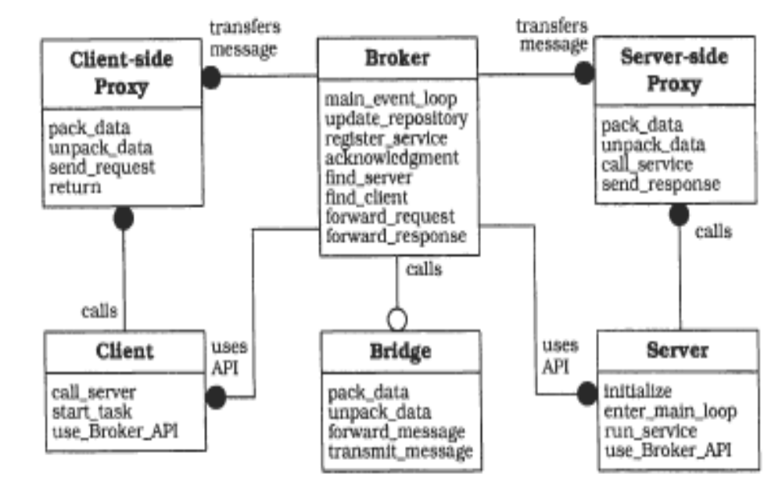
Broker in practice: Middleware
Tool for generating the Proxies
Library(API)+ Executable
Application Developer

Slide 2
Exercise
Implement a very simple Toy-ObjectRequestBroker
  We provide implementations of ByteSender/Receiver and Requester/Replyer)
    Download ByteCommunication.zip from the course webpage and try out the examples !
      Example 1: ServerWithSR, ClientWithSR
      Example 2: ServerWithRR, ClientWithRR
  Your implementation must not use other middleware technologies (they are your competitors ☺)
  See Assignment 3 lab: http://staff.cs.upt.ro/~ioana/arhit/2017/t3.html

Slide 3
ToyORB - Requirements
The goal of ToyORB is to support the developers of distributed applications (similar with his real-world “competitors” such as Java RMI)
ToyORB will come as:
  A library for the application developer, that will be used by the client and server of the application (similar java.Remote)
  A daemon executable, the Naming Service, needed to deploy and run applications developed over ToyORB (similar rmiregistry). It can be implemented using the communication mechanisms provided in ByteCommunication
  Optional, it includes tools or implements other methods such that the proxies are not written by the application developer

Slide 4
Using ToyORB for developing distributed applications
1. Define interface of remote object
INTERFACE
StockMarket
float get_price(Company)
2. Implement object
5. Implement Client
4. Implement Server
StockMarketServer
StockMarketClient
StockMarketImpl
3. Generate Proxy /
Write it “by hand”
6. Run application
3. Generate Proxy/
write it “by hand” in the simple version
StockMarket
ClientSide PROXY
StockMarket
ServerSide PROXY
Broker

Slide 5
ToyORB - Requirements(2)
ToyORB will be used to develop distributed applications such as the StockMarket application
The source code of StockMarket developed over ToyORB, contains:
  Interface of remote object, StockMarket.java
  Implementation of remote object, StockMarketImpl.java
  Implementation of the client program, StockMarketClient,java
  Implementation of the server program, StockMarketServer.java
  Implementation of StockMarketClientSideProxy.java (* in the standard requirements, this class is written by hand; in the optional version, you have to do something such that it is not written by hand any more)
  Implementation of StockMarketServerSideProxy.java (* in the standard requirements, this class is written by hand; in the optional version, you have to do something such that it is not written by hand any more)

Slide 6
ToyORB - Step1. Define interface
Define interface StockMarket, as a normal interface
This exports the operation get_price:
  Parameter: the name of the company
  Result: price
public interface StockMarket {
float get_price (String Company)
}
File StockMarket.java

Slide 7
ToyORB - Step 2. Implement Object
Implement class StockMarketImpl (a plain old java class)
It contains the implementation of operation get_price
public class StockMarketImpl implements StockMarket {
public StockMarketImpl() {}
public float get_price(String company) {
float price=12345;
return price;
}
}
File StockMarketImpl.java

Slide 8
ToyORB - Step 4. Implement Server
Implement the program StockMarketServer, which creates the remote object StockMarket
The createde object is registred with name “NASDAQ”
import toyORB.*;
public class StockMarketServer {
public static void main(String[] args) {
StockMarketImpl stockMarketImpl = new StockMarketImpl();
ToyORB.register("NASDAQ", stockMarketImpl );
}}
}
}}
}}
Specific ToyORB:
ToyORB.register:
The StockMarket object is registered with the Naming Service under name “Nasdaq”,
Assigns a port number for the server to listen
Creates the serverside proxy instance and invokes its start method
File StockMarketServer.java

Slide 9
ToyORB - Step 5. Implement Client
Implement the program StockMarketClient, which accesses the remote object StockMarket, and invokes the operation get_price for a company name companie
Prin intermediul Broker se localizeaza obiectul cu numele “NASDAQ”
import toyORB.*;
public class StockMarketClient {
public static void main(String[] args) {
StockMarket market= (StockMarket) ToyORB.getObjectRef("NASDAQ");
float price=market.get_price("ABC SRL");
System.out.println("Price is "+price);
}
Specific ToyORB:
ToyORB.getObjectReference
Interrogates the Naming service for the server address
Returns a reference (an instance of client side proxy) to the server object that has been registered as “Nasdaq”
File StockMarketClient.java

Slide 10
ToyORB - Step 3. Version 0:
Writing the proxies by hand
The standard requirements: write the classes:
StockMarketClientSideProxy.java
StockMarketSErverSideProxy.java
The implementation can use the support provided in ByteCommunication (Requester-Replyer)

Slide 11
ToyORB – To Do Checklist for the StockMarket application:
Source code to be written by the application developer Stockmarket:
  StockMarket.java, StockMarketImpl.java, StockMarketServer.java, StockMarketClient.java
  (**) StockMarketClientSideProxy.java, StockMarketServerSideProxy.java
Deployment Server:
    StockMarket.class, StockMarketImpl.class, StockMarketServerSideProxy.class, StockMarketServer.class
  Deployment Client:
    StockMarket.class, StockMarketClientSideProxy.class, StockMarketClient.class

Slide 12
ToyORB - Step 6. Run the application
> start ToyORBNamingService
> start java StockMarketServer
> java StockMarketClient

Slide 13
ToyORB: Variant using Forwarder-Receiver
2 different communication channels, one for transmitting requests parameters,
and one for receiving the result
StockMarket
ClientProxy
deliver ( marshal ( “ABC SRL” ) unmarshal ) receive
StockMarket
ServerProxy
F
R
R
receive ( unmarshal ( 1234.5 ) marshal ) deliver
F
ToyORB
NamingService
Disadvantage
The F-R pattern assumes that the participants are equal peers => clients must register as well)
Config.db
“StockMarketClient”: IP, Port
“NASDAQ”: IP, Port

Slide 14
ToyORB: Variant using Requester-Replyer
StockMarket
ClientProxy
Marshaller
Marshaller
StockMarket
ServerProxy
deliver_and_wait_feedback
Requester
Replyer
receive_transform_and_send_feedback
ToyORB
NamingService
deliver_and_wait_feedback: delivers the request followed by receiving the result over the same communication channel (socket)
receive_transform_and_send_feedback: receives the request followed by sending the result over the same communication channel
Config.db
“NASDAQ”: IP, Port

Slide 15
ToyORB: Implementation of Proxies
call_service
send_request
StockMarketClientSideProxy:
Uses a Requestor r
Uses a Marshaller m
Operation get_price:
  By using m – marshal, transforms the input parameters (company name) in a sequence of bytes
  By using r - deliver_and_wait_feedback, transmits to ServerSideProxy the sequence of bytes representing the request and receives a sequence of bytes representing the result
  By usingi m - unmarshal, transforms the received sequence of bytes into the value of the result (the price)
StockMarketServerSideProxy:
Uses a Replyer r
Has a reference to StockMarketImpl s
Uses a Transformer t : receives a sequence of bytes and returns the transformed sequence of bytes
Operation get_price :
While (true) r.receive_transform_and_send_feedback(t(s));
  Receives a sequence of bytes representing the request and parameters, t(s) transforms it into a sequence of bytes containing the result, that will be sent back to the client.
ServerTransformer:
Uses a Marshaller m
In order to do the transformation:
  By using m – unmarshal,extracts the input parameters (company name)
  Calls operation on StockMarketImpl s and obtains the result
  By using m - marshal, transforms the result (price) in sequence of bytes
pack_data
forward_
request
forward_
response
unpack_data
unpack_data
red italics text
identifies the operations
with their names in the
Broker pattern descr.
run_service
pack_data

Slide 16
ToyORB: support for more complex servers
A remote interface could be more complex (contain several operations).
Example:
public interface ComplexStockMarket {
  float get_price (String Company);
  String whois_highest_today();
  String whois_lowest_today();
  }
  Example client code:
  ComplexStockMarket objRef=(ComplexStockMarket) ToyORB.getObjectReference(“NASDAQ”);
  float price=objRef.get_price(“ABC SRL”);
  String junk=objRef.whois_lowest_today();
  The ClientSideProxy tmust marshal alsp some information describing which operation has been requested s-a cerut. The ServerSideProxy will unmarshall also the operation name

Slide 17
ToyORB: Must not depend on applications !
ToyORB should be used to develop any type of application (StockMarket, ComplexStockMarket, InfoServer, MathServer, etc )
Types of applications are unknown when developing ToyOrb !
ToyORB must be totally independent of anything application specific !
  Marshaller: must be able to transform any combination of parameters
  ToyORB.getObjectReference(String ServerName) must be able to instantiate and return a client side proxy object for any application (StockMarketClientSideProxy, MathServerClientSideProxy, InfoServerClientSideProxy, etc), but without depending on these applications !
    Possible solution: use Reflection to instantiate proxy object

Slide 18
Scenario for locating servers
ToyORB.getObjectReference(“NASDAQ”);
StockMarketImpl
NASDAQ
StockMarketClient1
StockMarketImpl
NIKKEI
StockMarketClient2
ToyORB.getObjectReference(StockMarket);
InfoServerImpl
TimisInfo
ToyORB.getObjectReference(“TimisInfo”)
InfoClient1

Slide 19
Scenario for locating servers
StockMarketImpl
NASDAQ
StockMarketClient1
StockMarketImpl
NIKKEI
StockMarketClient2
NamingService Address
127.0.0.1, 1111
InfoServerImpl
TimisInfo
InfoClient1
NamingService
NASDAQ, StockMarket,127.0.0.1,1112
NIKKEI, StockMarket, 127.0.0.1,1113
TimisInfo, InfoServer, 127.001,1114

Slide 20
Usage scenario: Register Server
StockMarketImpl
NASDAQ
ToyORB.register
Requester
NamingService Address
127.0.0.1, 1111
register NASDAQ of type StockMarket
At address 127.0.0.1, 1112
Replyer
NamingService
NASDAQ, StockMarket, 127.0.0.1, 1112

Slide 21
Usage scenario: Server ready
StockMarketImpl
NASDAQ
StockMarketClient1
StockMarketServerProxy
Replyer
NamingService Address
127.0.0.1, 1111
Replyer
NamingService
NASDAQ, StockMarket, 127.0.0.1, 1112

Slide 22
Usage scenario: getObjectReference
StockMarketImpl
NASDAQ
StockMarketClient1
StockMarketServerProxy
Replyer
ToyORB.getObjectRef
Requester
NamingService Address
127.0.0.1, 1111
1112
Adresa NASDAQ ?
Replyer
NamingService
NASDAQ, StockMarket, 127.0.0.1, 1112

Slide 23
Usage scenario: reference obtained
StockMarketImpl
NASDAQ
StockMarketClient1
StockMarketServerProxy
StockMarketClientProxy
Replyer
Requester
NamingService Address
127.0.0.1, 1111
Replyer
NamingService
NASDAQ, StockMarket, 127.0.0.1, 1112

Slide 24
ToyORB: Implement NamingService
NamingService with complex functionality(Trader):
  Locates remote object after its name (“NASDAQ”)
  Locates remote object after the description of the service (StockMarket) -> retrieves a reference to one of the remote objects implementing this service
Implementation of NamingService: as a server listening at an address which is known by ToyORB
  ToyORB:getObjectReference
  ToyORB:register
Interactions with the
NamingService
using Requester-Replyer

Slide 25
Making ToyORB more realistic
An Object Request Broker is an infrastructure for distributed applications
It must be usable in many different applications which are totally unknown to the developer of the broker infrastructure !
Consequences:
  It is essential that the ORB has no dependencies to any application specific code
  To have a real “usability”, the Broker should support the application developer with generating the code of the proxies
    Tools for the automatic generation of proxies

Slide 26
ToyORB: Automatic generation of proxies
Starting point: write manually the proxies for 2 different applications in order to identify their common “template”

Slide 27
ToyORB: Implementation of Proxies
call_service
send_request
StockMarketClientSideProxy:
Uses a Requestor r
Uses a Marshaller m
Operation get_price:
  By using m – marshal, transforms the input parameters (company name) in a sequence of bytes
  By using r - deliver_and_wait_feedback, transmits to ServerSideProxy the sequence of bytes representing the request and receives a sequence of bytes representing the result
  By usingi m - unmarshal, transforms the received sequence of bytes into the value of the result (the price)
StockMarketServerSideProxy:
Uses a Replyer r
Has a reference to StockMarketImpl s
Uses a Transformer t : receives a sequence of bytes and returns the transformed sequence of bytes
Operation get_price :
While (true) r.receive_transform_and_send_feedback(t(s));
  Receives a sequence of bytes representing the request and parameters, t(s) transforms it into a sequence of bytes containing the result, that will be sent back to the client.
ServerTransformer:
Uses a Marshaller m
In order to do the transformation:
  By using m – unmarshal,extracts the input parameters (company name)
  Calls operation on StockMarketImpl s and obtains the result
  By using m - marshal, transforms the result (price) in sequence of bytes
pack_data
forward_
request
forward_
response
unpack_data
unpack_data
run_service
pack_data

Slide 28
ToyORB: implementation template for Client Side Proxy
Let be a remote server with interface ServiceX
ServiceXClientSideProxy:
  Class ServiceXClientSideProxy implements ServiceX
  Each operation defined in interface ServiceX is implemented in following way:
    Create message (marshal): operation name, (number and types of paramers), parameter values
    Deliver_and_wait_feedback
    Extracts from the received message the value of the result (unmarshall) and returns it

Slide 29
ToyORB: Generate Client Side Proxy
  ServiceXClientSideProxy is a class implementing interface ServiceX, thus it depends on the application!
  In order to generate the Client Side Proxy:
    Possibility 1 (general applicable): the type ServiceX is known at design time, the code for ServiceXClientSideProxy is generated at application design time with help of a tool and is installed at the client side (Example: CORBA, RMI in java < 1.5)
      The generation tool takes as input the description of interface ServiceX and generates source code that must be compiled
    Possibility 2 (for technologies that support runtime code generation - dynamic proxy): the code of the class ServiceXClientSideProxy is automatically generated at runtime (no tools that must be used by the developer at design time), (Example: RMI in java >1.5 and .NET Remoting)

Slide 30
ToyORB: Template for Server Side Proxy
Suppose a remote server with interface ServiceX
ServiceXServerSideProxy:
  Class ServiceXServerSideProxy:
    Has a reference to original server object ServerXImpl
    Contains the “server-loop” (while (true) receive_transform_sendfeedback)
  Class ServiceXServerTransformer implements ServerTransformer
    Gets reference to original server object ServerXImpl
    Extracts from the message (unmarshals) the name of the operation and parameter values
    Invokes the operation on the original server object
      Possibility 1: code contains a “switch-case” (Java 1.1, CORBA)
      Possibility 2: uses Reflection -> eliminates dependency on ServiceX -> becomes a generic ServerSideProxy (Java 1.2, .NET)
    Creates the answer message(marshal) containing the result

