Slide 1
Design and Architecture of Complex Software Systems
Conf.dr.ing. Ioana Şora
http://staff.cs.upt.ro/~ioana/arhit-engl/
ioana.sora@cs.upt.ro

Slide 2
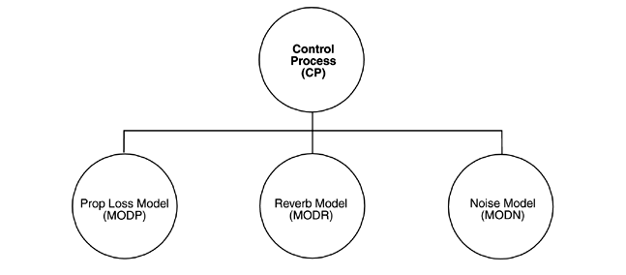
What is software architecture ?
What is not software architecture ?
?
Example: the figure claims to describe the architecture of a system that simulates subaquatic acustics
It uses a very popular informal notation - boxes-and-lines
“boxology”
Notes:
Bass – fig.2.1

Slide 3
What is software architecture ? (cont)
What can we not learn from this figure?
  What is the the type of the elements ?
  What are the responsibilities of each element?
  What is the significance of connections?
  What is the significance of alignment?
Conclusion: not a software architecture representation (or at least not a useful representation of a software architecture)
Architecture should not
be described like this !

Slide 4
Software architecture - definition
“The software architecture is the structure or structures of the system, which comprise software elements, the externally visible properties of those elements and the relationships among them”
  (Bass et al)
Notes:
Structure(s) – there’s more than one

Slide 5
Software architecture definition explained (1)
“The software architecture is the structure or structures of the system, which comprise software elements, the externally visible properties of those elements and the relationships among them”
  (Bass et al)
Software elements: (the term of architectural element is preferred instead of architectural component.)
  Architecture is an abstraction of a system
  Architecture is hiding certain details
  Externally visible properties: the provided services, performance characteristics, shared resources, etc.

Slide 6
Software architecture definition explained (2)
“The software architecture is the structure or structures of the system, which comprise software elements, the externally visible properties of those elements and the relationships among them”
  (Bass et al)
Structures of the system: Architecture is described by multiple different structures (views):
  The modules structure - the static structure of a system, results in the design phase
  The interactions structure – the dynamic structure that can be observed at runtime
  The allocation/deployment structures – describes how software elements are mapped onto non-software elements (hardware, staff)

Slide 7
Software architecture definition explained (3)
“The software architecture is the structure or structures of the system, which comprise software elements, the externally visible properties of those elements and the relationships among them”
  (Bass et al)
Inside each structural view, software elements and relationships among them may have different meanings:
  Elements can be: objects, classes, functions, processes, programs, libraries, databases, etc.
  Relationships between elements: part of, synchronization, function call, etc.

Slide 8
Example
Describe the architecture of a system doing simple text processing: the lines of the original text are transformed in following way: odd lines are rewritten in upper case and even lines are rewritten in lower case.
  Two different engineers draw following “boxology” diagrams:

Slide 9
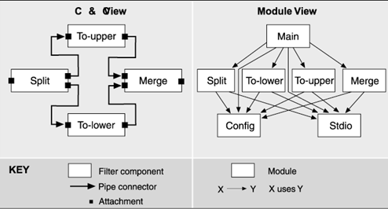
Example – Diagram 1

Slide 10
Example – Diagram 2

Slide 11
Example – The Architecture
No one of the 2 diagrams represents the software architecture of the system and neither a rigorous described structural view
The software architecture of the system is composed by both views

Slide 12
Multiple Architectural Structures =
Architectural Viewpoints
Software Architecture = a set of different views of different viewpoints
Viewpoints examples:
  Module (Design/Functional Structure)
  Component and Connector (Runtime)
  Allocation (Deployment, Physical Structure, Team Structure)
How is each viewpoint described ?
Which is the utility of each viewpoint ?
How does one chose the relevant viewpoints ?

Slide 13
The Module Structure: Elements & Relations
Elements: module
  Unit of implementation for software, representing a coherent entity from the point of view of functionality
Relations:
  Is-part-of: A is part of B
  Depends on (Uses or Allowed to use)
  Is-a: A is a B
Elements properties:
  Name: this is usually the primary information, it helps guessing the role of the element
  Responsibilities: the role of the module should be described with more details than just its name
Notes:
Clements 50-51

Slide 15
The Module Structure: Concluding remarks
The Module Viewpoint can be used for:
  Construction blueprint
  Analysis of certain system properties:
    Impact analysis: predicts the impact of changes in a part of the system based on dependency relationships
    Traceability to functional requirements: identify the modules where certain functionalities are implemented
  Communication:
    Understanding system functionality
    Relationships between system parts
The Module Viewpoint cannot be used for:
  Behavior at runtime
  Runtime qualities: performance, reliability, etc. => their analysis can be supported by Component-and-Connector views

Slide 16
Component-and-Connector: Overview
Deals with elements that appear at runtime, and not with implementation units
Similar in UML:
  Module Viewpoint <-> Class Diagrams
  Component&Connector Viewpoint <-> Object (Collaboration) Diagrams
Elements are called components and connectors
  Both categories of elements have well defined semantics
  Connectors cannot be reduced to a subcategory of components

Slide 17
Component-and-Connector Viewpoint:
Components
Elements: Components – Processing units or data storage units
  Appear at runtime, as: processes, objects, clients, servers, data bases, etc.
  Components have Ports: a port is the runtime interface of a component. It describes a certain way of interaction with its environment.
  Type of a component: defines its general functionality, number and type of its ports; for example, a “filter” component processes data streams received on input ports, and produces data streams on output ports.

Slide 18
Component-and-Connector Viewpoint:
Connectors
Elements: Connectors – mechanisms of interaction between components
  May be: function calls, messages, events, pipes
  Interactions abstracted as connectors can be also of a complex type, needing support of infrastructures and middleware (client-server connectors, publish-subscribe connectors, etc)
  Connectors have Roles: Roles correspond to the “interfaces” of connectors; for example, a pipe connector has 2 roles, “writer” and “reader”.
  Type of a connector: defines the type of interactions, number and type of its roles, and properties

Slide 19
Component-and-Connector Viewpoint:
Relations
Relationships – attachment relationships define the topology of the system
  specify which ports of a component are attached to which roles of a connector

Slide 21
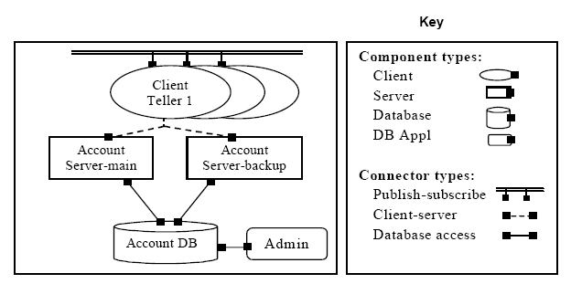
Example: C&C viewpoint
Notes:
Clements 102

Slide 22
The C&C Viewpoint
Which are the elements that appear at runtime and what are their interactions ?
Which is the dynamics of the elements ?
Which are the data sources ?
Are there replicated parts ?
Which are the data flows ?
What are the communication protocols ?

Slide 23
Module viewpoint vs C&C viewpoint
The same module can be executed in several components
The same component may execute code from several modules
[Clements] – fig.3.5

Slide 24
Allocation Structures
Deployment Structure:
  Describes how software elements are mapped on hardware elements
  Elements:
    Software components, defined in C&C
    Hardware elements: processors, storage devices, network nodes, etc.
  Relationships:
    Allocated-to
    Migrates-to, copy-migrates-to, execution-migrates-to
  Used for: analysis: performance, availability, security; cost estimation.
Work assignment Structure:
  Elements:
    Software: modules
    Environment elements: developers, persons, teams, subcontractors, etc
  Relationships: Allocated-to
  Used for: project management

Slide 25
Describing software architectures
IEEE/IEC/ISO 42010:2011 “Systems and software engineering – Architecture description”
Revises the earlier IEEE Std 1471:2000 “Recommended Practice for Architectural Description of Software-intensive Systems”
It specifies the requirements for architectural descriptions
It does not specify any description language
  ADL’s (Architecture Description Languages): Wright, ACME, SysML, Rapide, etc
  UML

Slide 26
The key principles of the Architecture Description Standard
Architecture descriptions should demonstrate how an architecture meets the needs of the system’s diverse stakeholders;
The architecture concerns of the diverse stakeholders can be addressed by an architecture description constructed with multiple architecture views of the system, where each view covers a subset of those concerns;
The rules for well-formedness, completeness and analyzability of each architecture view should be explicit via an architecture viewpoint;

Slide 27
Why is software architecture important ?
Reasons:
  Communication among stakeholders
  Early design decision
  Transferable abstraction of a system

Slide 28
Communication among stakeholders
Architecture is the vehicle for stakeholder communication
Each stakeholder (customer, user, project manager, tester, etc) is concerned with different characteristics that are affected by the architecture
The architect must find strategies to achieve all these goals (sometimes contradictory)
Architecture provides a common language in which the different concerns can be expressed, negotiated and resolved
  Architecture is abstract enough to capture a complex system
  Architecture is concrete enough to be analyzed for the systems desired characteristics and properties

Slide 29
Early design decisions
Architecture manifests the earliest set of design decisions
Defines constraints on implementation
Dictates organizational structure
Enables or inhibits certain quality attributes of the system (modifiability, performance, safety, security, etc)
Permits prediction of system qualities by analyzing the architecture
Enables cost and schedule estimates

Slide 30
Transferable, reusable model
Reuse of architecture = Software product lines
Architecture can be realized using externally developed components

Slide 31
Software architecture
Represents:
  Communication between stakeholders
  Early design decisions
  Transferable, reusable model
Terminology, vocabulary ?
Starting points ?
Established terminology,
good practices, standards,
success stories ….
PATTERNS

Slide 32
Basic Concepts
Reference Model
Reference
Architecture
Design
Pattern
Architectural
Pattern
Software
Architecture
Architectural
Style
Framework

Slide 33
Architectural Style
“An architectural style defines a family of software systems in terms of their structural organization. An architectural style expresses components and the relationships between them, with the constraints of their application, and the associated composition and design rules for their construction.”
[POSA1]/pag.394
Example: the Pipes-and-filters architectural style
  Components: all of the same type, Filter.
    Components process data flows, have 1 or more input ports and 1 or more output ports
  Connectors: Pipe
    Binary unidirectional connector, transmits dataflows from an output port to an input port of another filter
  Constraints and rules:
    A filter must not know the identity of the filters it sends or receives data

Slide 34
Architectural Pattern
“An architectural pattern expresses a fundamental structural organization schema for software systems. It provides a set of predefined subsystems, specifies their responsibilities, and includes rules and guidelines for organizing the relationships between them.”
[POSA1]/pag.12
Examples:
  Model-View-Controller
  Broker

Slide 35
Design pattern
“A design pattern provides a scheme for refining the subsystems of a software system, or the relationships between them. It describes a commonly-recurring structure of communicating components that solves a general design problem within a particular context. [Go4]”
[POSA1]/pag.13
Smaller in scale than architectural patterns, independent of a particular programming language but dependent on a programming paradigm
The application of a design pattern has no effect on the fundamental structure of a software system, but may have a strong influence on the architecture of a subsystem.

Slide 36
Reference Models
“A reference model is a division of functionality together with data flow between the pieces. It is a standard decomposition of a known problem into parts that cooperatively solve the problem.”
[Bass]/&2.3
Results from experience in mature application domains
Examples:
  Compilers: lexical analysis, syntactic analysis, semantic analysis, optimization, code generation
  Networks: the OSI reference model

Slide 37
Reference Architectures
“A reference architecture is a reference model mapped onto software elements (that cooperatively implement the functionality defined in the reference model) and the data flows between them.”
[Bass]/&2.3
A reference model defines a way of decomposing functionalities
A reference architecture defines a way of mapping a functionalities on subsystems/architectural components
Mapping can be 1-1 but not necessarily
Example: CORBA (Common Object Request Broker Architecture)

Slide 38
Frameworks
“A framework is a partially complete software system that is intended to be instantiated. It defines the architecture for a family of systems and provides the basic building blocks to create them.”
[POSA1]/pag.396
Defines places where insertions/adaptations can be done: hot spots
Difference framework ↔ reference architecture: a framework is given as code, reference architecture not
Difference framework ↔ library: when writing an application:
  With a library: write the main body and uses elements (functions, classes, etc) from the library
  With a framework: the framework provides the main body, the application developer provides only concrete elements for some of the hot spots. “inversion of control”

Slide 39
Concepts
Reference Model
Reference
Architecture
Design
Pattern
Architectural
Pattern
Software
Architecture
Architectural
Style
Framework

Slide 40
Course outline
Basic concepts
  What is software architecture ?
Fundamental architectural styles
  Pipes and filters
  Layers
  Blackboard
  Event-driven
Architectural patterns for :
  Adaptive systems
    The Reflection Pattern
  Distributed systems
    The Broker Pattern
  Data access patterns
    Pattern for Object-Relational Mappings
    Pattern for decoupling data access

Slide 41
Design problem
Our focus in this course
Architectural design
principles
(Architectural styles
and patterns)
Tehnologies,
Frameworks
APIs
Object Request Broker Pattern
RMI, .NET Remoting
Metalayer Architecture
Reflection (in Java,.NET)
Data Access Patterns
Object-Relational Mappers

Slide 42
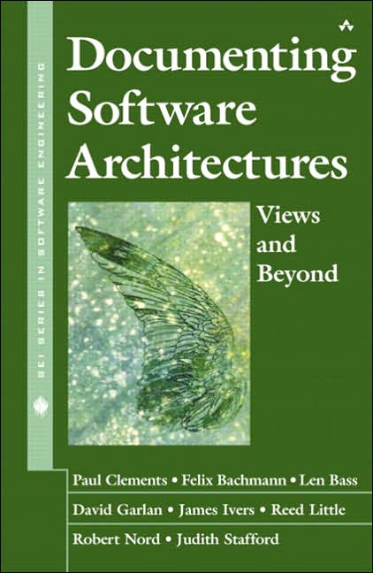
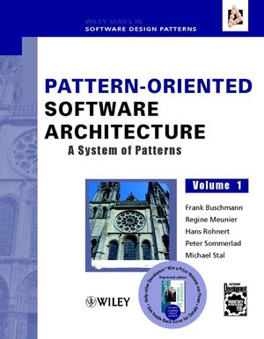
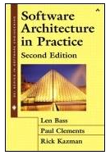
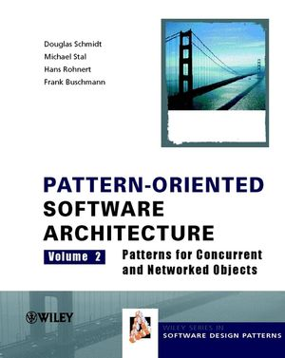
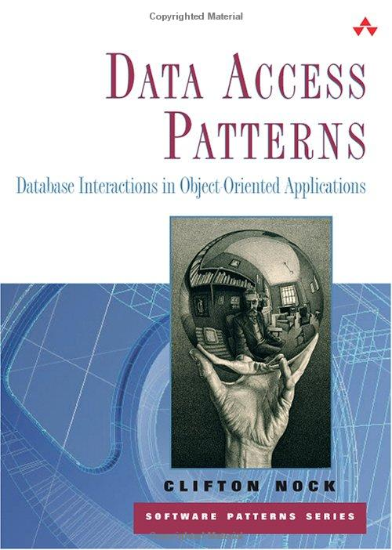

Resources

Slide 43
Course Webpage
http://staff.cs.upt.ro/~ioana/arhit-engl/
    Lectures slides and schedule
    Lab assignments
    Bibliographic pointers and additional resources

Slide 44
Lab
Applying the learned concepts in practice is essential
4 projects - design and implementation
Final grade = 50% written exam + 50% projects
Optional lab assignments can bring bonus points for exam !

