Slide 1
Fundamental architectural styles
Part 1

Slide 2
Fundamental architectural styles
Outline and bibliography:
  Layers
    [POSA1] – in 2.2
  Pipes and Filters
    [POSA1] – in 2.2
  Blackboard; with its variants: Repository, Active Database
    [POSA1] – in 2.2
  Event-driven (Implicit Invocation); variants: Publisher-Subscriber, Event-Bus
    [POSA1] – from 3.6
    S. Gupta, J. Hartkopf, S. Ramaswamy: Event Notifier, a Pattern for Event Notification, in Java Report, 1998 (republished as chapter 11 in the book More Java Gems, Cambridge University Press, 2000) http://sites.google.com/site/jeffhartkopf/notifier
Optional reading:
    David Garlan, Mary Shaw, An Introduction to Software Architecture, online http://www.cs.cmu.edu/afs/cs/project/able/ftp/intro_softarch/intro_softarch.pdf
PART 1
Notes:
POSA

Slide 3
Layers
    Bibliography:
    [POSA1] – in chap. 2.2
Notes:
POSA

Slide 4
Layers
“The Layers architectural pattern helps to structure applications that can be decomposed into groups of subtasks in which each group of subtasks is at a particular level of abstraction.”
Typical example:
  Network protocol stacks
  The protocols specify agreements at a variety of abstraction levels
  Each layer deals with a specific aspect of communication and uses the services of the next lower layer.
Notes:
POSA

Slide 5
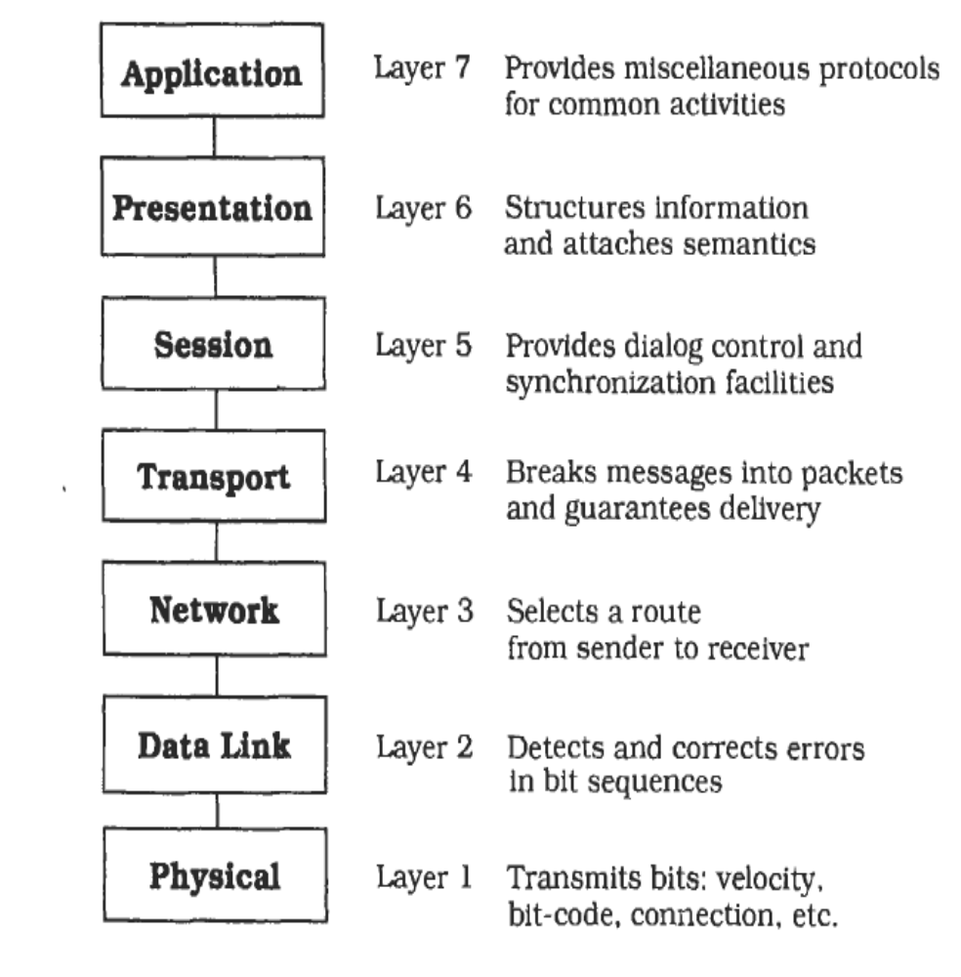
Typical Example for Layers
[POSA]-Fig/P.31
Notes:
POSA1

Slide 6
Layers: Context & Problem
Context:
  A large system that requires decomposition.
Problem:
  The main characteristic of the system is that it deals with a mix of low- and high-level issues, where high-level operations rely on the lower-level ones
  A typical pattern of communication flow consists of requests moving from high to low level, and answers to requests, incoming data or notification about events traveling in the opposite direction.
  The system specifications most often describe the high-level tasks to some extent, and specifies the target platform, but portability to other platforms is desired.

Slide 7
Layers - Analysis
Parts of the system should be exchangeable. Components should be able to be replaced by alternative implementations without affecting the rest of the system.
Interfaces of layers should be stable, and may even be prescribed by a standards body.
It may be necessary to build other systems at a later date with the same low-level issues as the system you are currently designing.
Similar responsibilities should be grouped to help understandability and maintainability.
There is no 'standard' component granularity.

Slide 8
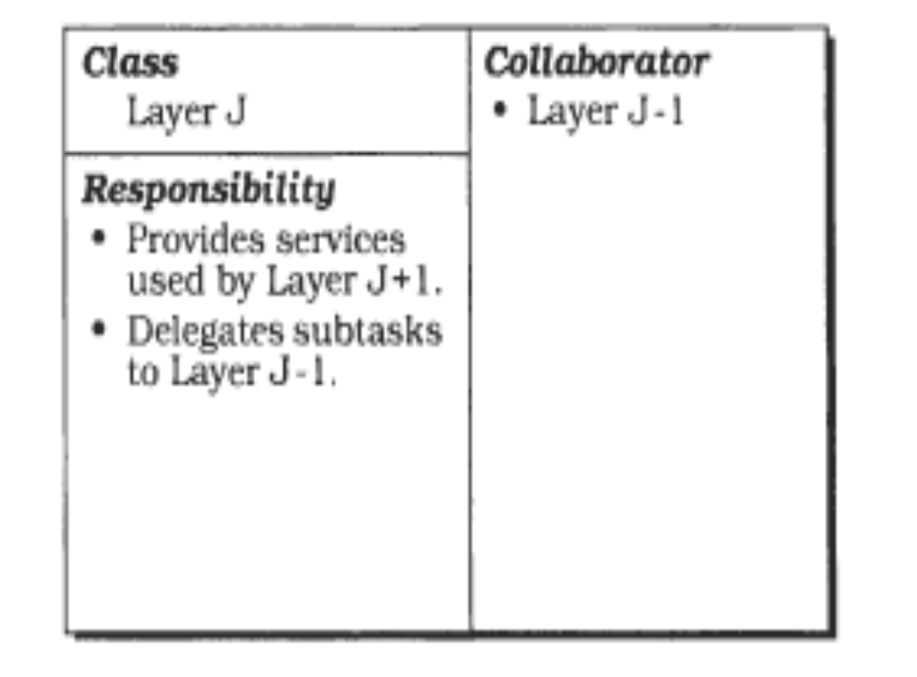
Layers: Solution - Structure
The system is organized as a o stack of subsystems (called layers)
Layer numbering: lowest is Layer1, highest is LayerN
The Layers pattern is defined by restrictions of the uses relationships:
LayerJ is allowed to use LayerJ-1
[POSA]-Fig/P.34

Slide 9
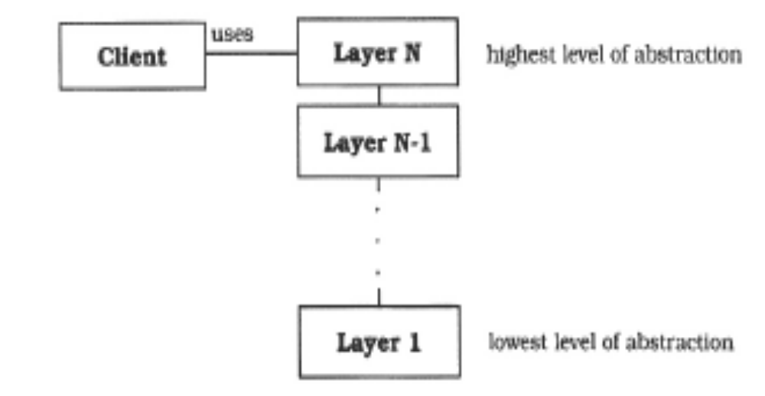
Layers: structural characteristics
“Stack”
“Onion”
Each layer hides all lower layers for accesses from higher layers
[POSA]-Fig/P.35

Slide 10
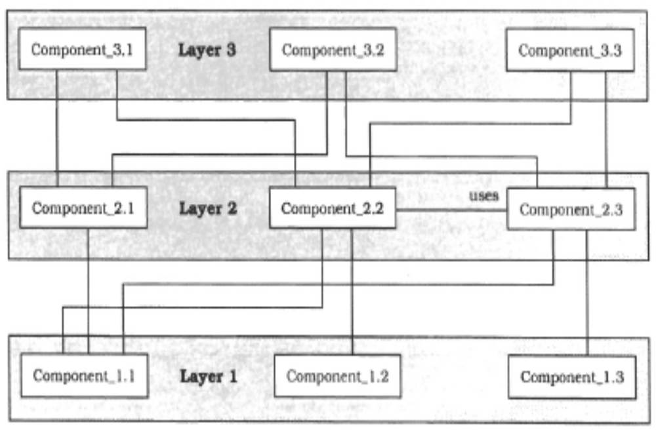
Layer structure
[POSA]-Fig/P.35
Notes:
POSA pag 35

Slide 11
Layers: Dynamic behavior
Two scenarios of dynamic behavior:
  Top-down communication
  Bottom-up communication
Notes:
POSA pag 36

Slide 12
Layers: top-down communication
EVENT, CAUSE
calls
Allowed direction
of uses relationships
Notes:
POSA pag 36

Slide 13
Layers: Dynamic behavior
Scenario 1: Top-down communication:
  A client issues a request to Layer N. Since Layer N cannot carry out the request on its own, it calls the Layer N – 1, which calls Layer N-2, etc until reaching Layer 1.
  A characteristic of such top-down communication is that Layer J often translates a single request from Layer J+1 Into several requests to Layer J- 1.
Notes:
POSA pag 36

Slide 14
Layers: bottom-up communication
Allowed direction
of uses relationships
calls via callback
EVENT, CAUSE
Notes:
POSA pag 36

Slide 15
Layers: Dynamic behavior
Scenario 2: Bottom-up communication:
  A chain of actions starts at Layer 1 (for example when a device driver detects input). Layer1 notifies Layer 2 about it, and so on. In this way data moves up through the layers until it arrives at the highest layer.
  This scenario must be realized by callbacks ! This mechanism allows having an ascending flow of data and control, but without having ascending Uses relationships
Notes:
POSA pag 36

Slide 16
A Side-Note about
The Callback Mechanism
Callback can solve the situation described by following relationships:
  FB calls FA but A uses B and B does not use A
The Callback mechanism is realized by transmitting the name of the function to be called (FA in the example) by the bottom layer in some form of data.
This mechanism allows an ascending flow of data and control, but without ascending Uses relationships -> it is not contradicting the restrictions imposed by the Layered style
A
FA
B
FB
Notes:
Clements 85-86

Slide 17
Example: a situation requiring use of callback
A school administration program handles students and sorts them in alphabetical order.
A graphics application handles points in a 2D plane, also sorting them in ascending order of their distance to the origin
Other application from other domains may also require the sorting of different type of data
All applications have a 2-layers architecture. They reuse a GenericUtilities layer, containing the sorting
DomainLogic
uses
GenericUtilities
Notes:
Clements 85-86

Slide 18
Example contd.
StudentAdministration
main
compare
callscalls
callscalls
GenericUtilities
sort
Notes:
Clements 85-86

Slide 19
How can you implement callbacks ?

Slide 20
Important steps for defining a layered architecture
Define the abstraction criterion for grouping tasks into layers
Determine the number of abstraction levels.
  If they are too many: big overhead, performance issues
  If they are too few: wrong structure
Name the layers and assign tasks to each of them
Specify the services
  Good practice: lower layers implement a small number of services, higher layers implement a bigger number of services
Specify an interface for each layer
Specify the communication between adjacent layers
Specify the communication between adjacent layers

Slide 21
Layers: variants
Relaxed Layered Systems:
  The restriction is-allowed-to-use is relaxed:
    A layer may use all the layers below him
  A layer may be partially opaque:
    Some services are visible only for the layer immediately above, but other services can be used by all layers of above
  Negative impact on maintenability
    Relaxed layers should be used only if performance is very important and the system is stable and will not change much
Layering through inheritance:
  Lower layer = base class; Upper layers are constructed by implementation inheritance from the lower layers
  Fragile base class problem: modifying the data representation of the base class (the lower layer) requires recompiling the whole hierarchy
  Not a good idea !

Slide 22
Layers: Properties of the style
Benefits:
  Reusability: each layer can be individually reused, if it represents a coherent abstraction of some services and has a well defined interface
  Portability: standardized interfaces allow to limit the effect of changes to the inside of one layer
  Testability: layers can be tested independently
  Exchangeability: implementations of layers can be changed without affecting the rest
Liabilities:
  Cascades of changing behavior: it is still possible that by changing one layer it will impact on others as well
  Lower efficiency: less efficient that a monolithical implementation
  Unnecessary work: if lower levels implement services that are not requested by upper levels
Notes:
POSA

Slide 23
Layers: Concluding remarks
The Layers architectural style is defined by restricting the direction of allowed dependency relationships (uses relationships)
Restricting the allowed dependency relationships (especially for avoiding cyclic dependencies !) is a general design principle, not only for systems labeled as belonging to the layered style!
There are tools for the analysis of dependency relationships in code:
  Examples:
  NDepend, dependencyfinder, Lattix, JDepend, etc
  ART

Slide 24
Pipes and Filters
    Bibliography:
    [POSA1] – in chap. 2.2
Notes:
POSA

Slide 25
Pipes and Filters
“The Pipes and Filters architectural pattern provides a structure for systems that process a stream of data. Each processing step is encapsulated in a filter component. Data is passed through pipes between adjacent filters. Recombining filters allows you to build families of related systems.”
Most well-known example: operating system command pipelines:
ls | grep old | more

Slide 26
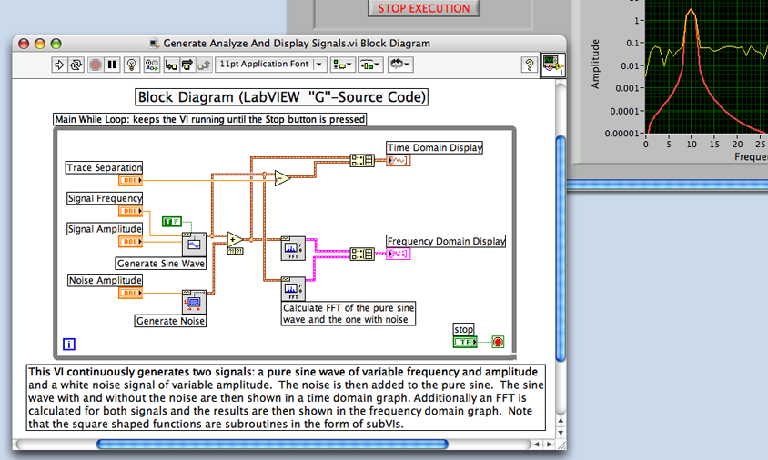
Another application domain example:
Signal processing & Virtual Instrumentation

Slide 27
Context & Problem
Context: Processing data flows
Problem: an application that can be naturally decomposed in processing stages;
  Flexibility will be needed, to reorder (recombine) the components
  It is possible to build a family of similar systems by reusing different subsets of components
  Non-adjacent components do not share information
  It is possible that the stages are executed in parallel
  The application is not an interactive application

Slide 28
Solution - structure
The system can be naturally decomposed in processing stages
Each stage is implemented by a component called a Filter
A Filter has following characteristics:
  Reads data from input streams
  Transforms data
  Writes data on output streams
The succession of Filters is given by the transformations of the data flow
Pipes (connectors) :
  Transport dataflows between consecutive filters
  Can be implemented by different mechanisms: function calls, pipes, etc

Slide 29
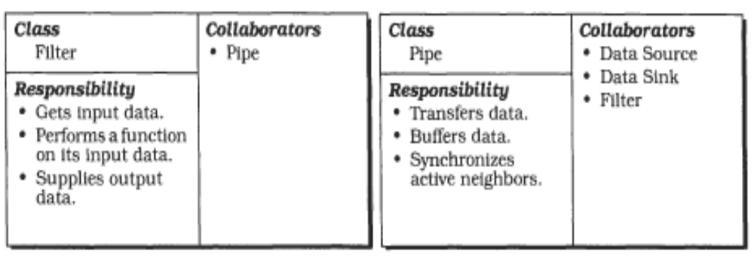
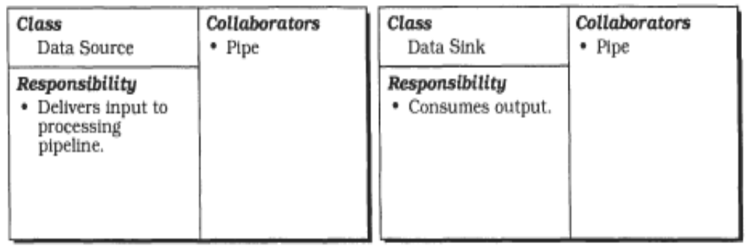
[POSA]-Fig/P.56

Slide 30
Solution - behavior
Types of Filters:
  Passive: they are explicitly activated by the preceding filter (push) or by the net filter (pull)
  Active: the body of the filter consists in a continuous loop that reads-transforms-writes data
    With Active Filters, the Pipes must ensure buffering and synchronization !
    In order to reduce the latency and to permit a concurrent processing, the Filters must function incrementally (read in one step small items of data, process them, write output and repeat)

Slide 31
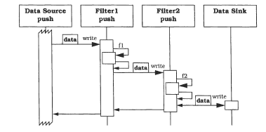
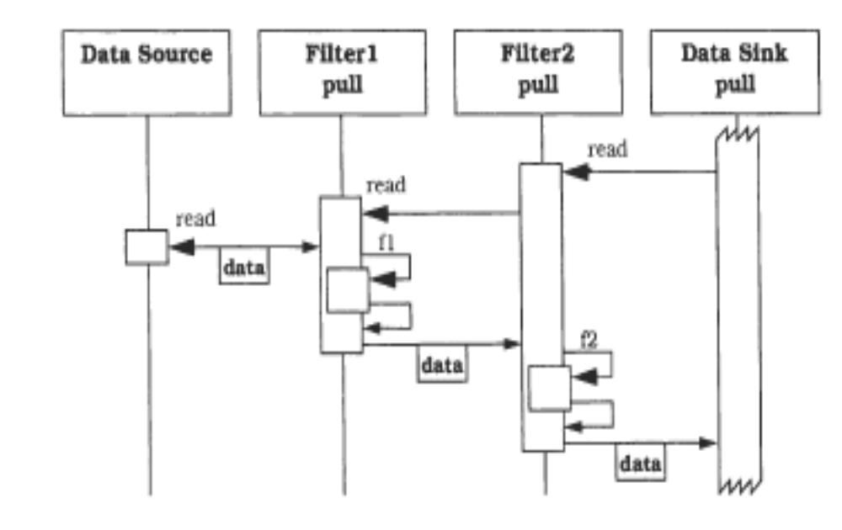
Passive Filters:
Push pipeline vs. Pull pipeline
[POSA]-Fig/P.58

Slide 32
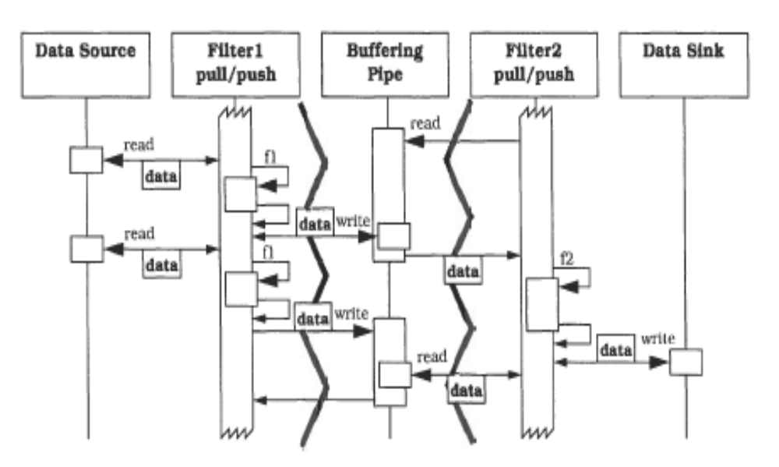
Active Filter: Push/pull pipeline
[POSA]-Fig/P.60
Notes:
POSA 60

Slide 33
Important steps for defining a pipes-filters architecture
Divide the system's task into a sequence of processing stages
Define the data format to be passed along each pipe
  The same format => maximum flexibility, but may have negative impact on efficiency
Decide how to implement each pipe connection. This determines if filters are active or passive.
Design and implement the filters.
  Rule of thumb: One filter should do one thing well => increases potential for individual filter reuse
Design the error handling
Set up the processing pipeline
Notes:
POSA

Slide 34
Pipes-and-filters: Variants
Tee and join pipeline systems
  The single-input single-output filter specification of the Pipes and Filters pattern can be varied to allow filters with more than one input and/or more than one output.
  Processing can then be set up as a directed graph that can even contain feedback loops.

Slide 35
Properties of the style:
Pipes-and-filters
Benefits:
  Flexibility by filter exchange or recombination
  Reuse of filter components
  Rapid prototyping of pipelines
  Potential for efficient concurrent processing
Liabilities:
  Sharing state information is expensive or inflexible.
  Data transformation overhead
  Error handling difficulties
  Efficiency gain by parallel processing is often an illusion

Slide 36
Discussion:
Pipes-and-Filters vs. Layers
Layer A
Filter A
Filter B
Filter C
Layer B
Layer C

Slide 37
Discussion:
Pipes-and-Filters vs. certain design patterns

Slide 38
Blackboard
    Bibliography:
    [POSA1] – in chap. 2.2
Notes:
POSA

Slide 39
Blackboard
“The Blackboard architectural pattern is useful for problems for which no deterministic solution strategies are known. In Blackboard several specialized subsystems assemble their knowledge to build a possibly partial or approximate solution.”
Example: a software system for speech recognition.
Input data:
  Speech recorded as waveform
  System accepts sentences (commands)
  sentences are restricted to the syntax and vocabulary needed for a specific application, such as a database query
Output data:
  A machine representation of the corresponding English sentence
  The transformations involved require acoustic- phonetic, linguistlc. and statistical expertise
Notes:
POSA

Slide 40
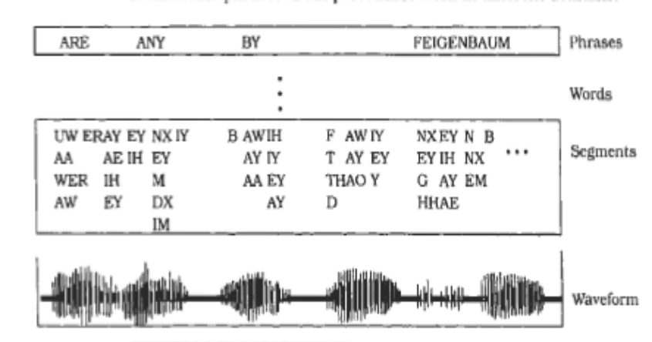
Blackboard example
A software system for speech recognition
HEARSAY-II
KS
BB
Word Creation
Syllable Creation
Segmentation
[POSA]-Fig/P.70
Notes:
POSA 71

Slide 41
Solution - Blackboard
The structure: a collection of independent programs (KS = Knowledge Sources) that work cooperatively on a common data structure (BB=Blackboard).
Each program (called a Knowledge Source) is specialized for solving a particular part of the overall task. These specialized programs are independent of each other. They do not call each other.
There is no predetermined sequence for the activation of KS. Instead, the direction taken by the system is mainly determined by the current state of progress.
A central control component evaluates the current state of processing and coordinates the specialized programs. This data-directed control regime is referred to as opportunistic problem solving.

Slide 42
Solution – Blackboard contd.
The blackboard is the central data store. Elements of the solution space and control data are stored here. The term vocabulary denotes the set of all data elements that can appear on the blackboard.
The blackboard provides an interface that enables all knowledge sources to read from and write to it.
All elements of the solution space can appear on the blackboard. Partial solutions that are constructed during the problem solving process and put on the blackboard, are called hypothesis of different levels of abstractions.
Knowledge sources have to understand the vocabulary of the blackboard.
Often a knowledge source operates on two levels of abstraction. It may implement forward reasoning or backward reasoning.

Slide 43
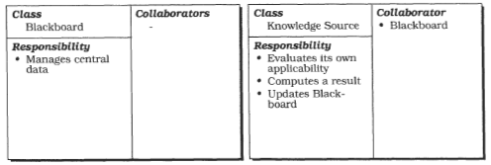
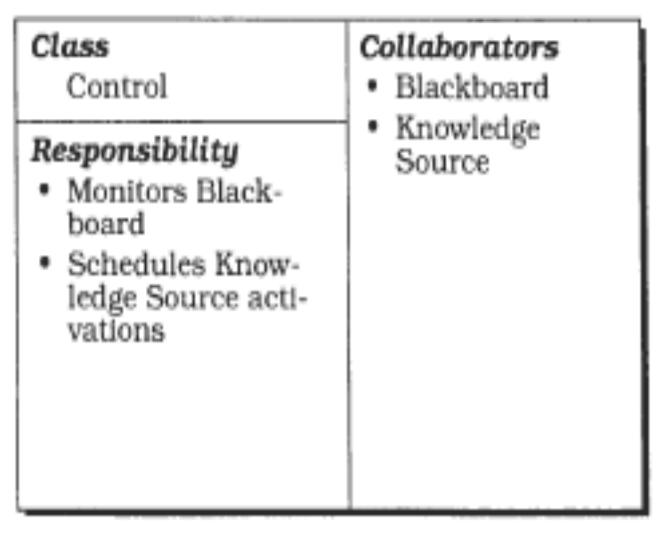
Solution - Blackboard
[POSA]-Fig/P.77

Slide 44
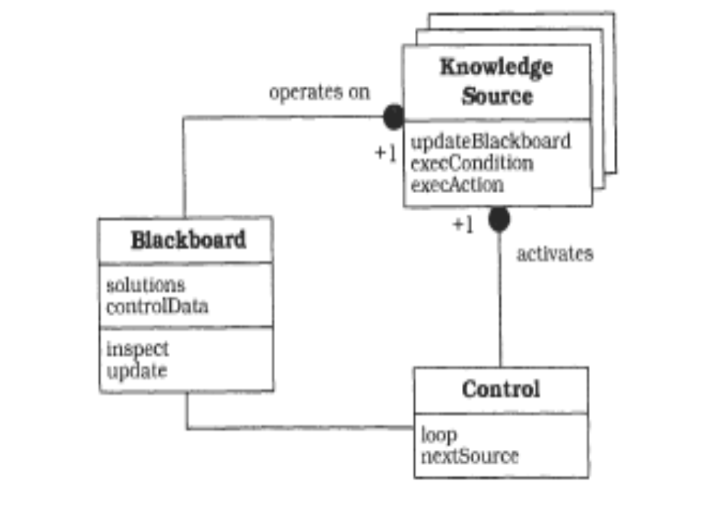
Solution - Blackboard
BB:
  Allows KS to read and write data
KS
  execCondition: evaluates the current data in the BB and determines if it has smth to do in these conditions
  execAction: executes its specific task, updates the BB
Control
  Monitors BB
  Activates KS for execCondition and decides who gets to execAction
[POSA]-Fig/P.79
Notes:
POSA 79

Slide 45
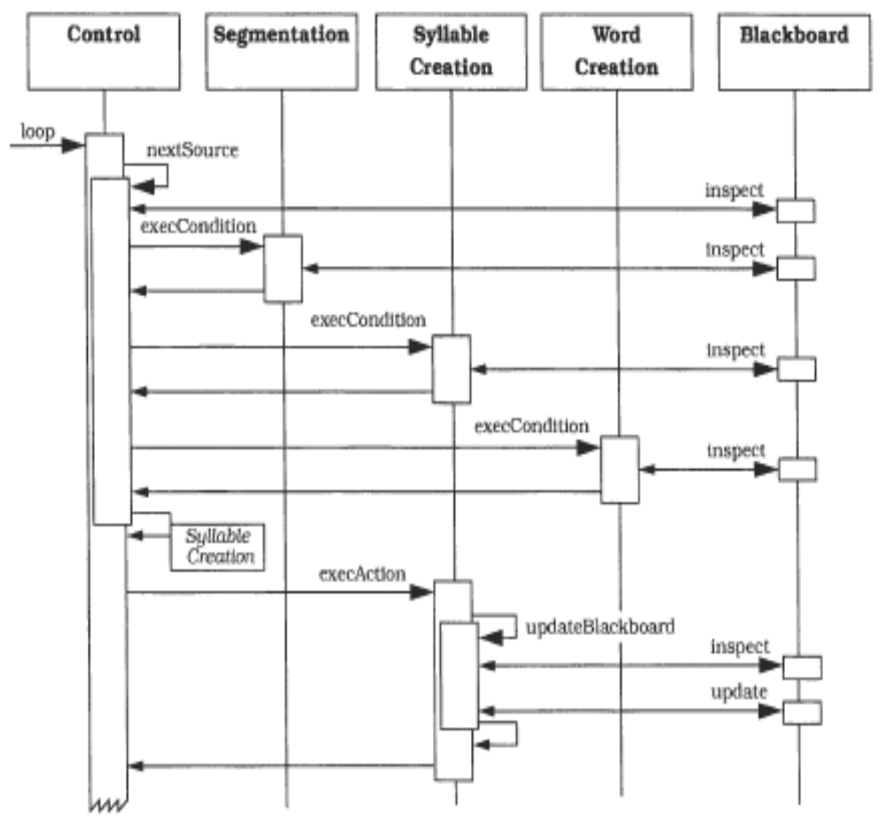
Blackboard – Dynamics Example
[POSA]-Fig/P.80

Slide 46
Important steps for defining a Blackboard architecture
Define the problem: establish the general fields of knowledge, define inputs and their properties
Define the solution space: partial/complete solutions, establish abstraction levels for partial solutions
Divide the solution process into steps: define how partial solutions of a lower level are transformed into higher level
Divide the knowledge into specialized knowledge sources with certain subtasks.
Define the vocabulary of the blackboard. Find a representation for solutions that allows all knowledge sources to read and write to BB
Specify the control of the system
Implement KS: identify the part of condition and part of action; each KS must not know any other KS or Control Component

Slide 47
Variant - Repository
Generalization of Blackboard
There is no central control component and KS do not have the part of execCondition
The order in which KS are executed is determined by a user or a program
Examples:
  Classical databases
  CASE Toolset

Slide 48
Variant – Active Database
Hybrid variant, results by combining Blackboard with Event-driven
Activation of KS is done through events:
  initially, every KS registers its interest for a certain part of the database.
  The KS will be automatically notified when changes occur in its area of interest
  The control loop in which KS test execCondition() disappears – it will be moved in the active database !

Slide 49
Properties of the
Blackboard architectural style
Advantages:
  Supports experimentation with different algorithms and heuristics
  Changeability
  Reusability for KS
Liabilities:
  Low testability
  Low efficiency
  High development effort

Slide 50
Fundamental architectural styles:
Conclusions (1)
They describes ways of structuring a system from different viewpoints:
  Module viewpoint (static structure): Layers
  Component & connector viewpoint (dynamic, runtime structure): Pipes-Filters, Blackboard, Event-driven
They describe elementary structures
In real systems, they may appear “pure” or “hybrids”

Slide 51
Fundamental architectural styles:
Conclusions (2)
The choice of the architectural style has an important influence over the systems properties !
For further reading: David Garlan, Mary Shaw, An Introduction to Software Architecture, Technical Report Carnegie-Mellon University, no CMU-CS-94-166, http://www.cs.cmu.edu/afs/cs/project/able/ftp/intro_softarch/intro_softarch.pdf
  Experiments: a problem is implemented according to different style and they study the impact of the style on the systems properties
Lab Assignment: “The Furniture Factory”

Slide 52
Fundamental architectural styles:
Conclusions (3)
The fundamental archit styles are general structuring solutions, that can be applied independent on a certain programming paradigm or technology
The components may have different granularities, from objects, components, and up to whole application that are integrated according to these patterns
For further reading: Enterprise Integration Patterns
  Book: Enterprise Integration Patterns, by Gregor Hohpe and Bobby Woolf, A Martin Fowler Signature Book, Addison Wesley, 2004
  Site: http://www.eaipatterns.com/
    Shared Database (Repository): http://www.eaipatterns.com/SharedDataBaseIntegration.html
    Pipes and Filters: http://www.eaipatterns.com/PipesAndFilters.html
    Messaging (Event-Driven) http://www.eaipatterns.com/Messaging.html

