Slide 1
Course contents
Basic concepts
  What is software architecture ?
Fundamental architectural styles
  Pipes and filters
  Layers
  Blackboard
  Event-driven
Architectural patterns for :
  Adaptive systems
    The Reflection Pattern
  Distributed systems
    The Broker Pattern
  Data access patterns
    Pattern for Object-Relational Mappings
    Pattern for decoupling data access

Slide 2
The Reflection Pattern
Bibliography:
  The architectural Reflection pattern, in general:
    [POSA1], [POSAforDummies]
  Detailed Design methods for meta-objects:
    Dirk Riehle, Michel Tilman, Ralph Johnson: The Dynamic Object Model, PLOP 2000, http://hillside.net/plop/plop2k/proceedings/Riehle/Riehle.pdf
    Joseph Yoder, Ralph Johnson: The Adaptive Object-Model Architectural Style, WICSA 2002, http://www.adaptiveobjectmodel.com/WICSA3/ArchitectureOfAOMsWICSA3.pdf

Slide 3
Reflection
The Reflection architectural pattern provides a mechanism for changing structure and behavior of software systems dynamically.
In this pattern, an application is split into two parts. A meta level provides information about selected system properties and makes the software self-aware. A base level includes the application logic. Its implementation builds on the meta level. Changes to information kept in the meta level affect subsequent base-level behavior.
[POSA1]

Slide 4
Reflection – The principle
A precondition for doing changes is to be aware of the current condition => a “mirror” is needed
A self-aware software system is built on 2 levels:
Meta level
Base level
There is a protocol that governs the interaction with the MetaLevel:
Meta Object Protocol

Slide 5
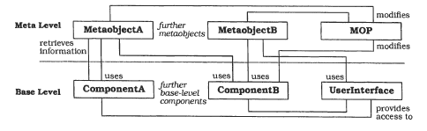
Reflection – The Structure
[POSA]-Fig/P.199

Slide 6
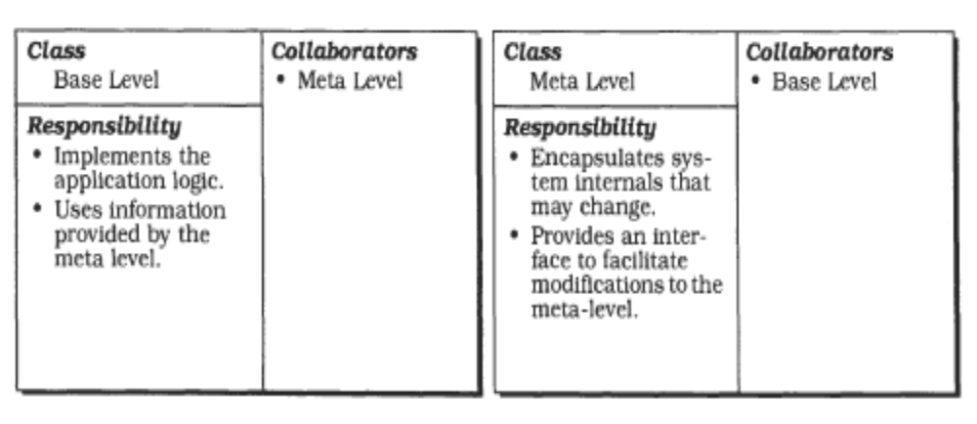
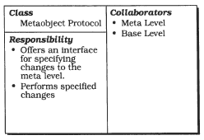
Reflection – The Elements
[POSA]-Fig/P.197

Slide 7
Reflection Example
Example: Configuring application at runtime by adding/updating components at runtime
  Application is created or updated by reading config files and executing the commands found there
  Base level: static parts
  Meta level: variable parts
  MOP: config file editor/interpreter

Slide 8
Kinds of Reflection
A taxonomy, according to:
  How much can be done via reflection:
    Introspection
    Intercession/Manipulation/Adaptation
  What it reflects:
    Structural reflection
    Behavioural reflection
Reflective towers: meta-meta-meta-….

Slide 9
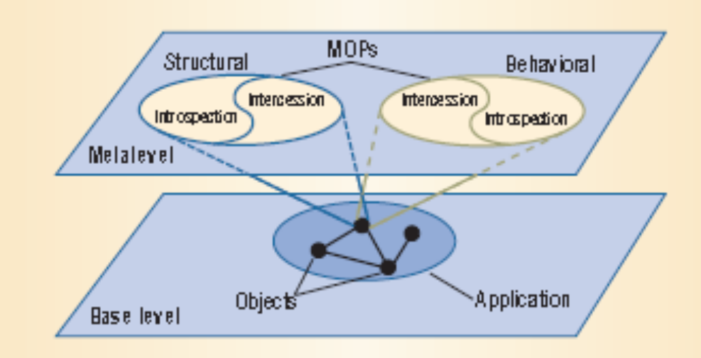
Reflection Taxonomy

Slide 10
Types of Reflection:
Find Examples
Structural introspection: …
Structural manipulation: …
  !
Behavioural introspection: …
Behavioural manipulation: …

Slide 11
Meta level
Meta level:
  provides a self-representation of the software to give it knowledge of its own structure and behavior
  It consists of metaobjects. Metaobjects encapsulate and represent information about the software.
    Examples of metaobjects include: type structures, algorithms, or even function call mechanisms.

Slide 12
Base level
Base level:
  The base level defines the application logic.
  Its implementation uses the metaobjects to remain independent of those aspects that are likely to change.
    Base-level components may only communicate with each other via a metaobject that implements a specific interaction mechanism. Changing this metaobject changes the way in which base-level components communicate, but without modifying the base-level code.

Slide 13
Meta Object Protocol
Meta Object Protocol (MOP):
  An interface for manipulating the metaobjects.
  It allows clients to request particular changes on the metaobjects.
  The metaobject protocol itself is responsible for checking the correctness of the change specification, and for performing the change. Every manipulation of metaobjects through the metaobject protocol affects subsequent base-level behavior

Slide 14
Designing a reflective architecture
Case study
Case study: Persistence Component in C++:
  We want to develop a persistence component that is independent of specific type structures. However, to store and read arbitrary C++ objects, we need dynamic access to their internal structure.

Slide 15
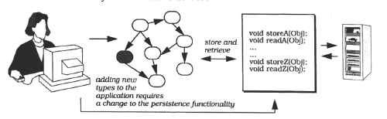
Persistence component:
A bad solution
Bad solution: implementing type-specific store and read methods
Disadvantages: expensive and error-prone. Whenever we change the class structure of the application we must modify these methods as well.
[POSA]-Fig/P.193

Slide 16
Persistence component:
Solution using Reflection
We want to develop a persistence component that is independent of specific type structures
Solution with Reflection:
  Base level: user application (contains objects to be serialized)
  Meta level: metaobjects that reflect base level objects
Most difficult design task: finding out which metaobjects are needed
  Where are they actually implemented ?

Slide 17
Steps for designing a reflective architecture
Identify varying behavior
Identify structural aspects of the system, which, when changed, should not affect the implementation of the base level
Define the metaobjects. For every aspect identified in the previous steps, define appropriate metaobjects.
Define the metaobject protocol. Support a defined and controlled modification and extension of the meta level
options for implementing the MOP:
  Integrate it with the metaobjects.
  Implement the metaobject protocol as a separate component.
5. Define Base Level

Slide 18
Designing the Persistence Component:
Steps 1-2:
Identify variable behavior:
  New types, objects that are instances of these types, must be handled (serialized) without modifying the Persistence Component
Identify aspects that do not change/ arte not allowed to change:
  Existing types cannot change

Slide 19
Designing the Persistence Component:
Step 3:
3. Define the metaobjects:
  Persistence component itself is part of the Base Level: reads/writes objects
  Metaobjects: give information about runtime types ( introspection only; in this example there are no changes of the types allowed).
  Most difficult step: choosing the right types of metaobjects !

Slide 20
Finding out the metaobjects (1)
Start from the scenario for writing an object:
We must know its class => A metaobject of type Type-Info (similar with Class); this metaobject must be retrieved starting from an object
We must know the internal structure (the fields) of an object. => from a Type-Info metaobject we must retrieve Data-Info (similar with Field) metaobjects.
For every field, if it is not a primitive type, recursiveley apply steps 1-2
If a field is of a primitive type, write its value in the output stream
The writing scenario requires following metaobject types:
Type-Info, Data-Info

Slide 21
Finding out the metaobjects (2)
Start from the scenario of reading an obiect:
We need to instantiate an object of a type with a given name => a metaobject of type ObjectCreator (similar to Class.newInstance)
From the Type-Info of the created object we wil know its internal structure (fields) (retrieve Data-Info metaobjects)
For every field, if it is not a primitive type, recursiveley apply steps 1-2
If a field is of a primitive type, set it to the value read from the input stream
The reading scenario requires following metaobject types:
ObjectCreator, Type-Info, Data-Info

Slide 22
Finding out the metaobjects (3)
Main metaobject types:
  Type-Info
  Data-Info
  ObjectCreator
  Others:
    Base-Info

Slide 23
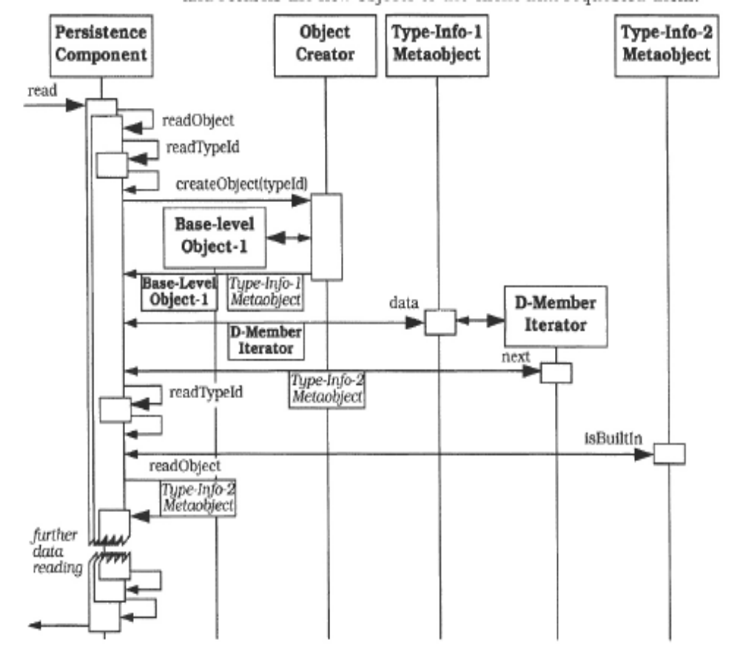
Example: Reading a object
Creates an object – instance of a type given by its name
[POSA]-Fig/P.201

Slide 24
Designing the Persistence Component:
Step 4:
4. Defining the MetaObjectProtocol (MOP):
Functions that modify the meta-layer:
  Create a new Type-Info metaobject newTypeId(typeName)
  Modify a Type-Info object, adding information newTypeInfo(typeName, isBuiltIn, isPointer)
  Create a new Base-Info metaobject and modify a Type-Info by addBase(typeName, baseName)
  Create metaobjects for the fields and modify aType-Info by: addData (typeName, memberTypeName, memberName)
  Modify the ObjectCreator: addCreationCode(typeName)
Functions that return info from the meta-layer:
  ObjectCreator.createObject(typeName) -> BaseLevelObject, TypeInfo
  TypeInfo.isBuiltIn
  TypeInfo.getData -> TypeInfo

Slide 25
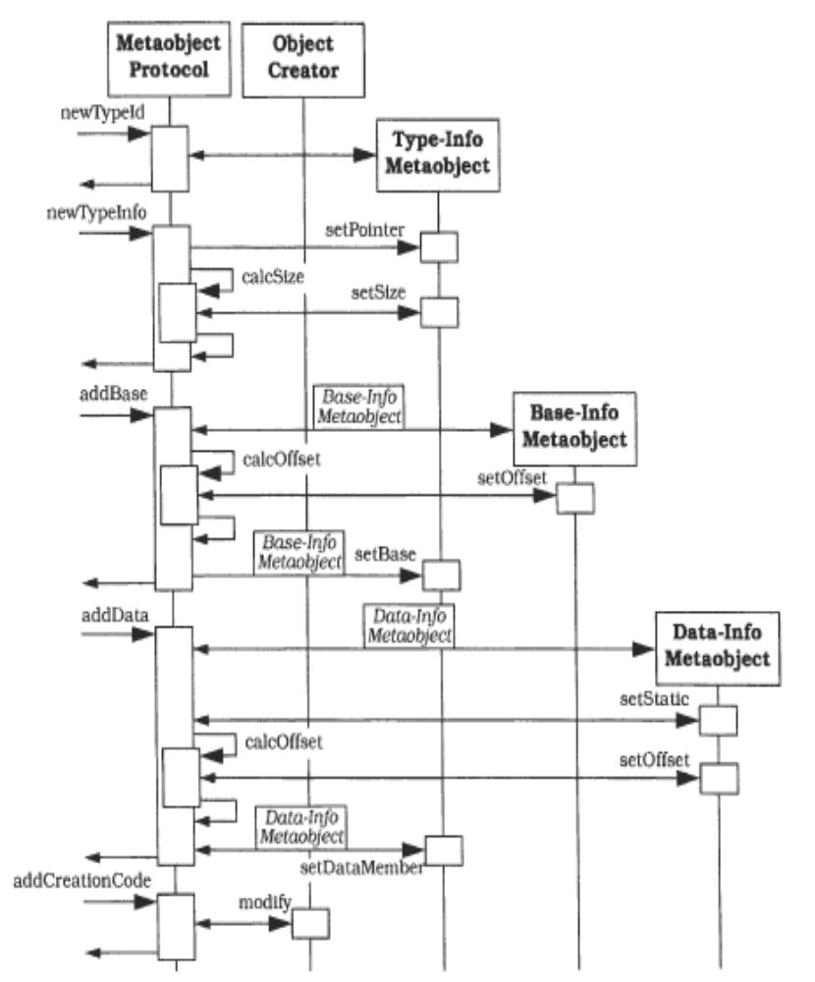
Example: Updating metaobjects
[POSA]-Fig/P.203

Slide 26
Designing the Persistence Component:
Step 5:
5. Defining the Base Level:
  Persistence component is the Base Level
  Implements readObject and writeObject as discussed before

Slide 27
Reflection - Conclusions
Advantages
  Modifying a system without changing code
  Supports structural or behavioral changes
Liabilities
  Modifications at the meta level may cause damage. Even the safest metaobject protocol does not prevent users from specifying incorrect modifications.
  Increased number of components: more metaobjects than base-level components.
  Lower efficiency. Reflective software systems are usually slow. The base level consults the meta level. This reflective capability requires extra processing: information retrieval, changing metaobjects, consistency checking.

Slide 28
Other examples using the Reflection pattern
Mostly known from reflective programming languages
  CLOS (Common Lisp Object System)
But the Reflection Pattern is used also in other different domains !
  Dynamic architectures, adaptive architectures:
    Operating systems ex: Apertos
    Middleware: OpenORB, TAO
    Reflective Component frameworks: OpenCOM, Fractal

Slide 29
Reflection – Patterns for the Detailed Design
The description of the architectural pattern specifies only the existence of a meta-layer and a base-layer, no other details
Patterns/methods/ideas for the detailed design:
  Dirk Riehle, Michel Tilman, Ralph Johnson: The Dynamic Object Model, PLOP 2000, http://hillside.net/plop/plop2k/proceedings/Riehle/Riehle.pdf
  Joseph Yoder, Ralph Johnson: The Adaptive Object-Model Architectural Style, WICSA 2002, http://www.adaptiveobjectmodel.com/WICSA3/ArchitectureOfAOMsWICSA3.pdf

Slide 30
Dynamic Object Model
Goal: allow the types of objects to change at runtime. This includes adding new types, changing existing types, and changing the relationships between types.
Solution: Dynamic Object Model (Adaptive Object Model, Runtime Domain Model)
  Composed from patterns Type Object and Property List
  Bibliography:
    D.Riehle, M.Tilman, R.Johnson: Dynamic Object Model, PLOP2000 http://hillside.net/plop/plop2k/proceedings/Riehle/Riehle.pdf

Slide 31
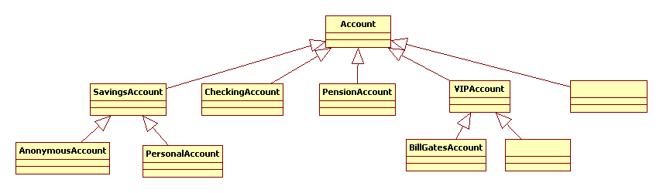
Motivating Example
A banking system for handling customer accounts
A class hierarchy of account classes is not feasible, because:
  more than 500 types of accounts
  Not all account types are known from the beginning
  Creating a new account type means changing source code (subtype)

Slide 32
The Dynamic Object Model
Dynamic Object Model Pattern =
Type Object Pattern +
Property List Pattern

Slide 33
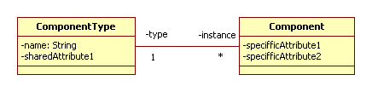
Type Object
Classical OO approach: a subclass for every new type
  Introducing a new type needs new code
The metaclass ComponentType: instances of this class replace subclasses
  Allows introducing new types at runtime
  Allows modifying the type of an object at runtime (example: an account is transformed from CheckingAccount in VIPAccount)
    Here comes also the problem of converting attributes, but with TypeObject the user has the control over the process

Slide 34
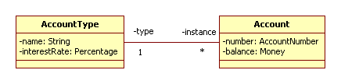
Type Object - Example
SavingsAccountType=new AccountType(“SavingsAccount”)
SavingsAccount1 = new Account(SavingsAccountType);
SavingsAccount2 = new Account(SavingsAccountType);
CurrentAccountType=new AccountType(“CurrentAccount”);
CurrentAccount1 = new Account(CurrentAccountType);

Slide 35
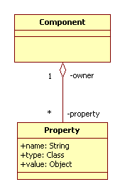
Property List
Allows instances of the same type to have different kinds of attributes
Makes it possible to add or remove attributes at runtime

Slide 36
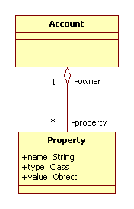
Property List - Example
Account1=new Account();
Account1.addProperty(“OverdrawLimit”, Float.class, new Float(1000.0));
Account2 = new Account();
Account2.addProperty(“DepositTerm”, Integer.class, new Integer(12));

Slide 37
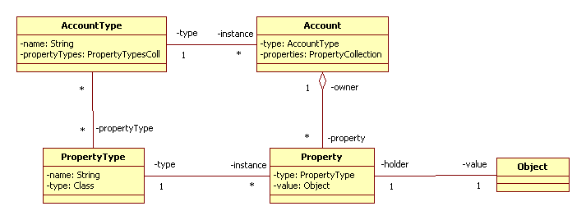
Accounts problem solved: with Type Object and Property List
Type Object: AccountType: new types of accounts can be dynamically created
PropertiesList: each account has its own set of properties
Type Object: PropertyType: controls the allowed types of properties for a certain type of account

Slide 38
Accounts Example – The Solution
PropertyType OverdrawLimit = new PropertyType("overdrawLimit", Integer.class);
PropertyType DepositTerm = new PropertyType("depositTerm", Integer.class);
PropertyType OwnerName = new PropertyType("ownerName", String.class);
AccountType SavingsAccount = new AccountType("SavingsAccount");
SavingsAccount.addPropertyType(DepositTerm);
SavingsAccount.addPropertyType(OwnerName);
AccountType AnonymousSavingsAccount = new AccountType("AnonymousSavingsAccount");
AnonymousSavingsAccount.addPropertyType(DepositTerm);
AccountType CurrentAccount = new AccountType("CurrentAccount");
CurrentAccount.addPropertyType(OverdrawLimit);
Account aSavingsAccount1 = new Account(SavingsAccount);
Account aSavingsAccount2 = new Account(SavingsAccount);
Account aCurrentAccount = new Account(CurrentAccount);
aSavingsAccount1.setProperty("depositTerm", new Integer(12));
aSavingsAccount1.setProperty(“overdrawLimit”, new Integer(1000)); // will be not allowed
aSavingsAccount1.setProperty(“ownerName”, new Integer(100)); // will be not allowed

Slide 39
Accounts example – the solution
PropertyType OverdrawLimit = new PropertyType("overdrawLimit", Integer.class);
PropertyType DepositTerm = new PropertyType("depositTerm", Integer.class);
PropertyType OwnerName = new PropertyType("ownerName", String.class);
AccountType SavingsAccount = new AccountType("SavingsAccount");
SavingsAccount.addPropertyType(DepositTerm);
SavingsAccount.addPropertyType(OwnerName);
AccountType AnonymousSavingsAccount = new AccountType("AnonymousSavingsAccount");
AnonymousSavingsAccount.addPropertyType(DepositTerm);
AccountType CurrentAccount = new AccountType("CurrentAccount");
CurrentAccount.addPropertyType(OverdrawLimit);
Account aSavingsAccount1 = new Account(SavingsAccount);
Account aSavingsAccount2 = new Account(SavingsAccount);
Account aCurrentAccount = new Account(CurrentAccount);
aSavingsAccount1.setProperty("depositTerm", new Integer(12));
aSavingsAccount1.setProperty(“overdrawLimit”, new Integer(1000)); // proprietate nepermisa
aSavingsAccount1.setProperty(“ownerName”, new Integer(100)); // valoare incompatibila
Implementation of setProperty (and of other operations) can can and must do verifications!

Slide 40
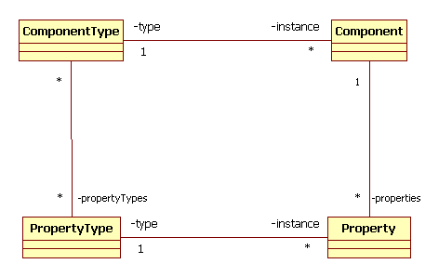
Dynamic Object Model (Type Square)
Meta Level, Knowledge Level
Base Level, Operational Level

Slide 41
Steps for defining a reflective architecture [POSA]
Example: The Dynamic Object Model problem
  Identify variable aspects
    Needs to modify types at runtime:
      Add a new type
      Modify an existing type (add new attributes)
  Identify what is not allowed to not change
  Define the metaobjects
    ComponentType (AccountType), PropertyType
  Define the MetaObjectProtocol (MOP)
    Operations that modify the meta-layer:
      New AccountType
      New PropertyType
      AccountType.addPropertyType
    Operations that retrieve data from the meta-layer
      Account.getType
      Account.getPropertyTypes

Slide 42
Dynamic Object Model - Conclusions
Advantages:
  Allows changes:
    Runtime typing
    Runtime object type creation
    Domain-speciffic typing
    Controlled dynamic type changing
    Runtime component type modification
  Reduces the number of classes
Drawbacks
  Increased number of objects
  Increased design complexity
  Increased runtime complexity
Limitations:
  Deals only with structural aspects ! -> behavioural aspects completed by the Adaptive Object Model

Slide 43
The Adaptive Object-Model Architectural Style
Completes the Dynamic Object Model by adding:
  Business Rules
  Interpreters
It builds a complete Domain Model: metadata represent application types with attributes, relations and behavior
The Domain Model can be described by a non-programmer, using a domain specific description language
  The description can be stored, reused, modified, etc
  The description is interpreted at runtime
  The interpreter is needed at 2 different stages:
    Initialize/modify metaobjects that describe the domain
    Create objects of the base level and applies business rules
Bibliography:
  Joseph Yoder, Ralph Johnson: The Adaptive Object-Model Architectural Style, WICSA 2002, http://www.adaptiveobjectmodel.com/WICSA3/ArchitectureOfAOMsWICSA3.pdf

Slide 44
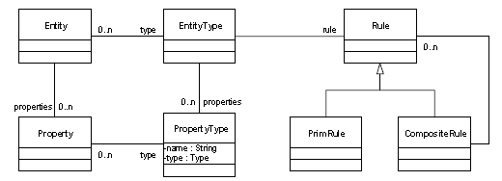
Representing Business Rules
Business Rules can be represented as Strategy/RuleObject/Composite of RuleObjects attached to an EntityType (ComponentType)
Describing Business Rules belongs to the Domain Model

Slide 45
A Domain Specific Language for AOM
NewEntityType <entityTypeName>
NewPropertyType <propTypeName, propTypeDescription>
AddPropType <entityTypeName, propTypeName>
RemovePropType <entityTypeName, propTypeName>
AddRule <entityTypeName, ruleName, ruleDescription>
NewEntity<entityName,entityTypeName>
AddNewProperty<entityName, propTypeName, propValue>
GetPropValue<entityName, propTypeName>
applyRule<entityName, ruleName>

Slide 46
Example: Interpreting applications from different domains
Commands
for describing
the
application
domain
Interpreter
Commands for
running a
particular
application

Slide 47
Example 1:
Managing bank accounts
NewEntityType CheckingAccount
NewPropertyType Owner, String
AddPropType CheckingAccount, Owner
NewEntityType SavingsAccount
NewPropertyType InterestRate, Double
AddPropType SavingsAccount, InterestRate
NewEntity BobsCheckingAccount, CheckingAccount
AddNewProperty BobsCheckingAccount, Owner, “Bob Bobbson”
NewEntity JohnsCheckingAccount, CheckingAccount
AddNewProperty JohnsCheckingAccount, Owner, “John Jones”
RemovePropType CheckingAccount, Owner

Slide 48
Example2:
Shop inventory
NewEntityType Cheese
NewPropertyType Valability, Integer
NewPropertyType ManufacturingCountry, String
AddPropType Cheese, Valability
AddPropType Cheese, ManufacturingCountry
AddRule Cheese, Price, 10-Valability+Lookup(ManufacturingCountry)
NewEntity CheeseDorna, Cheese
AddNewProperty CheeseDorna, Valability,6
AddNewProperty CheeseDorna, ManufacturingCountry, Romania
NewEntity CheeseEmmental, Cheese
AddNewProperty CheeseEmmental, Valability, 12
AddNewProperty CheeseEmmental, ManufacturingCountry, Germania
applyRule CheeseDorna, Price

Slide 49
Adaptive Object Model - Conclusions
Advantages:
  Appropriate for systems that must support continuous changes at their runtime
  Users(non-programmers) can modify at runtime the business model
Disadvantages:
  Complex, needs tool support (Interpretors, GUI, Domain Specific Languages) in order to make it usable
  Performance (time)

