Slide 1
FireFighter Car
Alexandra Ciobotea
Daian stein
Politehnica University of Timisoara, may 2018

Slide 2
I. Purpose
Car aimed to enter the affected area (closed space) before the firefighter crew gets inside
Make a diagnose of the zone

Slide 3
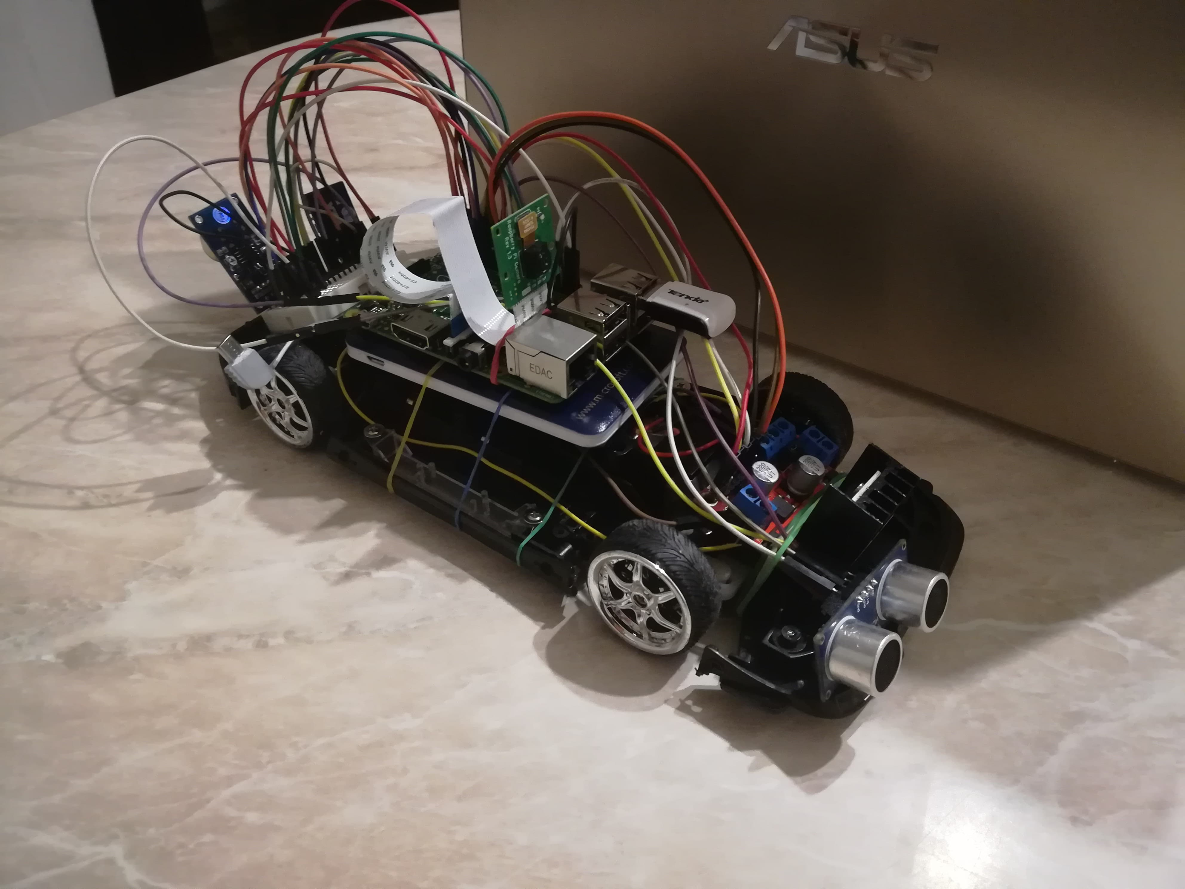

Slide 4
II. Features
Controlled car via an Android application
Joystick or vocal controllable
Video stream of what is inside displayed on the application’s interface together with data from all sensors

Slide 5
CO sensor
- CO level
- Smoke level
- CO leakage

Slide 6
Temperature sensor
Humidity sensor
Proximity sensor (cm)

Slide 7
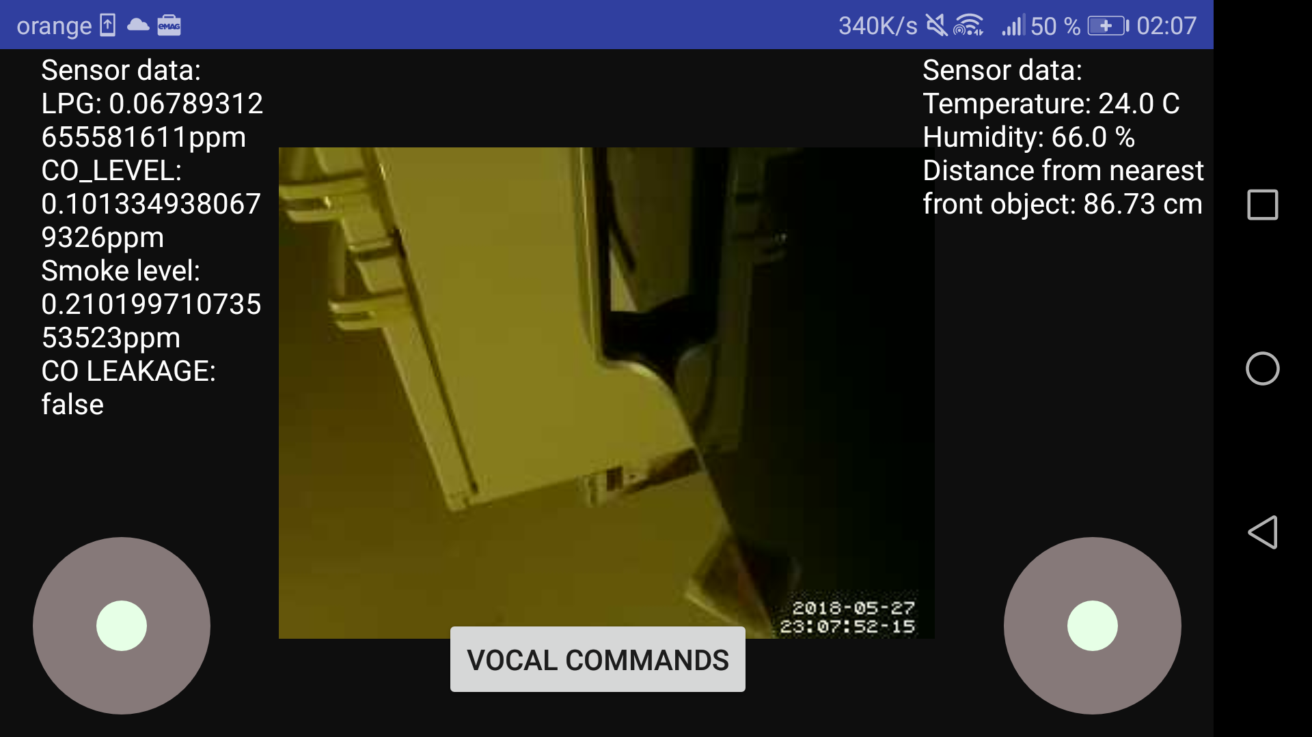
Screen shot from the application

Slide 8
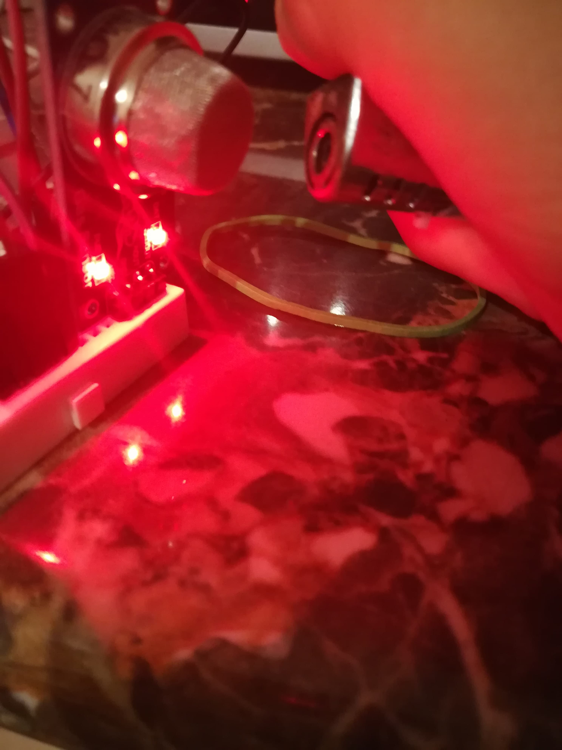
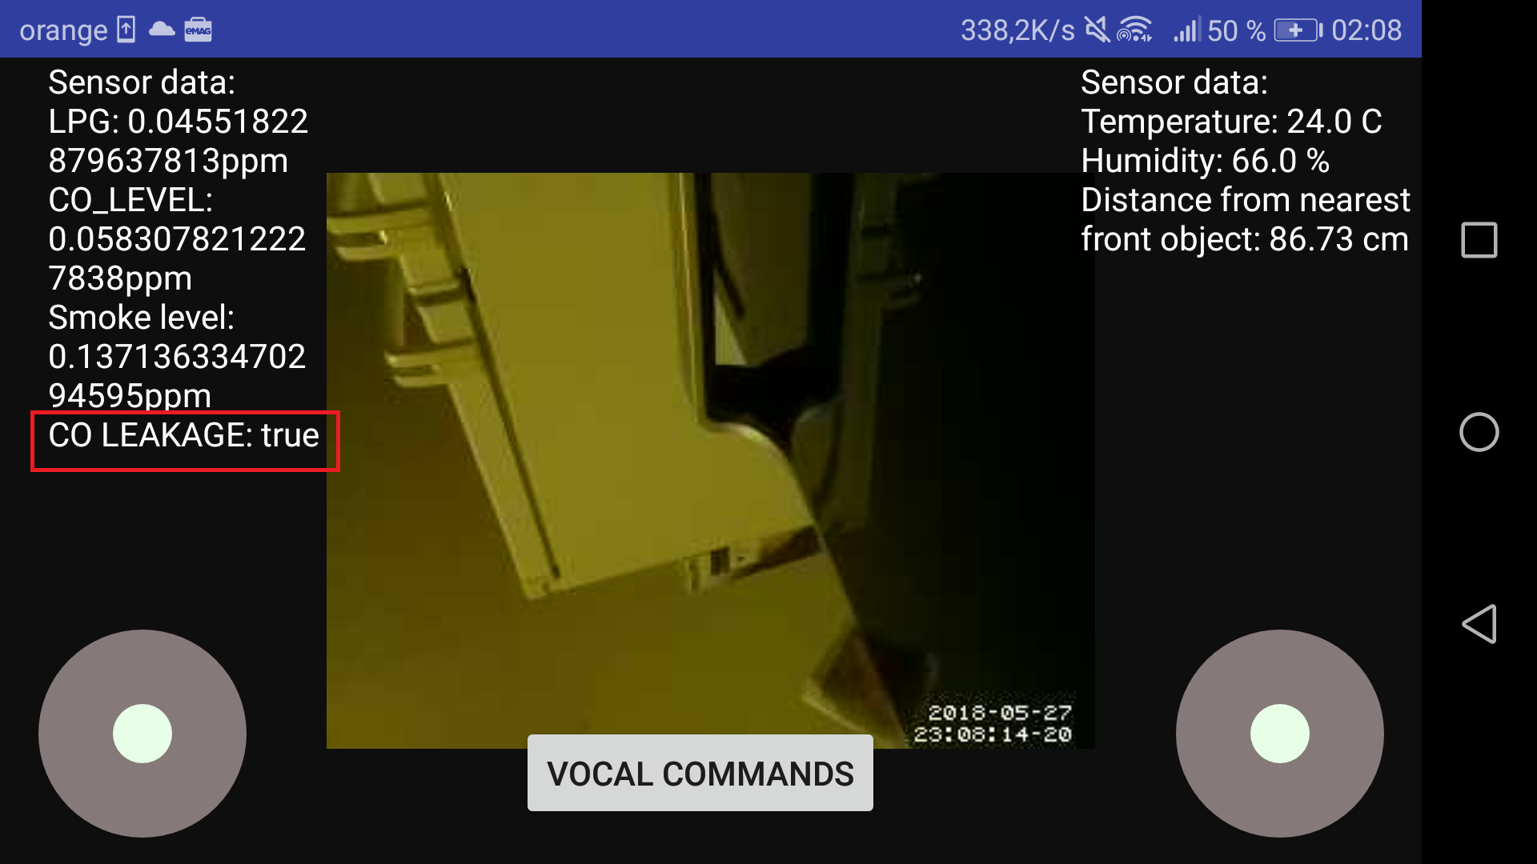
Detection of the CO leakage

Slide 9
III. Future improvements
Development of a Web Client where video stream and all data from the sensors will be supervised
Moving towards Machine Learning domain
Enhancing more features for the controller applications (i.e. diversity in vocal commands)
Making the car both access point and network device for better applicability

Slide 10
IV. Deployment on the real market
Fire isolation material to protect the care in real emergency situations
Investment in the quality and reliability of components (rigorous sensors)
Performing simulation tests in the presence of firefighters persuasion of a good product

