Slide 1
NHibernate workshop
SPS, 2013-11-25
Stein Jakob Nordbø

Slide 2
WHY, OH WHY?!
Notes:
So-called «object-relational impedance mismatch»…

Slide 3
Id | OwnerId | Title
1 | 42 | Cute cats
2 | 45 | Angry hens
3 | 47 | Pink cupcakes
public class Blog : Entity
{
public User Owner { get; }
public string Title { get; set; }
public IList<Post> Posts { get; }
public Post Write(string title, ...) {}
}
Id | Username | Name
42 | barack | Barack Obama
45 | erna | Erna Solberg
47 | lars | Lars Sponheim
Id | BlogId | Title
1 | 1 | LOLcatz, OMG
2 | 1 | Cute cat falling down
3 | 2 | Hen bites man
4 | 3 | Cupcakes with sheep!
Notes:
Sets/tuples/foreign keys vs objects/pointers
Simple vs complex types
Normalization vs SOLID
Data vs operations/behaviour
Interact with only one model – the model!

Slide 4
Id | OwnerId | Title
1 | 42 | Cute cats
2 | 45 | Angry hens
3 | 47 | Pink cupcakes
public class Blog : Entity
{
public User Owner { get; }
public string Title { get; set; }
public IList<Post> Posts { get; }
public Post Write(string title, ...) {}
}
Id | Username | Name
42 | barack | Barack Obama
45 | erna | Erna Solberg
47 | lars | Lars Sponheim
select Id, Title from Blog
select b.Id, b.Title, u.Username from Blogs b
inner join Users u on b.UserId=u.Id select p.Title, p.Content, u.Name from Post p
inner join Blog b on p.BlogId=b.Id inner join User u on b.OwnerId=u.Id …
Id | BlogId | Title
1 | 1 | LOLcatz, OMG
2 | 1 | Cute cat falling down
3 | 2 | Hen bites man
4 | 3 | Cupcakes with sheep!
Notes:
Many uses throughout the app
Each query embodies mapping knowledge
Also code to transform column values to object fields
What about adding a field, or reorganizing tables?
Also hard to optimize

Slide 5
WHY, OH WHY?!
Notes:
There’s another reason as well…

Slide 6
var localhost = "Data Source=(localdb)\\Projects;Initial Catalog=NHibernateWorkshop;Integrated Security=True";
var sql = "select b.Id, b.Title, b.OwnerId, u.Username, u.Name " +
"from [Blog] b inner join [User] u on u.Id = b.OwnerId " +
"where b.Title like @title";
var blogs = new List<Blog>();
Notes:
Doing things «manually»…
Given the connection string and sql, read the results into «blogs»

Slide 7
var localhost = "Data Source=(localdb)\\Projects;Initial Catalog=NHibernateWorkshop;Integrated Security=True";
var sql = "select b.Id, b.Title, b.OwnerId, u.Username, u.Name " +
"from [Blog] b inner join [User] u on u.Id = b.OwnerId " +
"where b.Title like @title";
var blogs = new List<Blog>();
using (var connection = new SqlConnection(localhost))
{
connection.Open();
using (var transaction = connection.BeginTransaction(IsolationLevel.ReadCommitted))
{
using (var query = new SqlCommand(sql, connection, transaction))
{
query.Parameters.Add("@title", SqlDbType.NVarChar, 255).Value = "%and%";
...read results into `blogs'...
}
transaction.Commit();
}
}
Notes:
Administrative stuff, note all the usings, note the lack of exception handling and connection pooling…

Slide 8
var localhost = "Data Source=(localdb)\\Projects;Initial Catalog=NHibernateWorkshop;Integrated Security=True";
var sql = "select b.Id, b.Title, b.OwnerId, u.Username, u.Name " +
"from [Blog] b inner join [User] u on u.Id = b.OwnerId " +
"where b.Title like @title";
... snip ...
while (results.Read())
{
blogs.Add(new Blog
{
Id = results.GetGuid(0),
Title = results.GetString(1),
Owner = new User
{
Id = results.GetGuid(2),
Username = results.GetString(3),
Name = results.GetString(4)
}
});
}
...print `blogs'...
Notes:
Result transformation – note the «magic numbers» referring to the select clause in the query and the specification
…magic numbers can be fixed…

Slide 9
var localhost = "Data Source=(localdb)\\Projects;Initial Catalog=NHibernateWorkshop;Integrated Security=True";
var sql = "select b.Id, b.Title, b.OwnerId, u.Username, u.Name " +
"from [Blog] b inner join [User] u on u.Id = b.OwnerId " +
"where b.Title like @title";
... snip ...
while (results.Read())
{
blogs.Add(new Blog
{
Id = results.GetGuid(results.GetOrdinal("Id")),
Title = results.GetString(results.GetOrdinal("Title")),
Owner = new User
{
Id = results.GetGuid(results.GetOrdinal("OwnerId")),
Username = results.GetString(results.GetOrdinal("Username")),
Name = results.GetString(results.GetOrdinal("Name"))
}
});
}
... snip ...
Notes:
Result transformation – magic numbers fixed (still needs to make sure that column names are unique)
Problems:
What if one user has two blogs? Then we’ll have two distinct objects referring to the same user!
What if we add a field to one of the classes – how would that affect all queries involving that class?
What if we didn’t need author information? What happens to invariants and expectations when the nullness of properties relies on which query read them?
To alleviate this, we can of course choose to forego the entire layer of business objects – but why is C# then the best tool for us?

Slide 10
Metadata
Session
Cache

Slide 11
Metadata
Session
Cache
mappings
DB config
Configuration
proxy generation
Notes:
DB config: Connection string, authentication details, name of DB, etc
Proxy: Get back to this
Mappings: The actual table->class/column->property-mappings

Slide 12
Metadata
Session
Cache
Configuration
BuildSessionFactory()
Session Factory
Notes:
One-time operation, «compiles» the information in the Config into a form suitable for runtime operation

Slide 13
Metadata
Session
Cache
Configuration
Session Factory
Session
OpenSession()
Notes:
The name reveals its function
Each request gets its own session

Slide 14
Metadata
Session
Cache
Configuration
Session Factory
Session
BeginTransaction()
Transaction
Commit()
Rollback()
Notes:
We wrap our operations in a Transaction
Two reasons:
Concistency – we need to make sure that data don’t change while we’re using it to make decisions
Performance – implicit transactions are slower

Slide 15
Metadata
Session
Cache
Configuration
Query<T>()
CreateQuery()
Save()
Delete()
…
Session Factory
Session
Transaction
Notes:
All the things we want to do in a single request

Slide 16
Metadata
Session
Cache
Commit()
Configuration
Session Factory
Session
Transaction
Notes:
On Commit, some data is allowed to propagate to the second level cache

Slide 17
Metadata
Session
Cache
Configuration
Session Factory
Session
Transaction
Notes:
Wrapup&repeat
Let’s see how this looks in practice…

Slide 18
Cache
Notes:
Let’s look at an example, and at the two levels of caches

Slide 19
Cache
var session = sessionFactory.OpenSession()
Notes:
We always start by opening a session

Slide 20
Session
Cache
Notes:
The session is a bit like the cache – in fact, it’s called the 1st level cache, as opposed to the 2nd level cache on the right

Slide 21
Session
Cache
var transaction = session.BeginTransaction()
Notes:
Always transactions, because:
Implicit transactions hurt performance
Implicit transactions mean that we can get inconcistencies

Slide 22
Transaction
Session
Cache
var transaction = session.BeginTransaction()
Notes:
The transaction is tied to the session

Slide 23
Transaction
Session
Cache
Session.Query<Blog>().ToArray()

Slide 24
Transaction
Session
Cache
Session.Query<Blog>().ToArray()
SELECT Id, Title, … FROM Blog
Notes:
NH generates a query

Slide 25
Transaction
Session
Cache
Session.Query<Blog>().ToArray()
SELECT Id, Title, … FROM Blog
Id | OwnerId | Title
1 | 42 | Cute cats
2 | 45 | Angry hens
3 | 47 | Pink cupcakes
Notes:
The DB returns a result set

Slide 26
Transaction
Session
Cache
Blogs:
1
2
3
Session.Query<Blog>().ToArray()
SELECT Id, Title, … FROM Blog
Id | OwnerId | Title
1 | 42 | Cute cats
2 | 45 | Angry hens
3 | 47 | Pink cupcakes
Notes:
NH takes care of hydrating objects from the result set

Slide 27
Transaction
Session
Cache
Blogs:
1
2
3
var name = blogs.First().Owner.Name
Notes:
What if we want to inspect some part of that object, that is not loaded yet?

Slide 28
Transaction
Session
Cache
Blogs:
1
2
3
Users:
42
var name = blogs.First().Owner.Name
SELECT Id, Username, … FROM User
WHERE Id = 42
Id | Username | Name
42 | barack | Barack Obama
Notes:
NH handles loading of referenced entities transparently
Convenient; don’t get NRE’s when accessing parts that haven’t been loaded
Dangerous…

Slide 29
BLACK MAGIC<?>
Notes:
And no mention of NH without reference to…

Slide 30
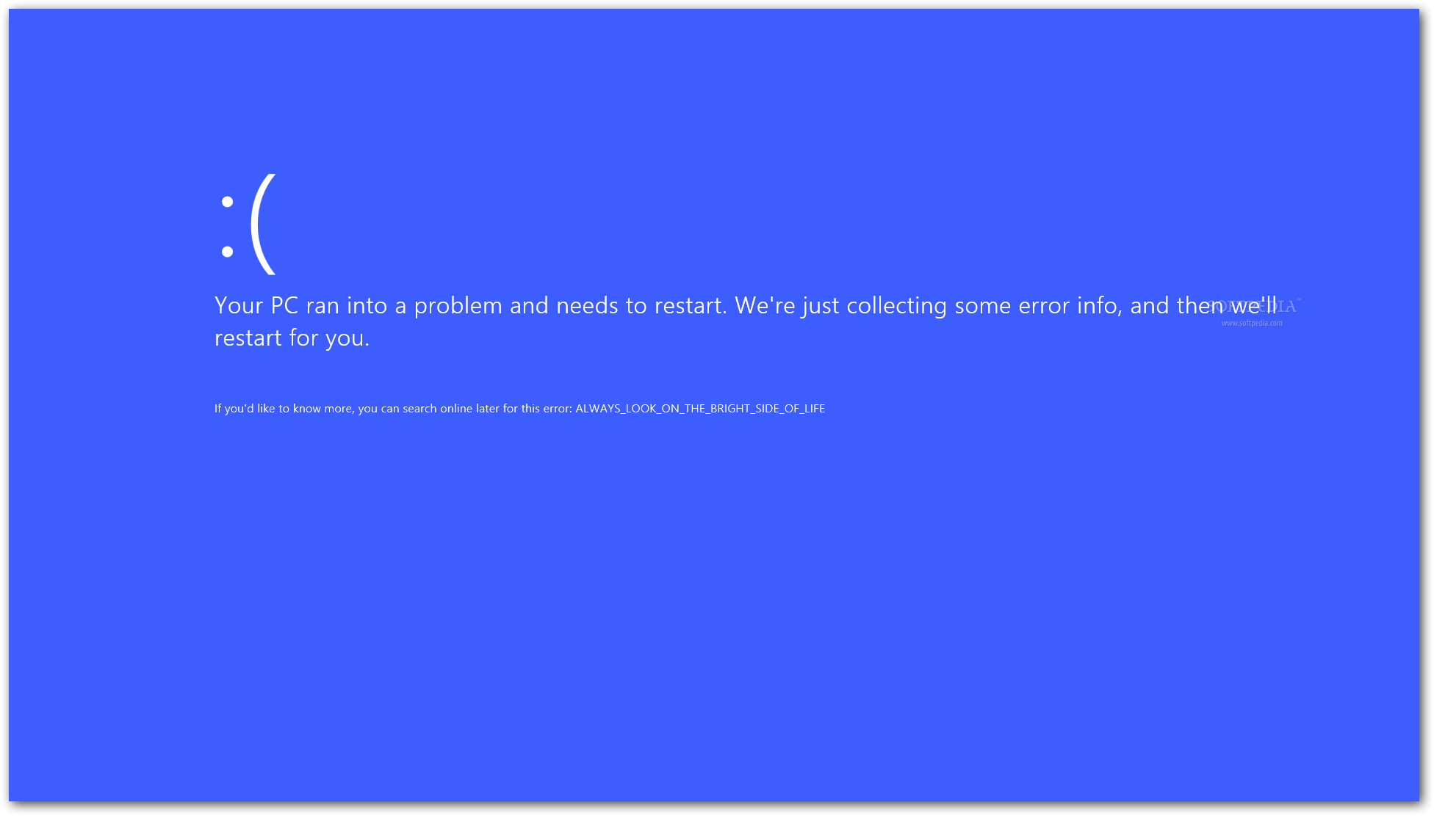

Slide 31
BLACK MAGIC<?>
Did I ask for a Proxy?
Notes:
Ever seen that strange class name in the stack trace when something went really bad? $UserProxy239484718994$.get_Name

Slide 32
public class Blog : Entity
{
public User Owner { get; }
public string Title { get; set; }
public IList<Post> Posts { get; }
public Post Write(string title, ...) {}
}

Slide 33
public class Blog : Entity
{
public User Owner { get; }
public string Title { get; set; }
public IList<Post> Posts { get; }
public Post Write(string title, ...) {}
}
User

Slide 34
public class Blog : Entity
{
public User Owner { get; }
public string Title { get; set; }
public IList<Post> Posts { get; }
public Post Write(string title, ...) {}
}
User
UserProxy

Slide 35
public class Blog : Entity
{
public User Owner { get; }
public string Title { get; set; }
public IList<Post> Posts { get; }
public Post Write(string title, ...) {}
}
must be virtual!
User
UserProxy
public override T Name
{
get
{
if (!Loaded)
{
Load();
}
return name;
}
set { … }
}
Notes:
This is why NH throws exceptions at you if you’re not making your public properties/methods virtual!

Slide 36
public class Blog : Entity
{
public User Owner { get; }
public string Title { get; set; }
public IList<Post> Posts { get; }
public Post Write(string title, ...) {}
}
IList<T>

Slide 37
public class Blog : Entity
{
public User Owner { get; }
public string Title { get; set; }
public IList<Post> Posts { get; }
public Post Write(string title, ...) {}
}
IList<T>
List<T>
Queue<T>

Slide 38
public class Blog : Entity
{
public User Owner { get; }
public string Title { get; set; }
public IList<Post> Posts { get; }
public Post Write(string title, ...) {}
}
IList<T>
List<T>
Queue<T>
NH.PersistentGenericBag<T>
Notes:
That’s why we can’t declare our collection as List<T>

Slide 39
public class Blog : Entity
{
public User Owner { get; }
public string Title { get; set; }
public IList<Post> Posts { get; }
public Post Write(string title, ...) {}
}
IList<T>
List<T>
Queue<T>
NH.PersistentGenericBag<T>
public T Get(i)
{
if (!Loaded)
{
Load();
}
return items[i];
}

Slide 40
Transaction
Session
Cache
Blogs:
1
2
3
Users:
42
var name = blogs.First().Owner.Name
SELECT Id, Username, … FROM User
WHERE Id = 42
Id | Username | Name
42 | barack | Barack Obama
Notes:
Back to our little example

Slide 41
Transaction
Session
Cache
Blogs:
1
2
3
Users:
42
transaction.Commit()
Notes:
Let’s pretend the metadata says that users should be cached…

Slide 42
Transaction
Session
Cache
Blogs:
1
2
3
Users:
42
Users:
42
transaction.Commit()

Slide 43
Transaction
Session
Cache
Users:
42
Session.Query<Blog>().ToArray()

Slide 44
Transaction
Session
Cache
Blogs:
1
2
3
Users:
42
Session.Query<Blog>().ToArray()
SELECT Id, Title, … FROM Blog
Id | OwnerId | Title
1 | 42 | Cute cats
2 | 45 | Angry hens
3 | 47 | Pink cupcakes

Slide 45
Transaction
Session
Cache
Blogs:
1
2
3
Users:
42
var name = blogs.First().Owner.Name

Slide 46
Transaction
Session
Cache
Blogs:
1
2
3
Users:
42
Users:
42
var name = blogs.First().Owner.Name
Notes:
This time, no DB
Note: The entity is enlisted in and copied to the session, in case we modify it; modifications are copied back on commit
This explains why we shouldn’t fiddle with the DB outside of NH (at least not without restarting the app)

Slide 47
Cache
Users:
42
Notes:
Didn’t tell the whole truth…

Slide 48
entity cache
Cache
Users:
42
query cache
Notes:
This is only half of the truth about the cache, it’s actually two caches:
Entity cache
Query cache

Slide 49
Transaction
Session
Cache
Blogs:
1
2
3
Users:
42
Session.Query<Blog>().Cacheable().ToArray()
SELECT Id, Title, … FROM Blog
Id | OwnerId | Title
1 | 42 | Cute cats
2 | 45 | Angry hens
3 | 47 | Pink cupcakes

Slide 50
Transaction
Session
Cache
Blogs:
1
2
3
Users:
42
SELECT Id,… FROM Blog
{1, 2, 3}
Session.Query<Blog>().Cacheable().ToArray()
SELECT Id, Title, … FROM Blog
Id | OwnerId | Title
1 | 42 | Cute cats
2 | 45 | Angry hens
3 | 47 | Pink cupcakes
Notes:
The result entity ID’s are entered into the query cache
In this case, blogs number 1, 2, 3 are returned and cached

Slide 51
Cache
Users:
42
SELECT Id,… FROM Blog
{1, 2, 3}
Notes:
Here we og again…

Slide 52
Transaction
Session
Cache
Users:
42
SELECT Id,… FROM Blog
{1, 2, 3}
Session.Query<Blog>().Cacheable().ToArray()
Notes:
Here we og again…

Slide 53
Transaction
Session
Cache
Users:
42
SELECT Id,… FROM Blog
{1, 2, 3}
Session.Query<Blog>().Cacheable().ToArray()
Id
1
2
3
Notes:
The results are returned from the cache…

Slide 54
Transaction
Session
Cache
Blogs:
1
2
3
Users:
42
SELECT Id,… FROM Blog
{1, 2, 3}
Session.Query<Blog>().Cacheable().ToArray()
Id
1
2
3
Notes:
…and NH builds objects for you
But: This is a case where you may be surprised while debugging…

Slide 55
Transaction
Session
Cache
Blogs:
1
2
3
Users:
42
SELECT Id,… FROM Blog
{1, 2, 3}
Session.Query<Blog>().Cacheable().ToArray()
Id | OwnerId | Title
1 | 42 | Cute cats
do something with the blogs
SELECT … FROM … WHERE Id = 1
SELECT … FROM … WHERE Id = 2
SELECT … FROM … WHERE Id = 3
Id | OwnerId | Title
2 | 45 | Angry hens
Id | OwnerId | Title
3 | 47 | Pink cupcakes
Notes:
If we start doing something with the blogs…
Ooops; SELECT N+1 – caching made the situation worse!
Lazy-loading bites again!
Conclusion: Query cache must be seen in relation to the use of the entity cache

Slide 56
Transaction
Session
Cache
Users:
42
SELECT Id,… FROM Blog
{1, 2, 3}
var user = Session.Load<User>(42);
var blog = new Blog { Owner = user };
Notes:
The case for inserting data

Slide 57
Transaction
Session
Cache
Blogs:
4
Users:
42
42
SELECT Id,… FROM Blog
{1, 2, 3}
var user = Session.Load<User>(42);
var blog = new Blog { Owner = user };
Session.Save(blog);
Notes:
Enlisted in the session, not in database
No DB traffic here
If User 42 was not in the cache, there would still not be any DB traffic, only a Proxy with Id

Slide 58
Transaction
Session
Cache
Blogs:
4
Users:
42
42
SELECT Id,… FROM Blog
{1, 2, 3}
var user = Session.Load<User>(42);
var blog = new Blog { Owner = user };
Session.Save(blog);
transaction.Commit();
INSERT … INTO Blog
Notes:
Database is synced with the session on Commit.
Insert/update run on
Commit
Query
…which means that exceptions from constraints happen only then.
EXCEPTION: Identity inserts

Slide 59
Transaction
Session
var user = new User();
var blog = new Blog { Owner = user };
Notes:
Another case: Insertions

Slide 60
Transaction
Session
Blogs:
4
var user = new User();
var blog = new Blog { Owner = user };
Session.Save(blog);
4

Slide 61
Transaction
Session
Blogs:
4
var user = new User();
var blog = new Blog { Owner = user };
Session.Save(blog);
transaction.Commit();
4
BOOM? :-P
it wouldn’t vooom if you put 20.000 volts through it
Notes:
Note the question mark – boom? – whether this succeeds depends on the mapping: Do we cascade?
Also BOOM! if User does not have a mapping

Slide 62
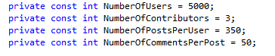
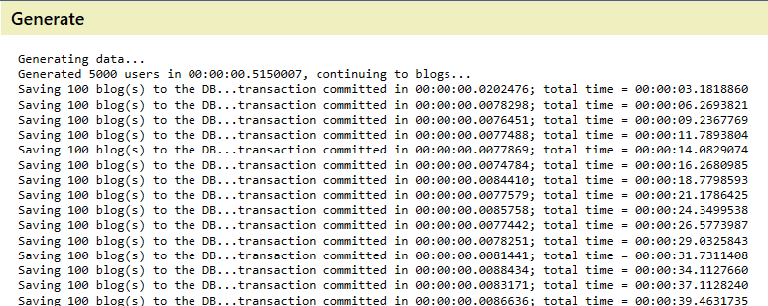
Notes:
~1.7M posts, ~87M comments
Finished in 00:02:06.7964369 as opposed to 00:11:30 for 200 blogs with a stateful session

Slide 63
Metadata
Session
Cache
Configuration
Session Factory
Session
Transaction
Notes:
Wrapup&repeat

Slide 64
MAPPING
Would I need a compass?

Slide 65
Id | OwnerId | Title
1 | 42 | Cute cats
2 | 45 | Angry hens
3 | 47 | Pink cupcakes
public class Blog : Entity
{
public User Owner { get; }
public string Title { get; set; }
public IList<Post> Posts { get; }
public Post Write(string title, ...) {}
}
Notes:
Mapping:
Properties – simple
One-end of many-to-one – simple

Slide 66
Id | OwnerId | Title
1 | 42 | Cute cats
2 | 45 | Angry hens
3 | 47 | Pink cupcakes
public class Blog : Entity
{
public User Owner { get; }
public string Title { get; set; }
public IList<Post> Posts { get; }
public Post Write(string title, ...) {}
}
<class name="Blog" table="Blog">
<id name="Id" type="Guid">
<generator class="guid.comb" />
</id>
<many-to-one name="Owner" column="OwnerId" cascade="save-update, persist" />
<property name="Title" type="StringClob" />
<bag name="Posts" cascade="all,delete-orphan">
<key column="BlogId" />
<one-to-many class="Post" />
</bag>
<bag name="Contributors" cascade="all,delete-orphan">
<key column="BlogId" />
<one-to-many class="Contributor" />
</bag>
</class>
Notes:
XML (old-style)

Slide 67
Id | OwnerId | Title
1 | 42 | Cute cats
2 | 45 | Angry hens
3 | 47 | Pink cupcakes
public class Blog : Entity
{
public User Owner { get; }
public string Title { get; set; }
public IList<Post> Posts { get; }
public Post Write(string title, ...) {}
}
public class BlogMap : ClassMap<Blog>
{
public BlogMap()
{
Id(x => x.Id).GeneratedBy.GuidComb();
Map(x => x.Title);
References(x => x.Owner);
HasMany(x => x.Posts);
}
}
Notes:
FluentNHibernate (Connect)

Slide 68
Id | OwnerId | Title
1 | 42 | Cute cats
2 | 45 | Angry hens
3 | 47 | Pink cupcakes
public class Blog : Entity
{
public User Owner { get; }
public string Title { get; set; }
public IList<Post> Posts { get; }
public Post Write(string title, ...) {}
}
code
look, ma, no hands!
Notes:
Automapping (by code and conventions)

Slide 69
Id | OwnerId | Title
1 | 42 | Cute cats
2 | 45 | Angry hens
3 | 47 | Pink cupcakes
Id | Username | Name
42 | barack | Barack Obama
45 | erna | Erna Solberg
47 | lars | Lars Sponheim
Id | Filename
1 | Kitten_1.jpg
2 | FunnyCatz_42.jpg
3 | Cupcake.jpg
Id | BlogId | Title
1 | 1 | LOLcatz, OMG
2 | 1 | Cute cat falling down
3 | 2 | Hen bites man
4 | 3 | Cupcakes with sheep!
PostId | MediaId
1 | 1
1 | 2
4 | 1
4 | 3

Slide 70
Id | OwnerId | Title
1 | 42 | Cute cats
2 | 45 | Angry hens
3 | 47 | Pink cupcakes
public class Blog
{
public User User { get; }
}
One-to-many (I)/«References»
Id | Username | Name
42 | barack | Barack Obama
45 | erna | Erna Solberg
47 | lars | Lars Sponheim
Id | Filename
1 | Kitten_1.jpg
2 | FunnyCatz_42.jpg
3 | Cupcake.jpg
Id | BlogId | Title
1 | 1 | LOLcatz, OMG
2 | 1 | Cute cat falling down
3 | 2 | Hen bites man
4 | 3 | Cupcakes with sheep!
PostId | MediaId
1 | 1
1 | 2
4 | 1
4 | 3

Slide 71
Id | OwnerId | Title
1 | 42 | Cute cats
2 | 45 | Angry hens
3 | 47 | Pink cupcakes
public class Blog
{
public IList<Post> Posts { get; }
}
Id | Username | Name
42 | barack | Barack Obama
45 | erna | Erna Solberg
47 | lars | Lars Sponheim
Id | Filename
1 | Kitten_1.jpg
2 | FunnyCatz_42.jpg
3 | Cupcake.jpg
One-to-many (II)/«HasMany»
Id | BlogId | Title
1 | 1 | LOLcatz, OMG
2 | 1 | Cute cat falling down
3 | 2 | Hen bites man
4 | 3 | Cupcakes with sheep!
PostId | MediaId
1 | 1
1 | 2
4 | 1
4 | 3
Notes:
Discuss «Inverse» – there isn’t necessarily an inverse property on Post
Cascading
NOT NULL problem on FK

Slide 72
Id | OwnerId | Title
1 | 42 | Cute cats
2 | 45 | Angry hens
3 | 47 | Pink cupcakes
public class Post
{
public IList<Media> Images { get; }
}
Id | Username | Name
42 | barack | Barack Obama
45 | erna | Erna Solberg
47 | lars | Lars Sponheim
Id | Filename
1 | Kitten_1.jpg
2 | FunnyCatz_42.jpg
3 | Cupcake.jpg
Many-to-many/«HasManyToMany»
Id | BlogId | Title
1 | 1 | LOLcatz, OMG
2 | 1 | Cute cat falling down
3 | 2 | Hen bites man
4 | 3 | Cupcakes with sheep!
PostId | MediaId
1 | 1
1 | 2
4 | 1
4 | 3
Notes:
The last case: Many-to-many, needs a table in-between
Cascading, etc

Slide 73
demo time :-)

