Slide 1
Neighborhood stars
Plan of the presentation
General context
Zooming closer : starting from a video game
Information about our stellar neigthborhood
Back to kaggle database
Conclusion

Slide 2
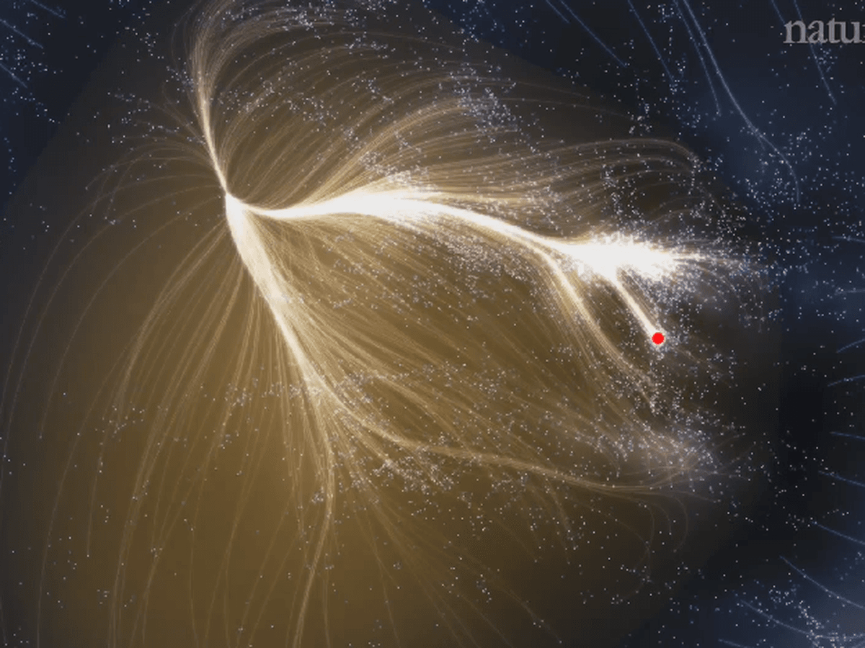

I. General contexte
Incommensurable paradise:
We are here

Slide 3
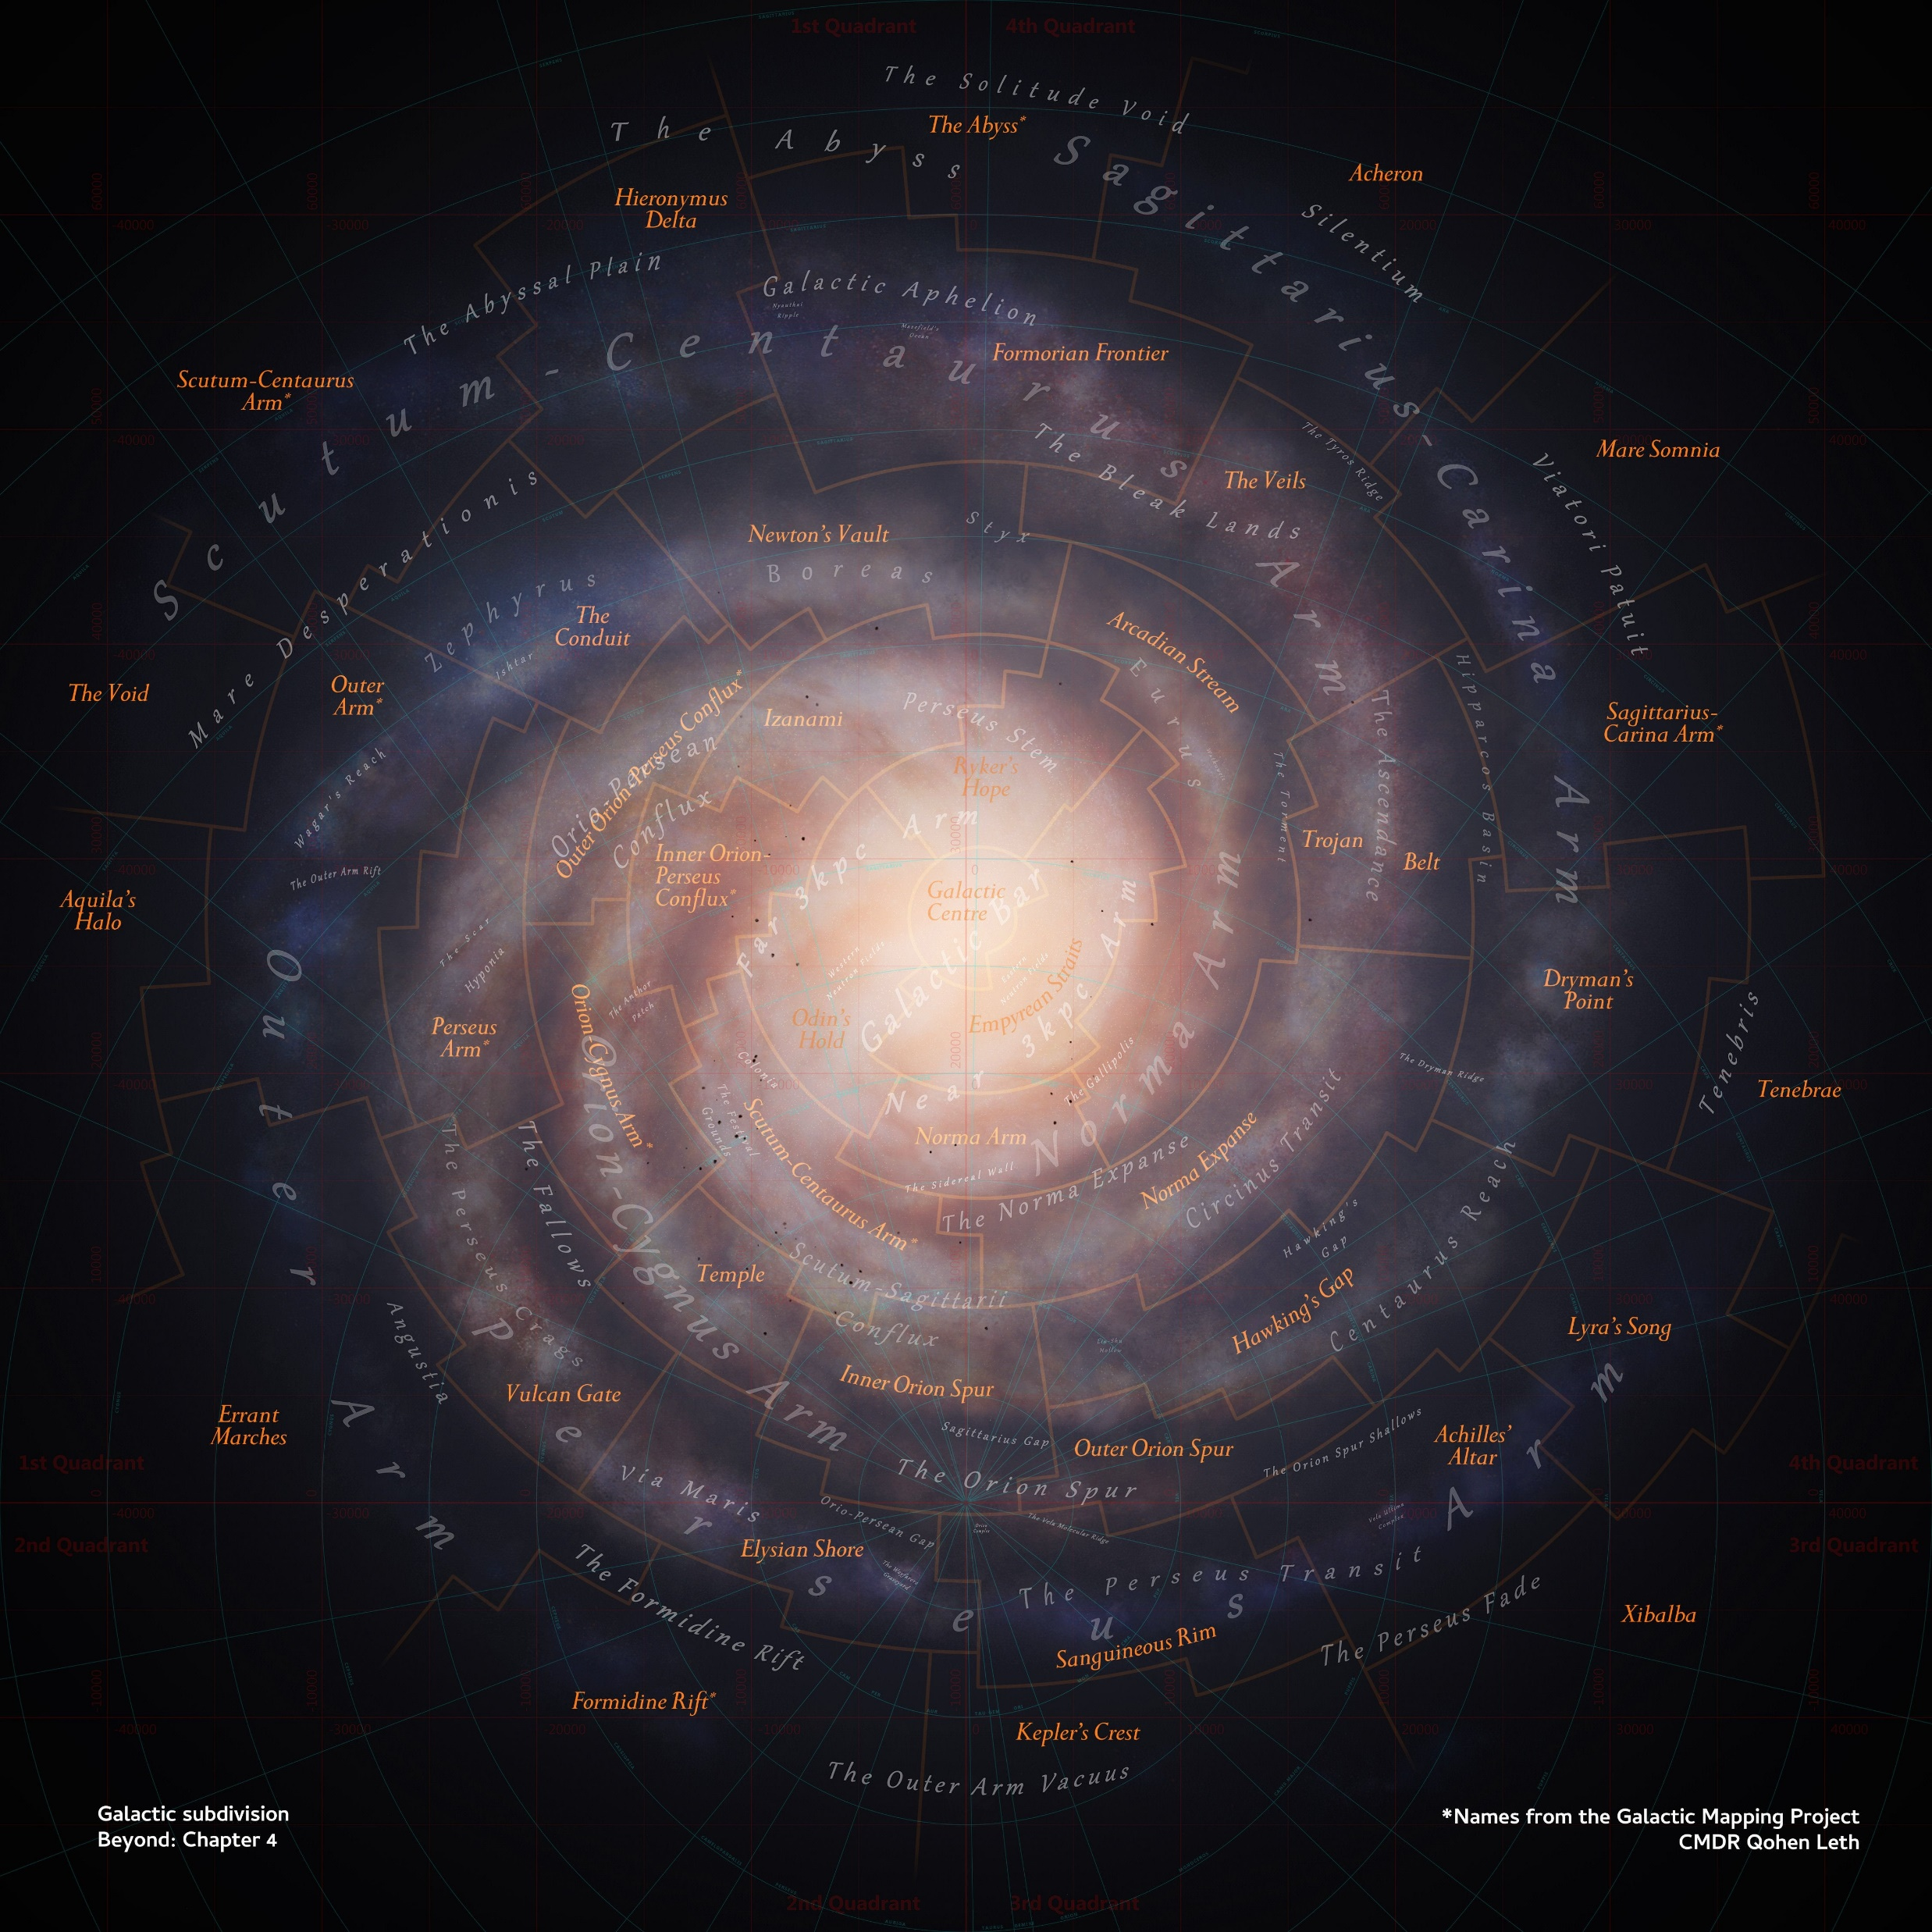
We are here

Slide 4

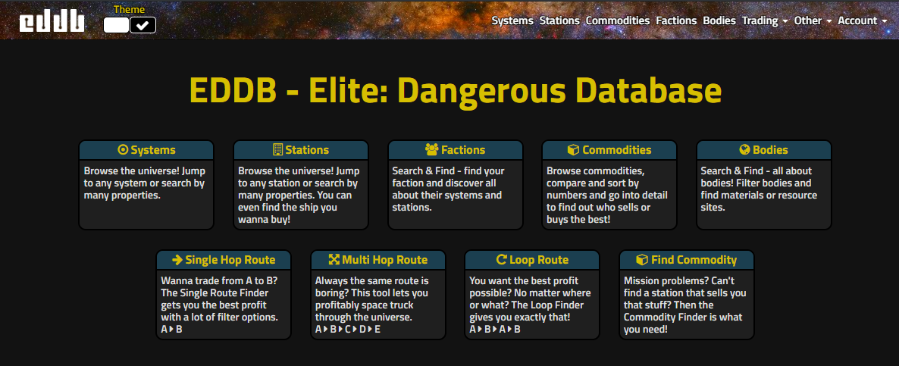
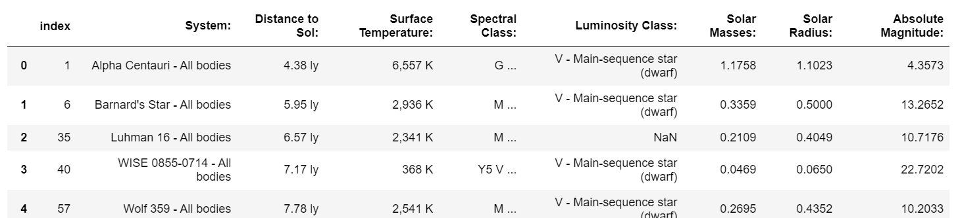
II. Zooming closer : starting from a video game
Elite dangerous database. 333 bodys
Select only stars
Collect connected information :
Name of the system
Distance to Sol
Surface temperature
Spectral Class
Luminosity class
Solar mass
Solar radius
Absolute Magnitude

Slide 5
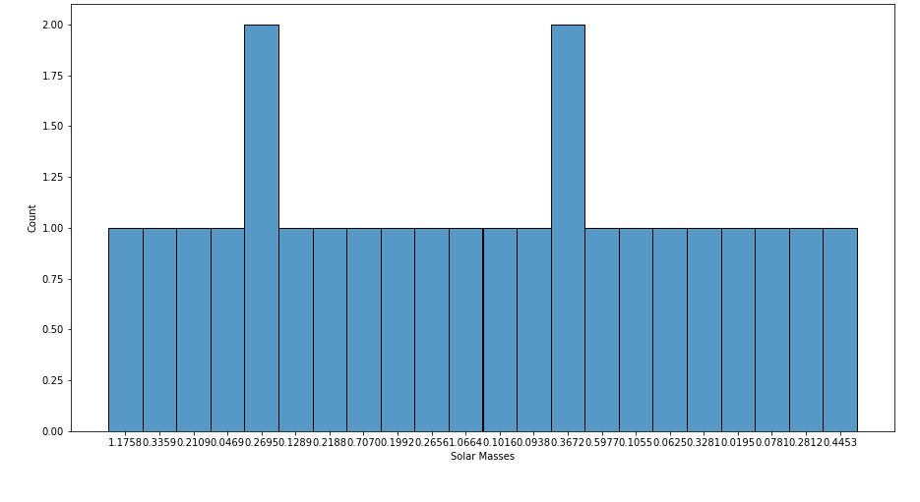
Our neighborhood
III. Information about our stellar neigthborhood
Solar Masses distribution
Interpretation:
1) Over 12 light-years: 24 stars have the mass comparable to the sun’s

Slide 6
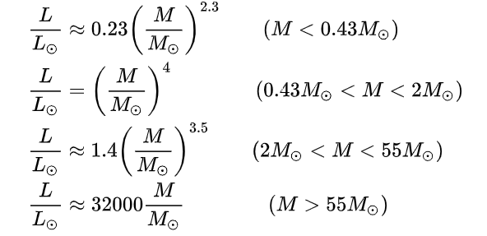
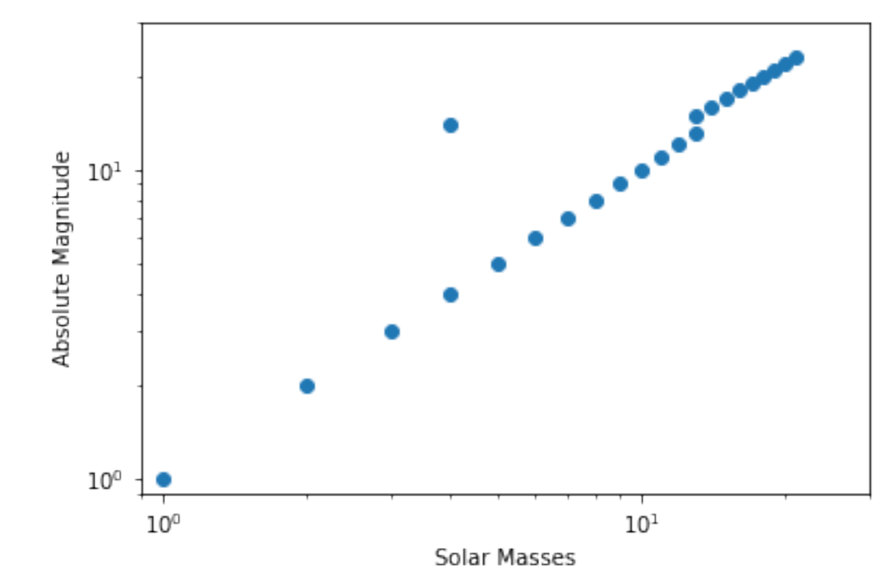
Our neighborhood
Relation between Absolute magnetude and Solar Mass
L α M³ !
1
Observation and Interpretation
The dependance does not suit the theory
Maybe a problem of sampling
How Absolute magnitude is difined?

Slide 7
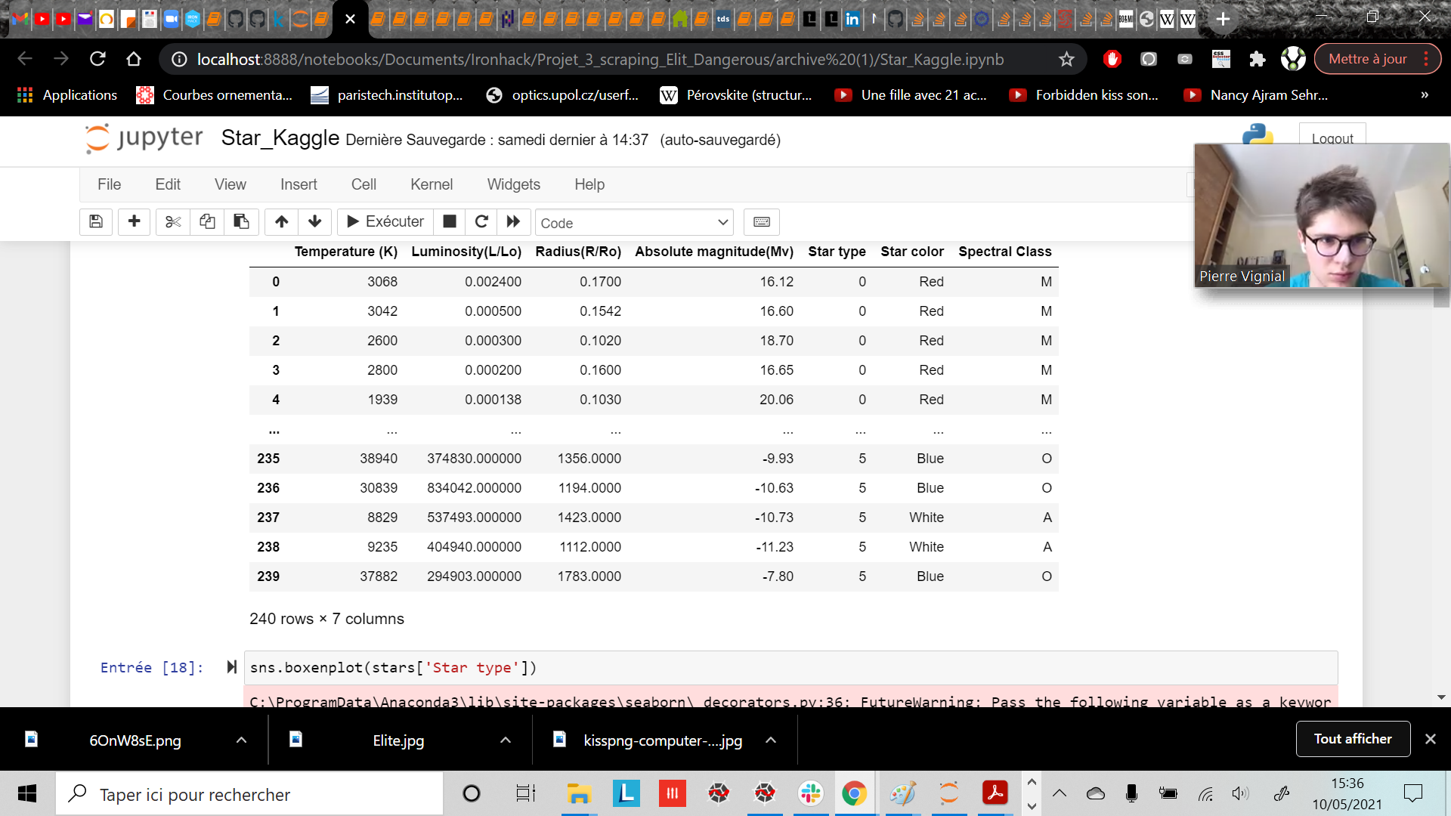
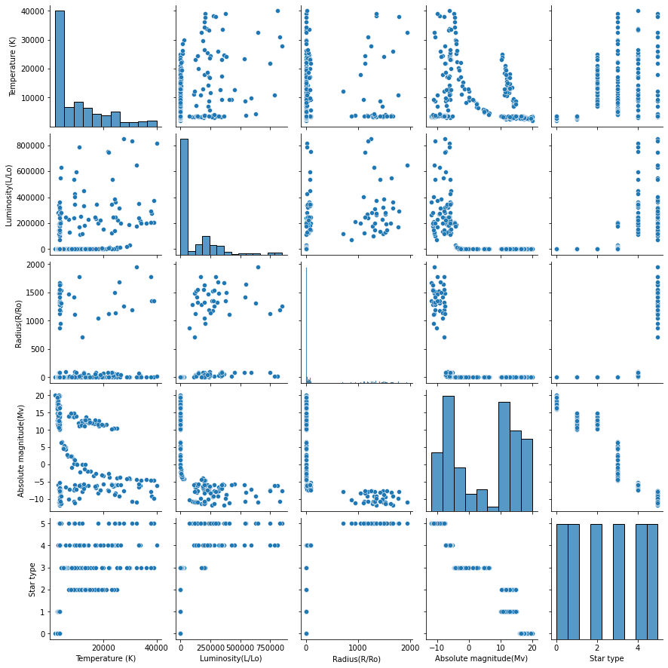
VI. Back to kaggle database
Paire plot

Slide 8
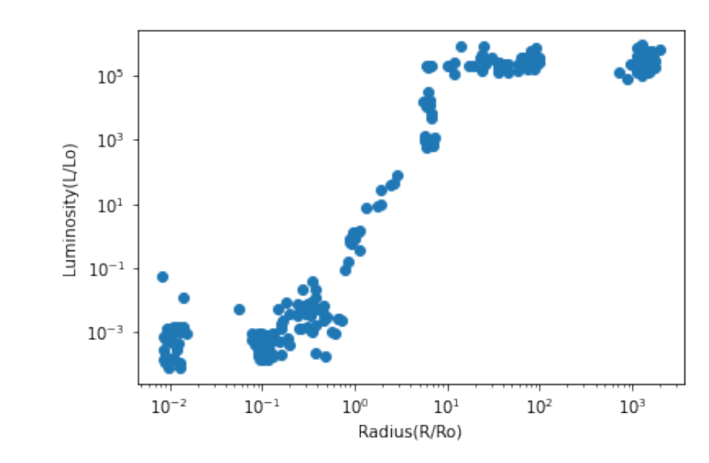
VI. Back to kaggle database
Relation between Absolute magnetude and radius
Wikipedia ressources

Slide 9
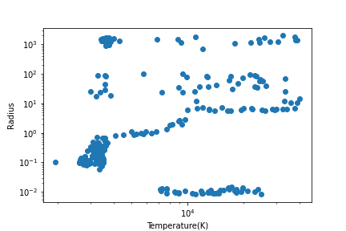
Relation between Radius and Temperature
The biggest stars are the hottest
Observation and Interpretation
Good consistency of datas

Slide 10
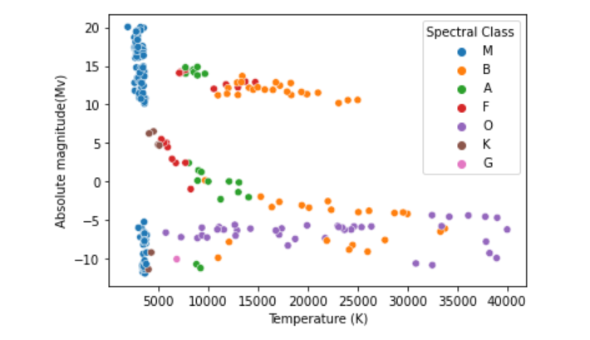
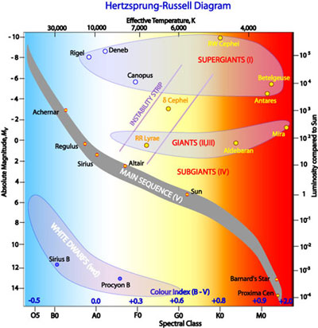
IV. Back to kaggle database
Relation between magnitudes and Temperature
Main sequence
Here we are
Observation and Interpretation
Good consistency of datas

Slide 11
Conclusion
Be careful about Elit-dangerous database
Kaggle datas are better and more consistent
Explore further the diagram HR

Slide 12
Thanks for your attention !

