Slide 1
Friendly Ions Team Project
2019/6/21
Jessie Warraich
Steinn Magnusson
Azumi Nawata
Miho Okamura
Shuji Doi

Slide 2
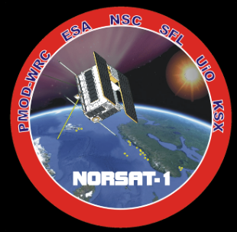
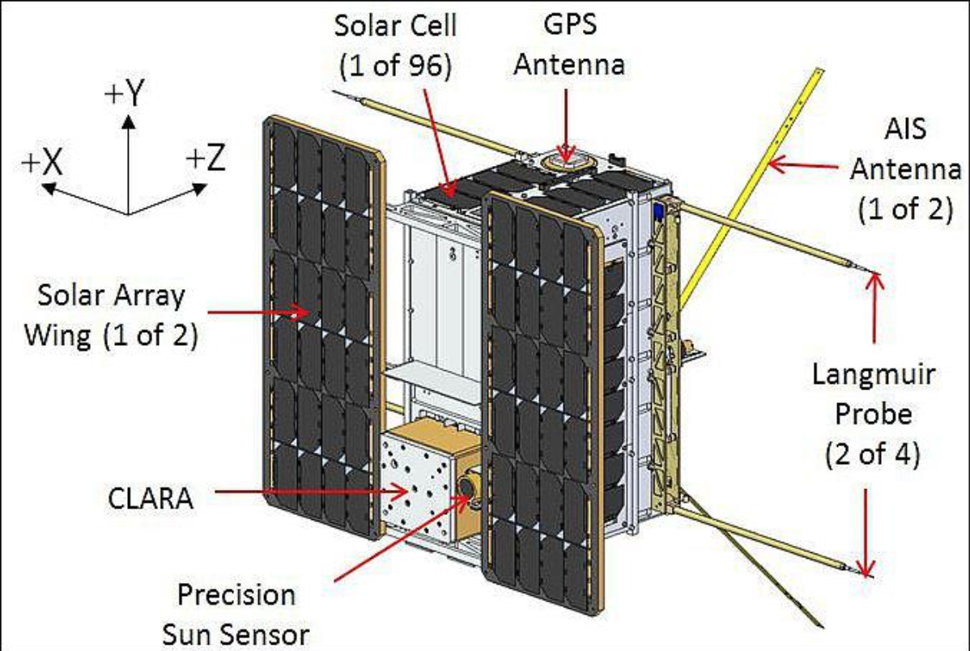
INTRODUCTION
NORSAT-1
Sudying ionosphere
Simulate enviorment of the probes
Notes:
Motivations::: Learn about new things and make friends along the way :)
Inspirations::: Wojciech, Yohei, Hide, and Mikael
Aspirations::: Zentani and Magnus ;)

Slide 3
METHOD
Langmuir probes
Method of simulation: PIC - Particle in Cell
Integrates eom.
Interpolates charge and density
Computes the field mesh points
Interpolates from mesh to particle locations

Slide 4
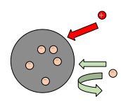

Plasma and potential
Quasineutral, n_{e} = n_{i}
Electrons are faster
-> gives a potential
Floating potential
I_{e} = I_{i} on the surface

Slide 5
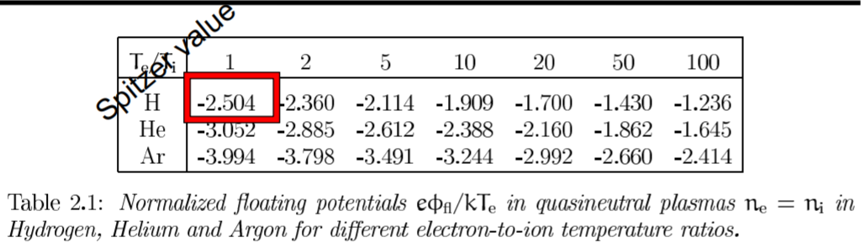
PP Regime and Spitzer Value
Motivation of simulations
Comparison to theoretical values
Accuracy benchmark of simulation (despite non-spherical spacecraft)

Slide 6
Initial Simulation Parameters (Run 2)
e⁻ Velocity Direction | Ion Velocity Direction | B Field Direction | e⁻ Temperature [K] | Ion Temperature [K]
+x | +x | +x | 1000 | 750
m_{i}/m_{e} | Grid Width [cm] | Plasma density [c⁻³] | Plasma flow speed[m/s] | Magnetic field [µT]
1000 | 0.5 | 100000 | 1354.4 | 50
Bias Potential [V] | Time step dt [ns]
4, 4, 4, 4 | 1.67

Slide 7
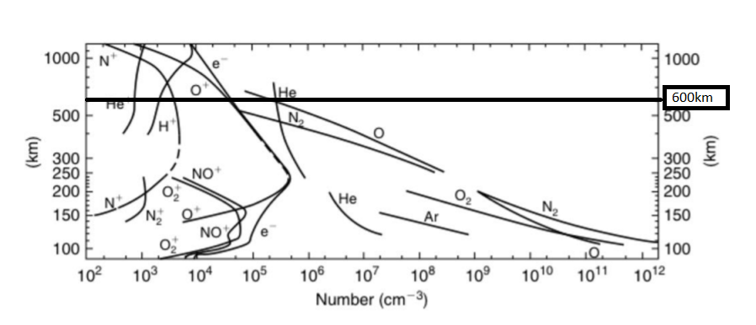
What can we expect for NORSAT?

Slide 8
Simulated variations:
- | Run 6 Hydrogen, H | Run 7 Helium, He | Run 8 Argon, Ar | Run 9 Oxygen, O
m_{i}/m_{e} | 1836 | 3672 | 33048 | 29376
Ion Temp [K] | 1000
Time step [ns] | 1.67 |  | 3.34

Slide 9
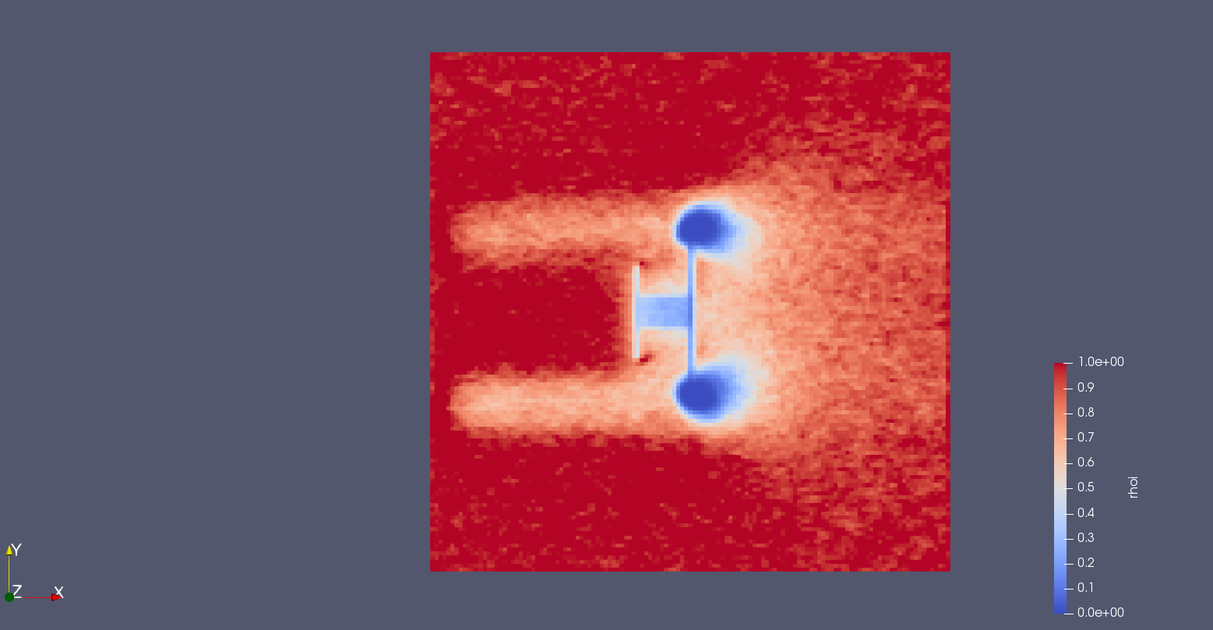
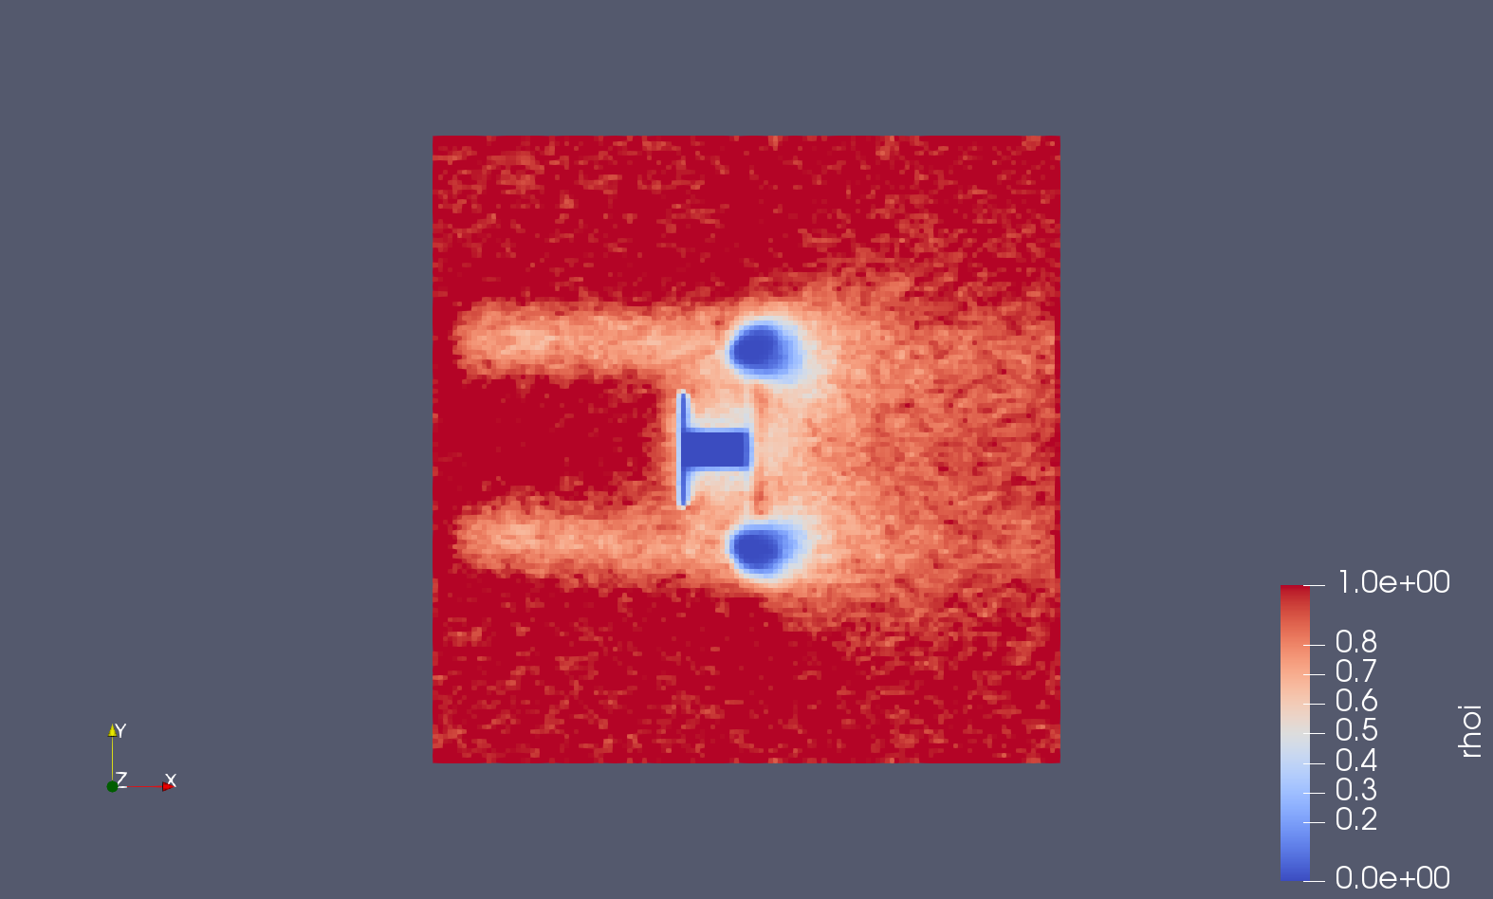
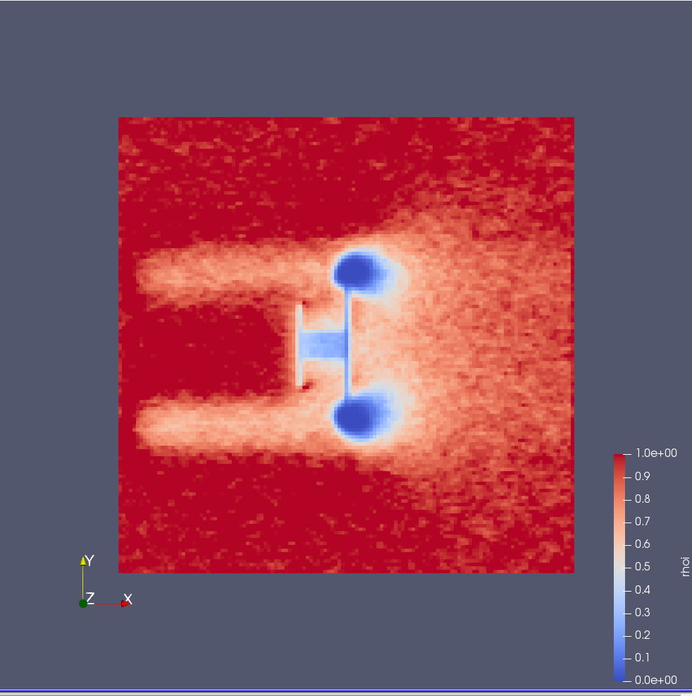
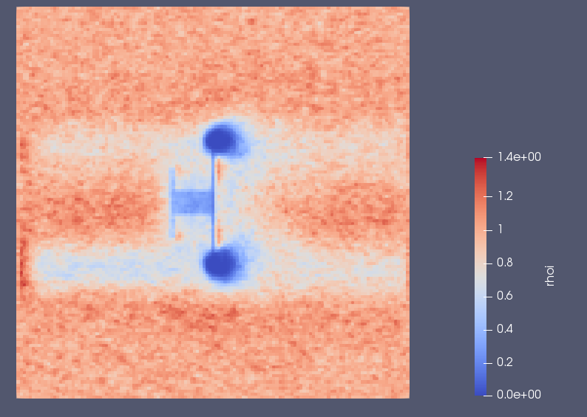
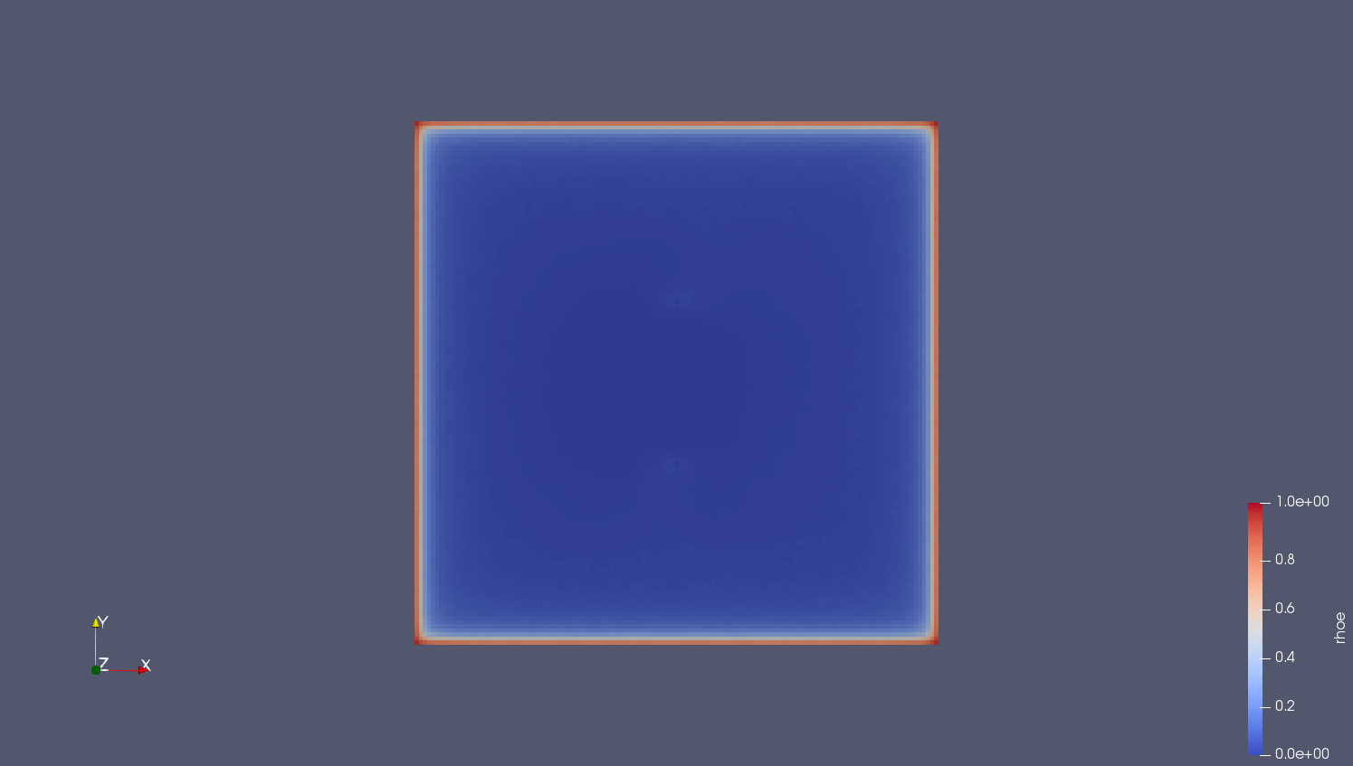
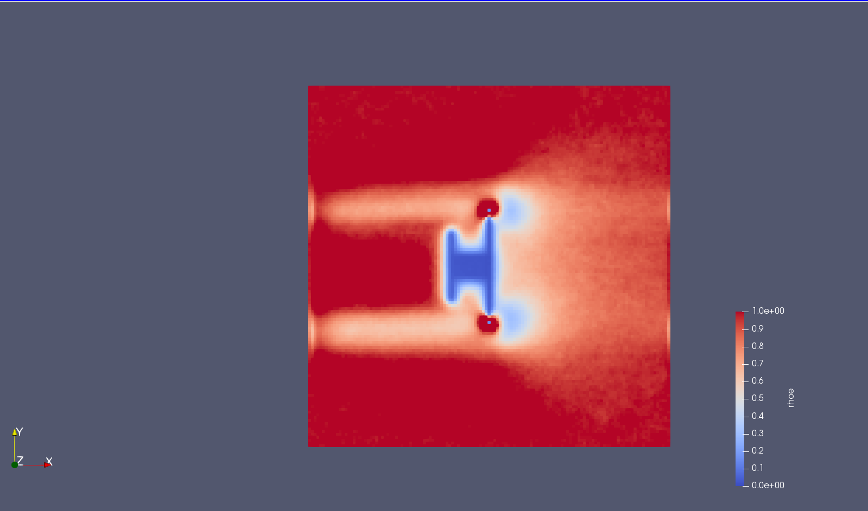
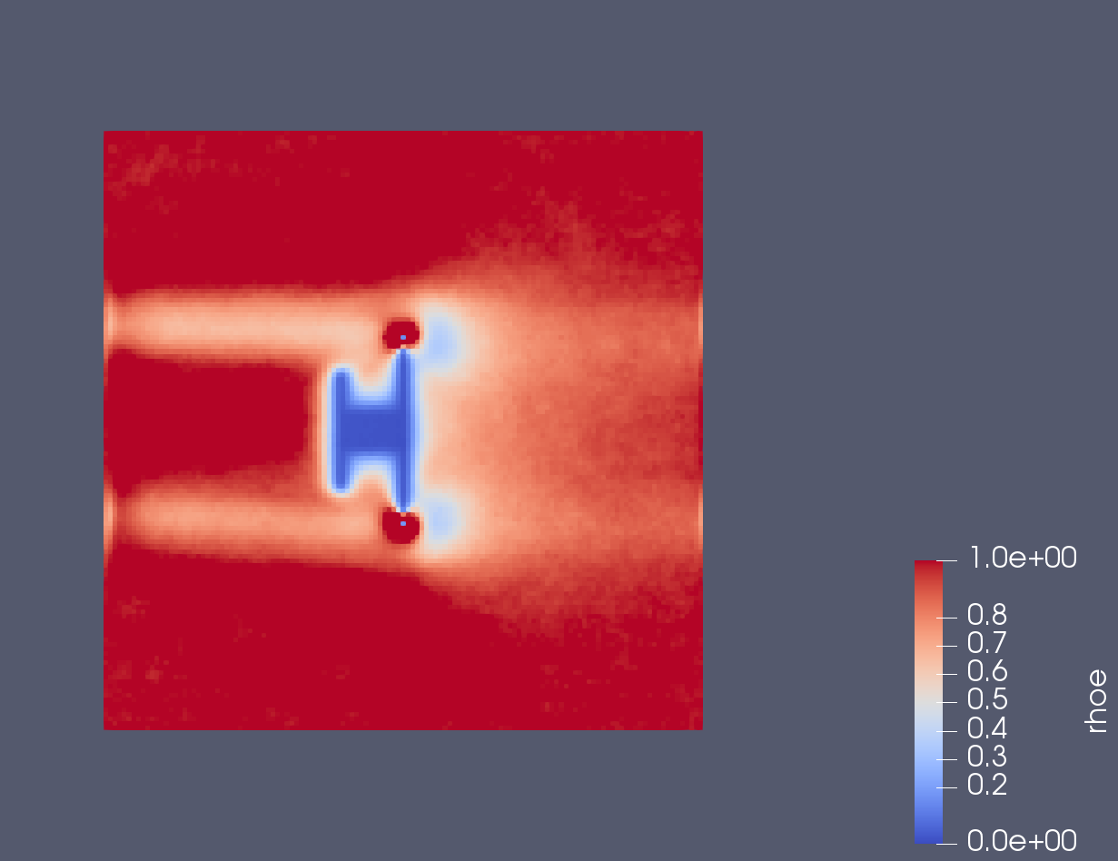
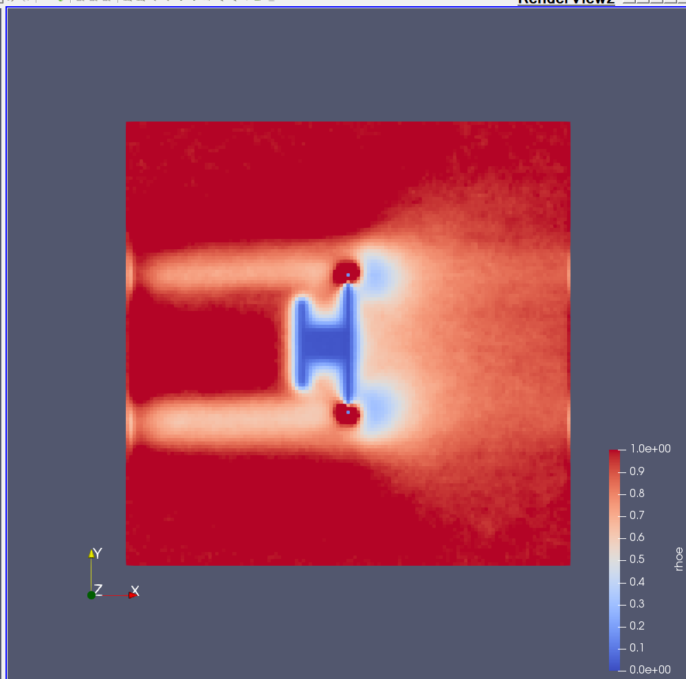
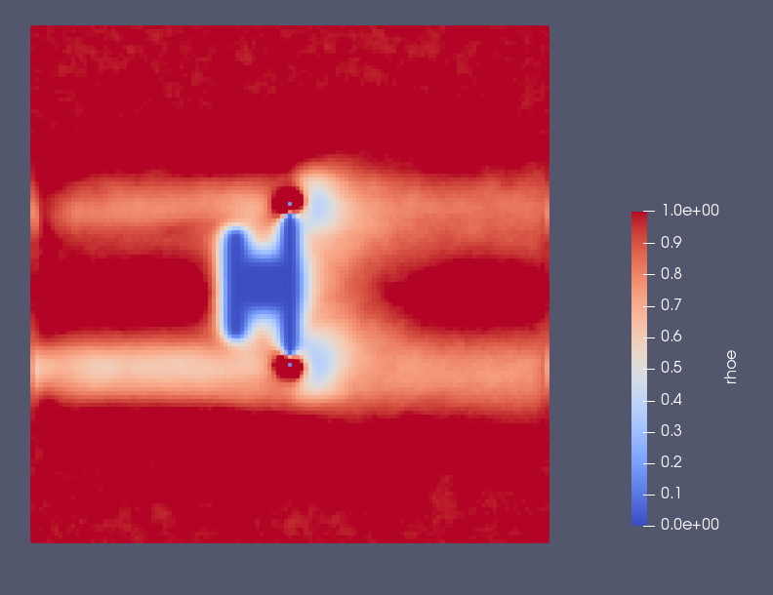
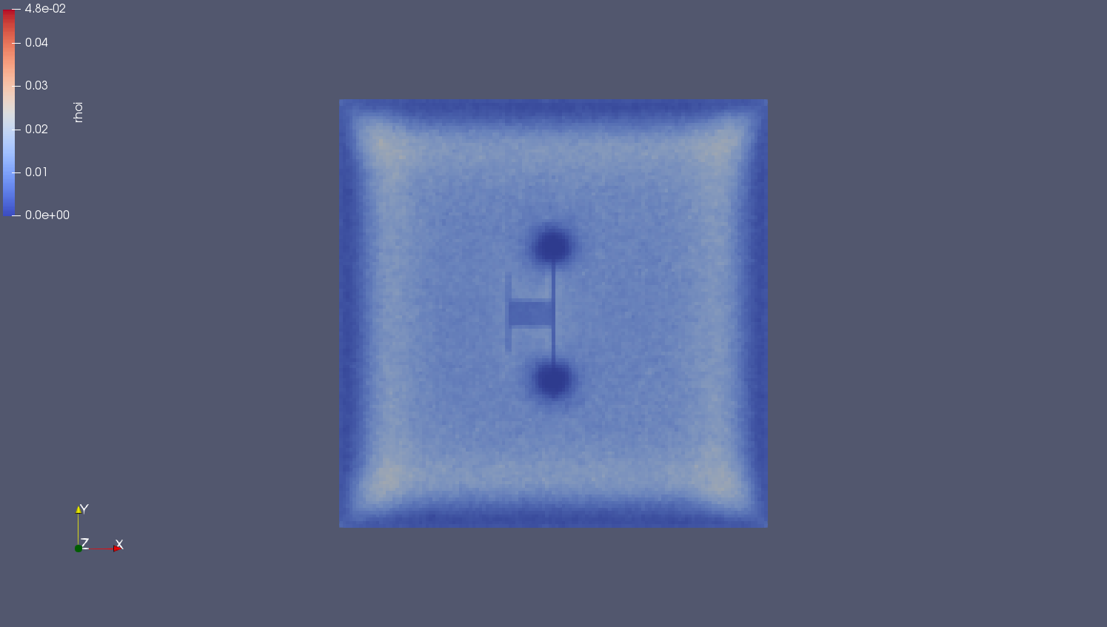
RESULT rhoi rhoe
run2 H He O Ar
rho_{i}
rho_{e}

Slide 10
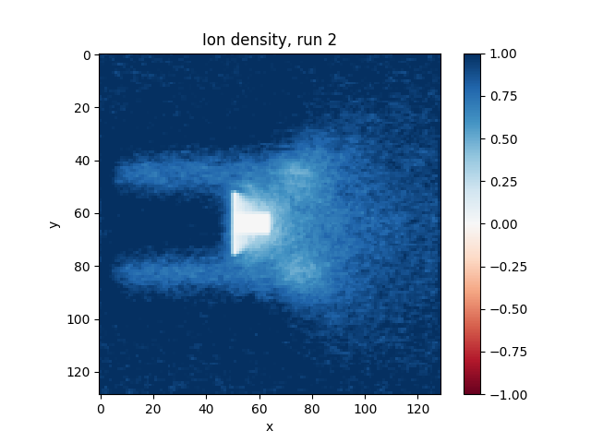
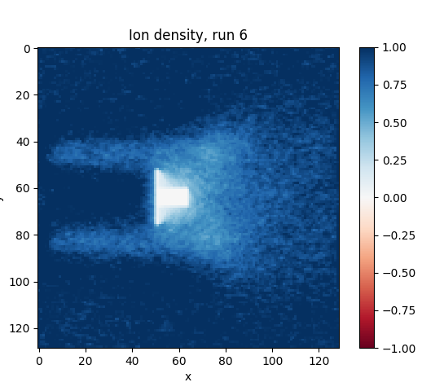
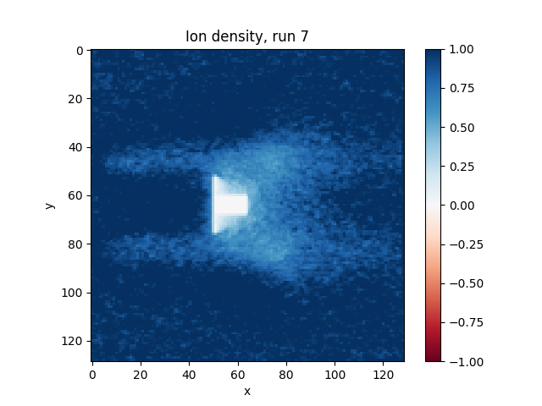
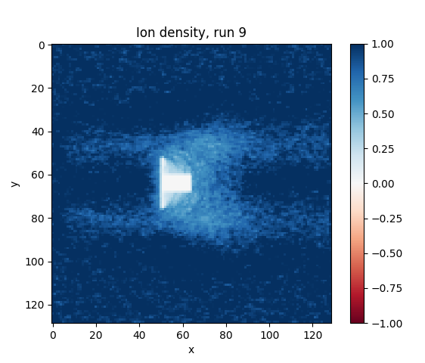
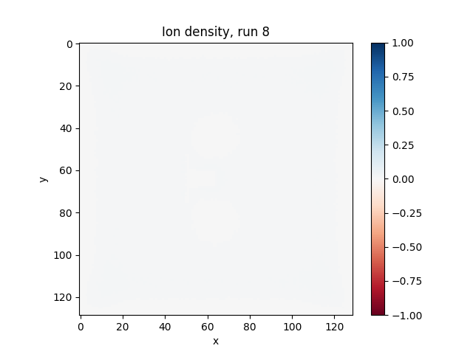
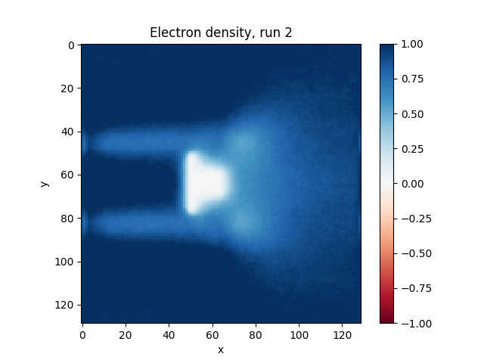
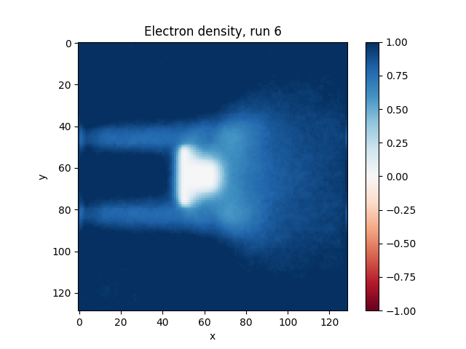
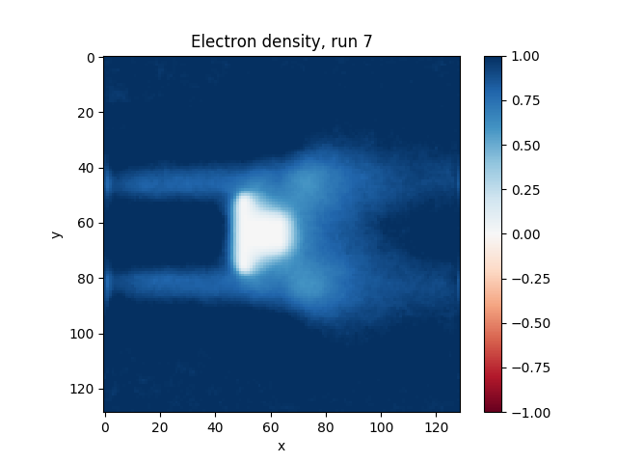
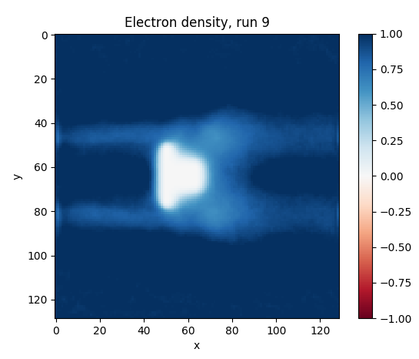
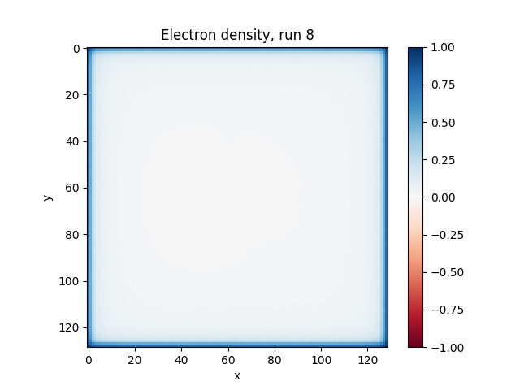
RESULT Ion and electron density
run2 H He O Ar
rho_{i}
rho_{e}

Slide 11
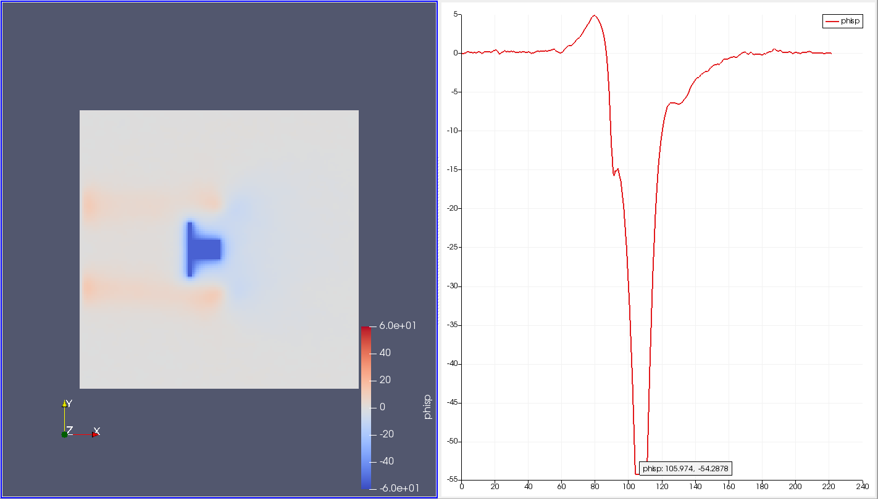
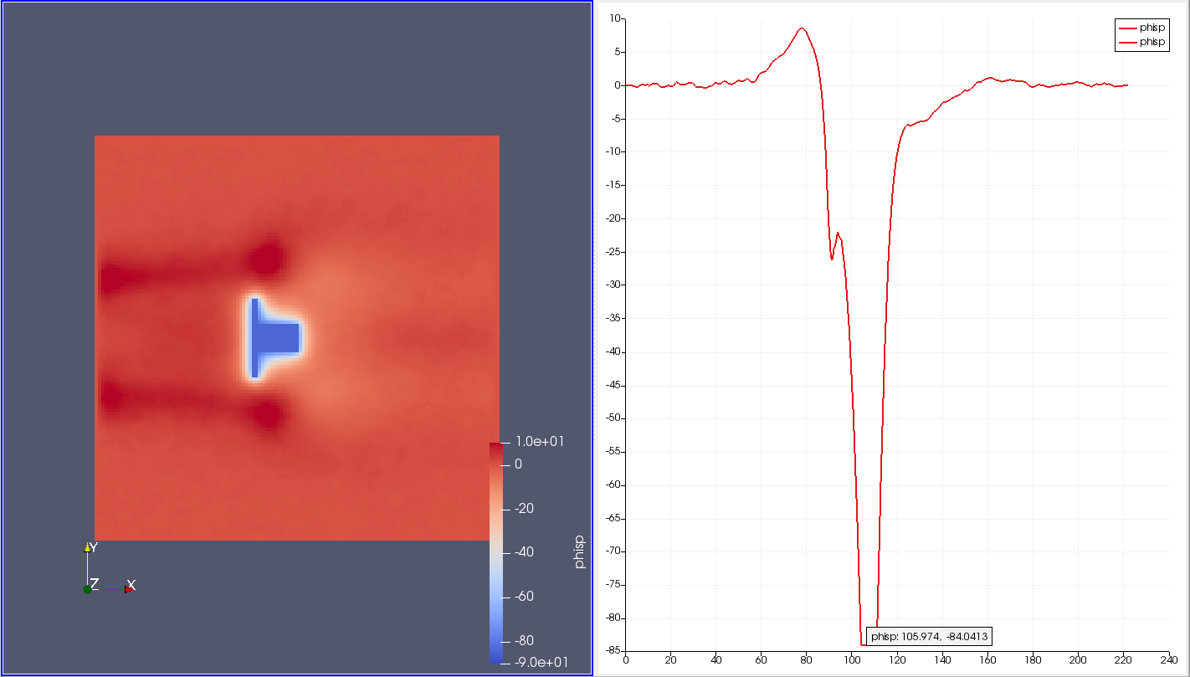
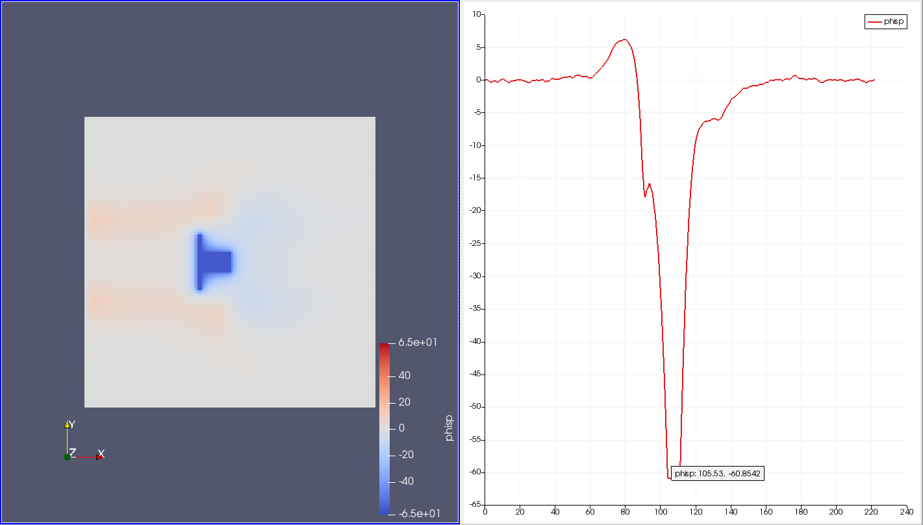
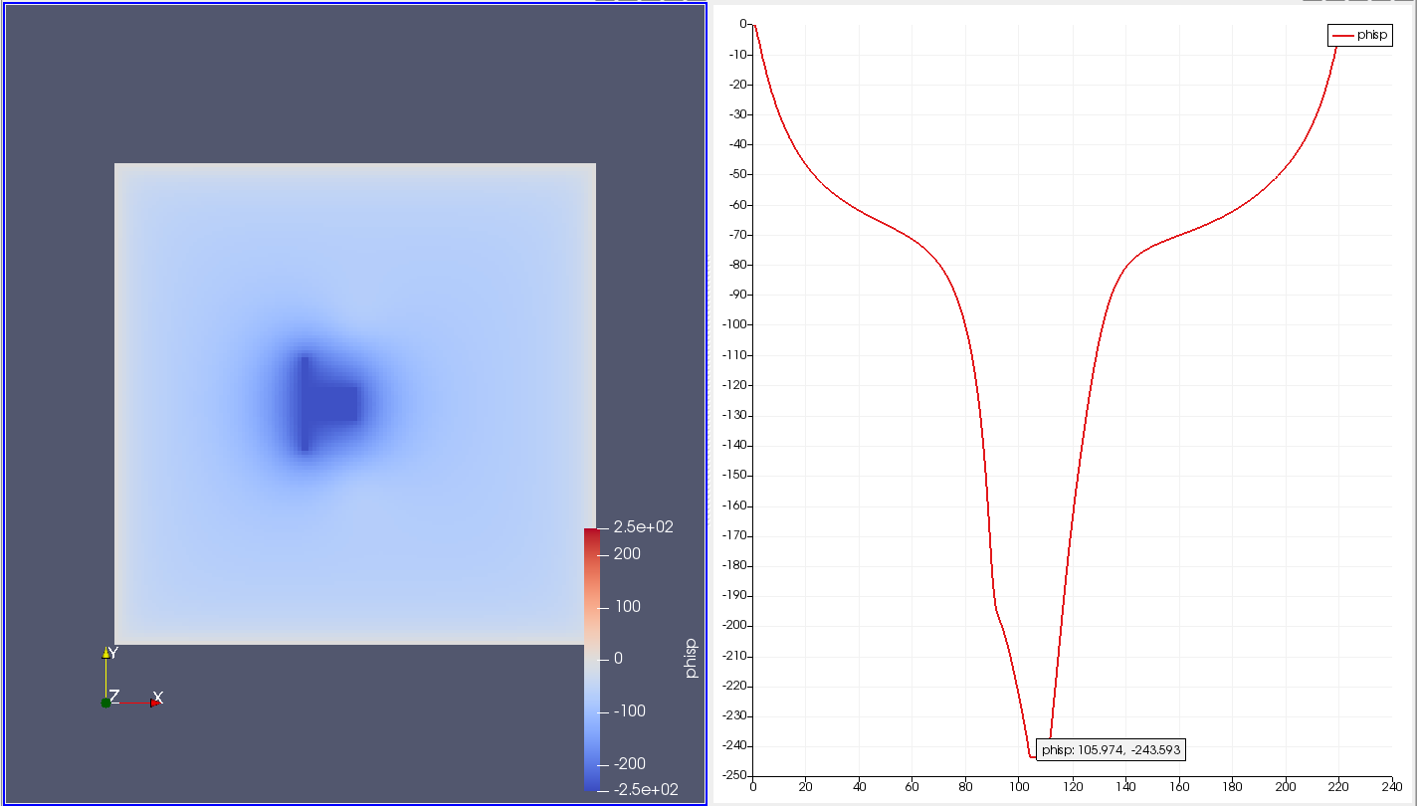
Floating Potential of Cases
H
O
He
Ar

Slide 12
Normalized floating potential table
T_{e}/T_{i} = 1 | Theoretical | Simulated | Relative error
H | -3.7578 | -3.2192 | 0.14329
He | -4.1042 | -3.6085 | 0.12076
O | -5.1439 | -4.9835 | 0.03118
Ar | -5.202 | -14.4453 | 1.77648

Slide 13
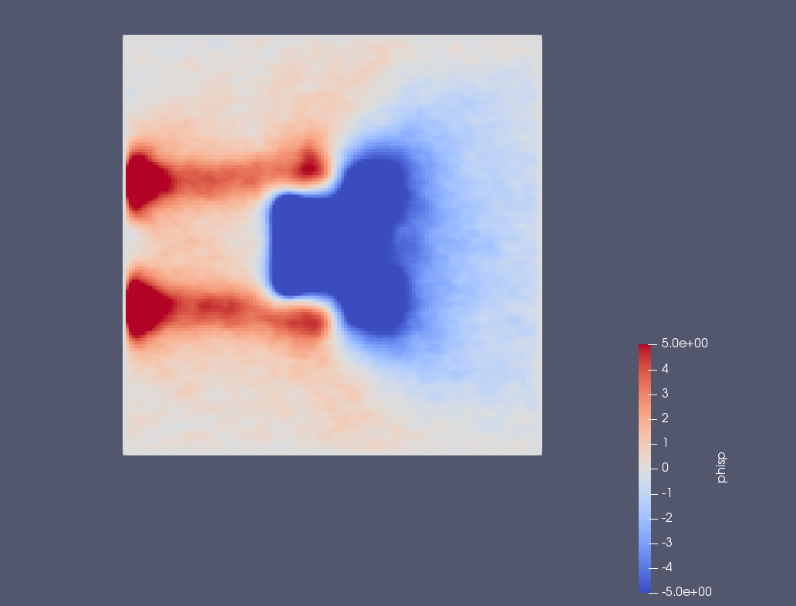
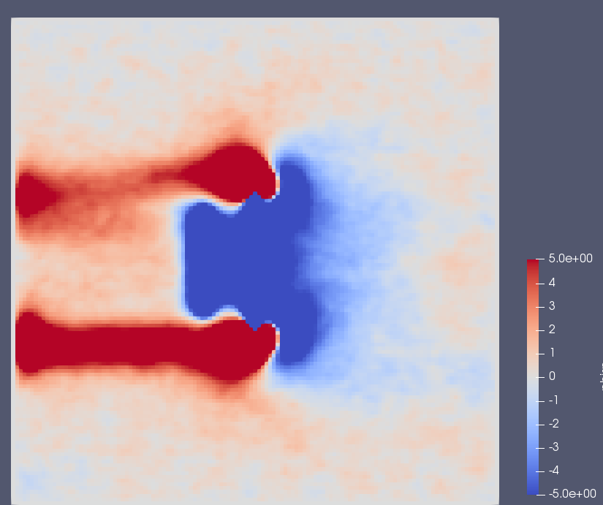
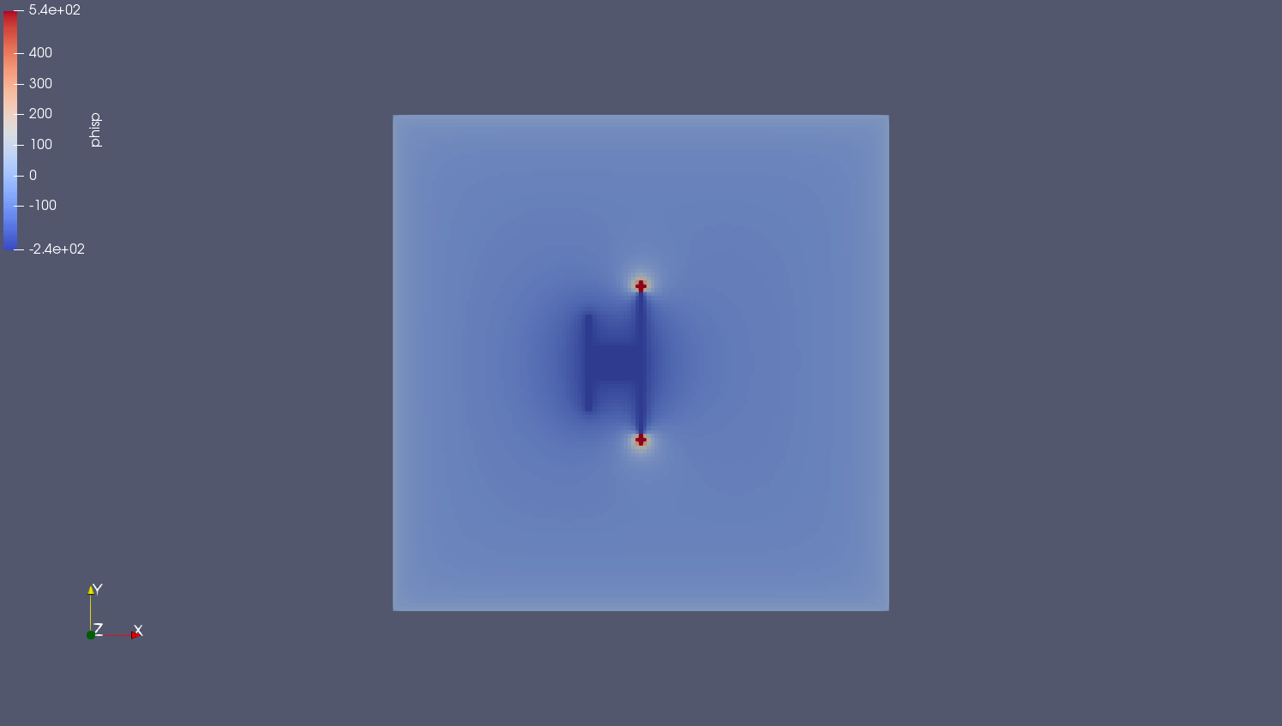
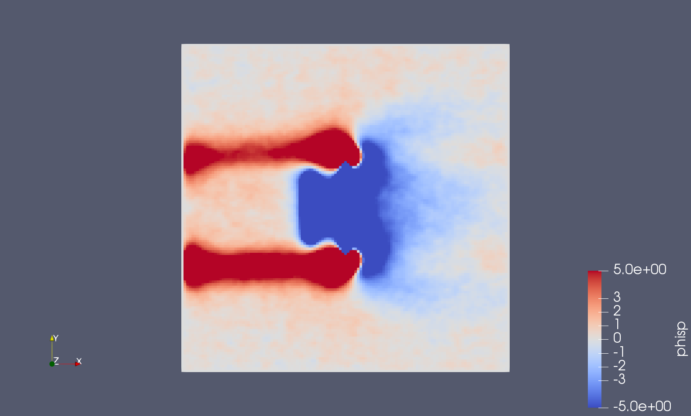
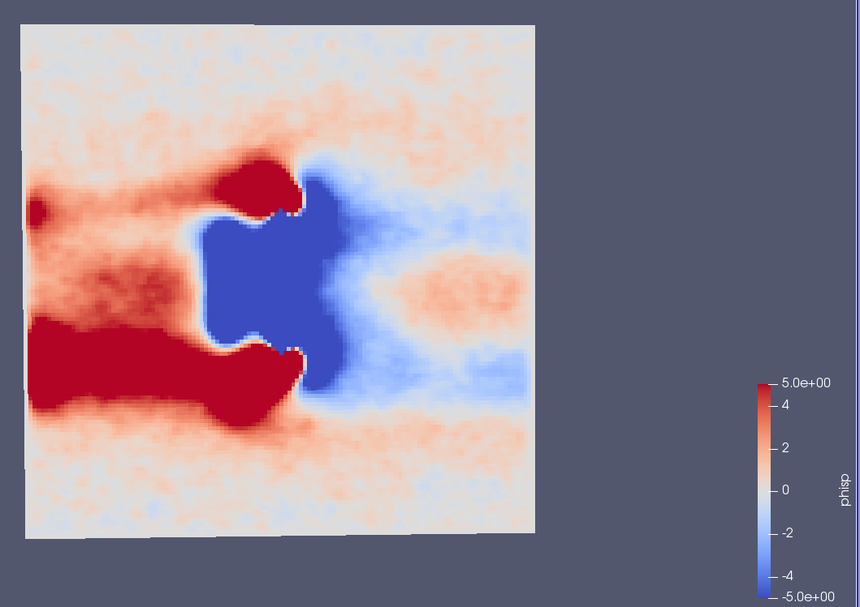
RESULT phisp
run2 H He O Ar

Slide 14
DISCUSSION
What kind of wakes were observed?
Ions/electrons?
Consequences?
How accurate is the theoretical model?
PIC simulation imaging
PP Scheme Results
Notes:
Ions/electrons: Thermal velocity causes convection
How does this relate to the NORSAT-1 probe?
The NORSAT-1 probe is at ca. 600km altitude. In that area there is a large concentration of Oxygen. We are interested in how

Slide 15
CONCLUSION
How does this relate to the NORSAT-1 satellite?
What did we learn from the project?
What kind of improvements can be made?
Atmospheric Composition
OML Scheme for the Langmuir probe

