Slide 1
Astounding astrophysics anomalies
By Peyton, DK and Steinn

Slide 2
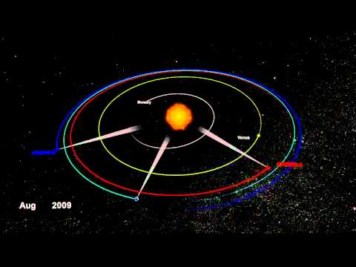
STEREO-A and –B Orbit Paths
Notes:
Steinn

Slide 3
SUN
At which angle does the data from the two satellites begin to differ?
φ
１ AU
Can conclusions be made about the data at a period of no significant event?
(Solar Minimum)
STEREO B
ACE
Notes:
Steinn

Slide 4
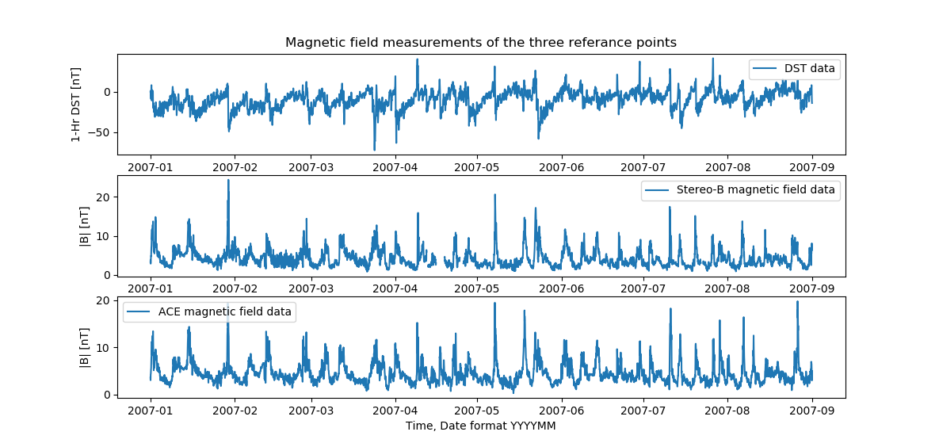
Notes:
DK

Slide 5
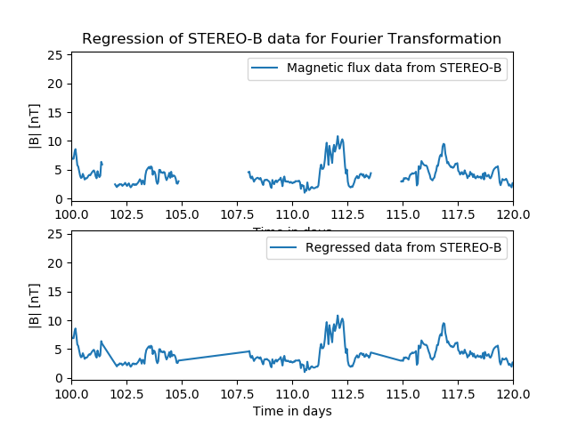
Interpolated data from STEREO-B
Notes:
DK

Slide 6
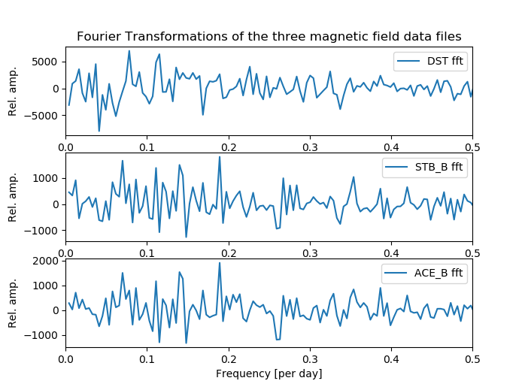
Notes:
DK

Slide 7
Fourier betrayal?
Are Fourier-Transformations a good way to study the correlation between the ACE and STEREO-B magnetic field strength data?
Notes:
DK

Slide 8
nope
Notes:
DK

Slide 9
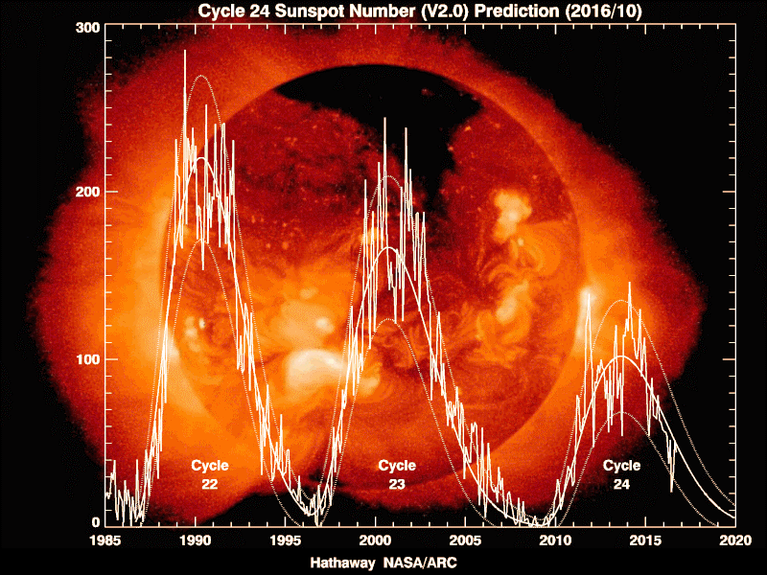
Other alternatives?
Wavelet Transformation
Pick another time with more significant solar activity?
Notes:
Peyton
We looked into other alternatives for analyzing the magnetic strength data

Slide 10
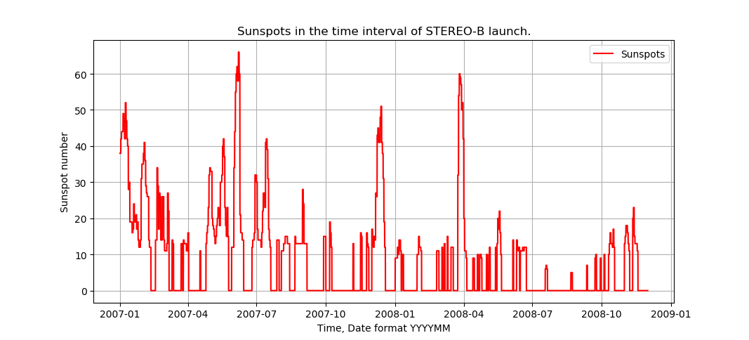
Notes:
Peyton
The STEREO satellites were unfortunately launched in a period of major solar minimumness.

Slide 11
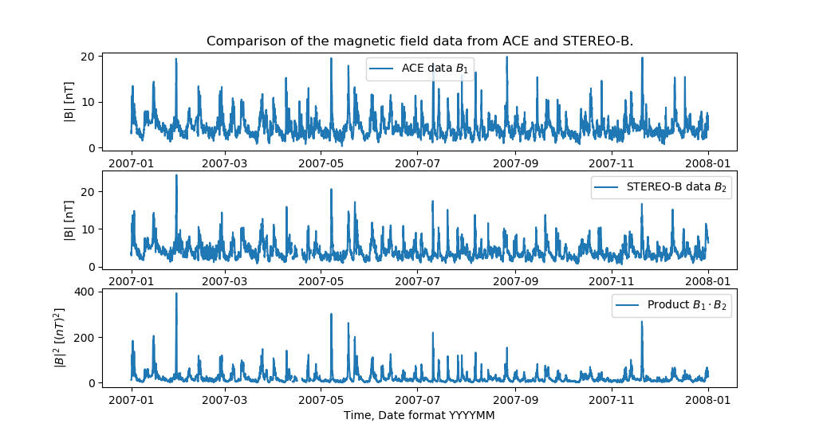
Notes:
Steinn

Slide 12
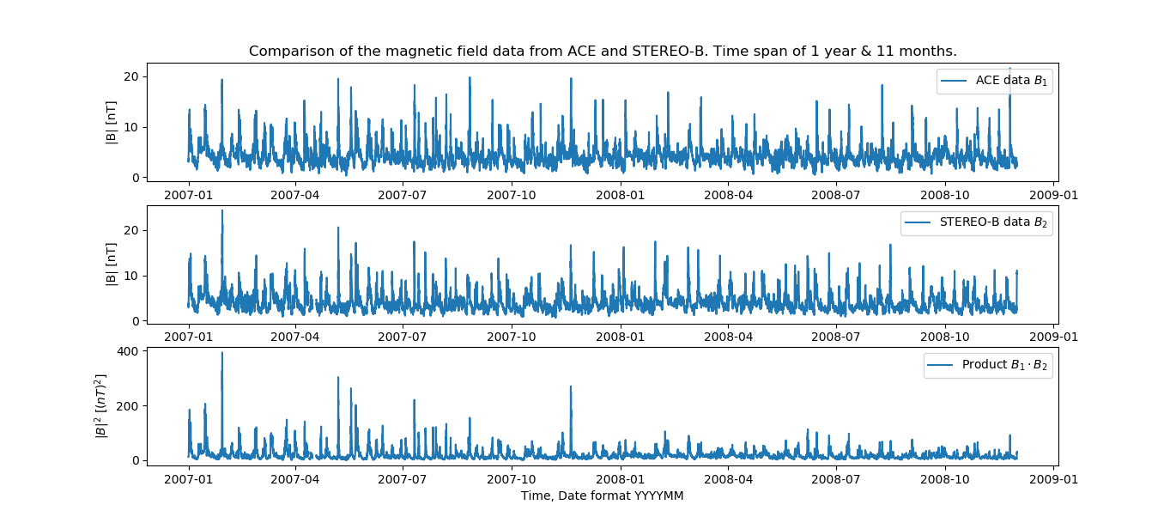
Notes:
Steinn

Slide 13
Final correlation spike on the 20th of November, 2007
STEREO-B has an orbiting period of 387 days around the Sun.
STEREO-B and ACE experienced the same magnetic spike after 324 days.
Separated by approximately 49 billion meters.
The angle between the two (assuming 1AU) is φ=18.75 degrees.
Notes:
Peyton

Slide 14
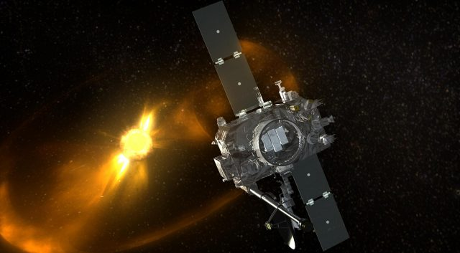
Discussion
Gradual transition from correlation
Random magnetic fluctuations
Radial emissions from the sun
Notes:
Steinn

Slide 15
References
https://cdaweb.sci.gsfc.nasa.gov/index.html/
https://solarscience.msfc.nasa.gov/predict.shtml
https://svs.gsfc.nasa.gov/10718
https://www.extremetech.com/extreme/234307-nasa-has-found-the-lost-stereo-b-spacecraft-after-two-years
DK computer graphic skills

