Slide 1
Voiceprint in multilingual environment
Transfer learning of multilingual modeling in speaker verification. (Not yet)
Zhihong Zhang

Slide 2
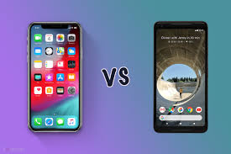

Speaker Verification
There are two kinds of the speaker verification.
Text-dependent(TD) and Text-Independent(TI).
In General, TD has better performance.

Slide 3
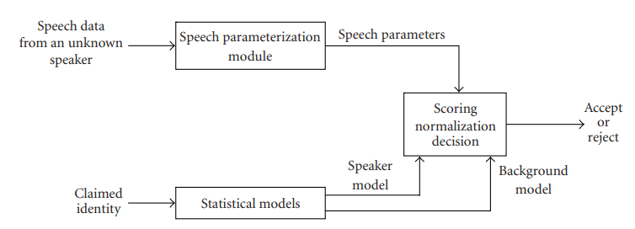
General Method

Slide 4
History of Cepstrum Technique Usage
1960s developed while study Echoes in seismic signals
1970s audio features of speech recognition / identification
In 2000, it is used in music processing

Slide 5
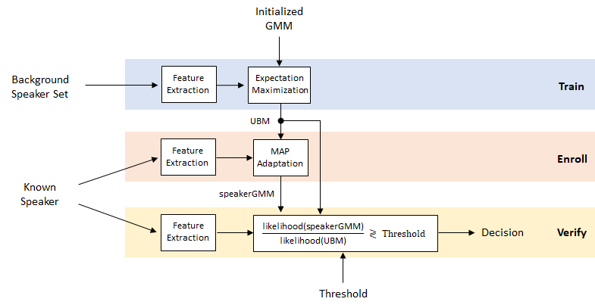
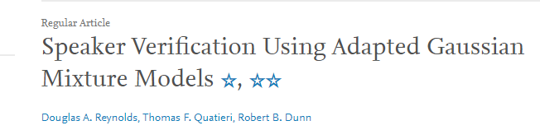

Slide 6
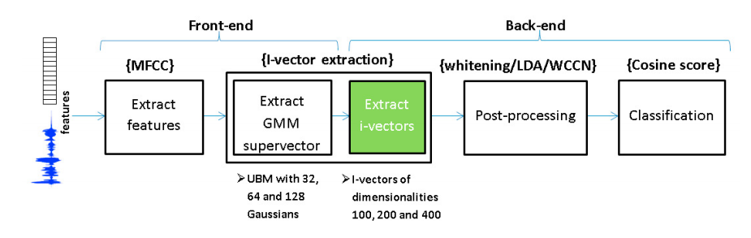
The ivector of a speech segment X is computed as the mean of the posterior probability P(w|X).
INTERSPEECH 2011, N. Dehak, 2011

Slide 7
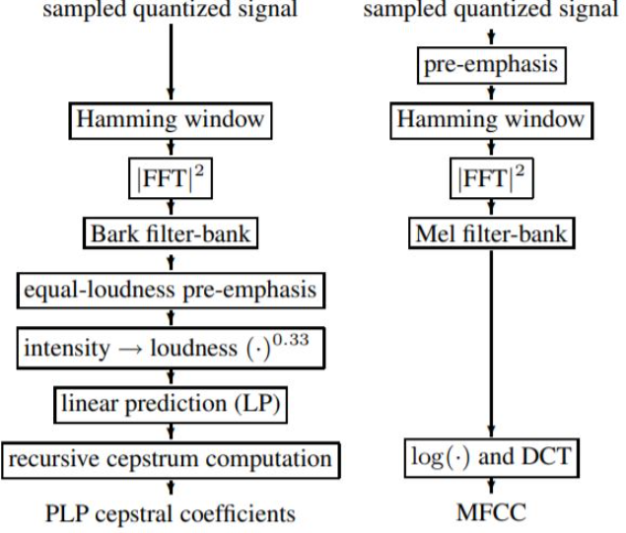
Two main way of preprocessing the data

Slide 8
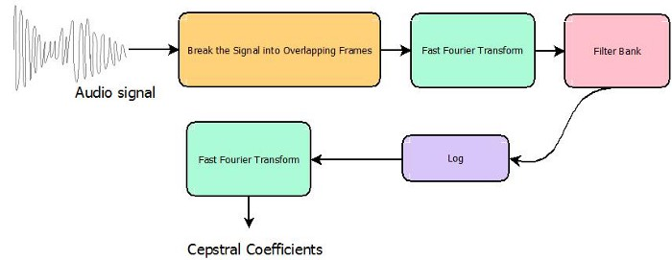

Slide 9
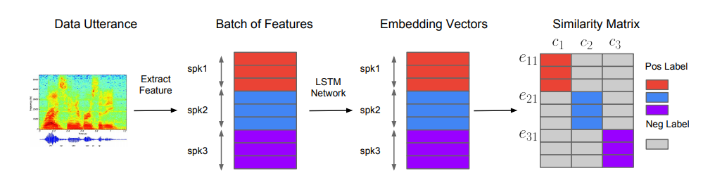
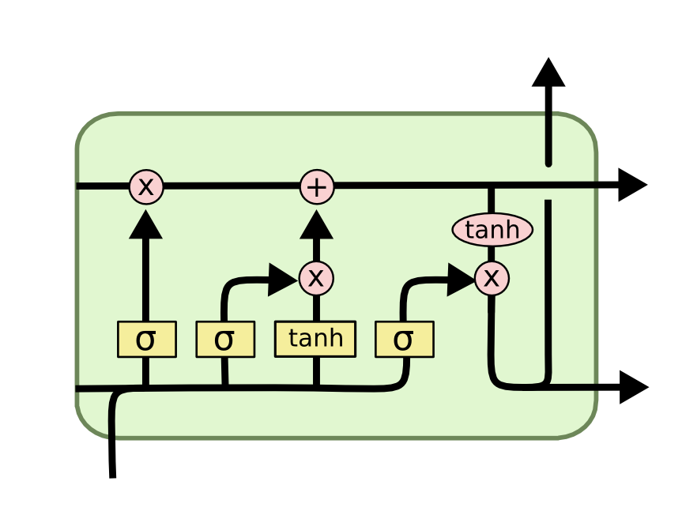
Baseline-GE2EMethod(Paper) 2018

Slide 10
Performance measure
𝐹𝑎𝑙𝑠𝑒 𝑅𝑒𝑗𝑒𝑐𝑡 𝑅𝑎𝑡e ( FRR)
𝐹𝑎𝑙𝑠𝑒 𝐴𝑐𝑐𝑒𝑝𝑡𝑎𝑛𝑐𝑒 𝑅𝑎𝑡𝑒 (FAR)
Equal Error Rate (EER) = FRR+FAR/2

Slide 11
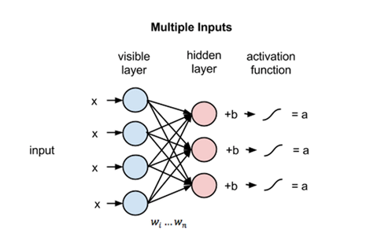
RBM

Slide 12
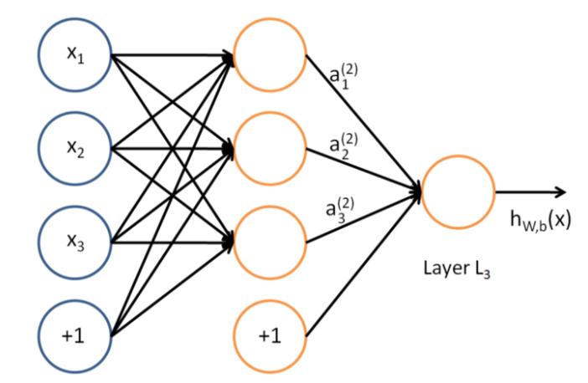

Slide 13
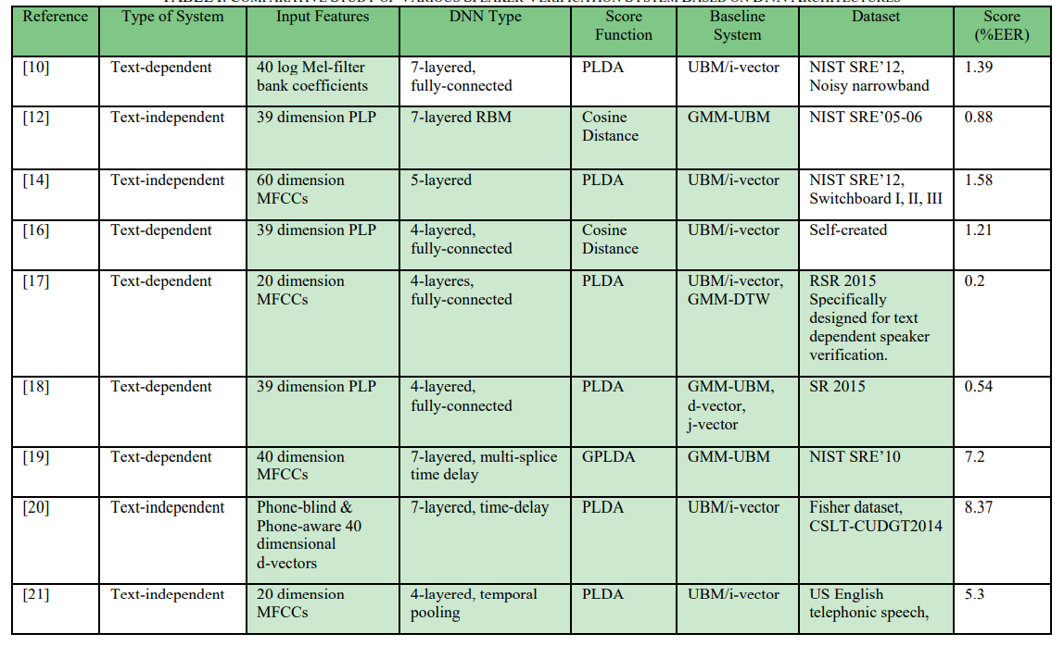
Based on paper Speaker Verification Using Deep Neural Networks: A Review [Irum 2019]

Slide 14
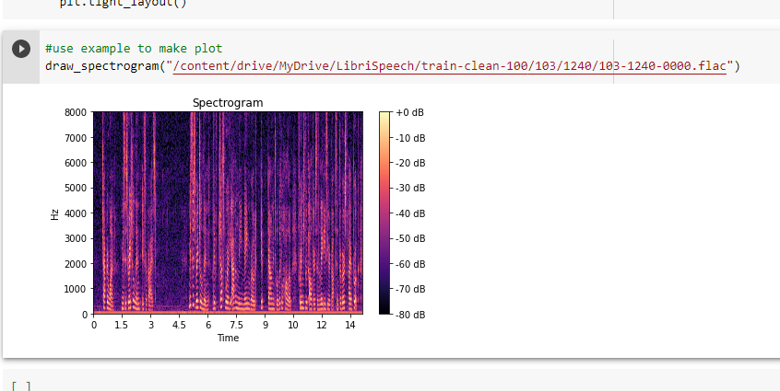

Slide 15
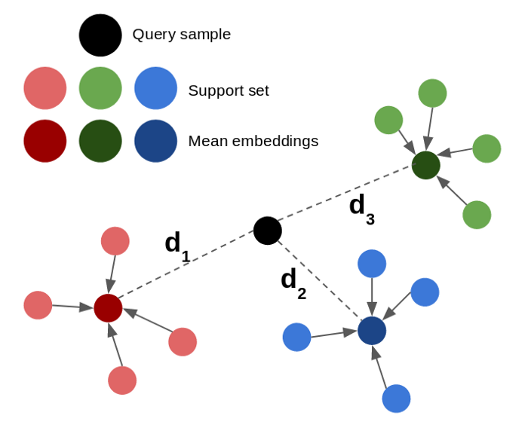
https://medium.com/analytics-vidhya/building-a-speaker-identification-system-from-scratch-with-deep-learning-f4c4aa558a56

Slide 16
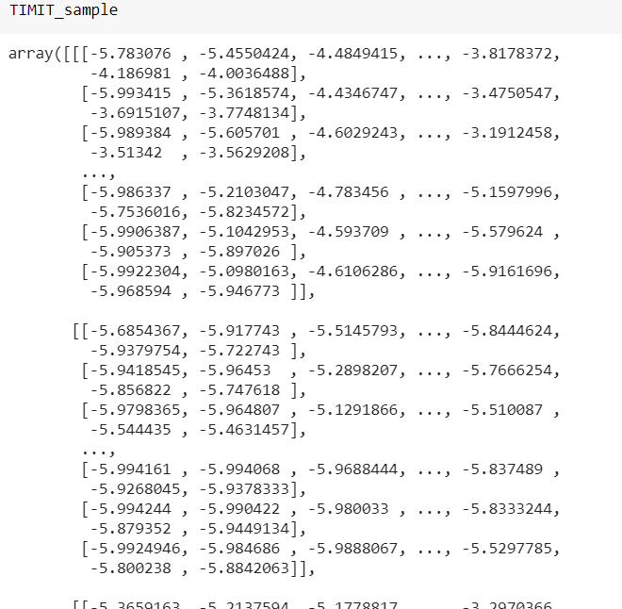
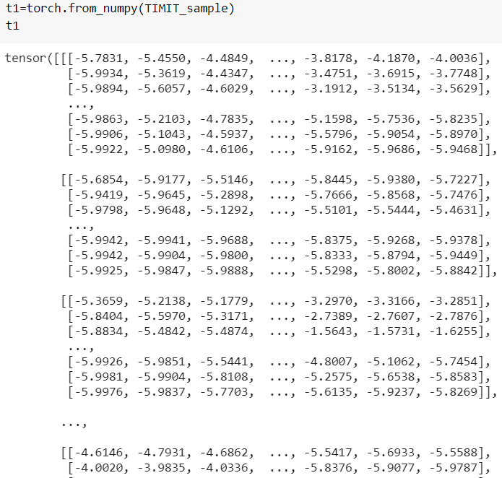


Slide 17
What I did:
Adding CNN layer to current deep learning model(Mainly LSTM).
Plan: Using the last layer of CNN for other less resourced language

Slide 18
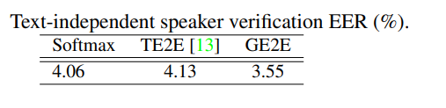
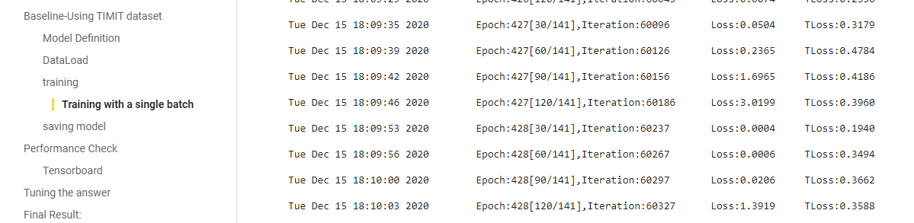
Baseline-GE2EMethod
3.77 %

Slide 19
Data(based on baseline)
For 950 epoch with batch size 140
TIMIT (602M)
Librispeech（train-100+test）(7.28gb )
Vctk (10.9GB)
Vox1+2（>30gb）
Own dataset (Underdevelopment)
Training(After preprocessing data):
For TIMIT, Local (Gtx 1050ti ~ 10 hrs) Colab (~4hrs varied based on assignment) Colab Pro (haven’t run full training yet)
For other larger data set, I haven’t done training, since it will take too long to revise model and so on. Plan for last step getting all model ready

Slide 20
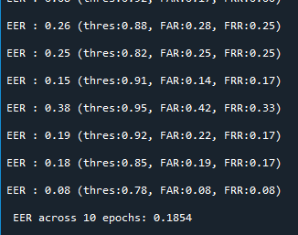
Considering the training , reduce size of model
Using only 90 epoch
Sample rate of 8000hz - comparing with 16khz
mels: 20 #Number of mel energies
hidden: 192 #Number of LSTM hidden layer units
num_layer: 2 #Number of LSTM layers
proj: 64 #Embedding size

Slide 21
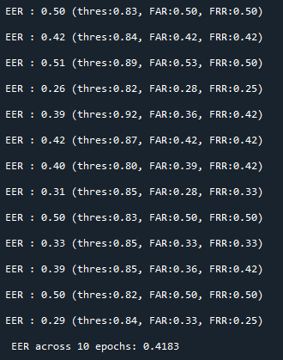
Moving training model from Colab to Local(parameter may be a bit different)

Slide 22
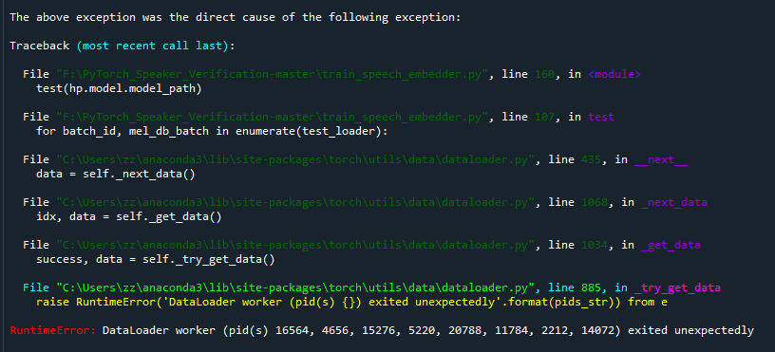
Issues

Slide 23
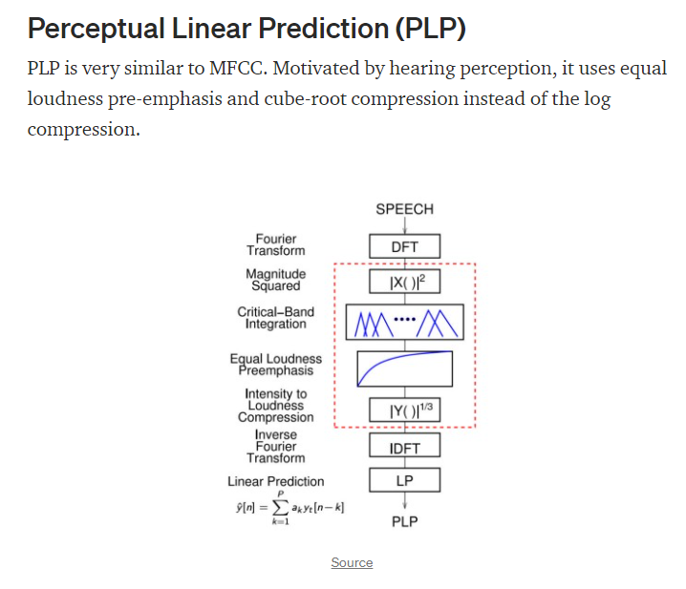

Slide 24
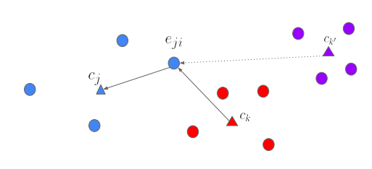
https://github.com/oscarknagg/voicemap/tree/master/notebooks

Slide 25
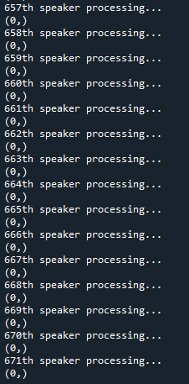
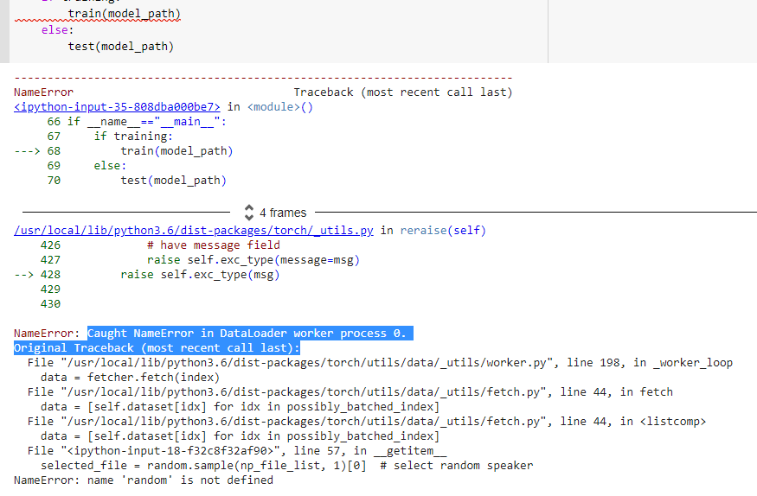
Challenging part

Slide 26
lessons
Programming and Data Structure
Paper reading
Debugging and Problem Solving
Have a nice overview of the field.
A lot of connect with CV and NLP.
Debugging takes long time !!!!
Colab will not show all error message!!!
Run in local py file!!!
Make me realized Python is an Object oriented language
Getting to Know Pytorch, play with Tensors.
Linux shell command (Colab)

Slide 27
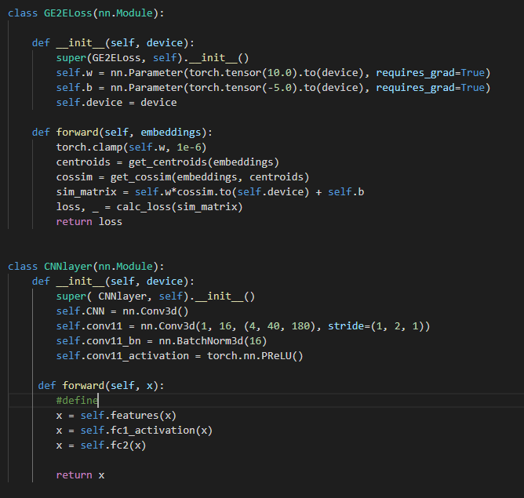
What can I do to improve the performance?
Make my CNN work
Add Transformer (inspired from CV), introduce attention, which will be better for explanation.

Slide 28
Thankyou
https://github.com/steinszzh/2020capstone

Slide 29
Reference(Paper List
GENERALIZED END-TO-END LOSS FOR SPEAKER VERIFICATION, Google
Speaker Verification Using Deep Neural Networks: A Review,
VERY DEEP CONVOLUTIONAL NEURAL NETWORKS FOR RAW WAVEFORMS
Voiceprint recognition of Parkinson patients based on deep learning 1812.06613
……

Slide 30
Reference(Video or website)
Sound of AI https://www.youtube.com/channel/UCZPFjMe1uRSirmSpznqvJfQ
NYU Pytorch leason
Deeplizard Pytorch tutorial

