Slide 1
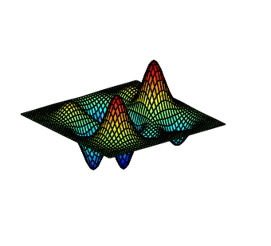


Role of Stein’s Lemma in Guaranteed Training of Neural Networks
Anima Anandkumar
NVIDIA and Caltech

Slide 2
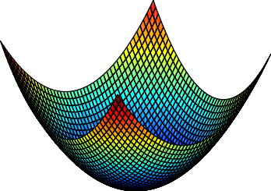
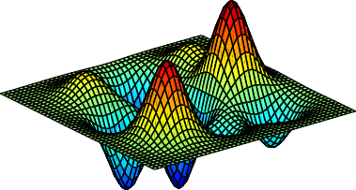
Non-Convex Optimization
► Unique optimum: global/local
► Multiple local optima
► In high dimensions possibly exponential local optima
How to deal with the challenge of non-convexity?
Finding the global optimum
3/ 33

Slide 3
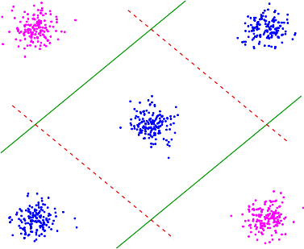



Local Optima in Neural Networks
Example of Failure of Backpropagation
y
y = −1
y =1
σ(·)
σ(·)
Local optimum
Global optimum
x
x₁
x₂
Exponential (in dimensions) no. of local optima for backpropagation

Slide 4
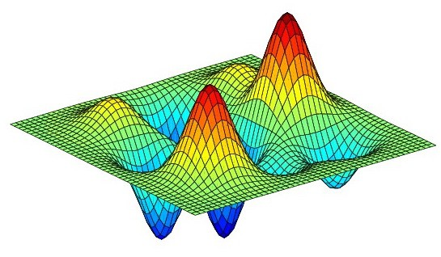

Guaranteed Learning through Tensor Methods
Replace the objective function
Cross Entropy vs. Best Tensor decomp.
Preserves Global Optimum (infinite samples)
arg min IT (x) − T (θ)
I
2
θ
F
T (x): empirical tensor, T (θ): low rank tensor based on θ.
Dataset 1
Dataset 2
Finding globally opt tensor decomposition
Model Class
Simple algorithms succeed under mild and natural
conditions for many learning problems.

Slide 5
Why Tensors? Method of Moments

Slide 6
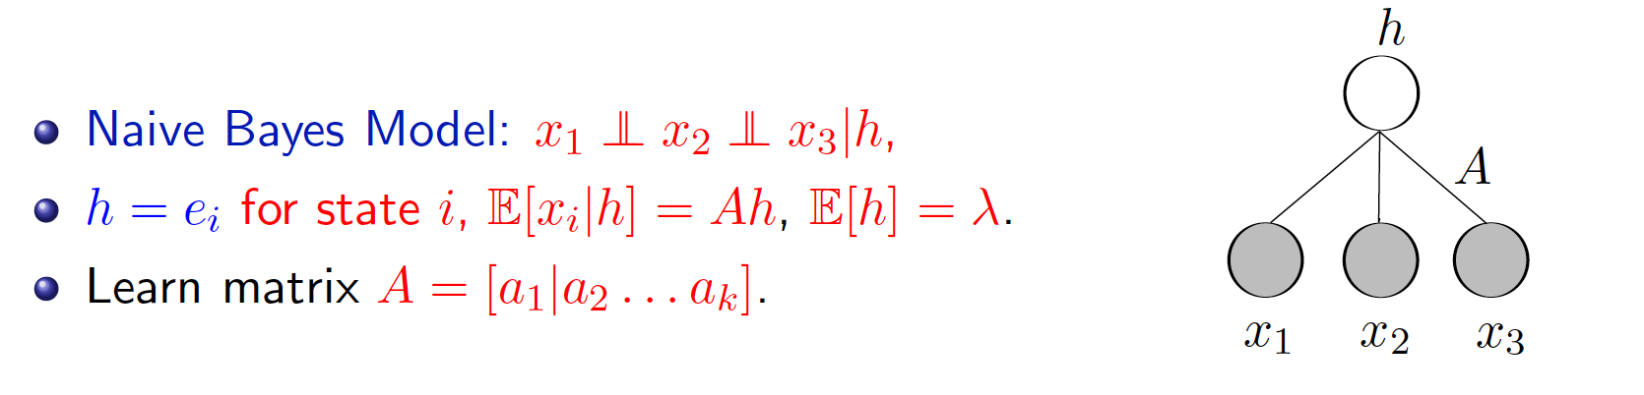
Matrix vs. Tensor: Why Tensors are Necessary?

Slide 7
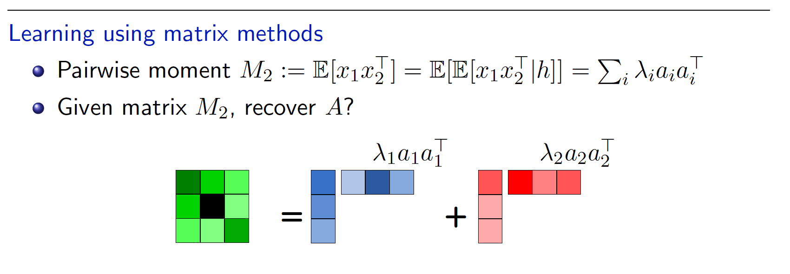
Matrix vs. Tensor: Why Tensors are Necessary?

Slide 8
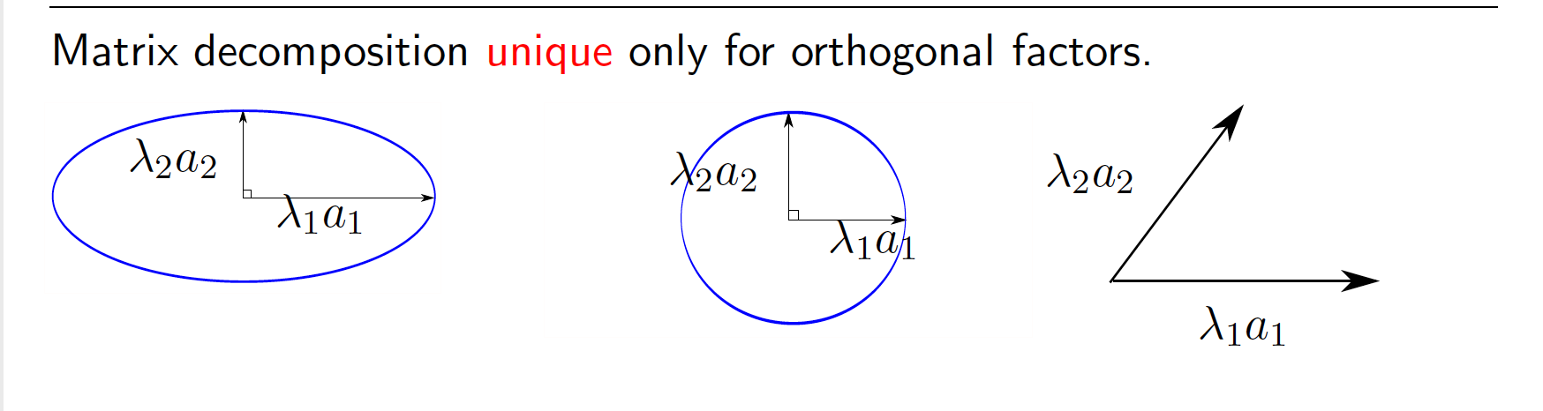
Matrix vs. Tensor: Why Tensors are Necessary?

Slide 9


Matrix vs. Tensor: Why Tensors are Necessary?

Slide 10
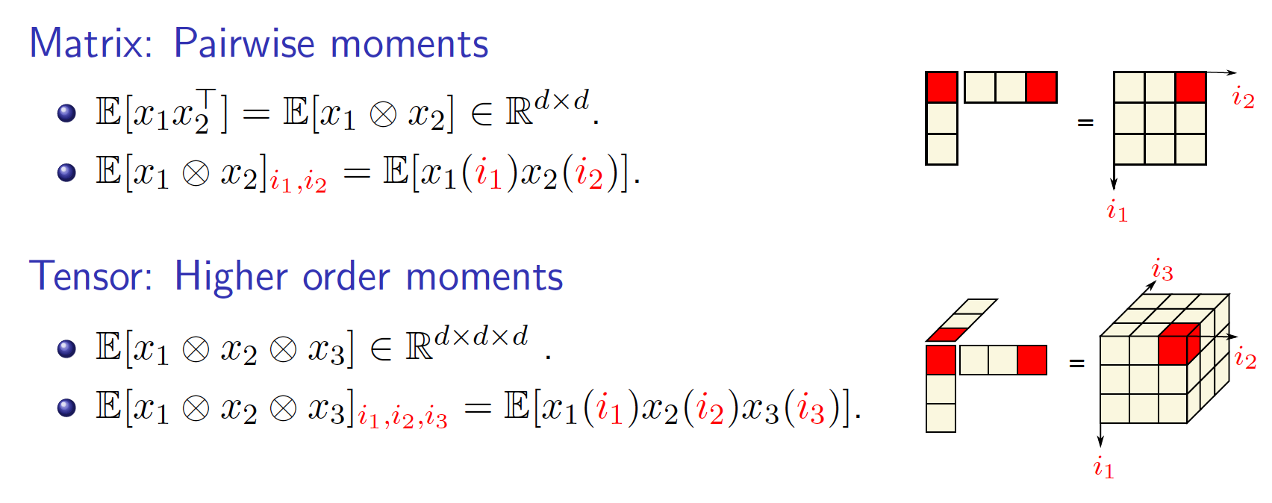
From Matrix to Tensor

Slide 11
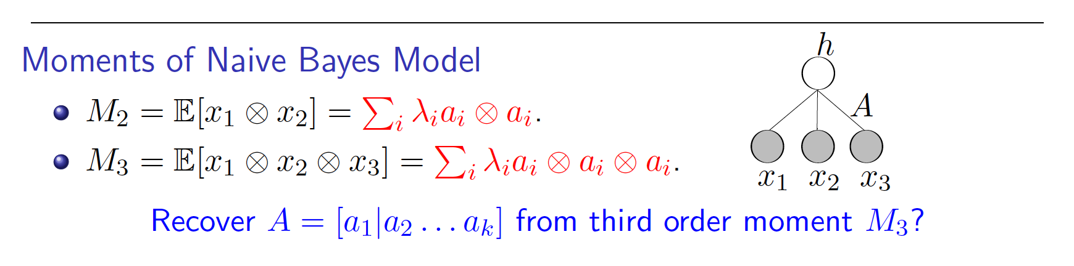
From Matrix to Tensor

Slide 12
From Matrix to Tensor

Slide 13


Guaranteed Training of Neural Networks using Tensor Decomposition
Majid Janzamin
Hanie Sedghi

Slide 14

Method of Moments for a Neural Network
► Supervised setting: observing {(x_{i}, y_{i})}
► Non-linear transformations via activating function σ(·)
► Random x and y:
Moment possibilities: E[y ⊗ y], E[y ⊗ x], . . .
y
σ(·) σ(·)
E[y ⊗ x] = E[σ(A^{T}x) ⊗ x]
⇒
1
A1
No linear transformation of A₁. ×
x x1
x2 x3
One solution: Linearization by using Stein’s Lemma
σ(A^{T}x)
Derivative
−−−−−−→ σ'(·)A₁^{T}
1
26/ 33

Slide 15




Moments of a Neural Network
y
E[y|x] := f (x) = (a₂, σ(A^{T}₁ x))
a₂
σ(·) σ(·)


A =


1

x
x₁ x₂ x₃
“Score Function Features for Discriminative Learning: Matrix and Tensor Framework” by M.
Janzamin, H. Sedghi, and A. , Dec. 2014.

Slide 16
Moments of a Neural Network
y
E[y|x] := f (x) = (a₂, σ(A^{T}₁ x))
Moments using score functions S(·)
a₂
σ(·)
σ(·)


A =


1

x
x₁ x₂ x₃
“Score Function Features for Discriminative Learning: Matrix and Tensor Framework” by M.
Janzamin, H. Sedghi, and A. , Dec. 2014.

Slide 17


Moments of a Neural Network
y
E[y|x] := f (x) = (a₂, σ(A^{T}₁ x))
Moments using score functions S(·)
E [y · S₁(x)] = +
a₂
σ(·)
σ(·)


A =


1

x
x
x
x 1
2
3
“Score Function Features for Discriminative Learning: Matrix and Tensor Framework” by M.
Janzamin, H. Sedghi, and A. , Dec. 2014.

Slide 18


Moments of a Neural Network
y
E[y|x] := f (x) = (a₂, σ(A^{T}₁ x))
Moments using score functions S(·)
E [y · S₂(x)] = +
a₂
σ(·)
σ(·)


A =


1

x
x₁ x₂ x₃
“Score Function Features for Discriminative Learning: Matrix and Tensor Framework” by M.
Janzamin, H. Sedghi, and A. , Dec. 2014.

Slide 19


Moments of a Neural Network
y
E[y|x] := f (x) = (a₂, σ(A^{T}₁ x))
Moments using score functions S(·)
E [y · S₃(x)] = +
a₂
σ(·)
σ(·)


A =


1

x
x₁ x₂ x₃
“Score Function Features for Discriminative Learning: Matrix and Tensor Framework” by M.
Janzamin, H. Sedghi, and A. , Dec. 2014.

Slide 20
Moments of a Neural Network
y
E[y|x] := f (x) = (a₂, σ(A^{T}₁ x))
Moments using score functions S(·)
E [y · S₃(x)] = +
a₂
σ(·)
σ(·)


A =


1

x
x₁ x₂ x₃
► Linearization using derivative operator. Stein’s lemma
φ_{m}(x) : m-th order derivative operator
“Score Function Features for Discriminative Learning: Matrix and Tensor Framework” by M.
Janzamin, H. Sedghi, and A. , Dec. 2014.

Slide 21
Moments of a Neural Network
y
E[y|x] := f (x) = (a₂, σ(A^{T}₁ x))
Moments using score functions S(·)
E [y · S₃(x)] = +
a₂
σ(·)
σ(·)


A =


1

x
x₁ x₂ x₃
Theorem (Score function property) When p(x) vanishes at boundary,
S_{m}(x) exists, and m-diﬀerentiable function f (·)
Stein’s lemma
(m)
E [y · S (x)] = E [f (x) · S (x)] = E [ ∇ f (x)] .
.
m m
x
“Score Function Features for Discriminative Learning: Matrix and Tensor Framework” by M.
Janzamin, H. Sedghi, and A. , Dec. 2014.

Slide 22
Stein’s Lemma through Score functions
► Continuous x with pdf p(·):
S₁(x) := −∇_{x} log p(x)
Input: S₁(x) ∈ R^{d}
x ∈ R^{d}
28/ 33

Slide 23
Stein’s Lemma through Score functions
► Continuous x with pdf p(·):
► m^{th}-order score function:
Input: S₁(x) ∈ R^{d}
x ∈ R^{d}
_{m} ∇^{(m)}p(x)
S_{m}(x) := (−1)
p(x)
28/ 33

Slide 24
Stein’s Lemma through Score functions
► Continuous x with pdf p(·):
► m^{th}-order score function:
x ∈ R^{d}
_{m} ∇^{(m)}p(x)
S_{m}(x) := (−1)
Input: S₂(x) ∈ R^{d×d}
p(x)
28/ 33

Slide 25
Stein’s Lemma through Score functions
► Continuous x with pdf p(·):
► m^{th}-order score function:
x ∈ R^{d}
_{m} ∇^{(m)}p(x)
S_{m}(x) := (−1)
Input:
p(x)
S₃(x) ∈ R^{d×d×d}
28/ 33

Slide 26
Stein’s Lemma through Score functions
► Continuous x with pdf p(·):
► m^{th}-order score function:
x ∈ R^{d}
_{m} ∇^{(m)}p(x)
S_{m}(x) := (−1)
Input:
p(x)
S₃(x) ∈ R^{d×d×d}
► For Gaussian x ∼ N (0, I): orthogonal Hermite polynomials
S₁(x) = x, S₂(x) = xx^{T} − I, . . .
28/ 33

Slide 27
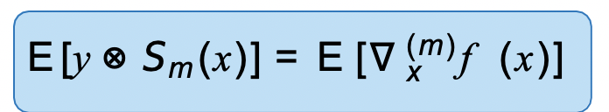
Stein’s Lemma through Score functions
► Continuous x with pdf p(·):
► m^{th}-order score function:
x ∈ R^{d}
_{m} ∇^{(m)}p(x)
S_{m}(x) := (−1)
Input:
p(x)
S₃(x) ∈ R^{d×d×d}
► For Gaussian x ∼ N (0, I): orthogonal Hermite polynomials
S₁(x) = x, S₂(x) = xx^{T} − I, . . .
Application of Stein’s Lemma
► Providing derivative information: let E[y|x] := f (x), then
► For Gaussian x ∼ N (0, I): orthogonal Hermite polynomials
S₁(x) = x, S₂(x) = xx^{T} − I, . . .
28/ 33

Slide 28
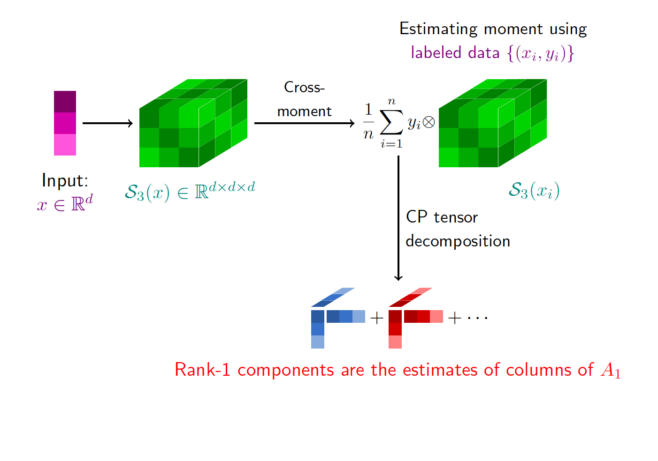
NN-LIFT: Neural Network-LearnIng using Feature Tensors

Slide 29

NN-LIFT: Neural Network-LearnIng using Feature Tensors

Slide 30
Realizable: E[y · S_{m}(x)] has CP tensor decomposition.
Training Neural Networks with Tensors
M. Janzamin, H. Sedghi, and A., “Beating the Perils of Non-Convexity: Guaranteed Training of
Neural Networks using Tensor Methods,” June. 2015.
A. Barron, “Approximation and Estimation Bounds for Artiﬁcial Neural Networks,” Machine Learning, 1994.

Slide 31
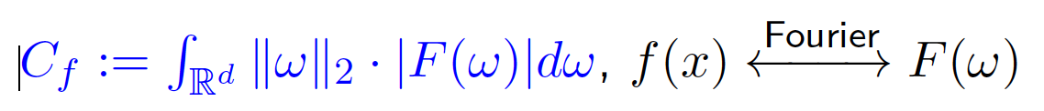
Training Neural Networks with Tensors
Realizable: E[y · S_{m}(x)] has tensor decomposition.
Non-realizable:
Theorem (training neural networks)
ˆ ˜
E [|f (x) − f (x)
2
2
f
For small enough C
x
| ] ≤ O(C /k)+ O(1/n).
f
n samples, k number of neurons
M. Janzamin, H. Sedghi, and A., “Beating the Perils of Non-Convexity: Guaranteed Training of
Neural Networks using Tensor Methods,” June. 2015.
A. Barron, “Approximation and Estimation Bounds for Artiﬁcial Neural Networks,” Machine Learning, 1994.

Slide 32
Training Neural Networks with Tensors
First guaranteed method for training neural networks
M. Janzamin, H. Sedghi, and A., “Beating the Perils of Non-Convexity: Guaranteed Training of
Neural Networks using Tensor Methods,” June. 2015.
A. Barron, “Approximation and Estimation Bounds for Artiﬁcial Neural Networks,” Machine Learning, 1994.

Slide 33
Background on optimization landscape of tensor decomposition

Slide 34
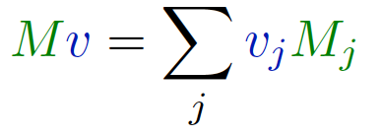
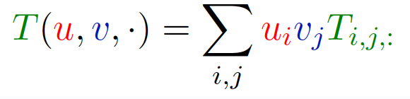


Notion of Tensor Contraction
Extends the notion of matrix product
Matrix product Tensor Contraction

Slide 35
Symmetric Tensor Decomposition
=
+
+ ···
T = v₁^{⊗3} + v₂^{⊗3} + ··· ,
A., R. Ge, D. Hsu, S. Kakade, M. Telgarsky, “Tensor Decompositions for Learning Latent
Variable Models,” JMLR 2014.

Slide 36



Symmetric Tensor Decomposition
Tensor Power Method
= +
+···
T (v, v, ·)
v
→ IT (v, v, ·)I .
2 2
T (v, v, ·) = (v, v₁) v₁ + (v, v₂) v₂
A., R. Ge, D. Hsu, S. Kakade, M. Telgarsky, “Tensor Decompositions for Learning Latent
Variable Models,” JMLR 2014.

Slide 37
Symmetric Tensor Decomposition
Tensor Power Method
= +
+···
T (v, v, ·)
^{v →} IT (v, v, ·)I .
2 2
T (v, v, ·) = (v, v₁) v₁ + (v, v₂) v₂
Orthogonal Tensors
v₁ ⊥ v₂.
T (v₁, v₁, ·) = λ₁v₁.
A., R. Ge, D. Hsu, S. Kakade, M. Telgarsky, “Tensor Decompositions for Learning Latent
Variable Models,” JMLR 2014.

Slide 38


Symmetric Tensor Decomposition
Tensor Power Method
= +
+···
T (v, v, ·)
^{v →} IT (v, v, ·)I .
2 2
T (v, v, ·) = (v, v₁) v₁ + (v, v₂) v₂
Orthogonal Tensors
v₁ ⊥ v₂.
T (v₁, v₁, ·) = λ₁v₁.
=
A., R. Ge, D. Hsu, S. Kakade, M. Telgarsky, “Tensor Decompositions for Learning Latent
Variable Models,” JMLR 2014.

Slide 39
Symmetric Tensor Decomposition
Tensor Power Method
= +
+···
T (v, v, ·)
^{v →} IT (v, v, ·)I .
T (v, v, ·) = (v, v₁)²v₁ + (v, v₂)²v₂
Exponential no. of stationary points for power method:
T (v, v, ·)= λv
A., R. Ge, D. Hsu, S. Kakade, M. Telgarsky, “Tensor Decompositions for Learning Latent
Variable Models,” JMLR 2014.

Slide 40










Symmetric Tensor Decomposition
Tensor Power Method
= +
+···
T (v, v, ·)
^{v →} IT (v, v, ·)I .
T (v, v, ·) = (v, v₁)²v₁ + (v, v₂)²v₂
Exponential no. of stationary points for power method:
T (v, v, ·)= λv
Stable
Unstable
Other statitionary points
A., R. Ge, D. Hsu, S. Kakade, M. Telgarsky, “Tensor Decompositions for Learning Latent
Variable Models,” JMLR 2014.

Slide 41
Symmetric Tensor Decomposition
Tensor Power Method
= +
+···
T (v, v, ·)
^{v →} IT (v, v, ·)I .
T (v, v, ·) = (v, v₁)²v₁ + (v, v₂)²v₂
Exponential no. of stationary points for power method:
T (v, v, ·)= λv
For power method on orthogonal tensor, no spurious stable points
A., R. Ge, D. Hsu, S. Kakade, M. Telgarsky, “Tensor Decompositions for Learning Latent
Variable Models,” JMLR 2014.

Slide 42
Non-orthogonal Tensor Decomposition
=
+
+ ···
T = v₁^{⊗3} + v₂^{⊗3} + ··· ,
A., R. Ge, D. Hsu, S. Kakade, M. Telgarsky, “Tensor Decompositions for Learning Latent
Variable Models,” JMLR 2014.

Slide 43
Non-orthogonal Tensor Decomposition
Orthogonalization
Input tensor T
A., R. Ge, D. Hsu, S. Kakade, M. Telgarsky, “Tensor Decompositions for Learning Latent
Variable Models,” JMLR 2014.

Slide 44
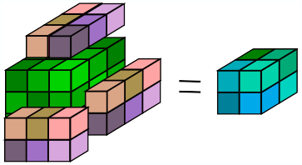
Non-orthogonal Tensor Decomposition
Orthogonalization
T (W, W, W ) = T˜
A., R. Ge, D. Hsu, S. Kakade, M. Telgarsky, “Tensor Decompositions for Learning Latent
Variable Models,” JMLR 2014.

Slide 45



Non-orthogonal Tensor Decomposition
Orthogonalization
v₁ v₂
W v˜1 v˜2
T (W, W, W ) = T˜
A., R. Ge, D. Hsu, S. Kakade, M. Telgarsky, “Tensor Decompositions for Learning Latent
Variable Models,” JMLR 2014.

Slide 46

Non-orthogonal Tensor Decomposition
Orthogonalization
v₁ v₂
W v˜1 v˜2
T (W, W, W ) = T˜
T˜ = T (W, W, W ) = v˜₁^{⊗3} + v˜₂^{⊗3} + ··· ,
=
+
A., R. Ge, D. Hsu, S. Kakade, M. Telgarsky, “Tensor Decompositions for Learning Latent
Variable Models,” JMLR 2014.

Slide 47

Non-orthogonal Tensor Decomposition
Orthogonalization
v₁ v₂
W v˜1 v˜2
T (W, W, W ) = T˜
Find W using SVD of Matrix Slice
+
M = T (·, ·, θ) =
A., R. Ge, D. Hsu, S. Kakade, M. Telgarsky, “Tensor Decompositions for Learning Latent
Variable Models,” JMLR 2014.

Slide 48
Non-orthogonal Tensor Decomposition
Orthogonalization
v₁ v₂
W v˜1 v˜2
T (W, W, W ) = T˜
Orthogonalization: invertible when v_{i}’s linearly independent.
A., R. Ge, D. Hsu, S. Kakade, M. Telgarsky, “Tensor Decompositions for Learning Latent
Variable Models,” JMLR 2014.

Slide 49
Non-orthogonal Tensor Decomposition
Orthogonalization
v₁ v₂
W v˜1 v˜2
T (W, W, W ) = T˜
Orthogonalization: invertible when v_{i}’s linearly independent. Recovery of Network Weights under Linear Independence
A., R. Ge, D. Hsu, S. Kakade, M. Telgarsky, “Tensor Decompositions for Learning Latent
Variable Models,” JMLR 2014.

Slide 50
Perturbation Analysis for Tensor Decomposition
Well understood for matrix decomposition vs. hard for polynomials. Contribution: ﬁrst results for tensor decomposition.
A., R. Ge, D. Hsu, S. Kakade, M. Telgarsky, “Tensor Decompositions for Learning Latent
Variable Models,” JMLR 2014.

Slide 51
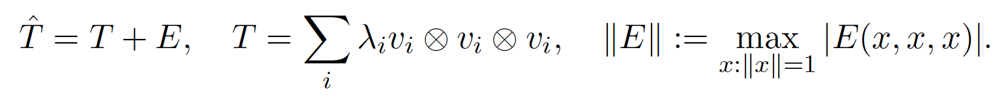
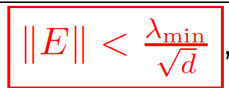
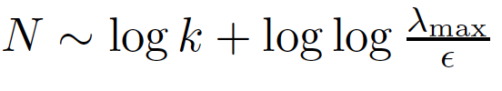
Perturbation Analysis for Tensor Decomposition
Well understood for matrix decomposition vs. hard for polynomials. Contribution: ﬁrst results for tensor decomposition.
T ∈ R^{d×d×d}: Orthogonal tensor. E: noise tensor.
Theorem: When
, in
iterations of
power method and linear no. of restarts, recovery of {v_{i}} up to error IEI.
A., R. Ge, D. Hsu, S. Kakade, M. Telgarsky, “Tensor Decompositions for Learning Latent
Variable Models,” JMLR 2014.

Slide 52
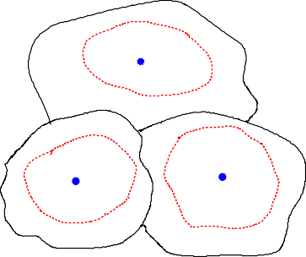
Perturbation Analysis for Tensor Decomposition
v₃
v₁
v₂
Theorem: When
iterations of
power method and linear no. of restarts, recovery of {v_{i}} up to error IEI.
A., R. Ge, D. Hsu, S. Kakade, M. Telgarsky, “Tensor Decompositions for Learning Latent
Variable Models,” JMLR 2014.

Slide 53

Perturbation Analysis for Tensor Decomposition
Dataset 1
Dataset 2
Model Class
Require datasets with good model ﬁtting.
Theorem: When
λ
iterations of
power method and linear no. of restarts, recovery of {v_{i}} up to error IEI.
Polynomial computational and sample complexity for tensor methods
A., R. Ge, D. Hsu, S. Kakade, M. Telgarsky, “Tensor Decompositions for Learning Latent
Variable Models,” JMLR 2014.

Slide 54
Implications and next steps

Slide 55
NN-LIFT: Neural Network-LearnIng using Feature Tensors

Slide 56
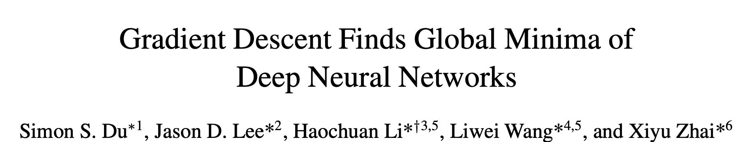
Overparameterization as a solution?
Gradient descent (no stochasticity)
Width of each layer exponentially large in number of layers for fully connected but polynomial for ConvNets and Resnets (but requires overparameterization in each layer)

Slide 57
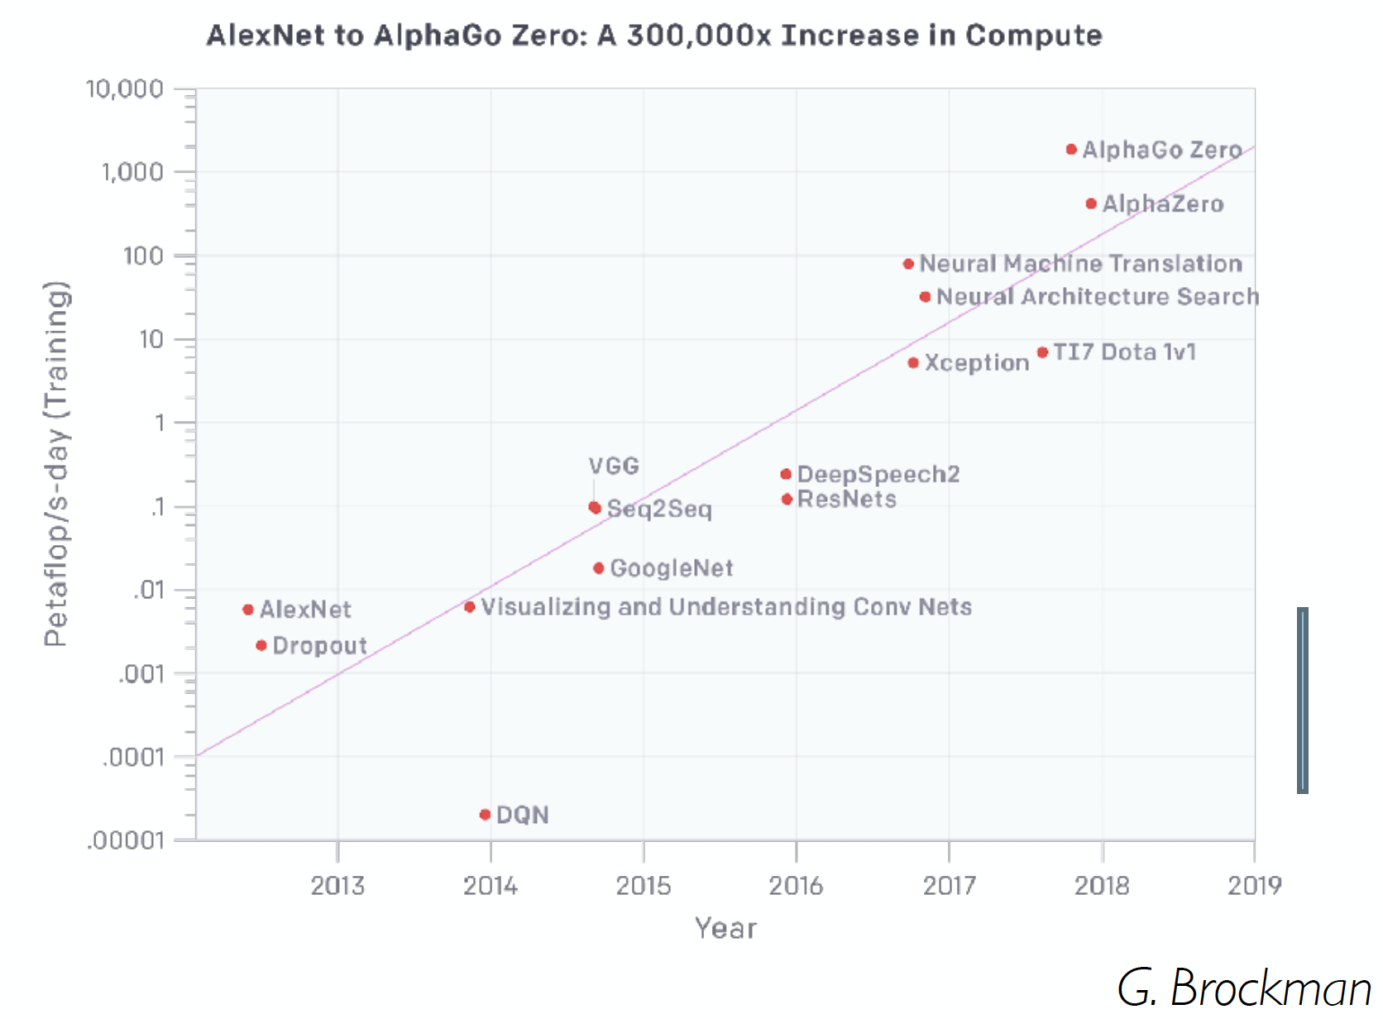
So what is the cost?
Slides from Ben Recht

Slide 58
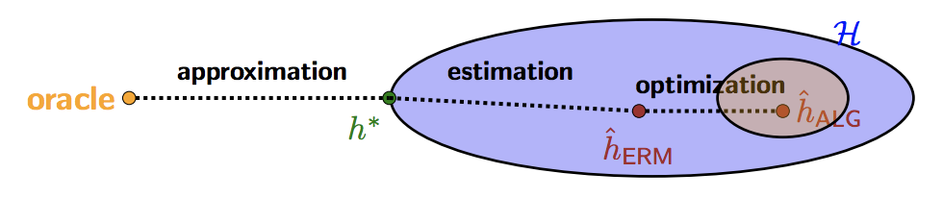
Optimization is only part of picture..

Slide 59
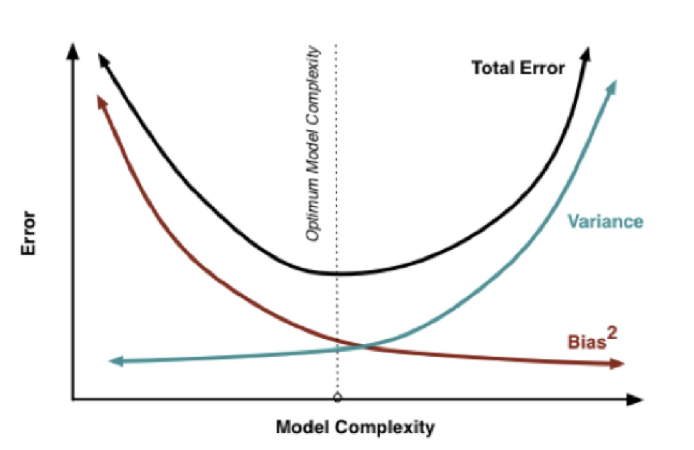
Classical Theory

Slide 60
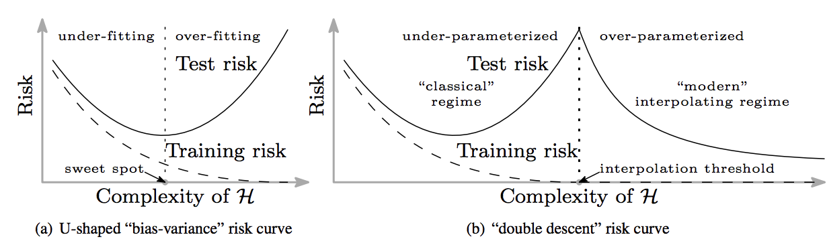
Theory for Modern NN?
Belkin et.al, “Reconciling modern machine learning and the bias-variance trade-off”

Slide 61
Role of Generative Process
► Continuous x with pdf p(·):
► m^{th}-order score function:
x ∈ R^{d}
_{m} ∇^{(m)}p(x)
S_{m}(x) := (−1)
Input:
p(x)
S₃(x) ∈ R^{d×d×d}
Score functions: need generative model.
Shows role of generative process in discriminative learning.
Estimating this is hard in general.
More relevant in system ID setting where p(x) is known.
In control, wireless networks (channel estimation) etc.
Open question: how to optimally select p(x)?
Also, how to generalize it to multi-layer networks?

