Slide 1
The Ornstein-Uhlenbeck process ⇒ Generalization for deep learning
Paul Valiant
Brown University
Joint work with:
Guy Blanc, Neha Gupta, and Gregory Valiant

Slide 2
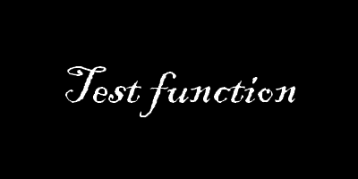
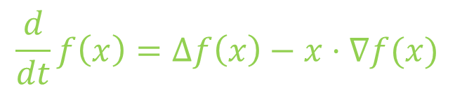
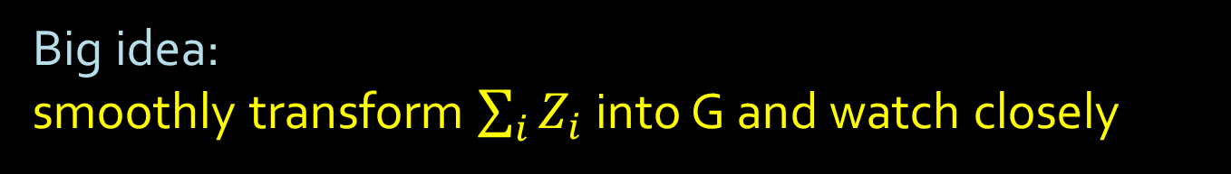
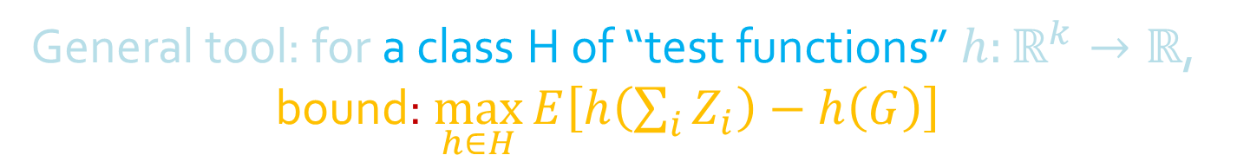
Stein’s Method
Goal: ∑_{i} Z_{i} ≈ G (multivariate Gaussian)
General tool: for a class H of “test functions” ${h:ℝ}^{k}→ℝ$, bound: $\max_{h∈H}{E\left[h\left(\sum_{i}{Z_{i}}\right)−h\left(G\right)\right] }$
Big idea:
smoothly transform $\sum_{i}{Z_{i}}$ into G and watch closely
(Bonus: simulate doing this, changing only h)
Ornstein-Uhlenbeck: 1) add noise, 2) rescale towards center
$$\frac{d}{dt}f\left(x\right)=Δf\left(x\right)−x⋅∇f(x)$$
Notes:
Technically, Gaussian rounded to the nearest lattice points, since our fingerprint distribution is on the lattice points, but a rounded Gaussian is less natural, so, next vignette for this too.

Slide 3
On Counting Fish
D
Goal: characterize generalized multinomial distributions, so we can easily estimate their TV distance from each other (so we can know whether algorithms are impossible or not)
Aim: compare to Gaussians (rounded to the nearest lattice point), in TV distance.
(Poisson distribution not flexible enough)
Fishing Poi(k) times:
A fish of probability p_{i} →
Intermediate step: Compare with (unrounded) Gaussians, in earthmover distance → Stein’s method
Pr[0 catches] | Pr[1 catch] | Pr[2 catches] | Pr[3 catches] | …
Pr[Poi(k p_{i}) = 0] | Pr[Poi(k p_{i}) = 1] | Pr[Poi(k p_{i}) = 2] | Pr[Poi(k p_{i}) = 3] | …
“Generalized multinomial distribution”

Slide 4
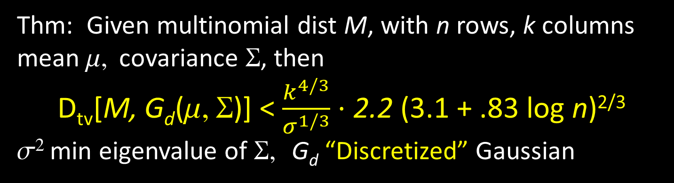
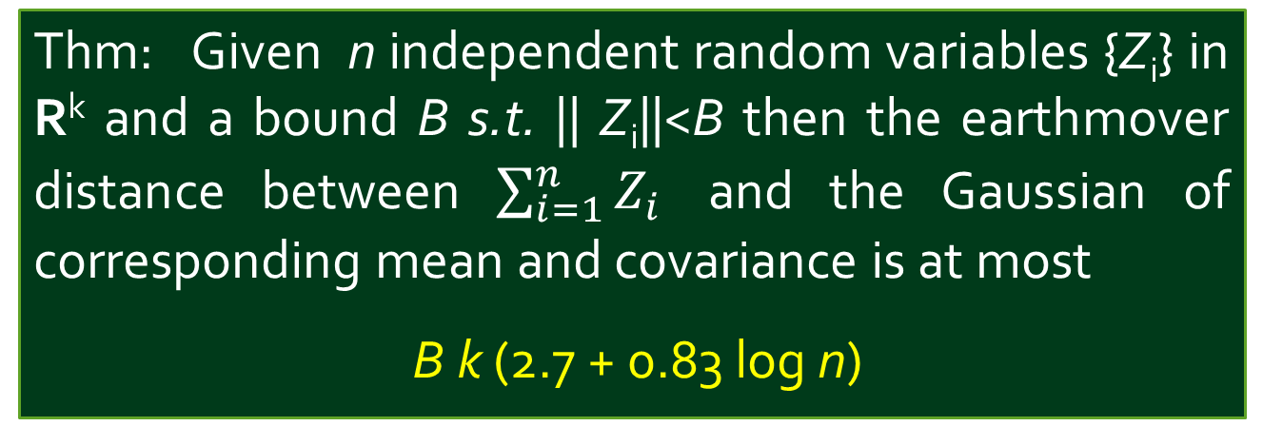
On Counting Fish: Theorems
Earthmover → TV: convolve both sides with a binomial bump
Thm: Given n independent random variables {Z_{i}} in R^{k} and a bound B s.t. || Z_{i}||<B then the earthmover distance between $\sum_{i=1}^{n}{Z_{i}}$ and the Gaussian of corresponding mean and covariance is at most
B k (2.7 + 0.83 log n)
Convolving with a bump doesn’t change G much in TV sense (G’s pdf is unimodal and bounded)
Generalized multinomials are unimodal in any coordinate
Does it change M?
Lemma: enough for the other distribution (G) to be bounded

Slide 5
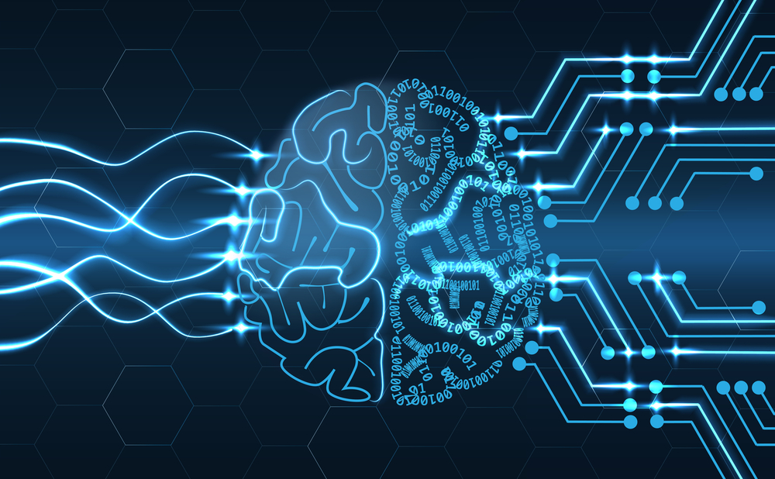
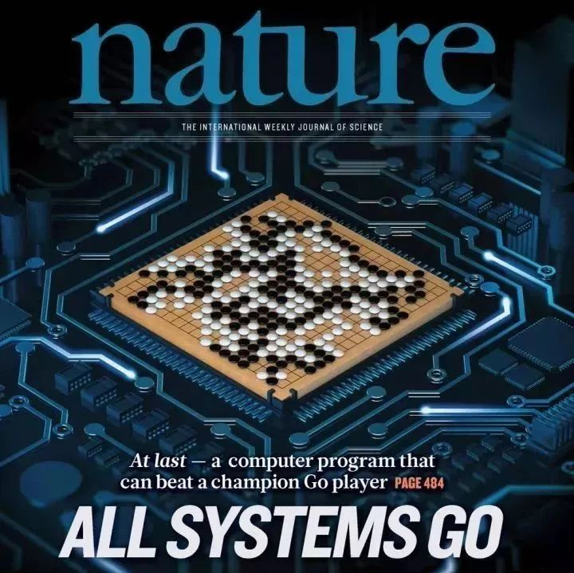
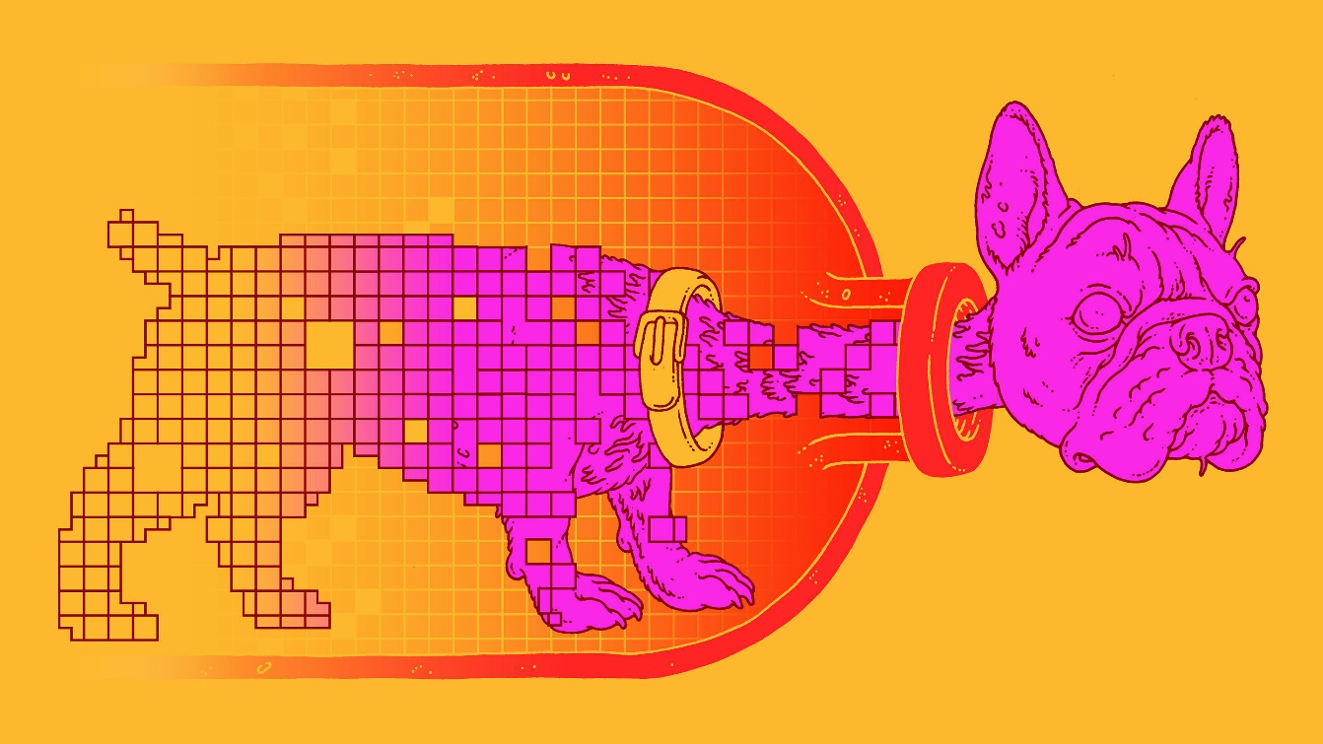
Deep Learning

Slide 6
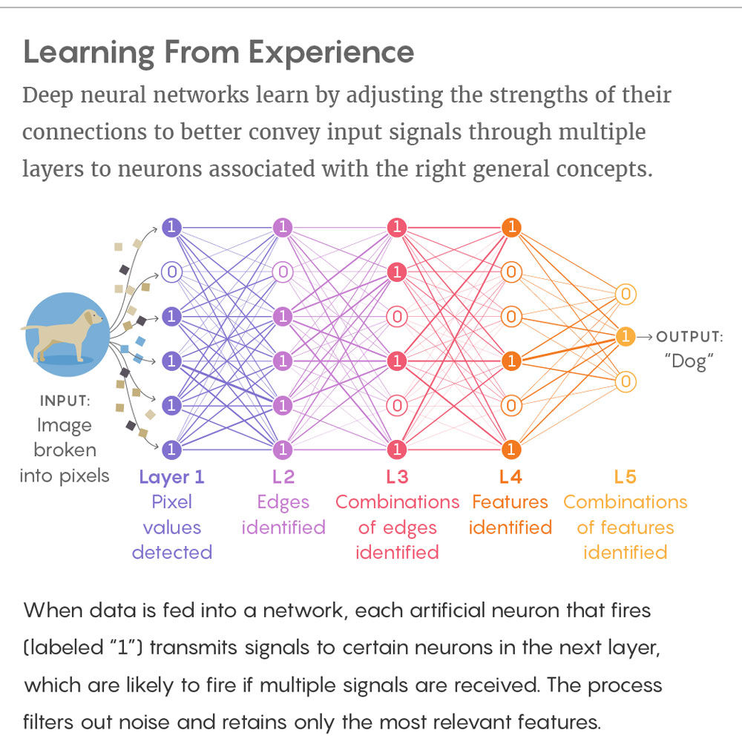
Deep Learning
>100M trainable weights
Parameters optimized via gradient descent

Slide 7
The Unreasonable Effectiveness of Deep Learning
It has revolutionized many ML areas overnight
“Gold rush” mentality
As a theoretician: why? Explanations missing
THEORY
PRACTICE

Slide 8
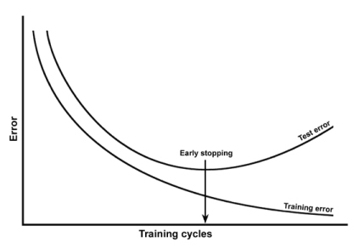
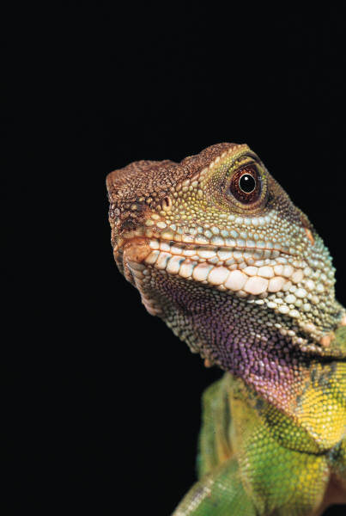
Generalization and Overfitting
Unless… maybe deep models can only express simple, natural concepts?
>100M trainable weights
No! Deep models can fit arbitrary data.
Model Complexity
Deeper (more expressive) models tend to generalize better.
Modeling issue: deep learning means >100M parameters; how to get a simple model?

Slide 9
Our Model
(One unmotivated sidestep)
Stochastic gradient descent (SGD) with label noise:
At each time step,
Pick a random piece of training data (x_{i},y_{i})
Add iid noise to the label y_{i}
Adjust the parameters of the hypothesis h (via gradient descent) so that h(x_{i}) more closely matches y_{i}
(adjust proportionally to y_{i}-h(x_{i}), namely, L2 norm
Not so unrealistic: captures the case of “impossible to fit” data where the same (or similar) x_{i} is associated with multiple different y_{i}

Slide 10
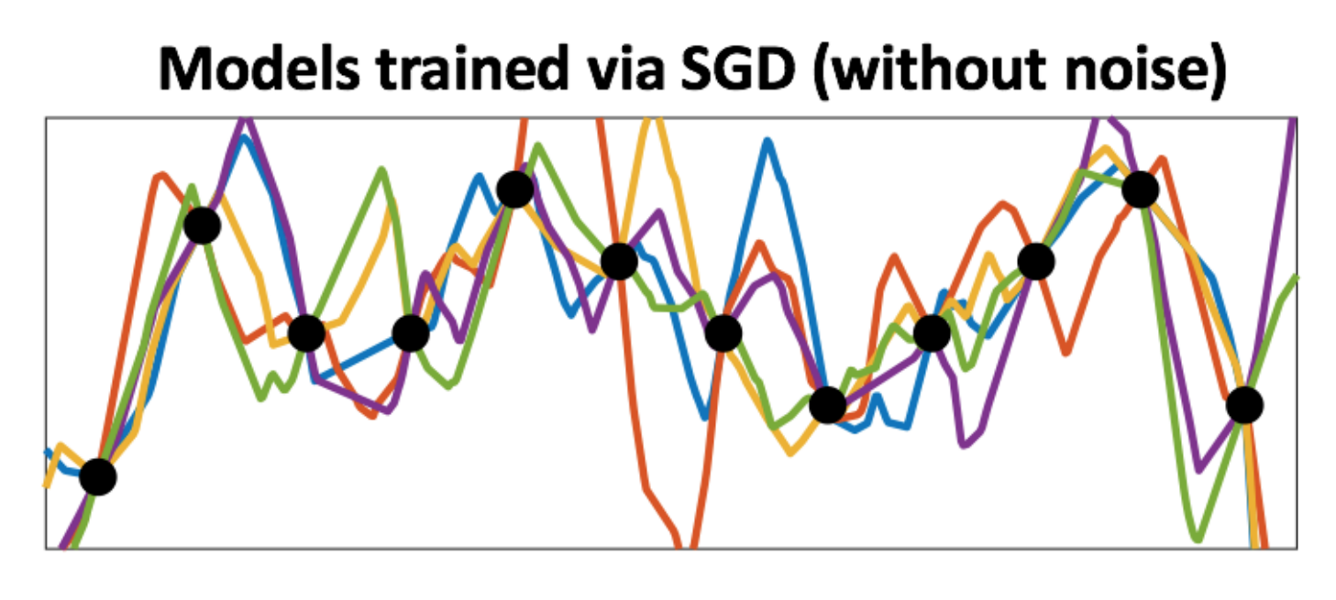
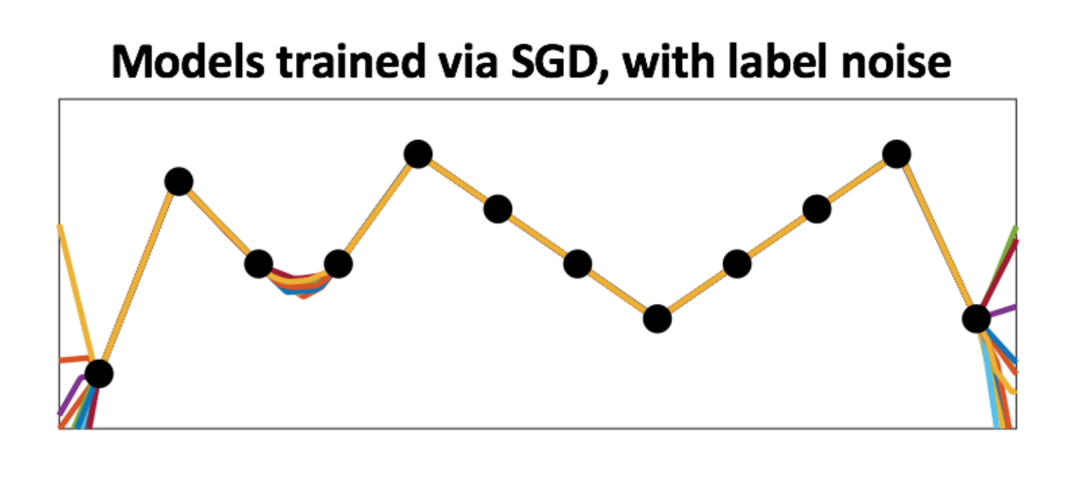
Results
(in pictures)
ReLU network,
2 trainable layers
inp
out

Slide 11
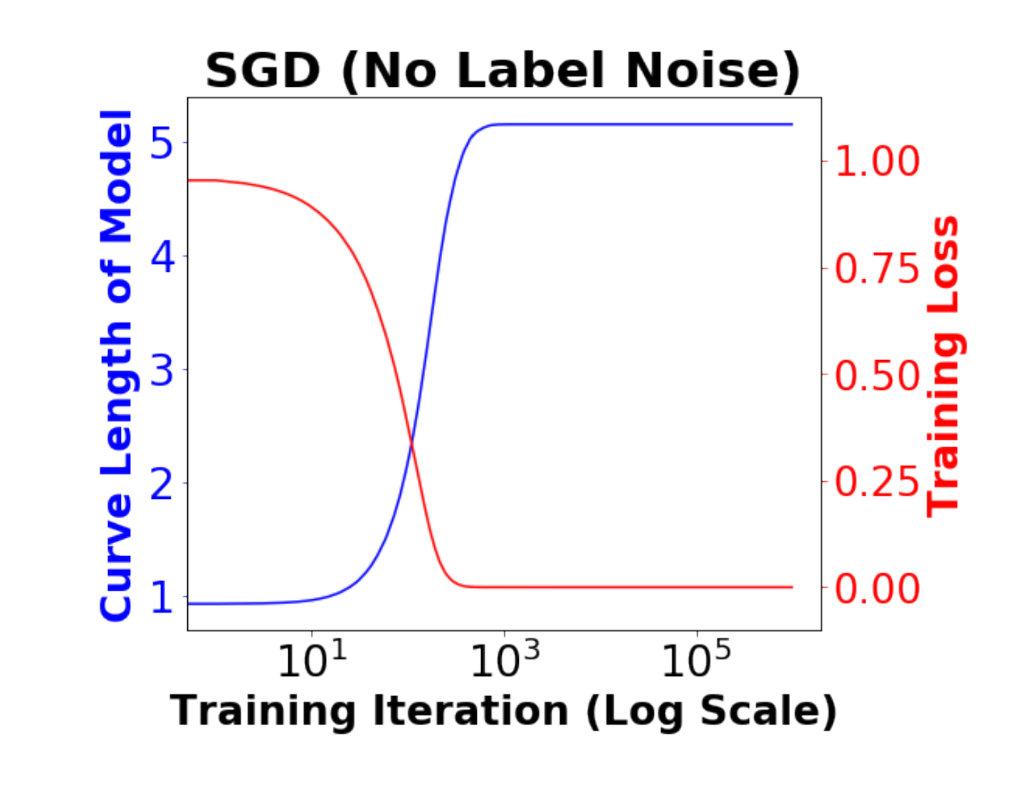
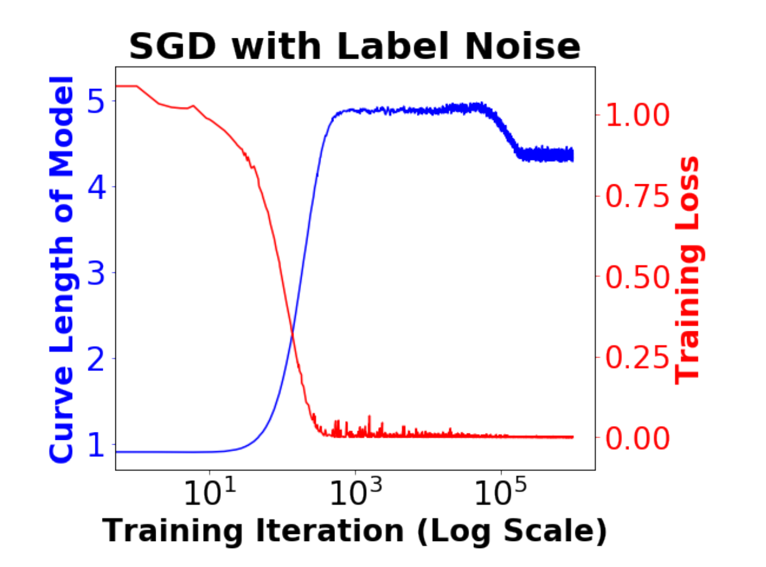
Results
(in pictures)
Intuitively, label noise makes this (shallow) network train with the characteristics of deep learning:
ReLU network,
2 trainable layers
Seems: generalization is helped not hurt by overparameterization
inp
out
Performance continues improving long after training error converges

Slide 12
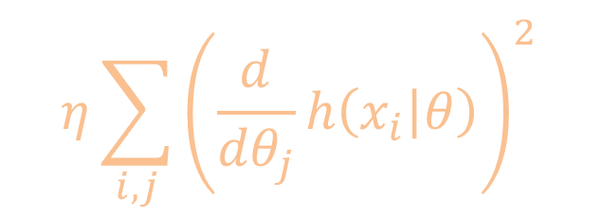
Results
1. L2 SGD with label noise induces an Ornstein-Uhlenbeck process on the model parameters which implicitly adds a regularization term to the objective function. Any stable point of the dynamics, with 0 training error, must be a local minimum of the regularizer.
Subtly pushes the model to be simpler, generalize better
$$η\sum_{i,j}{{\left(\frac{d}{{dθ}_{j}}h\left(x_{i} | θ\right)\right)}^{2}}$$
Regularizer:
ReLU network,
2 trainable layers
2. In the 1d setting, local minima of the regularizer are piecewise linear with the fewest possible kinks subject to the data.
inp
out

Slide 13
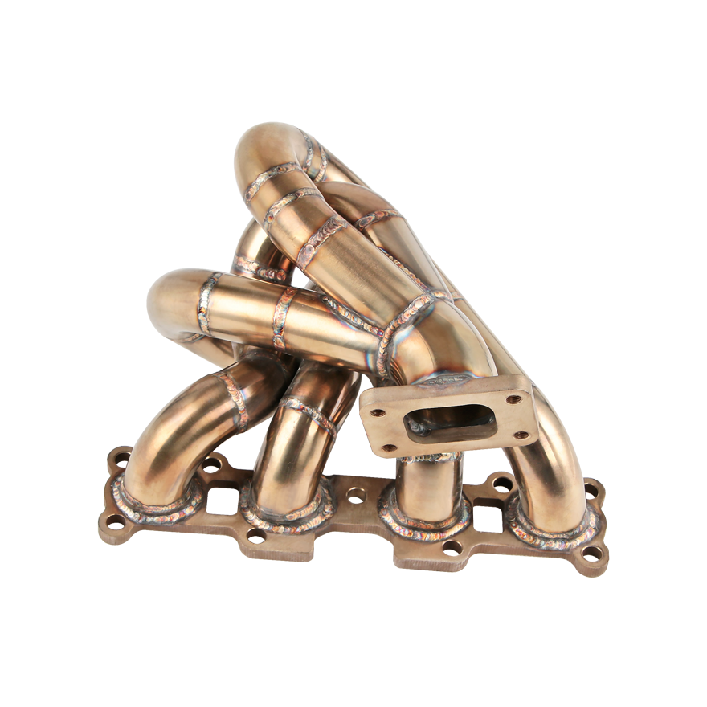



Intuition (1/2)
What are the dynamics of SGD on the manifold?
Given:
100M trainable parameters
1M items of training data
Label noise → noise term
(Re-)minimizing training error → mean reversion
99M-dimensional
“manifold of 0 training error”
…Ornstein-Uhlenbeck:
$$dθ=−Aθdt+BdW$$
$$dθ=−DD^{T}θdt+DdW$$
Let $D_{i,j}=\frac{d}{dθ_{j}}h(x_{i},θ)$
Spherical covariance!

Slide 14
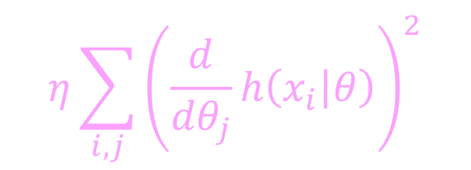
Intuition (2/2)
Short timescales:
Noise and (re)minimizing training error → spherical Ornstein-Uhlenbeck
Drift on manifold, seeking to minimize objective value of Ornstein-Uhlenbeck neighborhood. Effectively: SGD on regularizer instead of objective
What are the dynamics of SGD on the manifold?
Medium timescales:
$$η\sum_{i,j}{{\left(\frac{d}{{dθ}_{j}}h\left(x_{i} | θ\right)\right)}^{2}}$$
Regularizer:
Long timescales:
End up at local minimum of regularizer, subject to 0 training error

Slide 15
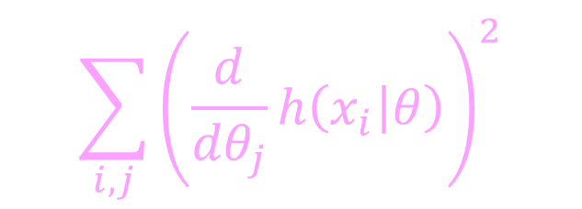
The Regularizer
$$\sum_{i,j}{{\left(\frac{d}{{dθ}_{j}}h\left(x_{i} | θ\right)\right)}^{2}}$$
Arises naturally in this context.
And if you morally believe these results, then you would want to use it in general.
Side story:
Unknown, low rank matrix A
Given: measurements of products of random vectors with A
Recover A (<< samples than full rank)
Compressive sensing:
Surprising algorithm: L2 gradient descent on full n×n matrices, from small initialization
New observation [Hongyang Zhang]: with our regularizer, works from any initialization! Regularizer → nuclear norm. (L1 of sing. val.)
Gives new motivation for nuclear norm.
[Li, Ma, Zhang, COLT 2018 best paper]

Slide 16
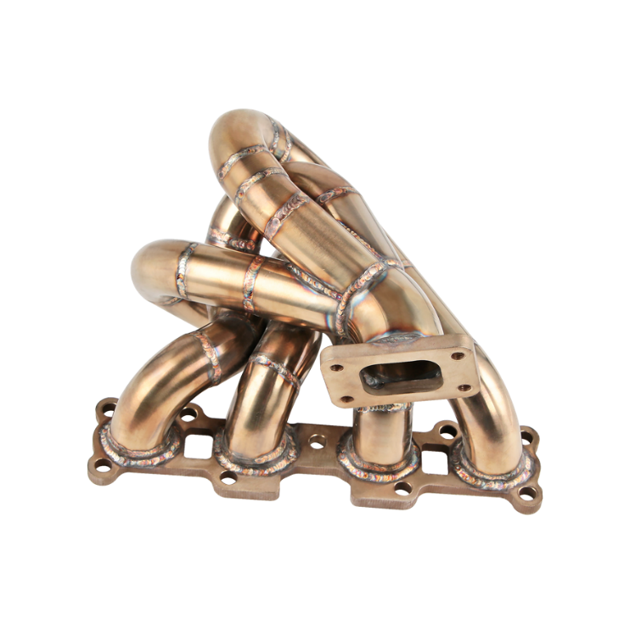
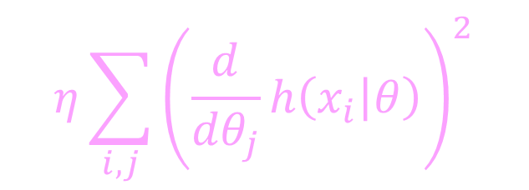
Conclusions
More parameters → more paths through manifold
Ornstein-Uhlenbeck dynamics are crucial to ML, DL
Provable results
Tons of open questions:
Characterize minima of regularizer beyond 1d, or compressed sensing
Huge scale of deep learning → any other crucial 2nd-order effects in other stochastic processes?
☺
Dynamics of SGD on the 0-training-error manifold: slow implicit regularizer minimization.
$$η\sum_{i,j}{{\left(\frac{d}{{dθ}_{j}}h\left(x_{i} | θ\right)\right)}^{2}}$$
Arxiv: Implicit regularization for deep neural networks driven by an Ornstein-Uhlenbeck like process

Slide 17
Thanks!

Slide 18
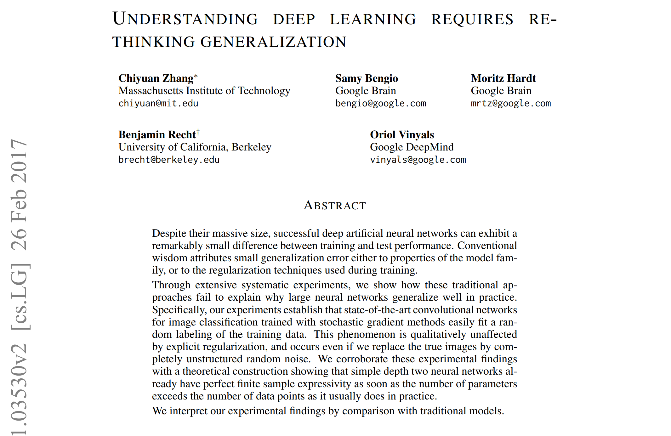
Generalization and Overfitting
Can’t say “deep learning produces only nice models” if it will fit literally anything!

