Slide 1
Apptainer Workshop
How to
* build an Apptainer based software stack
* maintain several version of that
* deploy your software on COSMOS-SENS
BMC Bioinformatics core unit

Slide 2
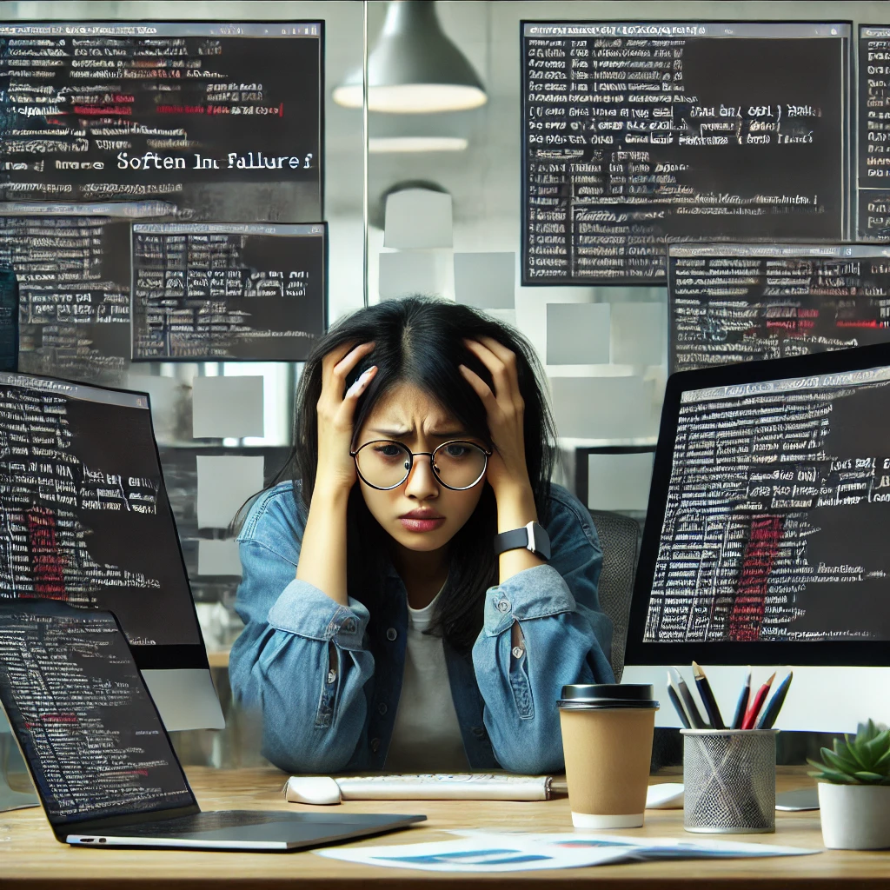
Lost Your Software?
You can not reproduce your results as your R has updated?
Your Laptop can not handle the amount of data that you need to process?

Slide 3
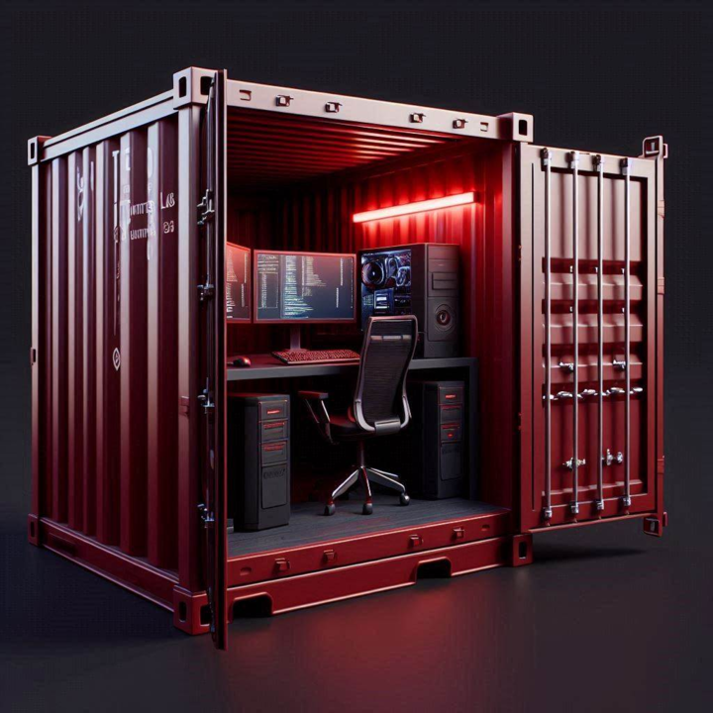
Apptainer
Create a save image Even an “unsafe” R version can be run inside
Share the image Share exactly your software stack
Run the image anywhere Even on a save HPC without internet

Slide 4
Thank you for your patience!

