Slide 1

AWS Developer
Other Services

Slide 2

SQS
Message queue used to store messages as they get processed by worker nodes
SQS is pull based system (SNS is push based system)
Visibility timeout – message becomes invisible while being processed
Acts as buffer between producer and receiver in case one is producer is faster than the other or if producer/consumer lose network connection

Slide 3
2 Types
Standard queue (default)
High throughput, nearly unlimited number of transactions per second
Could be out of order, no guarantees
There could be duplicates
FIFO
Guarantees order
No duplicates
300 TPS limit

Slide 4
Features
Messages are 256 KB
Messages can be kept in queue 1min – 14 days
Default retention period is 4 days
SQS message will be processed at least once
Default visibility timeout – 30sec , max is 12 hours

Slide 5
Polling
Long polling
Does not return after every check, only responds if message is in queue
Short polling
responds after every check even if queue is empty

Slide 6
SNS
Setup, operate and send notifications in the cloud, scalable, highly available
Besides pushing cloud notifications
SMS text
Email to SQS queue
To HTTP endpoint
Can trigger lambda functions
Topics: subscribe to a topic so notifications can be sent to multiple recipients
Messages stored redundantly across multiple AZs

Slide 7
Benefits
Push based
Flexible message delivery
Pay as you go
$50 per 1 million requests

Slide 8
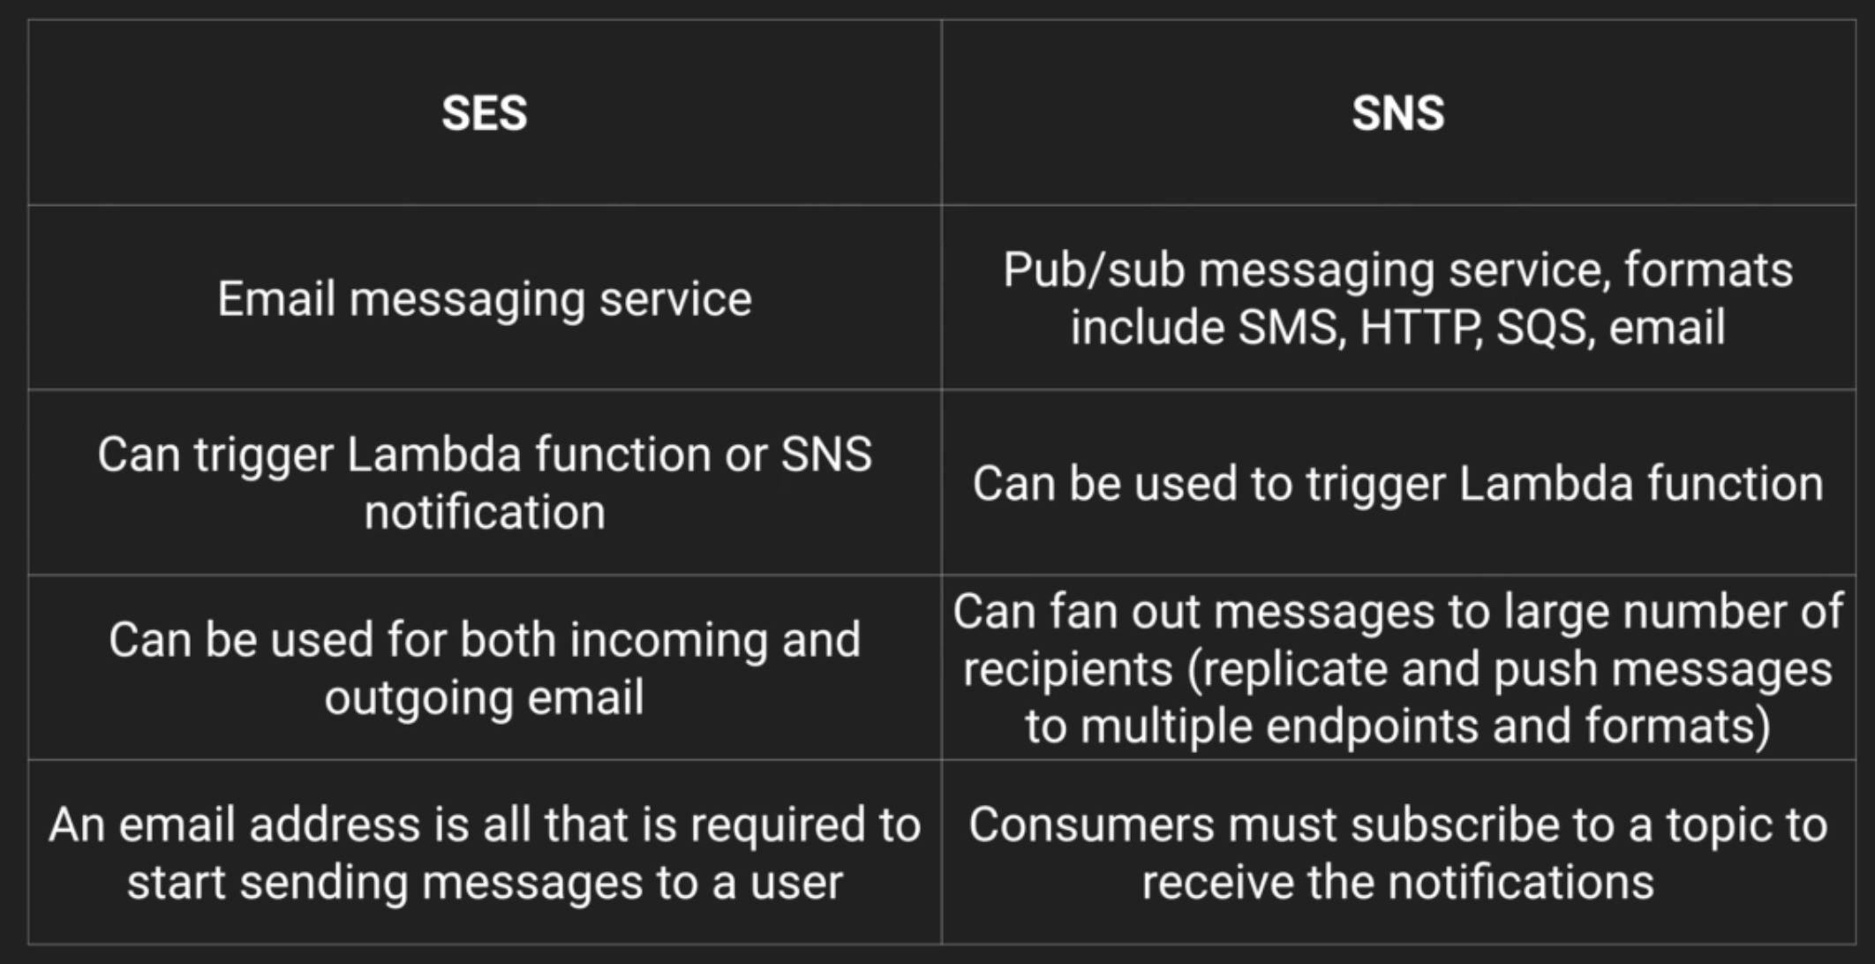
SES vs SNS

Slide 9
Elastic Beanstalk
Deploys, scaled web application, takes care of infra
Upload code and Beanstalk handles deployment, infra, LB, scaling, app health
Retain control of underlying AWS resources
You can take control of EC2, choose instance type etc

Slide 10
Beanstalk deployment policies
All at once – downtime (dev and test)
Rolling – not ideal for performance sensitive
Rolling with additional batch – no downtime or performance issues
Immutable – preferred option for mission critical

Slide 11
Advanced EB
.config extention saved in folder called .ebextentions

