Slide 1

AWS Developer
Dev Theory

Slide 2
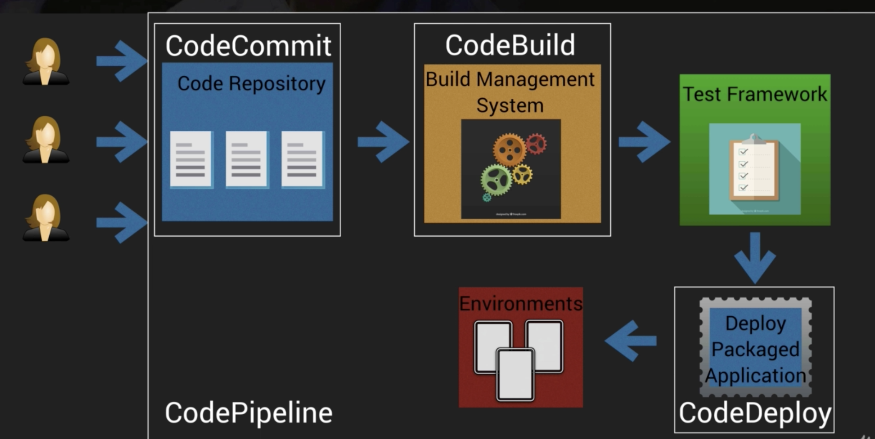
CICD

Slide 3
Code Commit
Fully managed source control service
Tracks code changes, versions
Git based

Slide 4

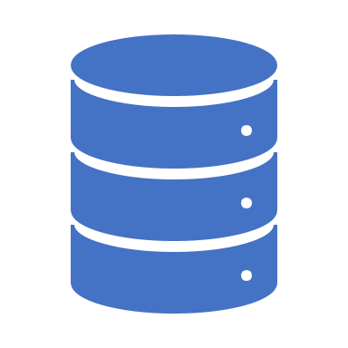
Code Deploy
Automated deployment service which allows you to deploy your application code automatically to EC2, on–prem systems, Lambda
Integrates with Github, Jenkins, and config management tools like Ansible, Puppet

Slide 5

Code Pipeline
Select a source for code – for e.g. S3 bucket
Select instance type, service role
Select build tool – Jenkins, codebuild, solaceCI, or leave blank
Code deploy integrates with code pipeline
Pipeline is kicked off everytime source code changes for e.g. S3 bucket event

Slide 6
Appspec file
Defines parameters for code deploy deployment
Lambda – YAML or JSON
Version: 0.0 (for future use)
Resources: properties of lambda functions
Hooks: specifies lambda functions to run at set times for e.g. validation tests
Before allow traffic (before traffic is routed to the lambda)
After allow traffic (after traffic is routed to the lambda)
EC2
Version: 0.0
OS: for e.g. Windows or Linux
Files: Location of any app files
Hooks: Applicationstop, downloadbundle, Beforeinstall, install, afterinstall, applicationstart, validateservice, beforeblocktraffic, blocktraffic, afterblocktraffic.
Appspec file must be in root directory

Slide 7
Docker and CodeBuild
Commands:
docker build –t myimagerepo . (builds docker image)
docker tag myimagerepo: latest [target image URL]
docker push [target image URL]
We use buildspec for CodeBuild. It is optional.
Prebuild
Build
postbuild

Slide 8
Cfn
Allows IaC
JSON/YAML templates
Cfn is a service that reads the template and makes API calls
Benefits:
Consistency
Less time and effort
Free
Version control
Remembers state, can be used to rollback or delete stack

Slide 9
How cfn works
Create template
Upload to s3
Cfn reads and creates stack (resulting resources)

Slide 10
Template content
AWSTemplateFormatVersion – template version number
Description – describe template
Metadata – data about data
Parameters – for e.g. env [dev|prod]
Conditions – do things based on parameters
Mappings – set values based on region
Transform – include snippets of code outside code template (think code re-use)
Resources – AWS resources specified here – only mandatory section
Output – outputs values to console and can be input to other cfn

Slide 11
SAM – Serverless Application Model
Extention to cfn for serverless applications
Simplified syntax
SAM CLI
sam package \
-- template-file
sam deploy

Slide 12
More Stuff
Codebuild –
Create s3 bucket to add zipped up code
Create buildspec.yml
Create project – aws codebuild create-project
Start build – aws codebuild start-build –project-name
Aws codebuild batch-get-builds
Code with Jenkins
Follow same steps above to setup project
Install codebuild plugin on Jenkins
Add build step - Run build on AWS AWS CodeBuild
Debug builds on dashboard or Cloudwatch
Security
Encrypt artifacts using KMS
Use IAM for permission control

Slide 13

More Stuff
Cloudwatch
Supports all OSs EC2 supports
Real time application and system monitoring
Long term log retention
CW log agent can be installed on non AWS resources
CW logs insight – interactive, integrated log analytics, run queries on logs, debug
High resolution metrics (1 sec) available for 3 hours for only custom metrics – Set StorageResolution using PutMetricData API
Low rez (1 hour) available for 15 months
Default resolution is 1 min
Can’t delete metrics

Slide 14
More Stuff
CW monitoring
Create alarms for number of error - use `error` keyword
EC2config used to send variety of log files to CW
CW agent sends data every 5 sec
JSON or text based logs ingestable
Non-text based logs will show up as errors in /var/logs/awslogs.log.
Use metric filter to filter metric further for e.g. occurrence of “error”
CW let’s you test metric patterns
Metric filters do not support regular expressions, instead use Kinesis

Slide 15
More Stuff
CW log retrieval
CLI getLogEvents – based on groups, stream and time
How long does log data stay? Indefinite. Retention period can be changed
Log Analytics
logs:DescribeLogGroups and logs:FilterLogEvents
@message, @timestamp, @logstream – for querying

