Slide 1

AWS Dev White paper
Microservices

Slide 2
Characteristics of a Microservice
Decentralized – rely on own data (schema),
Independent - built and operated independently
Do one thing well
Polygot – teams have freedom to choose tools to solve for problems
Blackbox

Slide 3
Challenges
How to avoid duplication
Tracking 100s of code pipelines
Managing interactions between 100s of microservices

Slide 4
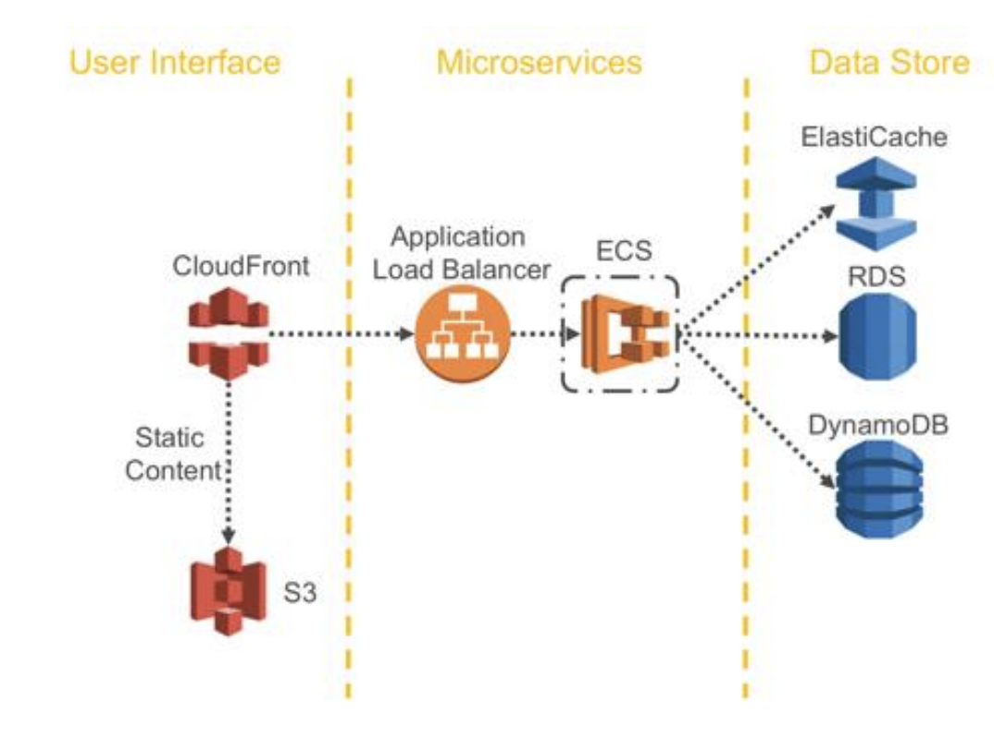
Typical Microservice on AWS

Slide 5
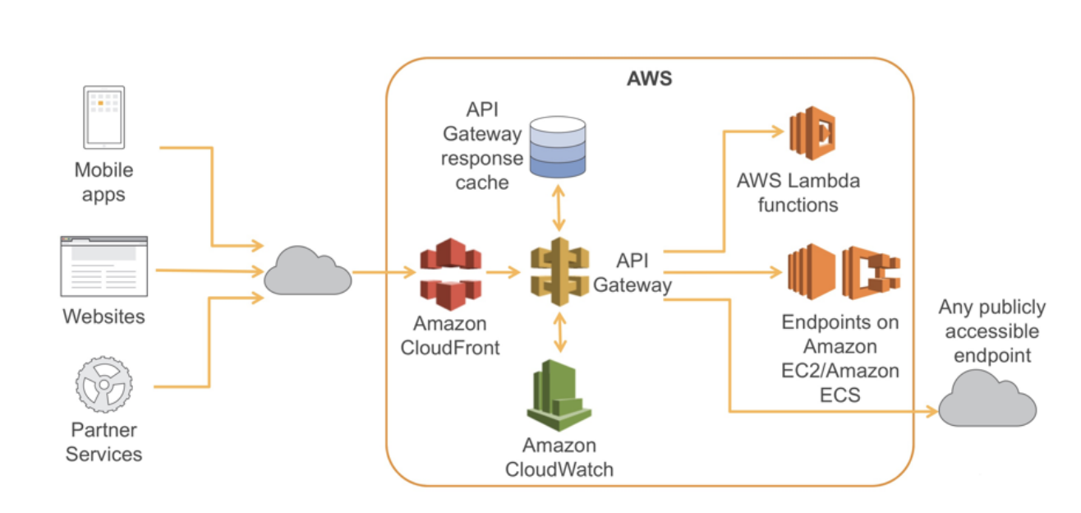
API GW Microservice

Slide 6
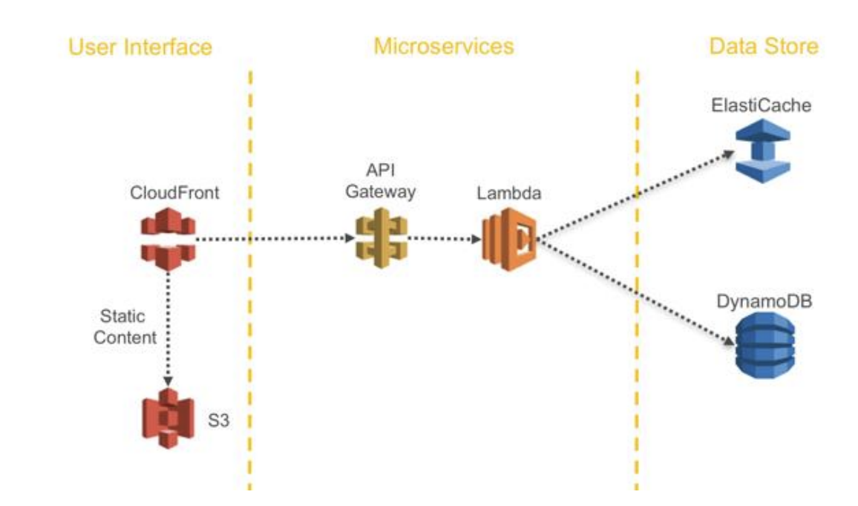
Serverless Microservice

Slide 7

Service Discovery
ALB – health checks
Route53
ECS event stream – near real time status of container instance and task health
CM – Opsworks is a service that uses Chef to automate server configuration

