Slide 1

AWS Developer
Whitepapers

Slide 2
Security
AWS shared responsibility model
Infra services:
AWS responsibility – Facilities, Physical security of hardware, Network infrastructure, Virtualization infrastructure
Customer responsibility - Amazon Machine Images (AMIs) • Operating systems • Applications • Data in transit • Data at rest • Data stores • Credentials • Policies and configuration
Security services – IAM

Slide 3
Customer responsibility
Infra – Manage OS, the app, configure IAM access. For e.g. EC2 access – keys (pem)
Container – OS managed by AWS, you manage network controls such as SG, and IAM. For e.g. RDS
Abstract – for e.g. SQS, SES, S3 – you use IAM for security, AWS manages underlying infrastructure

Slide 4
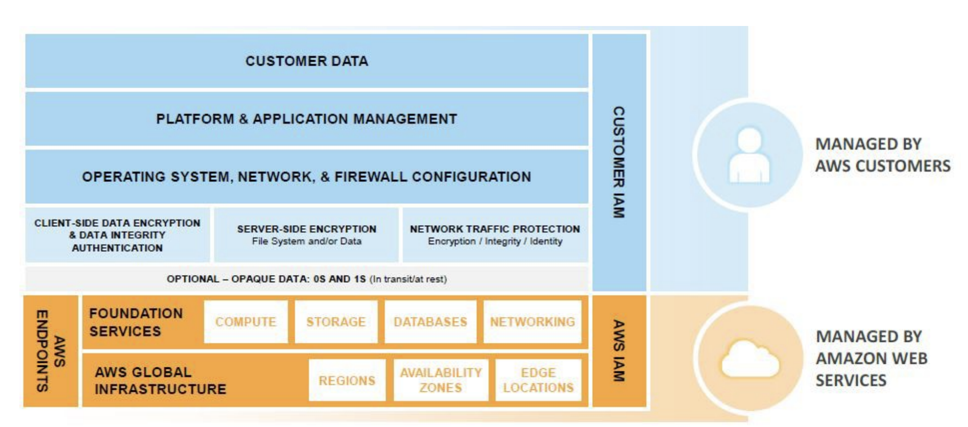
Shared responsibility – infra services

Slide 5
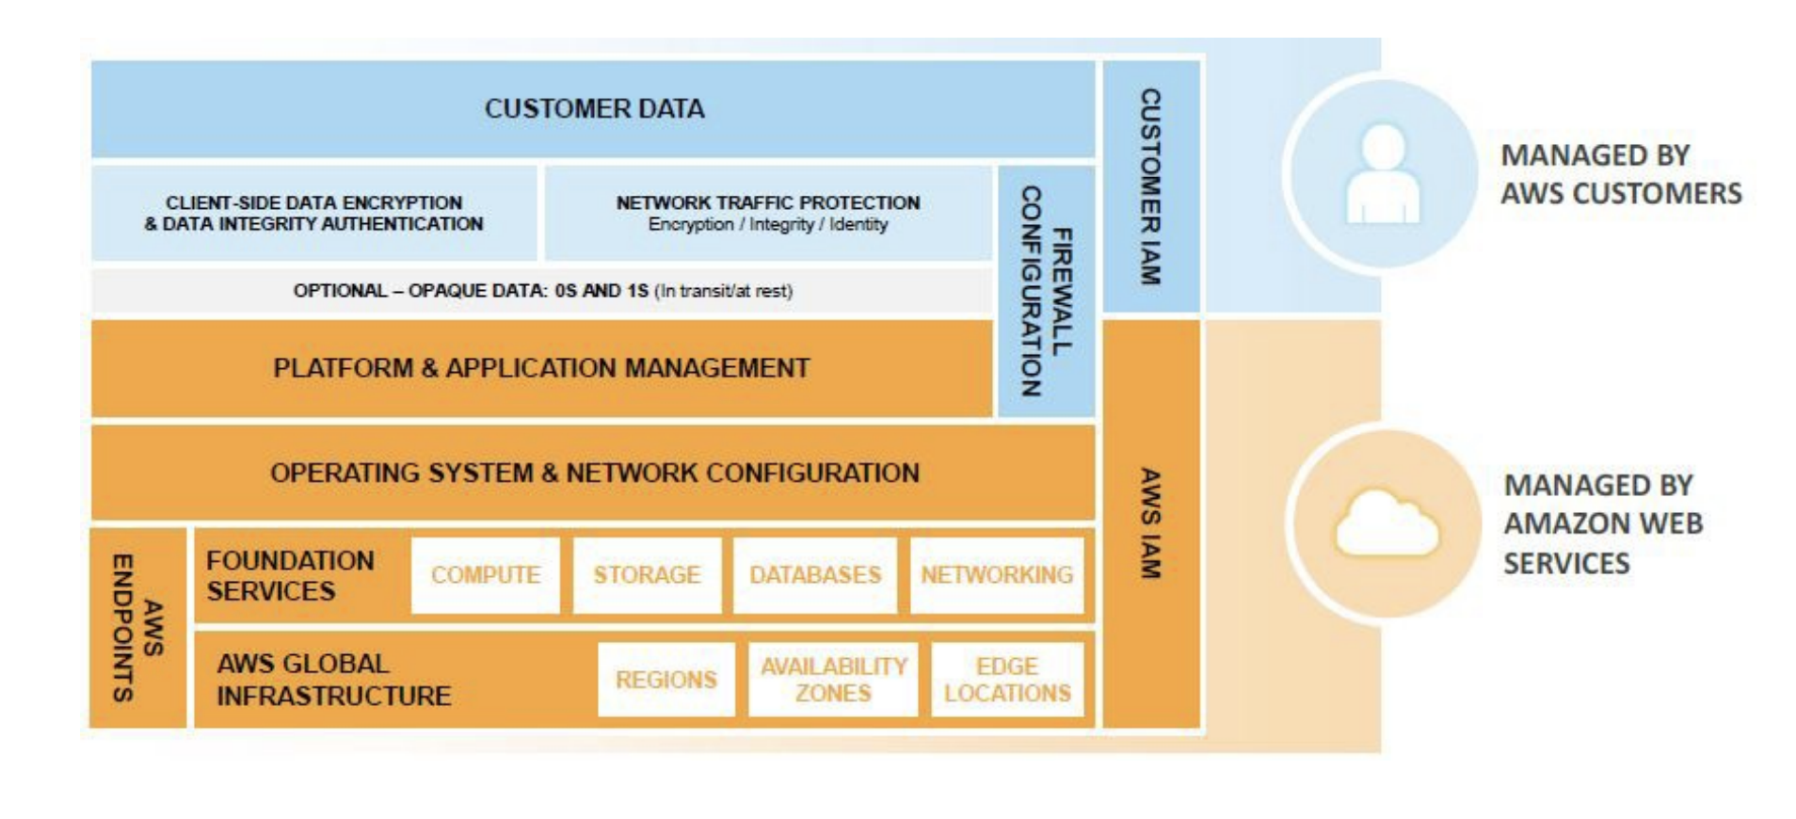
Shared responsibility – containers services

Slide 6
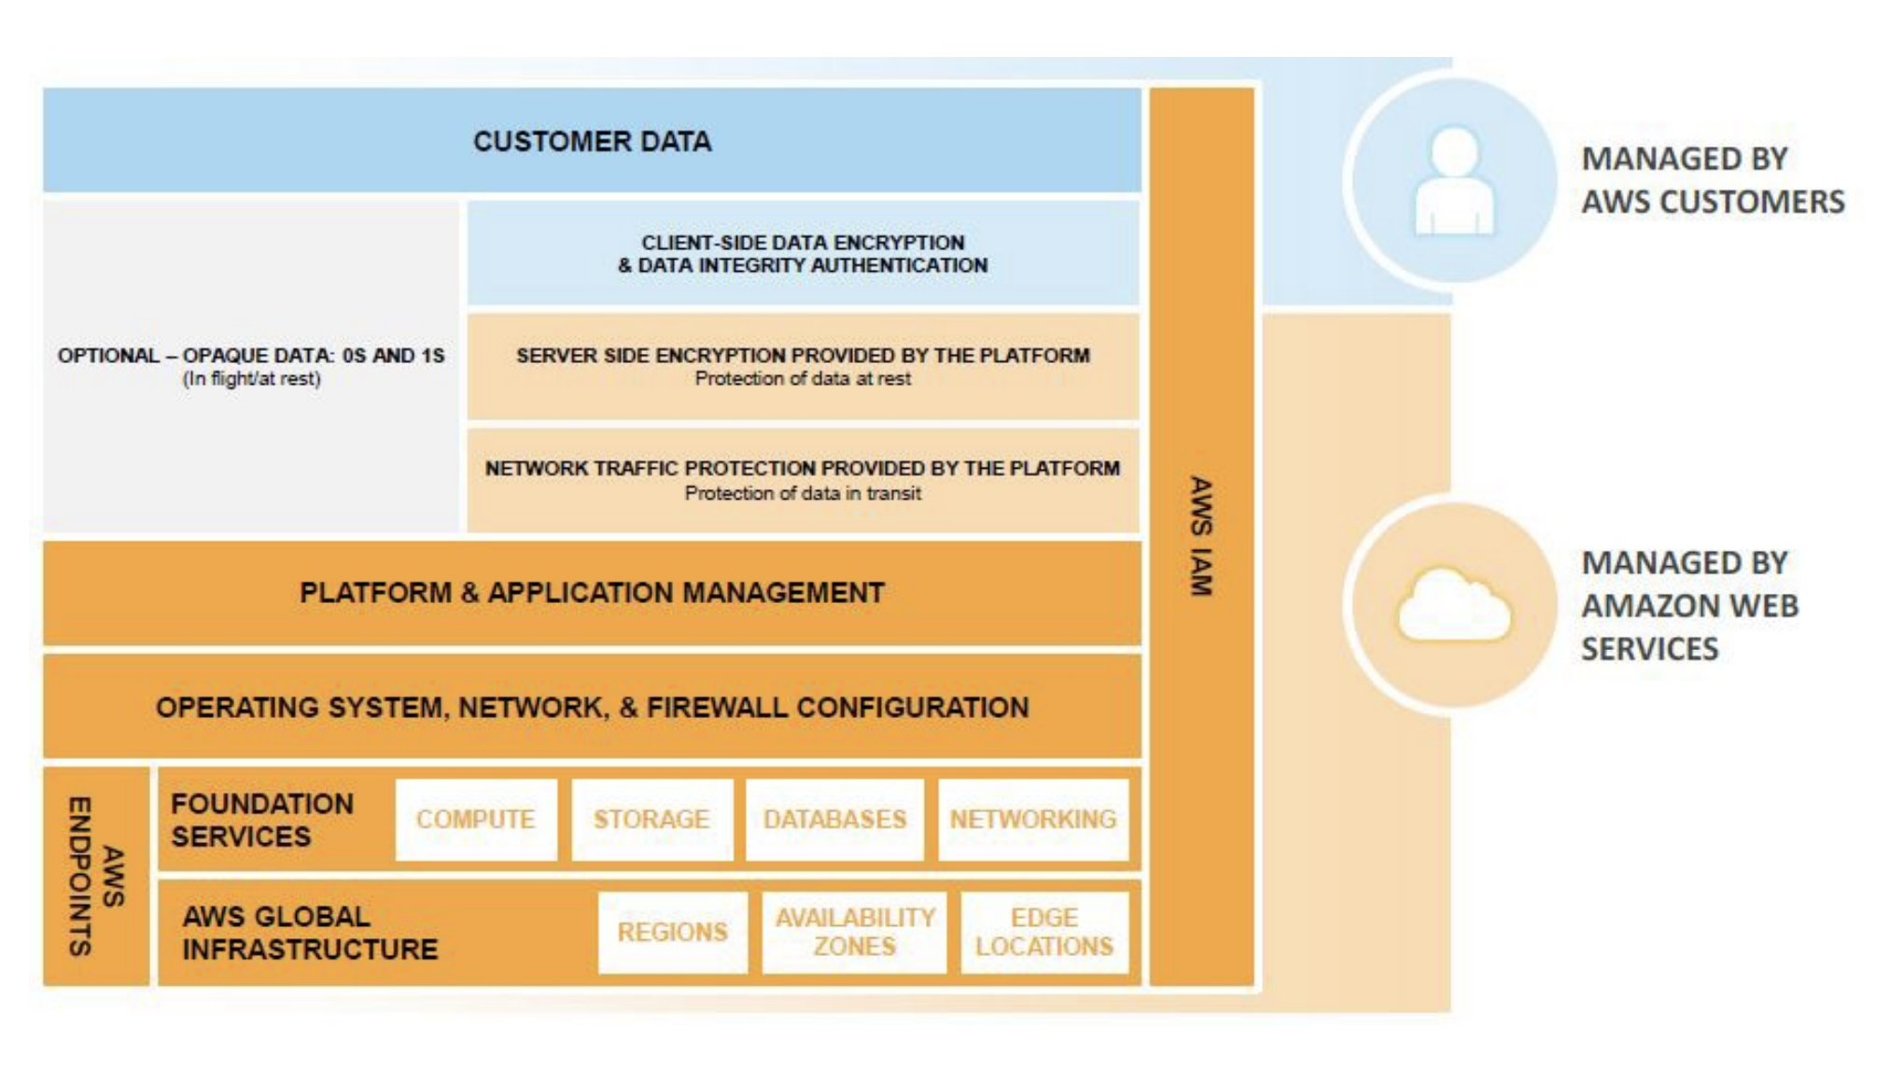
Shared responsibility – abstract services

Slide 7
Trusted Advisor
Included with premium support
Checks compliance on common ports such as: 22, 23 (telnet), 3389 (RDP), DB ports 5432 (PG) etc.
Checks if IAM is configuration
Checks if MFA token is enabled

Slide 8
Strategies for AWS accounts
Create separate accounts for dev, test and prod
One shared services account for e.g. for AD and other accounts for autonomous organizations
Different accounts for autonomous organizations
Can use consolidated billing and centralized security management

Slide 9
IAM
Use roles instead of keys
Cross account access – create roles with cross account access
Identity federation – use identity broker to authenticate via corporate identity store (for e.g. LDAP), use STS to retrieve temp tokens to access AWS console.

