Slide 1
AWS Kinesis

Slide 2
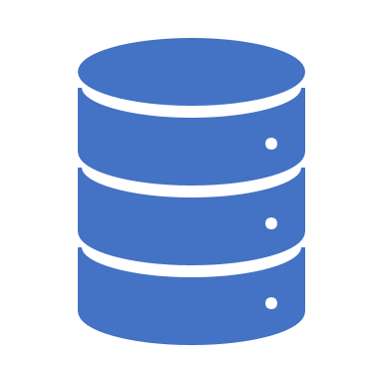
Streaming Data
Generated continuously by thousands of sources
Data records sent simultaneously
Data record size typically in KBs
For e.g. Game data,

Slide 3
Kinesis
Platform to send streaming data to
Makes it easy to load and analyze data

Slide 4
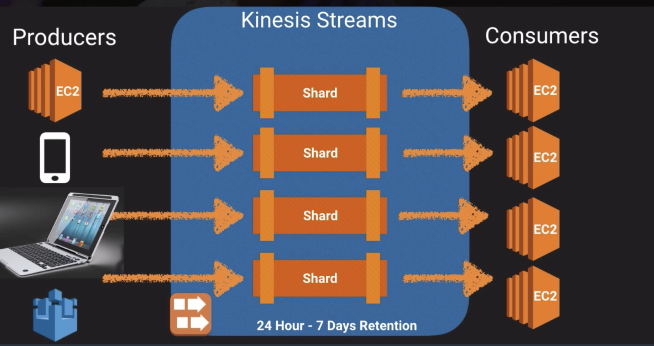

Slide 5
Features
Data stored in shard for 24hours by default
Can be increased to 7 days
Data sent to data consumers for e.g. ec2 worker nodes

Slide 6
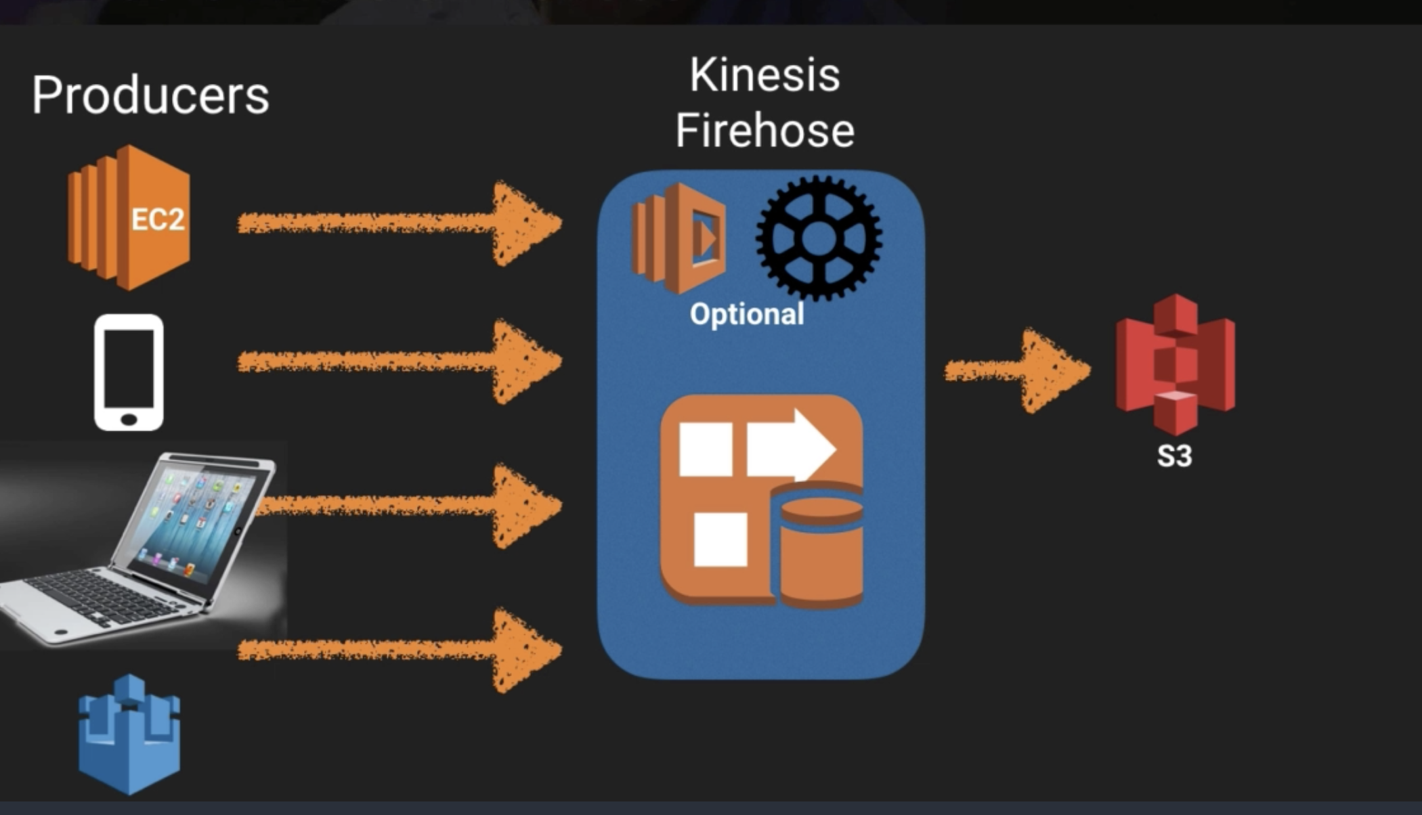

Slide 7
Firehose
No shards
It uses auto analyzes data using Lambdas (optional)

Slide 8
Kinesis Analytics
Query data on Firehose, Streams (Shards) and store in S3 for e.g.

