Slide 1
AWS ML Intro

Slide 2
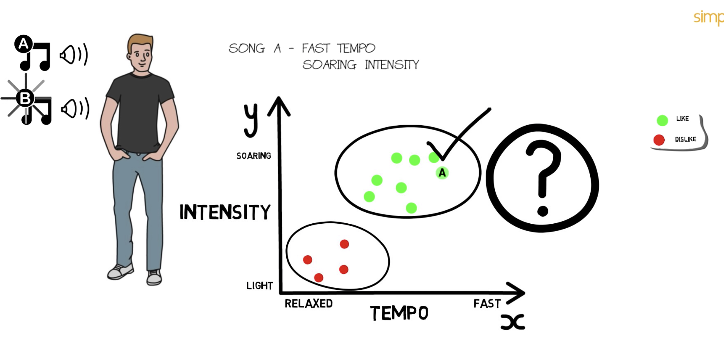
ML concepts – k-nearest algorithm

Slide 3
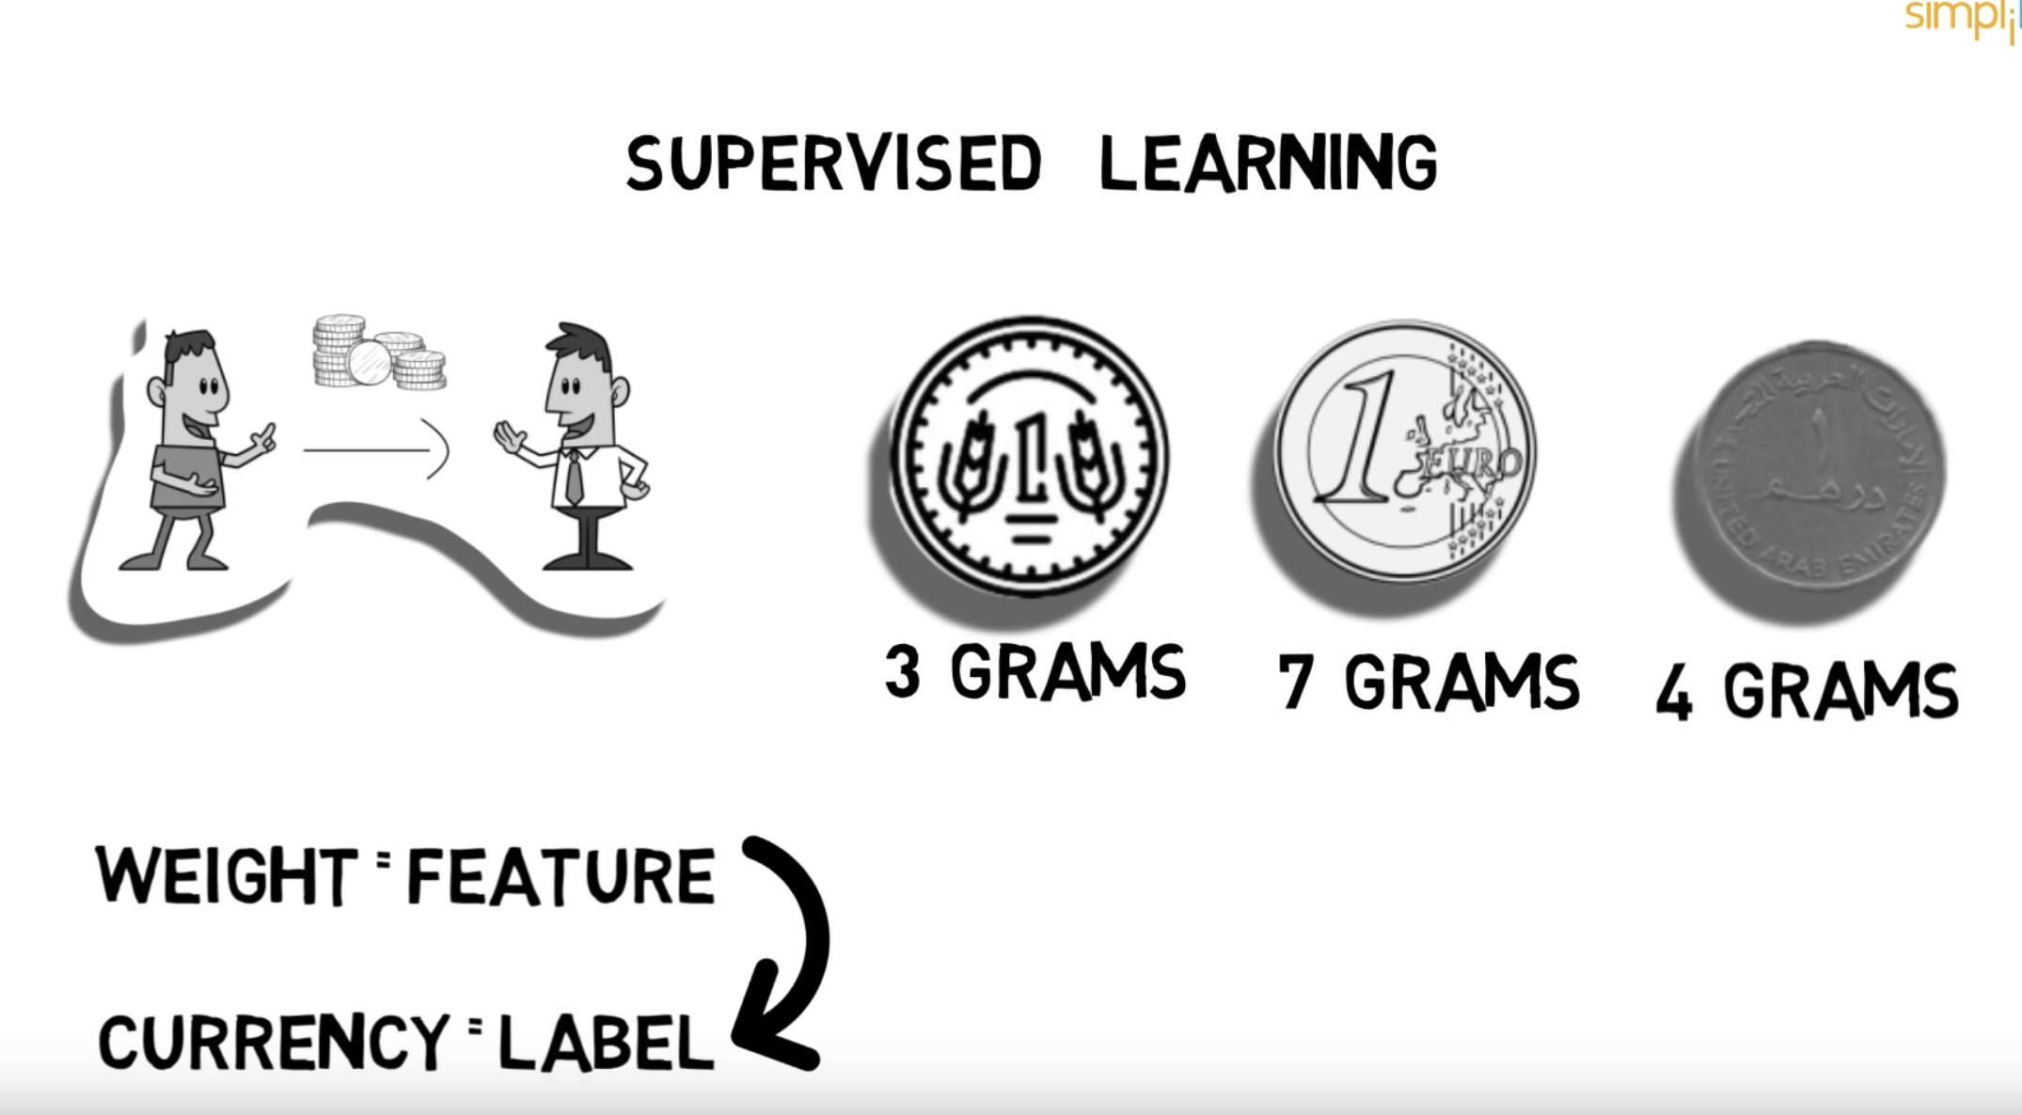
Supervised learning

Slide 4
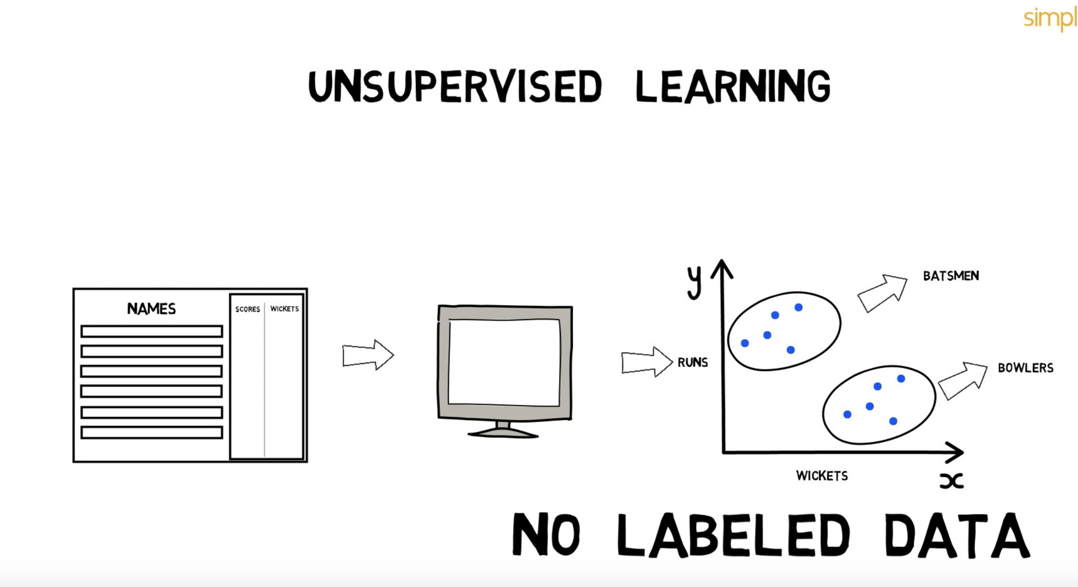
Unsupervised learning

Slide 5
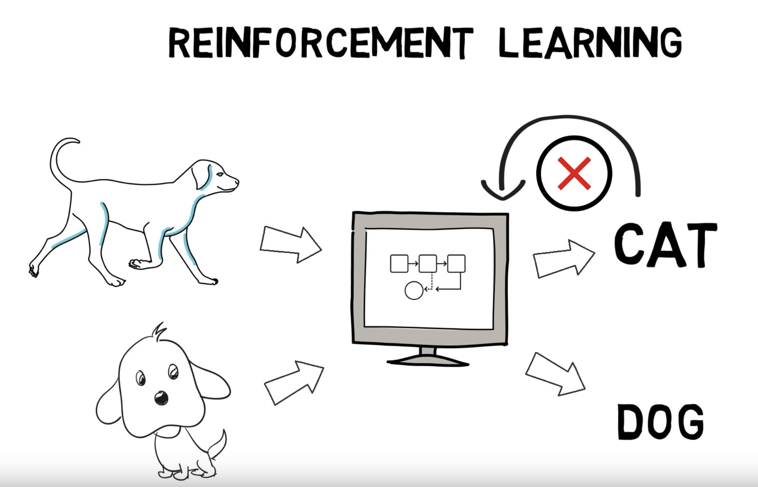
Re-inforcement learning

Slide 6
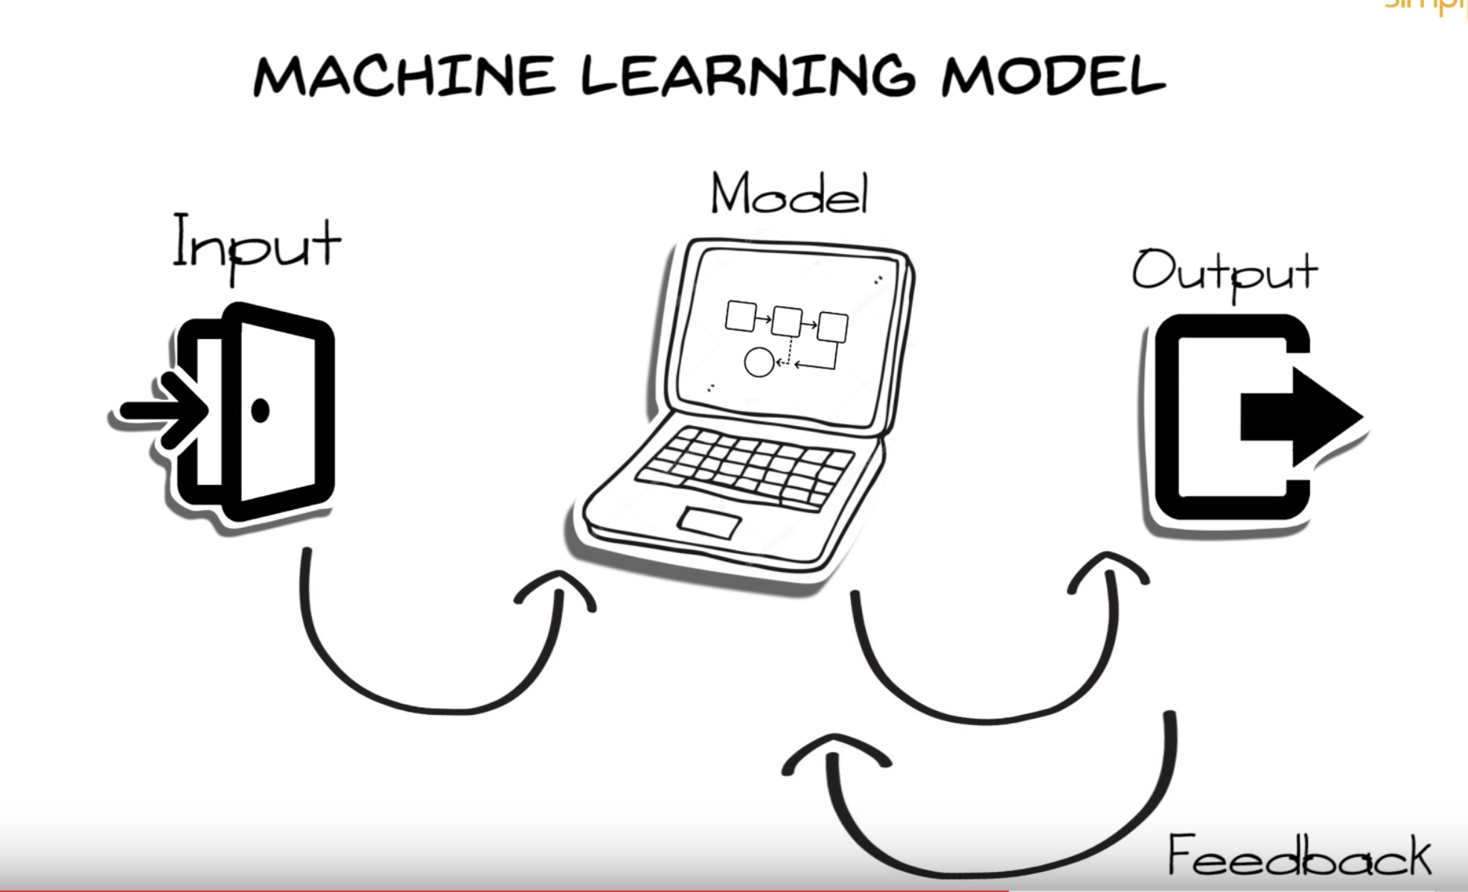
ML Model

