Slide 1
AWS Solutions Architect Associate
Storage

Slide 2
S3
Object based, not block based
0 – 5TB in size
Unlimited storage, you pay by Gigs
Files stored in buckets – they are a universal namespace, accessible globally. When you create an S3 bucket it generates a unique domain name
https://s3-us-east-1.amazonaws.com/sidtelang
Notes:
Object based storage is eventually consistent, block based is strongly consistent. Object based storage has an identifier and meta data, hence can be geographically accessible, block based storage is split up in blocks without any meta data, performance reduced during geographic distribution. Block based storage can be used for mount points

Slide 3
Data consistency
Read after write consistency for PUTS of new objects
Eventual consistency for overwrite PUTS and DELETES (takes time to propagate)
S3 is object based
Key is the name
Value is the byte sequence (data)
Version ID
Metadata (data about data)
Subresources
ACL (access control lists)
Torrents

Slide 4
Built for 99.99% availability, amazon guarantee 99.9% availability
11*9 durable 99.999999999
Tiered storage available
Lifecycle management
Secure data using ACL (access control lists) and bucket policies

Slide 5
S3 Tiers
S3 Standard – 99.99% availability and 11 9’s durability. Redundant across multiple AZs, can sustain loss at 2 facilities
S3 IA (Infrequently accessed) – 11 9’s durability, 99.9% availability and durability but cost is less to store but retrieval fee higher
S3 IA One Zone – 99.5% available and 11 9’s durability durable. Only stored in 1 AZ. Lower cost
Glacier – cheapest. Used for archival only. Expedited, Standard or Bulk

Slide 6
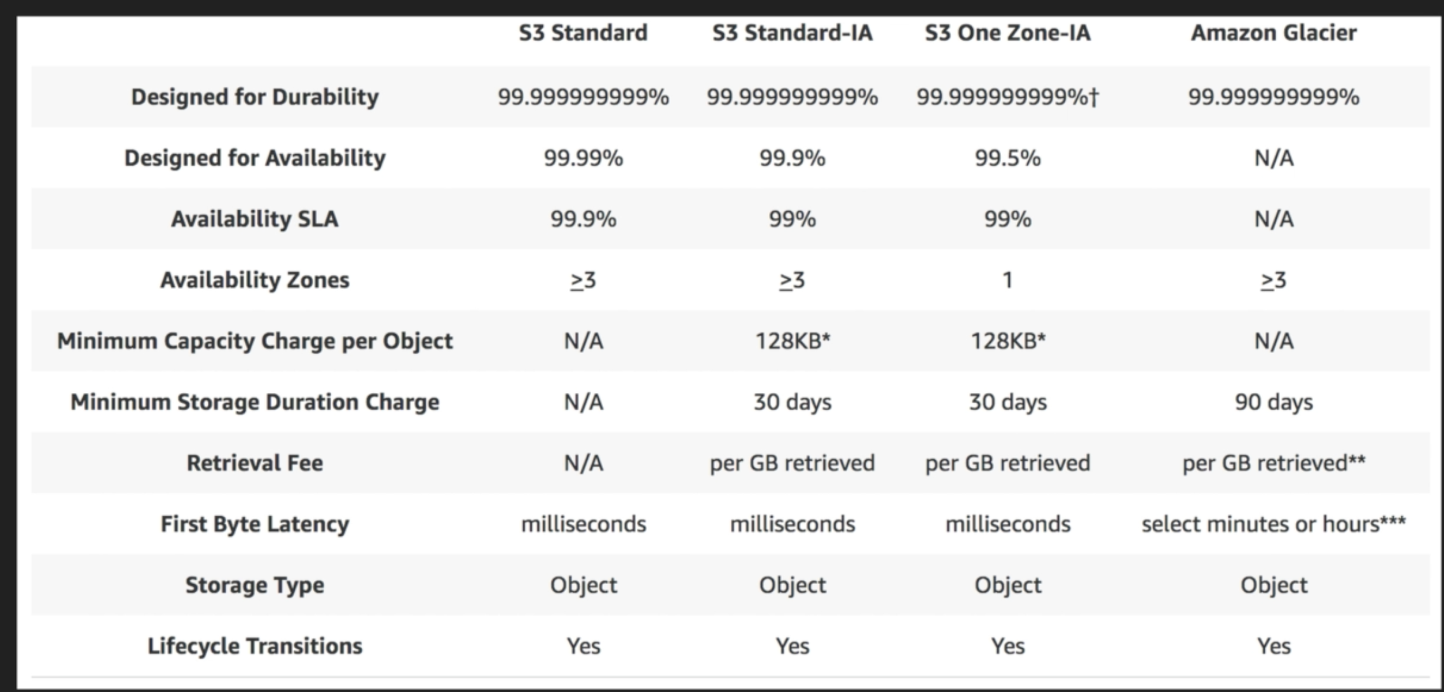

Slide 7
Charges
Storage – per Gig basis
Number of requests
Storage management pricing – tagging (metadata)
Data transfer (cross region replication)
Transfer acceleration – fast easy secure long distance transfer (used cloud front distributed edge locations)
Notes:
Edge locations are datacenters located in different parts of the world, Behind the scene, Files are uploaded to the edge location closest to you and synced to S3 using AWS backbone.

Slide 8
3 types of storage – S3 standard, RRS, IA
Encryption – client side, server side – KMS, SSE-S3 (AWS managed), Access to buckets controlled by ACL, bucket policy.
By default buckets are private

