Slide 1

AWS SysOps
HA and Scaling

Slide 2
Elasticity vs Scalability
Elasticity – short periods (use ASG)
Scalability – longer periods (add reserved instances)

Slide 3

Fail Over - DNS

Slide 4

Multi AZ vs Read Replica
Multi AZ – for DR
Read Replica - for performance improvements

Slide 5


Multi AZ
MS SQL – logical mirroring
Others – synchronous physical replication
Pros:
Backups taken from secondary, avoiding latency on primary
HA
Force fail over on reboot primary DB

Slide 6
Read Replica
Read only copy of DB
CreateDBInstanceReadReplica API call
Read traffic can be distributed to multiple read replicas (native async)
Read traffic can be distributed to share workload or when source DB is I/O suspended for scheduled maintenance
Business reporting or data warehousing can be done from read replica
Aurora – has same storage for read replicas
Read replica can be promoted to primary DB
Can have up to 5 read replicas
Read replicas can be multi AZ
DB Backups or snapshots cannot be taken from read replicas
Metrics – Replica Lag
Read replicas cannot be taken if backups not on

Slide 7

RDS Version
Aws rds describe-db-instances

Slide 8
Elasticache
In-memory cache
Elasticache used when DB is in stress and if DB is read heavy, not prone to data changing.
Redshift is a good answer because management keeps running OLAP transactions (business analytics)

Slide 9
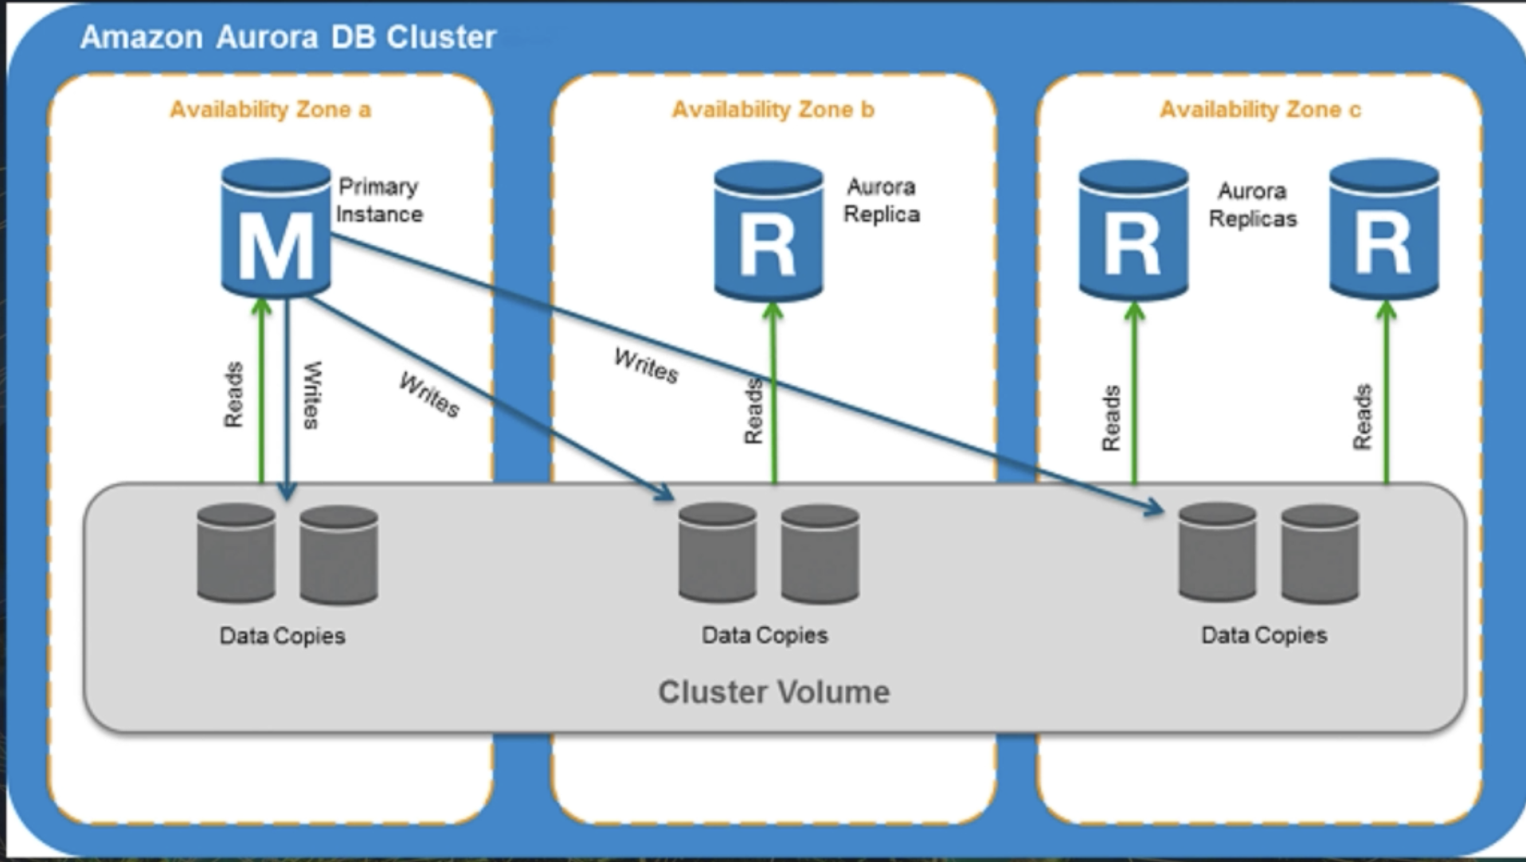
Aurora

Slide 10
Aurora
MySQL/PostGreSQL – better price point and highly available (2 copies stored in 3 AZ, so 6 copies
Self healing data blocks
Starts at 10GB increments to 64TB storage
Compute resources can scale upto 64vCPU
Can have upto 15 replicas
At 100% CPU – if writes are high – scale up, if reads are high scale out
Aurora serverless – per second on demand
Encryption turned on by default

Slide 11
Aurora
Writer and Reader roles
Cross region replication possible – if disrupted, have to start over
Failover defined by tiers – 0 being highest priority

