Slide 1

AWS VPC

Slide 2

VPC
Virtual Logical Data Center
You have control over IP ranges, subnet creation, configuring route tables and network GWs

Slide 3
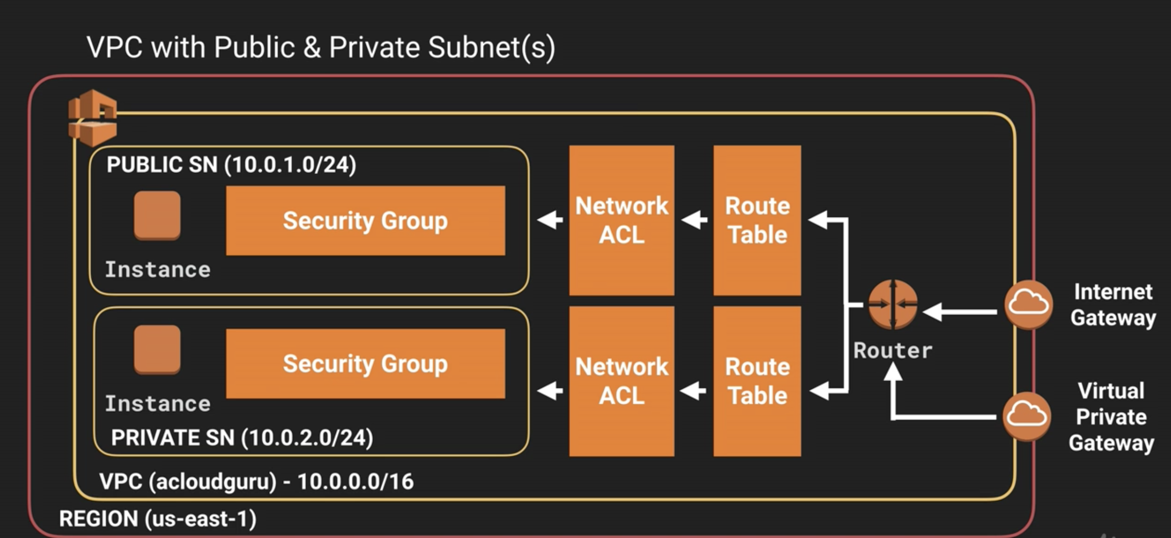

Slide 4
1 subnet spans 1 AZ
In a VPC you can:
Launch instances in your subnet
Assign custom IP ranges in subnets
Configure route tables between subnets
Create IG for internet access
Can peer other VPCs (no transitive peering)

Slide 5
IGW can only be attached to 1 VPC
VPC spans across entire region
1 subnet 1 AZ

Slide 6
Creating VPCs
Select IP range
create subnet IP ranges
create additional route tables for access to IGW for access to internet for public subnet (only for public subnets)
Route table to NAT GW for private subnet route out, preferable to have in each AZ
Legacy – NAT instance (self managed)

Slide 7
NACL
Default VPC come with NACL, it allows all inbound outbound traffic
Custom NACLs deny inbound and outbound traffic
Subnets are automatically associated with default subnet, if not associated with custom
NACLs are stateless
A NACL to subnet has one to many association ratio. Previous association gets removed if associated to NACL
NACL spans AZs while subnets cannot
Increments of 100
By default a private NACL denies all

Slide 8
VPC and ELB
For ELB, at-least 2 subnets need to be selected and both need to be public subnets

Slide 9
Flow Logs
VPC network traffic captured in a CW log group
All, Accept or Reject traffic
Cannot change IAM role once created
Can’t tag it
Not all Ip traffic is monitored:
169.254.169.254 meta data traffic
DHCP
Windows license

Slide 10
ECS
AWS provided container management service
Docker image – read only template for creating docker containers
Docker container – virtualization method that runs application and dependencies as an isolated process. They are OS independent.
Dockerfile – text file that specifies steps for creating Docker image
Task definition – needed to run containers on ECS. Like Cfn but for running containers. Configure things such as CPU, RAM
Services – are like ASG
Cluster – logical grouping of container instances

Slide 11
More stuff
VPC endpoints – GW type, interface type
No charge to create VPC
Connectivity – internet, DC (VPG),
VPC -> internet using IGW, horizontally scaled
Use public subnets and public IPs for internet access
Private IPs – NAT GW (Recommended) or NAT instance (not recommended)
Traffic stays within AWS network (even public IP to public IP within VPC)
Default CIDR - 172.31.0.0/16
Size limit - /16 (max) /28 (Min) ipv6 - /56
Subnet limit – 200
Amazon reserves 5 IPs

Slide 12
More stuff
You can expand existing VPC
Amazon reserves 5 Ips
Private IP can’t be changed, secondary IP can be added
EIPs no IPv6 support, not in private subnet
NACL is stateless, SG is stateful (allows return)
Monitor traffic using flow logs

Slide 13
More Stuff
Minimum subnet size /28
Can specify private IP for instance
Can BYOIP /24 range 5 IP ranges
NI – point of interconnection between computer and public/private network
ENI has attributes such as private IP, public IP etc
EMI can be attached or detached from EC2 while running
ENI can be attached to instances within own VPC and AZ
You cannot detach etho on ec2

Slide 14
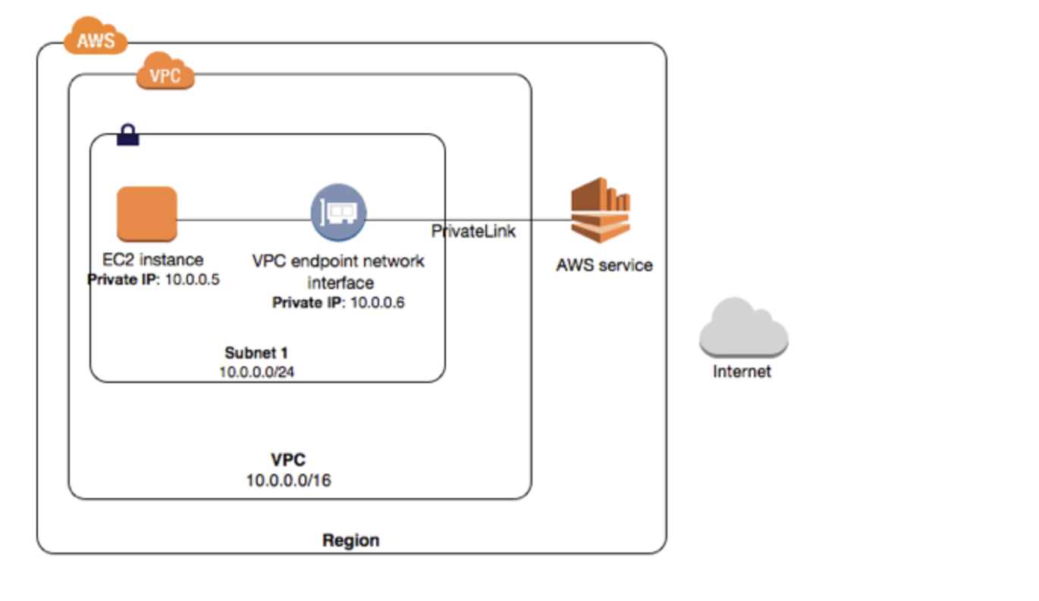
Privatelink
Service users – create interface type VPC endpoint
which will create ENI
Service owners – create endpoint service NLB

Slide 15
More stuff
DescribeInstances() brings all EC2s. EC2 classic and EC2VPC (abides by subnets concept)
One subnet – one AZ
Instances residing in different subnets charged 0.01$/ GB for data transfer
EC2 classic is the original release.

Slide 16

More stuff
Cloudwatch vs Cloudtrail vs VPC Flow logs
Cloudwatch: Metrics for cloud resources for e.g. CPU of EC2, RDS
Cloudtrail: API calls captured, stored in defined S3 bucket and also deliver cloudwatch event
VPC Flow logs: IP traffic going to and from network interfaces in your VPC. Flow log data can be published to Amazon CloudWatch Logs and Amazon S3

