Slide 1


National Technical University of Athens
Using Audio FX
to alter music emotion
Studying the correlation between FX and emotion
Stelios Katsis
7th Jan, 2025, at 10:30
AILS Lab, NTUA
Author and student

Slide 2


Motivation
This study examines how audio effects influence the emotional perception of music and whether state-of-the-art datasets and models can predict these changes
Music Emotion Recognition (MER) identifies emotions and maps audio features to emotioal dimentions or categories
While MER focuses on intrinsic features, the role of FX in shaping emotional perception remains underexplored

Slide 3

Emotion and FX in Audio
There are two main methods of mapping an audio into an emotional response:
Valence
Discrete emotion model (distinct classes, such as happiness, sadness,anger and fear)
-
1
x
Dimentional emotion model (continuous dimensions, most commonly valence (emotional positivity or negativity, uplifting - melancholic) and arousal (energy or intensity of music, calm - energetic)
x
-
-
Arousal
-1
x
1
x
The most common audio effects used are:
-
Equalization (EQ)
Delay
Echo
-1
Reverb
Distortion
Tempo/ Pitch Shifting

Slide 4

Methodology
Datasets
Music UndERstanding with Large-Scale Self-Supervised Training (MERT)
EMOPIA:
1000 songs
monophonic (piano)
4 Quadrants (eg (+1,-1), (-1,-1) etc)
2. RAVDESS:
2024 tracks
vocal performances
descrete labels(happy, sad...)
3. DEAM:
a. 1802 songs
b. comercial music
c. continuous VA metrics
A foundation model for analyzing musical audio using self-supervised learning
Combines acoustic (low-level sound features) and musical (harmonic and tonal structures) representations through a dual-teacher framework
A variety of different models with different parameters. We are going to use two of them:
MERT-v1-330M : over 300h hours of training
MERT-v0-public : contains only publicly available music

Slide 5
Model Evaluation
First of all we will train the MERT models for both discrete (classification) and continuous values (regression)
valence
arousal
MAE
RMSE
R^2
MAE
RMSE
R^2
Regression (Continuous Values)
MERT-v1-330M
0.1228
0.1588
0.4923
0.1009
0.1287
0.7270
We use a neural network with 3 layers and a tanh activation function in the output layer
MERT-v0-public
0.1270
0.1653
0.4497
0.1118
0.1429
0.6638
precision
recall
f1-score
accuracy
Classification (Discrete Values)
MERT-v1-330M
0.61
0.61
0.61
0.6149
We use the XGBoost model, known for its performance and accuracy
MERT-v0-public
0.68
0.68
0.68
0.6832

Slide 6
Audio FX Integration
In this step we used the pedalboard library to insert 5 basic effects in the music. We randomly selected 40 songs from each dataset and apply 5 different levels for each one of the effects
Reverb
Distortion
Delay
EQ
Pitch Shifting

Slide 7

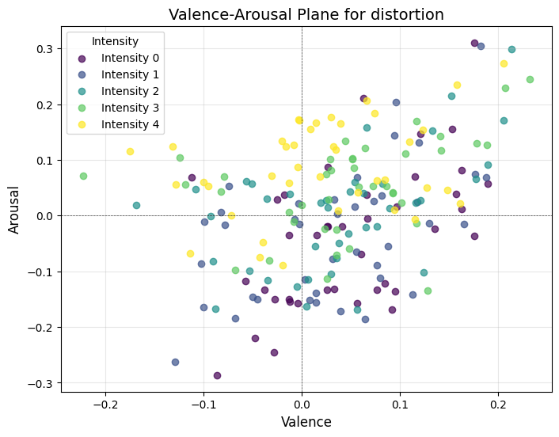
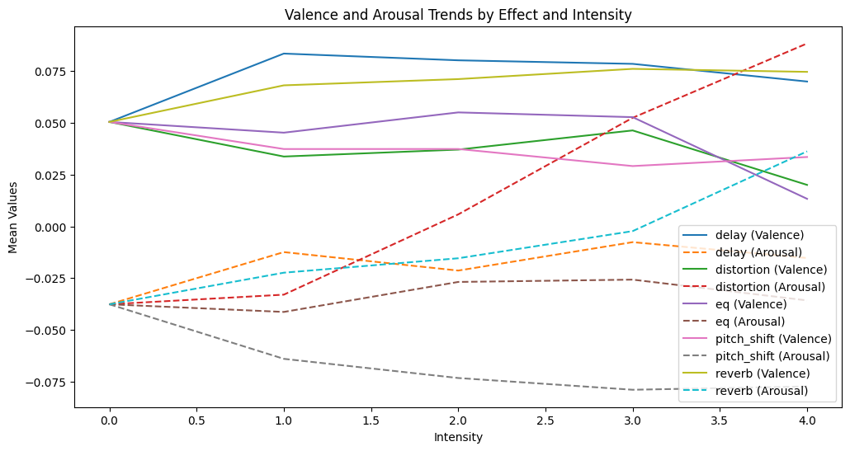
Regression Results

Slide 8
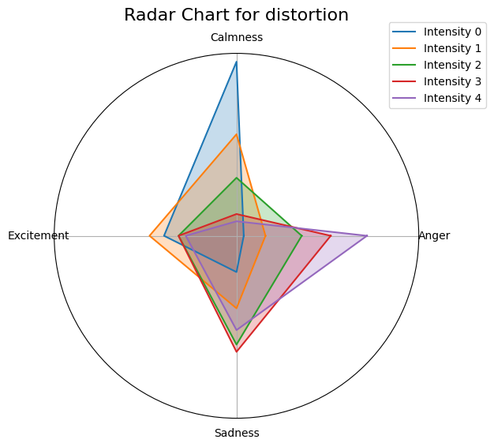
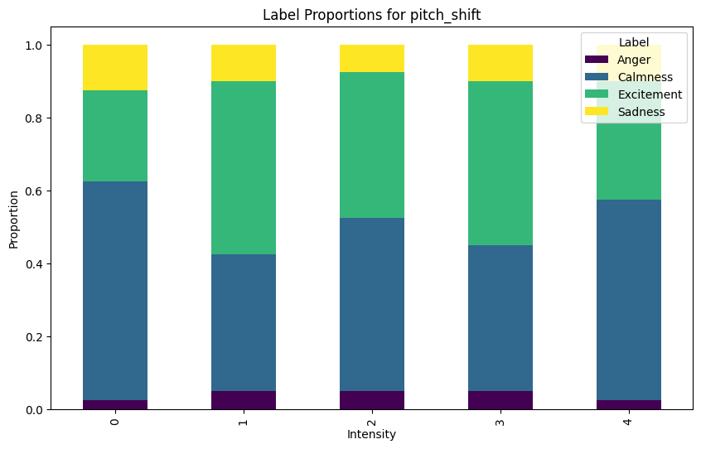
Classification Results

Slide 9

National Technical University of Athens
Thank you for listening
Any questions?

