Slide 1

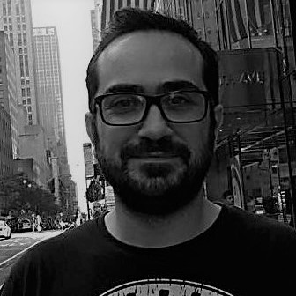
Cloud Computing Workshop Session 1: Introduction
Dimitris Kargatzis
Stelios Sotiriadis

Slide 2
Welcome to Cloud Computing Workshop
Explore the Cloud Computing technology and its tools
Explore the Google Cloud Platform (GCP)
Virtualisation
Containerisation
Orchestration systems
Deployment methods and version control software

Slide 3
Tools to focus
Virtual Machines (VMs) on GCP
GitHub
Docker containers
Google Kubernetes Engine
DevOps with Terraform and GCP and GitHub actions

Slide 4
Workshop administration

Slide 5
Plan for Session 1
Short lecture (15 minutes): Cloud computing and Virtualisation
Demo:
Redeem GCP coupons
Introduction to GCP, create VMs, connect from SSH, connect using pub key, open port, what is VPC, init script
GitHub: Push/Pull code from laptop to GitHub to VM
Practical session:
Create VM, setup pub/key, connect from laptop
Install Python, run Hello World
Tutorials:
Intro to Linux, Linux user management, GCP tutorial, Exercise on Python

Slide 6
Session 1: Cloud intro

Slide 7
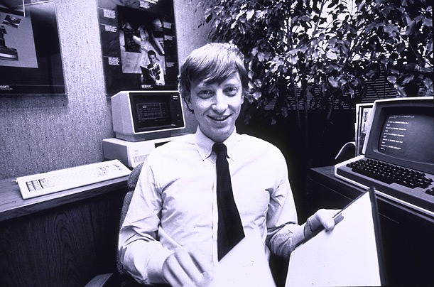
Some facts!
640K ought to be enough for anybody! (B. Gates – a rumor)
How much data is generated every minute?
YouTube users search 5M videos per day
Netflix users spent a combined 164 million hours per day watching content
Amazon ships 306 items per second
In the fourth quarter of 2020, Uber's ridership worldwide reached 1.4 billion trip, it was 1.9 in 2019…
Instagram users post 49.380 photos
Google conducts 5.9M searches per day, it was 3.9 two years ago…
Everyday, we create roughly 2.5 quintillion bytes of data.

Slide 8
Essential questions?
Where is such humongous data stored?
How is data managed?
Do we have enough resources to accommodate data, if data size is growing every day?
That is called data scaling
How fast a software can analyze such data?
Computational intensive applications:
Need a lot of CPU and memory
Data intensive applications
Big data software solutions
Need CPU, memory and access to huge storage

Slide 9
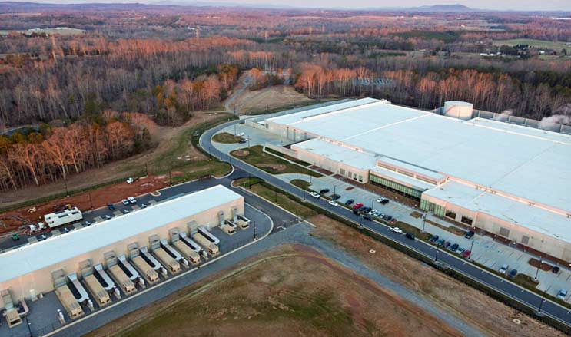
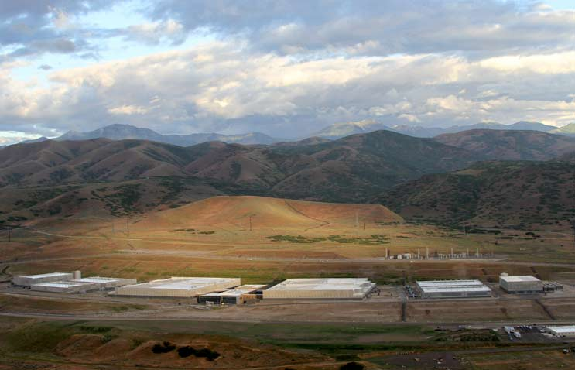
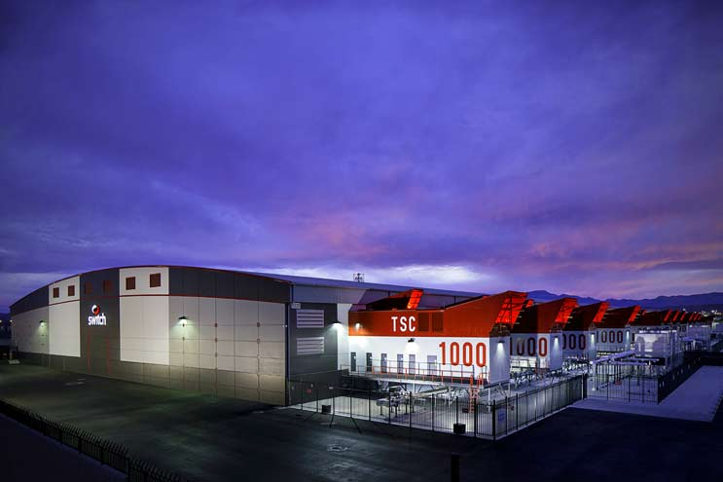
Where data is stored?
In a Cloud datacenter…
A building, dedicated space within a building, or a group of buildings used to house computer systems and associated components, such as telecommunications and storage systems. [Source]
Switch SUPERNAP Campus (Las Vegas)
Size: 7 football fields…
Apple (Maiden, N.C.)
NSA (Utah)

Slide 10
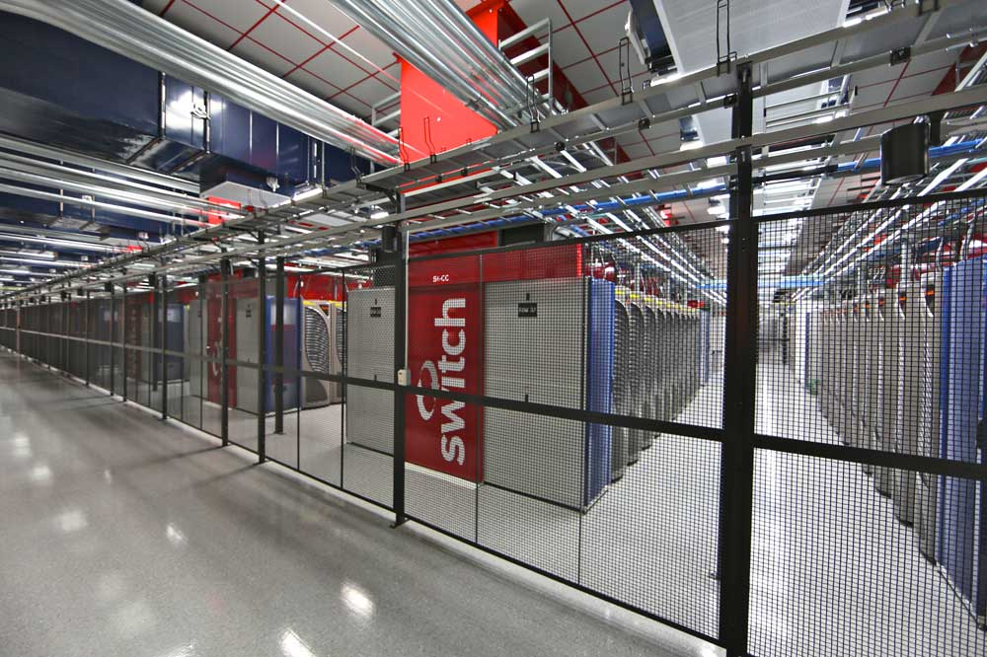
SUPERNAP at a glance
SUPERNAP
A big building with a lot of electricity and air conditioning.
It uses renewable power sources, the Nevada desert is an ideal place for solar panels
From the street, though, all you see is a high concrete wall – to innocent bystanders, it could be a prison or military base back there
SUPERNAP clients include eBay, AWS, Marvel, Cisco, PS4, MGM, Verizon, Salesforce, HP, Deutsche Bank…
[Source]

Slide 11
What is Cloud Computing?
Example of New York stock exchange market
www.nyse.com
NYSE is the largest equities-based exchange in the world, according to the total market capitalization of its listed securities
Data is generated on huge volumes
Core Trading Session: 9:30 a.m. TO 4:00 p.m. ET
NYSE calendar

Slide 12
NYSE system
On-line real time stock market data system resource utilization
Example of NYSE workload
9:30 AM - 4 PM,
Monday-Friday
Why to pay for resources and capacity for evening-early morning and weekends?
100
50
0
NYSE server usage
Why to run the servers if there aren’t any workloads?
all other days and times
Monday
Tuesday
Wednesday
Thursday
Friday

Slide 13
What is provision?
Provision of resources:
Create a virtualized environment with resources
Resources: CPU, memory, hard disk, virtual networks etc.
Cloud environments are virtualized, this means it is easy to scale up in size
Scale up means:
From 2 cores, 4GB RAM, 100GB disk to move to
4 cores, 64GB RAM, 250GB disk

Slide 14
What is deprovision?
Deprovision of resources:
Freeing up resources
In some case refer to changing the configuration of a virtualized environment
Deprovision also refers: turning off a virtual server
More cheap!

Slide 15
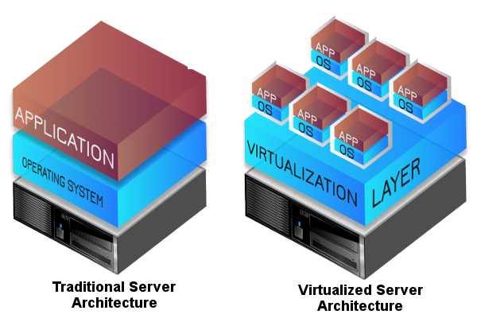
Virtualization
Act of creating a virtual (rather than actual) version of something
Something: HW + SW
It includes virtual computer hardware platforms, storage devices, and computer network resources. [Wikipedia]
Me too! ☺
I am a VM ☺

Slide 16
Virtual machine (VM)
Preferred definition:
A virtual machine is a computer file, typically called an image, that behaves like an actual computer
Each virtual machine provides its own virtual hardware, including CPU, memory, hard drive, network interface, and other devices.
Multiple virtual machines can run simultaneously on the same physical computer.
The virtual machine is sandboxed from the rest of the system.
A VM provides isolation from the rest of the environment
[Source: MS Azure]

Slide 17
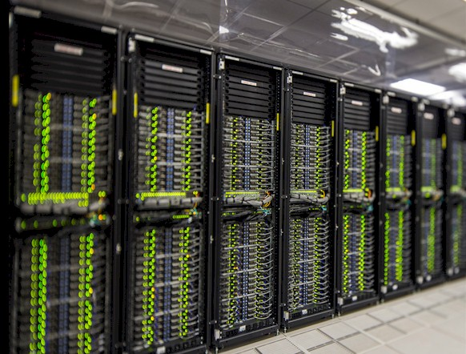
Characteristics of virtualization
Multi tenancy in one bare metal server
Bare metal?
A ‘Single-tenant physical server’
Cloud administrators creates several virtual machines (multi-tenancy).
Run multiple VMs of same or different operating systems in same hardware
Isolation:
Each VMs is isolated from each other
This means that users have access to only their own data and applications

Slide 18
Let us summarize what we just learned
Cloud Computing:
A fancy name for a very cool technology
Pay as you go for online services (HW and SW)
On demand hardware resources over the network
Virtualization
Process of creating a virtual version of a computer
Virtual machines (VMs) are “seating” on top of a bare metal
Easy to manage!
Hard to alter (e.g. scale up and down)

Slide 19
What is Cloud deployment?
Cloud deployment refers to the enablement of:
SaaS (software as a service)
PaaS (platform as a service)
IaaS (infrastructure as a service)
Models are delivered to end users over the Internet
A key technical skill for a modern computer engineer, application developer and data engineer
Understanding the complexity of a deployment will give you intuitions to develop a better software

Slide 20
Demo: Welcome to GCP

Slide 21
Connecting to GCP
Intro to GCP and interface
Create a VM
Connecting (ssh) and running commands
Connecting (ssh) from your laptop
Installing software
GitHub (push/pull code)

Slide 22
Practical Session

Slide 23
Connecting to GCP
Run the tutorials:
Introduction to Linux (ready)
User Linux management (ready)
GCP Tutorial (video)
Exercises:
Create VM (todo)
GitHub push-pull code from laptop (todo)

