Slide 1


MIDI Musical Instrument Digital Interface
Stylianos Tsagkarakis
up201911231

Slide 2

MIDI Musical Instrument Digital Interface
Communication Protocol, Digital Interface & Electrical Connectors
1 MIDI link through a MIDI cable can carry up to 16 channels of information – NOT Sound
MIDI encapsulates the instructions not the sound.
Notes:
MIDI is a technical standard and stands for Musical Instrument Digital Interface.
It describes a Communication Protocol, Digital Interface & Electrical Connectors that connect a wide variety of electronic musical instruments, computers and different audio devices for
Playing
Editing
And recording music
- 1 MIDI connection through a specific MIDI cable can carry up to 16 channels which can be translated to
16 different devices or instruments
MIDI carries event messages NOT AN AUDIO SINGAL format, like an analog plug.
It transmits data that specify the instructions for music like:
Notation
Pitch
velocity (which is heard typically as loudness or softness of volume)
panning to the right or left of stereo
and others
For example: When a musician plays a MIDI instrument, all of the key presses, button presses, knob turns and slider changes are converted into MIDI data.
MIDI was created in 1981 because of the need of a standardized means to synchronize electronic musical instruments manufactured by different companies.

Slide 3
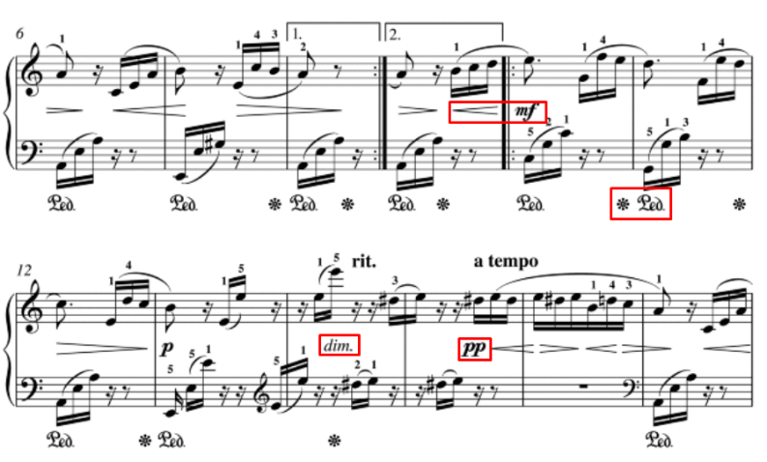
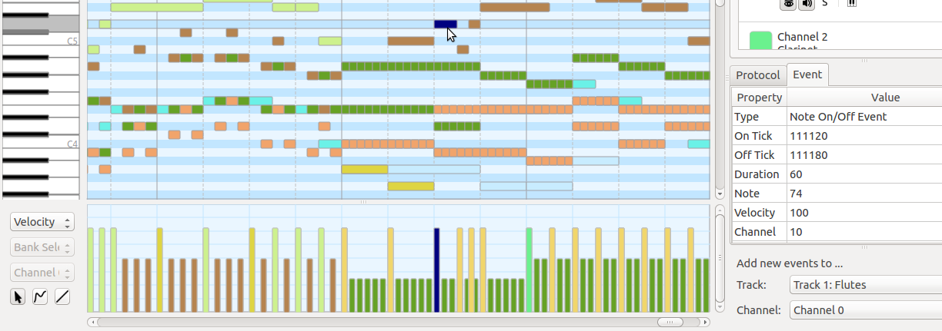
History of MIDI
Why was it created?
The need of a standard to synchronize electronic musical instruments manufactured by different companies.
Creators?
Ikutaro Kakehashi, Dave Smith & Tom Oberheim
When?
First mention on a paper of 1981
Notes:
The first person who had the idea of synchronizing digital instruments of different manufacturers was Ikutaro Kakehashi, who contacted Dave Smith & Tom Oberheim (who worked in different companies) and they organized a multinational effort to create this standard.
Until 1981, when this coordinated effort took place, there was nothing similar to MIDI.
But one can say there was, only in a non digital form.
The predecessor of MIDI are actually music scores.
Here we can observe the similarity between them.
On the left image the marked spots represent the way the specific note is played. Intensity, loudness
On the right image, besides that each line represents a specific note, The information is depicted by the coloring, the “length” of each bar and on the table on the right.

Slide 4
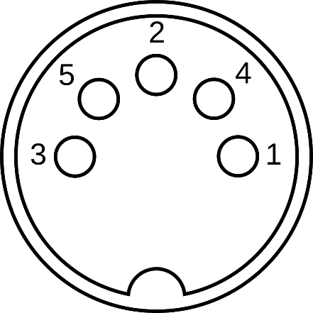
Characteristics & Specification of MIDI
Small file size
Easy modification and manipulation
Wide choice of electronic instruments
MIDI over USB standard / Easy connection with PC
8-bit words transmitted serially at 31.25 Kbit/s
16 channels of transmission (0-15)
Representation of 128 notes (C-1 to G9) [8, 12500] Hz
MIDI 2.0 256 Channels / 32, 64, 96 or 128 bits length messages
MIDI Cable
Notes:
Now, regarding the characteristics and specification of MIDI:
Some of many pros about it is that
it has a significantly smaller file size than an audio file.
Through an editor we can make modifications and corrections to any MIDI recording very easily.
Nowadays most digital musical instruments support it
And there is an easy connection with computers through MIDI over USB standard.
You can see on the right side a cut of a MIDI cable which has 5 wires that carry the 16 forementioned channels.
They transmit 1 byte words at 31.25 Kbit/s. This rate was chosen because it is an exact division of 1 MHz, the operational speed of many early microprocessors.
MIDI notes are numbered from 0 to 127 assigned to C-1 to G9.
This corresponds to a range of around 8 Hz to 12500 Hz and extends beyond the 88 note piano range.
In 2020, MIDI version 2.0 was announced and it supports 256 channels which contains messages of varying length depending on the payload type.

