Slide 1
GeoVision
Stiliyan Nanovski

Slide 2


Slide 3

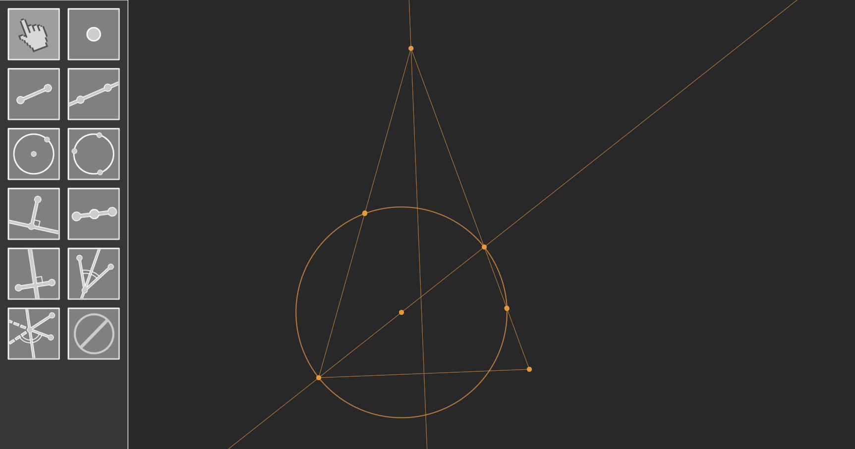

Slide 4
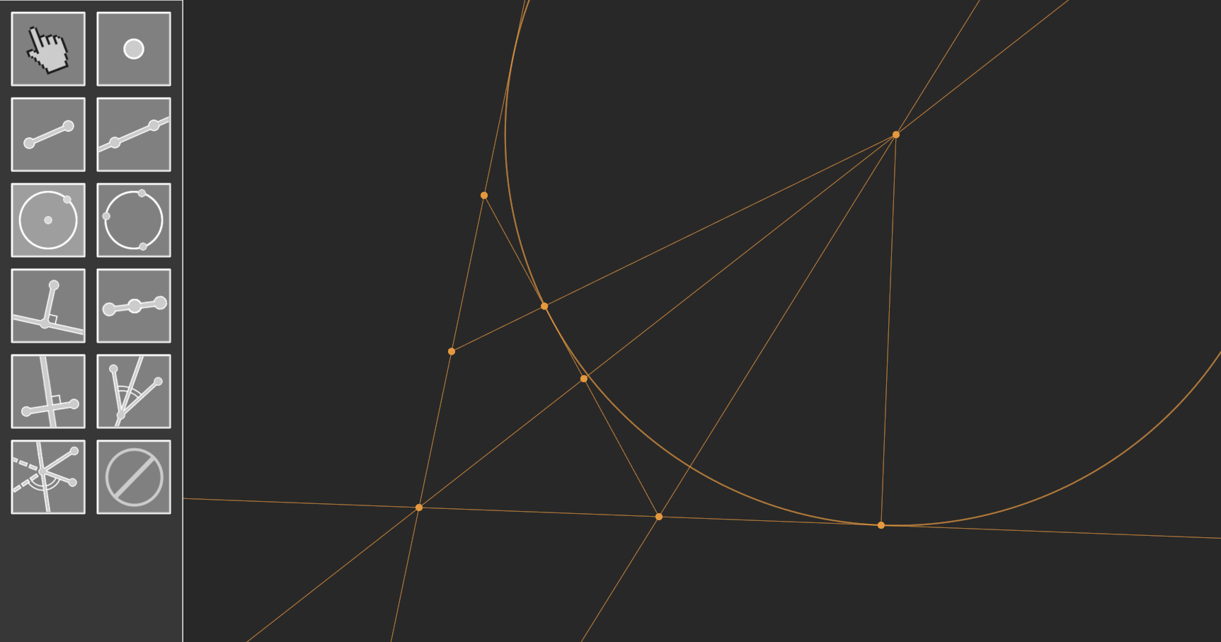

Slide 5

