Slide 1
Example 1 “To be or not to be.”

Slide 2
Outline of the Basic Genetic Algorithm
[Start] Generate random population of n chromosomes (suitable solutions for the problem)
[Fitness] Evaluate the fitness f(x) of each chromosome x in the population
[New population] Create a new population by repeating following steps until the new population is complete
[Selection] Select two parent chromosomes from a population according to their fitness (the better fitness, the bigger chance to be selected)
[Crossover] With a crossover probability cross over the parents to form a new offspring (children). If no crossover was performed, offspring is an exact copy of parents.
[Mutation] With a mutation probability mutate new offspring at each locus (position in chromosome).
[Accepting] Place new offspring in a new population
[Replace] Use new generated population for a further run of algorithm
[Test] If the end condition is satisfied, stop, and return the best solution in current population
[Loop] Go to step 2

Slide 3
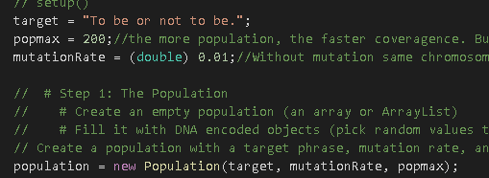
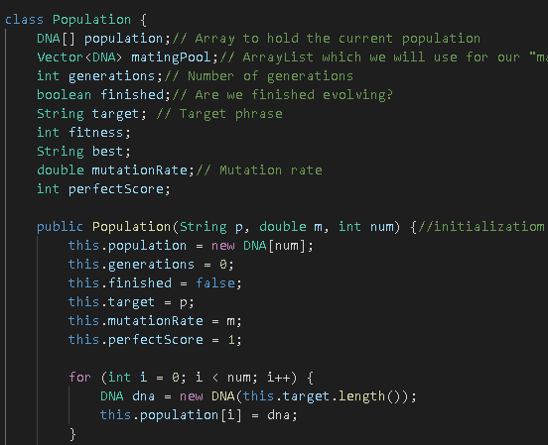
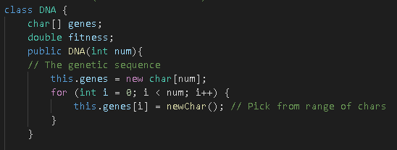
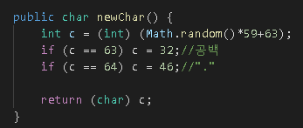
1. [Start] Generate random population of n chromosomes
<sketch.java>
<population.java>
<DNA.java>

Slide 4
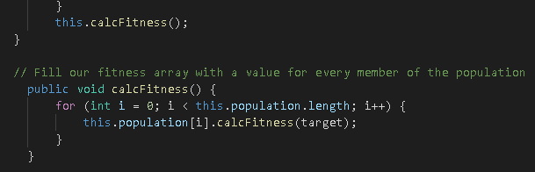
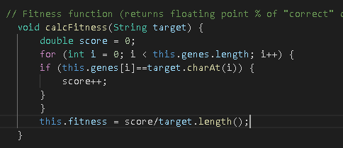
2. [Fitness] Evaluate the fitness f(x) of each chromosome x in the population
<population.java>
<DNA.java>

Slide 5
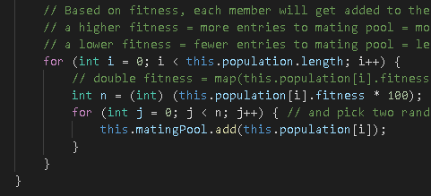
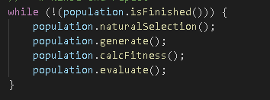
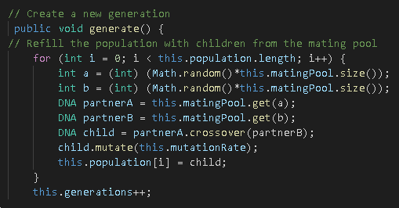
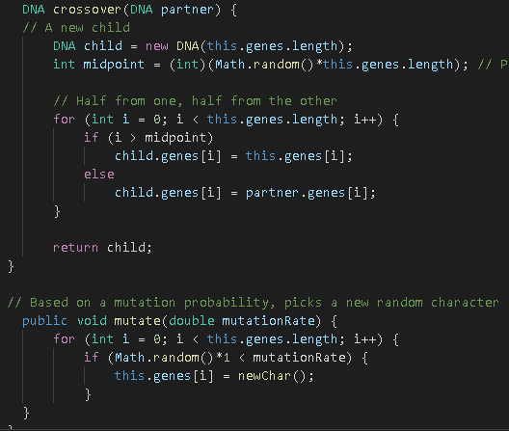
3. [New population] Create a new population by repeating following steps until the new population is complete
<population.java>
<sketch.java>
<population.java>
<DNA.java>

Slide 6
4. [Replace] Use new generated population for a further run of algorithm
<sketch.java>
<population.java>

Slide 7
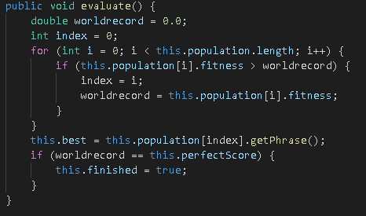
5. [Test] If the end condition is satisfied, stop, and return the best solution in current population
<sketch.java>
Step 2 [Fitness]
<population.java>

