Slide 1
Genetic Algorithm ~ Introduction ~

Slide 2
Brute Force Search
: Try every possible cases!
“to be or not to be that is the question”
Likelihood of type a “t” randomly: 1/27
Likelihood of type a “t” randomly: 1/27*1/27
Likelihood of typing entire phase: (1/27)^39 or
1 in
66,555,937,033,867,822,549,241,096,482,953,017,615,834,735,226,163
A “blind generate and test” algorithm: Repeat, Generate a random possible solution. Test the solution and see how good it is Until solution is good enough

Slide 3
Can we use this Brute-Force idea?
Sometimes - YES:
if there are only a few possible solutions
and you have enough time
then such a method could be used.
For most problems - NO:
many possible solutions
with no time to try them all
so this method cannot be used

Slide 4
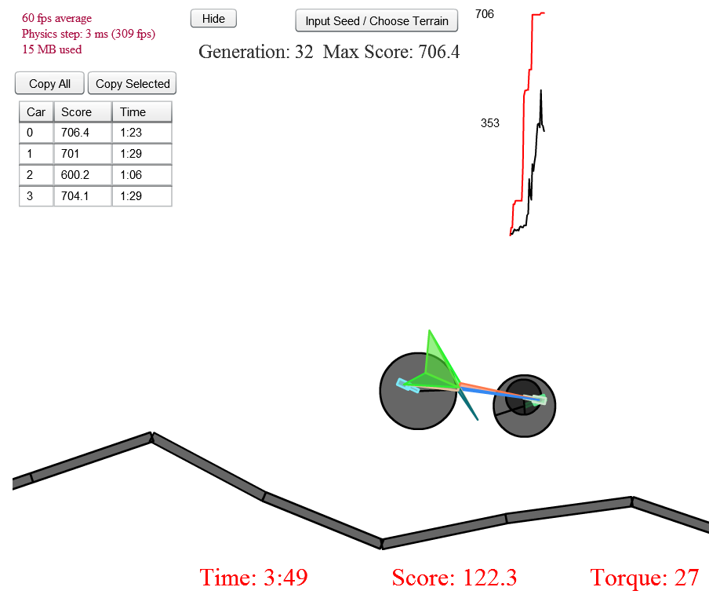
Evolutionary Computing
boxcar2d. problem

Slide 5
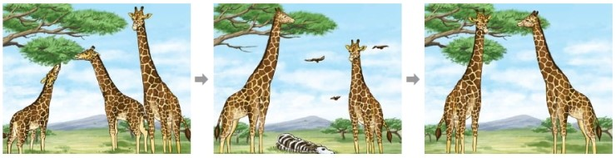
Darwin's Theory of Evolution - Natural Selection
all species of organisms arise and develop through the natural selection (survival of fittest) of small, inherited variations that increase the individual's ability to compete, survive, and reproduce
Notes:
종이 생기고 발달한다.

Slide 6
mimics the process of natural selection

Slide 7
Genetic Algorithm
GA is a search heuristic that mimics the process of natural selection.
Initial population
Selection
Crossover and mutation
Termination
loop
Fitness:
The fitness function determines how fit an individual is (the ability of an individual to compete with other individuals). It gives a fitness score to each individual. The probability that an individual will be selected for reproduction is based on its fitness score.
Termination:
The algorithm terminates if the population has converged (does not produce offspring which are significantly different from the previous generation).

Slide 8
Simple Example
(1) Create a random population of N elements
(2) Calculate Fitness of N elements
(3) Reproduction/Selection
Pick “k” parents
Make a new elements
CROSSOVER: recombination
MUTATION: elements of DNA are a bit change
loop

Slide 9
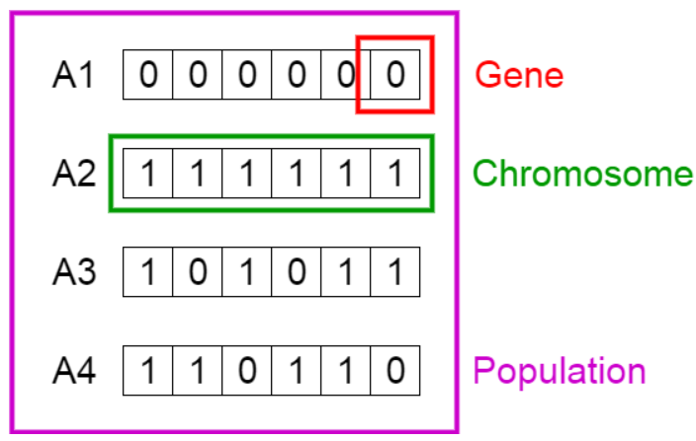
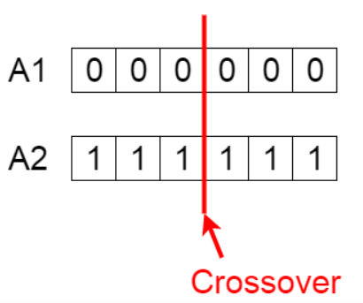
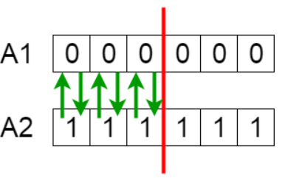
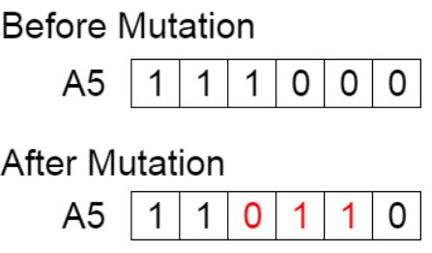
Crossover point
Fitness function f(x) = # of 1,
A1=> 0,
A2=> 6,
A3=> 4,
A4=> 4.
If select “2” elements
New population

Slide 10
Outline of the Basic Genetic Algorithm
[Start] Generate random population of n chromosomes (suitable solutions for the problem)
[Fitness] Evaluate the fitness f(x) of each chromosome x in the population
[New population] Create a new population by repeating following steps until the new population is complete
[Selection] Select two parent chromosomes from a population according to their fitness (the better fitness, the bigger chance to be selected)
[Crossover] With a crossover probability cross over the parents to form a new offspring (children). If no crossover was performed, offspring is an exact copy of parents.
[Mutation] With a mutation probability mutate new offspring at each locus (position in chromosome).
[Accepting] Place new offspring in a new population
[Replace] Use new generated population for a further run of algorithm
[Test] If the end condition is satisfied, stop, and return the best solution in current population
[Loop] Go to step 2

