Slide 1
Monte Carlo Method

Slide 2
Monte Carlo Method
“A method of estimating the value of an unknown quantity using the principles of inferential statistics”
Inferential statistics
Population: a set of examples
Sample: a proper subset of a population
Key fact: a random sample tends to exhibit the same properties as the population from which it is drawn
“e.g., random walks”
Notes:
통계적 추론(statistical inference) 또는 통계적 추측은 모집단에 대한 어떤 미지의 양상을 알기 위해 통계학을 이용하여 추측하는 과정을 지칭한다.

Slide 3
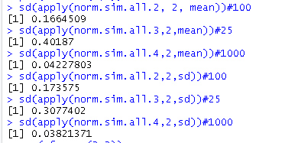
Monte Carlo method from the simulations from the specified distribution (mean =5, sd=2):
“As our n increase we will get closer to the expected value”
Notes:
replicate() 함수는 반복문의 내용(expr)을 두 번째 인자에 부여하고, 첫 번째 인자에 반복회수를 넣어줌으로써 반복 실행된 코드의 결과를 벡터형태로 반환시켜주는 편리한 함수
사전준비에 대한 로직을 replicate() 함수가 대신해준다

Slide 4
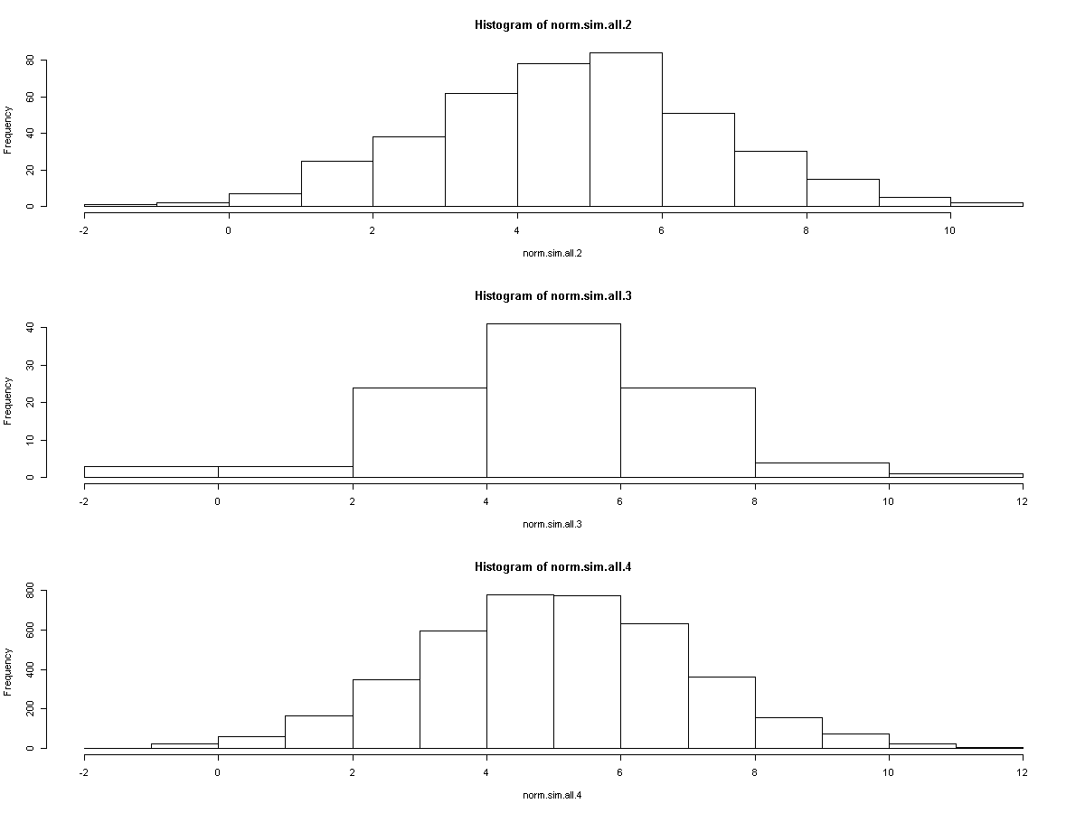

Slide 5
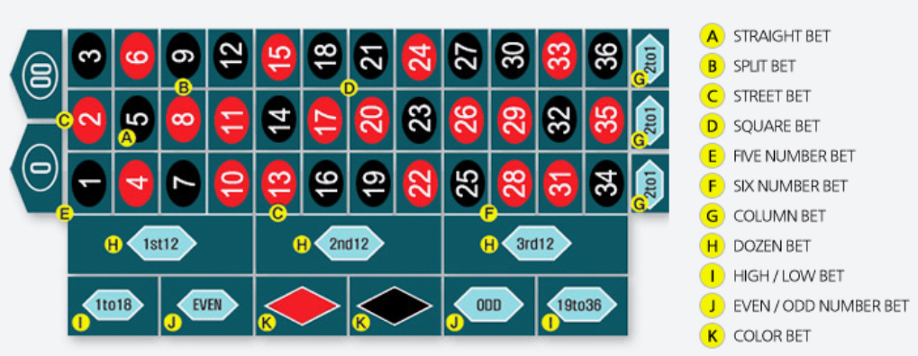
Roulette Game
Eu-/Am-Roulette
35times
17times
11times
1times

Slide 6
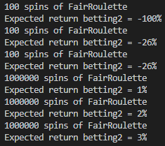
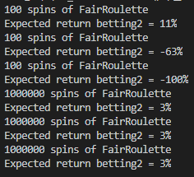
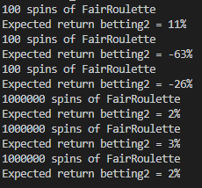
Law of Large Numbers
In repeated independent tests with the same actual probability p of a particular outcome in each test,
the chance that the fraction of times that outcome occurs differs from p converges to zero as the number of trials goes to infinity
0
0
0
Notes:
0에 가까워짐은 평균에 근접한다는 의미?

Slide 7
Sampling Space of Possible Outcomes
Never possible to guarantee perfect accuracy through sampling
Not to say that an estimate is not precisely correct
Key question:
◦ How many samples do we need to look at before we can have justified confidence on our answer?
Depends upon variability in underlying distribution

Slide 8
Confidence Levels and Intervals
Instead of estimating an unknown parameter by a single value (e.g., the mean of a set of trials), a confidence interval provides a range that is likely to contain the unknown value and a confidence that the unknown value lays within that range
”The return on betting a pocket 10k times in European roulette is -3.3%. The margin of error is +/-3.5% with a 95% level of confidence”
What does this mean?
If I were to conduct an infinite number of trials of 10k bets each, my expected average return would be -3.3%.
My return would be between roughly -6.8% and +0.2% 95% of the time.

Slide 9
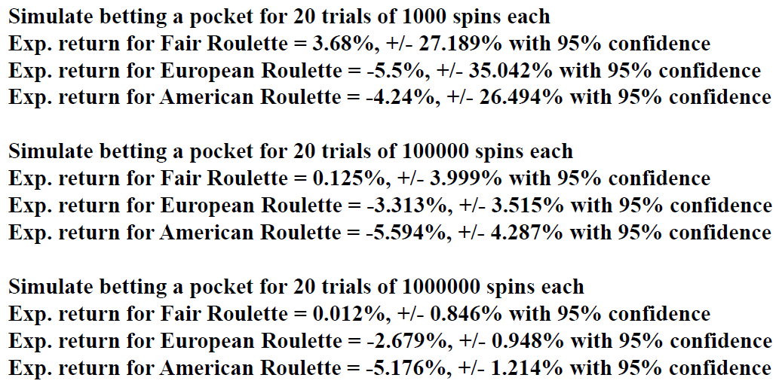
Results

Slide 10
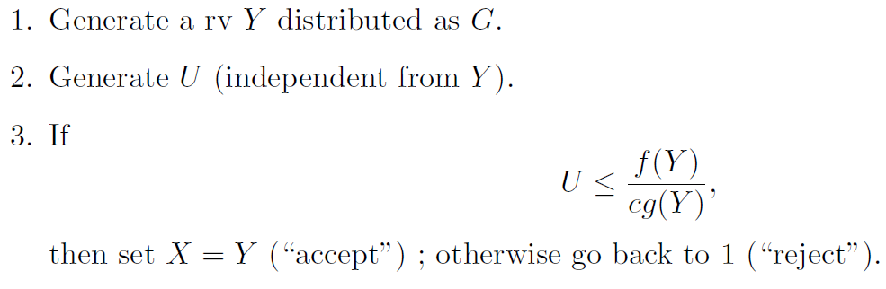
Accept-Reject Algorithm, one of Monte Carlo method algorithms
Random sampling from populations
Random sampling from 1~maxfitness
Fitness value of the selected pop.
본래 몬테칼로 법칙은 random sampling 결과가 정규분포를 따르는 경향이 있음을 이용하는 것인데,
이 알고리즘은 샘플링한 후에 분포의 밀도 함수의 표본들을 선택적으로 남기는 기법

