Slide 1
Traveling Salesperson Problem

Slide 2
TSP?
Finding shortest path to visit every cities
If the number of city is 10, (10)! paths (permutation) should be compared…
Lots of solutions studied
E.g. dynamic programming (O(n^2*2^n)), heuristic and approximation algorithms (NN, Randomized improvement(GA, SA,..), Ant colony optimization, etc.
https://en.wikipedia.org/wiki/Travelling_salesman_problem

Slide 3
TSP with GA
Population
Order of cities to visit
E.g., [0, 1, 2, 3, 4], [0, 4, 3, 1, 2], …
Fitness
Sum of distances between cities
Find best one in the population
Normalization
Fitness[i]/sum of fitness
New population: pick One
Use accept-reject algorithm
Mutation
Pick one population and then change indexA^{th} gene and indexB^{th} gene, where indexA and indexB are chosen randomly by using determined mutation rate

Slide 4
TSP with SA

Slide 5
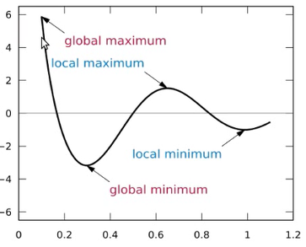
Simulated Annealing
Local and global maxima and minima
SA: an algorithm to jump out of local maximum or minimum
Fitness value
Solution
Notes:
True solution/good solution

Slide 6
Simulated Annealing
Is a simulation of the process of annealing
Can be used to generate a solution to combinatorial (permutation) optimization problems
We use following analogy
Solutions in combinatorial problem – states in a physical system
The cost of a solution – energy of state

Slide 7
Acceptance Function
How do we decide which solutions to accept?
First, we check if the neighbor solution is better than our current solution
If it is, we accept it unconditionally
If however, the neighbor solution is not better we need to consider two factors
Firstly, how much worse the neighbor solution is
Secondly, how high the current temperature of our system is
At high temperatures the system is more likely to accept solution that are worse
The math for this is pretty simple:
P = exp( (solutionEnergy – neighborEnergy ) / temperature )
P > r ? (accept-reject): the smaller the change in energy or the higher the temperature, more likely it is for the algorithm to accept the solution.

Slide 8
Algorithm Overview
Set the initial temperature and create a random initial solution
Begin looping until our stop condition (e.g. in the case of TSP, traveling distance is certain level of minimum distance) is met:
Sufficiently cooled, or
A good-enough solution has been found
Select a neighbor by making a small change to our current solution
Decide whether to move to that neighbor solution
Decrease the temperature and continue looping (looping 2))

Slide 9
GA vs SA
Initial population
Selection
Crossover and mutation <looping (2)>
Termination
Initial temperature, initial solution
Begin loop until the stop condition met
Select an neighbor by making a small change
Decide whether to move to that neighbor solution <P>r?>
Decrease the temperature and continue looping (looping 2))

Slide 10
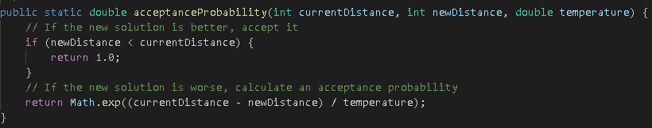
12개의 city (city_name, x, y)
Cooling rate: 0.003, Temparature: 100000
Initial solution 생성 <currentSolution> => Tour/TourManager class/Collections.shuffle을 통해 생성
=> Euclidian distance로 total distance 계산 <currentDistance>
New solution 생성 => 두 개의 서로 다른 city를 random하게 선택하여 교환
=> Euclidian distance로 total distance 계산 <neighbourDistance>
Accept-Reject?
=> 0~1.0 사이 random number 생성
=> newDistance가 currentDistance보다 작으면 currentSolution을 neSolution으로 대체
아니면,
Temperature를 0.003씩 내림.
Temperature가 1이하가 되면 중단.

