Slide 1
本科生多媒体实验
—Compression domain
张康 <zk54188@gmail.com>

Slide 2
Outline
Image Encoding and Decoding (IED)
  DCT/IDCT (exp1)
  Quantization (exp2)
选做：Video Encoding and Decoding (VED)
  Motion Estimation and Compensation (exp3)

Slide 3
Image Codec Block Diagram
Encoder
Codeword
assignment
Input data
Transform
(DCT)
Quantization
Coded
bit-string
Decoder
Codeword
decoder
Output data
Inverse
Transform (IDCT)

Slide 4
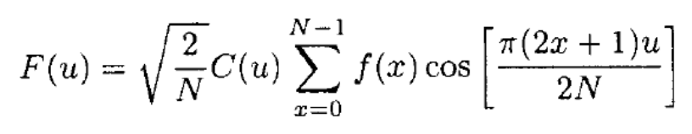
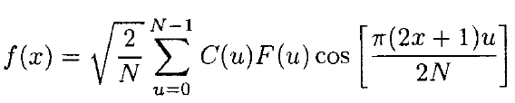
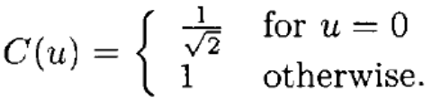
DCT/IDCT (1D)
The one-dimensional forward Discrete Cosine Transform (1-D DCT) of N samples is formulated by
for u = 0, 1, . . . , N - 1, where
  The function f(x) represents the value of the xth sample of the input signal.
  F(u) represents a Discrete Cosine Transformed coefficient for u = 0, 1, … , N – 1

Slide 5
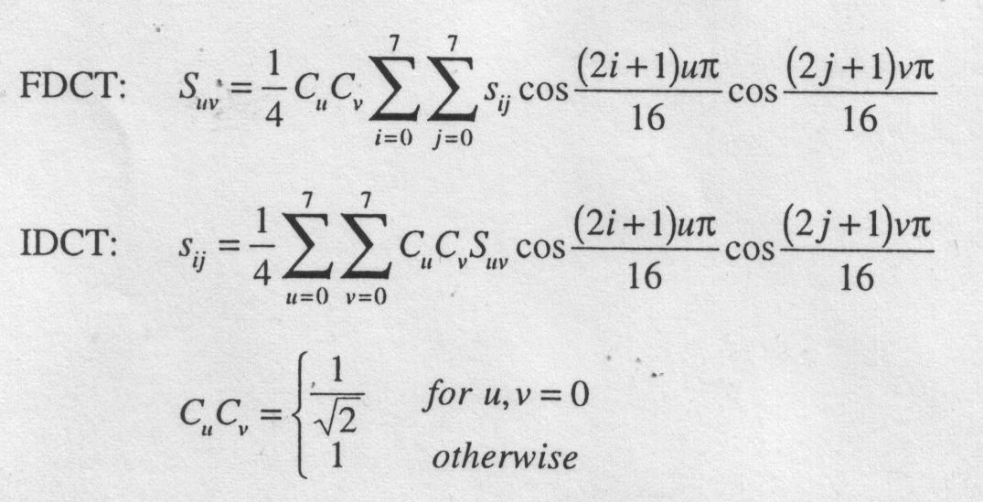
DCT/IDCT (2D)
If dividing image matrix into 8x8 blocks, 2D-DCT/IDCT is defined by:

Slide 6
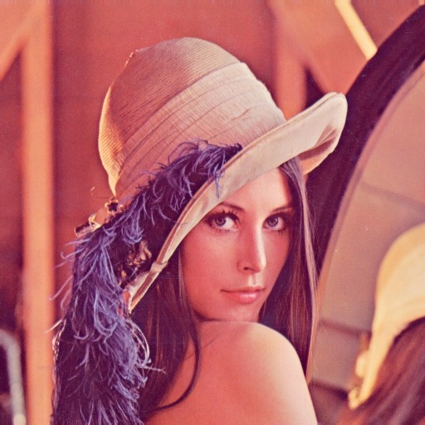
Exp1: Are they equivalent in effect?
Experiment Design
  Given an image “lena”
  Transform it into gray-scale (5%)
  Three trials (20%)
    1D-DCT on the whole image
      First-Row-Then-Column
    2D-DCT on the whole image
    2D-DCT on 8*8 blocks
  Comparison(25%)
    Time complexity (analysis and experiment)
    PSNR after reconstruction by IDCT
  Insights (50%)
    What if only using 1/4,1/16, 1/64 DCT coefficients?
      How to choose the coefficients?
      Repeat the above three trials
    Give me your idea, experiment design, results, and analysis.

Slide 7
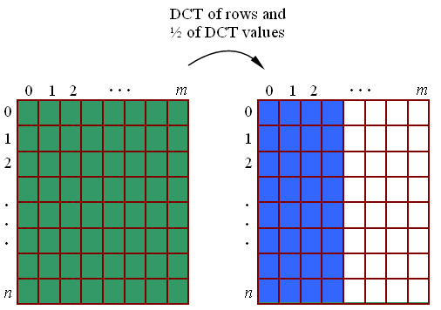
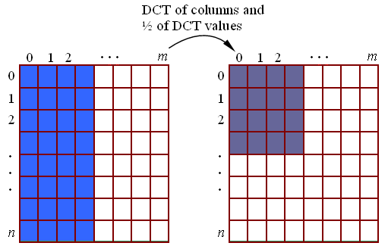
1D-DCT by Rows and Columns

Slide 8
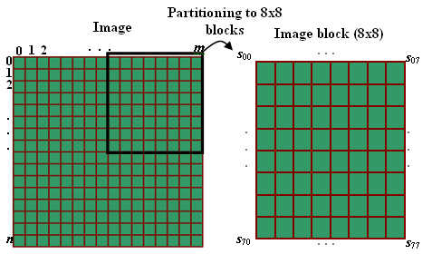
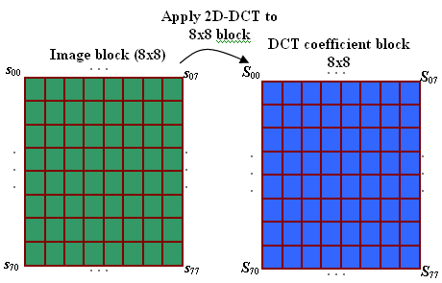
2D-DCT on 8*8 Blocks

Slide 9
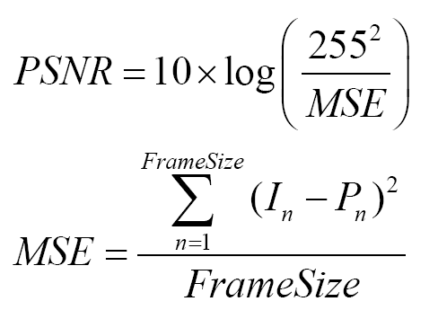
PSNR

Slide 10
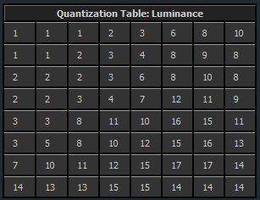
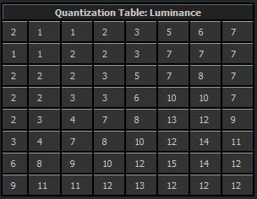
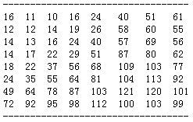
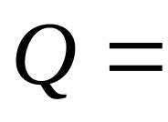
Quantization
Canon IXUS 60 (fine)
Nikon CoolPix L12 (fine)
Jpeg Standard

Slide 11
Exp2: Why quantization is so important?
Experiment Design
  Given an image ‘lena’
  Partition it into 8*8 blocks
  For each block (30%)
    Applying 2D DCT
    Using Q to quantize the DCT coefficients
    Applying 2D IDCT, and calculate the PSNR
  Over all blocks, calculate the average PSNR
  Insights (70%)
    Use a*Q as quantization matrix (0.1<a<2), and repeat the above process.
    Plot the curve of a and PSNR (10%)
    Explain your results. (20%)
    Illustrate some factors that affect the design of quantization matrix. Can you give a better Q? (Ideas are ok! Program is better!) (20%)
    Use Cannon and Nikon quantization matrix given above, and compare their PSNR. (try it on your favorite images) (20%)

Slide 12
Reference
Motion video adaptive quantization in the transform domain (TCSVT)

Slide 13
VED – Motion Estimation (ME)
Regulator
Frame
Memory
+
-
DCT
Quantizer
(Q)
VLC
Encoder
Q⁻¹
Buffer
Pre
processing
IDCT
Predictive frame
Motion vectors
+
Output
Input
Motion
Compensation
Frame
Memory
Motion
Estimation

Slide 14
Exp3: Intuitive interpretation of ME (选做)
Experiment Design:
  Given a video sequence (video)
  Select a suitable 16*16 block as the reference block (50%)
    Perform compression domain block matching to locate the same block in following frames
    Note down the MVs and plot them against frame numbers
    Calculate the prediction errors (MSE) and plot them against frame numbers
  Insights (50%)
    (1) Compare the performance of pixel domain block matching and compression domain block matching
    (2) What if we only use a part of DCT coefficients in compression domain block matching?
    (3) What if we only use a part of raw pixels in pixel domain block matching?
    (4) How to choose the reference block?
    (5) Any other features for better matching?
    Give me your idea, exp design, results and analysis.

Slide 15
Reference
Fast image domain fractal compression by DCT domain block matching
(Electronics Letters)
Frequency-domain motion estimation using a complex lapped transform (IEEE Transaction on Image Processing)
Moving Object Detection and Tracking in Videos and Block Matching Algorithm

Slide 16
Requirements
编程环境
  不限
提交形式
  源代码
  可执行程序（不依赖于本机环境）
  实验分析报告
评分标准
  工作量
  分析深入性及新颖性
Deadline

Slide 17
关于copy
得到了
  更多打游戏的时间
  被fail掉的可能
  鄙视
失去了
  超越的机会
  知识的理解
  尊严
鼓励头脑风暴，但请相信助教的智商。
一旦发现，后果很严重——连坐！

Slide 18
Thanks!
张康 Kang <zk54188@gmail.com>

