Slide 1
Preliminary Content Based Image Retrieval
张 康
zk54188@gmail.com

Slide 2

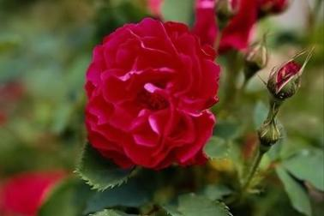

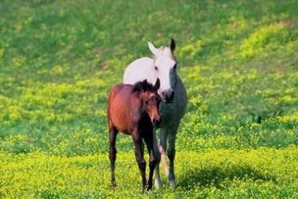
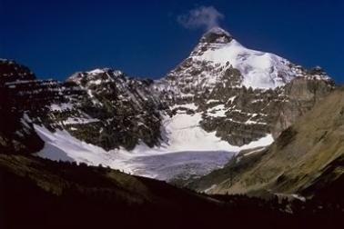
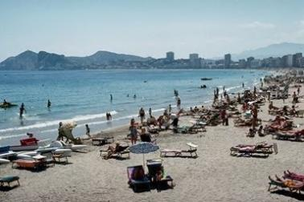
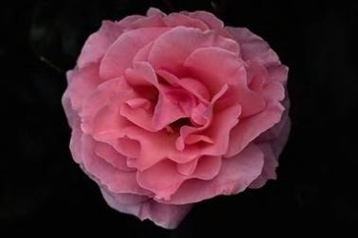
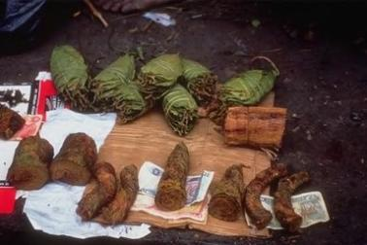
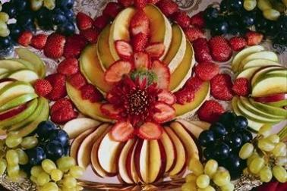
What is CBIR?

Slide 3
Experiment Description
Goal: Color histogram based image retrieval
Content：
  Feature extraction
    Calculate the histogram of each image in the given dataset, and store it.
  Query image
    Calculate the histogram of the query image
  Image similarity evaluation
    Histogram distance

Slide 4
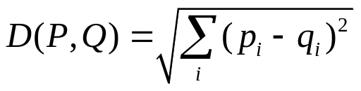
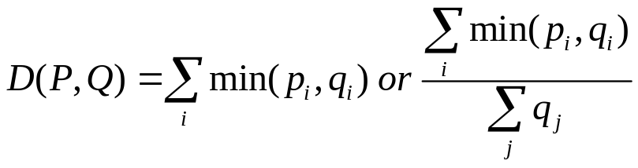
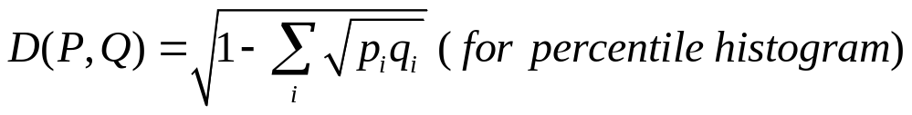
Details
Histogram
  Color space: RGB
  Color space partitioning
    16 bins: R:G:B=2:4:2, i.e., R,G,B are partitioned into 2,4,2 sections.
    128 bins: R:G:B=4:8:4
Distance metrics
  Euclidean (L2)
  Histogram Intersection (HI)
  Bhattacharyya (Bh)

Slide 5
Details (cont.)
Combinations
 | 16 bins | 128 bins
L2 | √ | √
HI | √ | √
Bh | √ | √

Slide 6
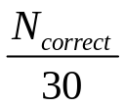
Tasks
For each combination:
  Task1: for one query image
    Return an ordered list of images (from smallest distance to largest distance)
    Calculate the precision of first 30 returned images
  Task2: for all query images
    Based on task 1, calculate the average precision over all query images

Slide 7
Software Input
Classified images
  Dataset
All images list
  AllImages.txt
Query images list
  QueryImages.txt
  Note:
    arborgreens/Image01.jpg 378 252
File name
Width and height

Slide 8
Software Output (For each combination)
For every query image
  A result file named: res_QUERYIMAGENAME.txt, e.g. res_beach_110.txt
    Consists of 30 lines
    Each line format: ImageName Distance
    Lines are ordered
      Distance in K+1 line should be larger than that in K line
Another text file for precision(res_overall.txt)
  One query image per line
    Format: QueryImageName Precision
    The last line: average precision over all query images

Slide 9
Report
Analyze the results to find:
  The effect of the distance metric on the accuracy of image retrieval
  The effect of the number of histogram bins on the accuracy of image retrieval
  Analyze the retrieval error types and suggest ways to improve the retrieval accuracy

Slide 10
Bonus Points
A good-looking interface
Attempts on other distance measures
Attempts on other features
Any attempt on improving the retrieval effect
  Regional features
  …
Reference
  Content based image retrieval at the end of the early years, PAMI2000.

Slide 11
Evaluation
Baseline
  Penalty based
    Late submission
    Program clarity
    Report quality
Bonus
  Performance improvement
  Novelty
  Analysis depth

Slide 12
Development Environment
No constraint.
An executable file is necessary, except matlab
  If using matlab, you have to give an example of the command.

Slide 13
Q&A

